Slide 1
Prospects for Full Employment
Presented at the UNOG-WAAS conference on
Opportunities & Challenges of the 21st Century
June 3, 2013
Garry Jacobs
Chairman of the Board of Trustees, World Academy of Art & Science
Vice President, The Mother’s Service Society, Pondicherry

Slide 2
Radical Transformation of Society & Work
1800
Population 1 billion
3% urban population
Life expectancy 29 years
Manual labour
Land-based
85% employed in agriculture
World trade 3% of global GDP
2012
Population 7 billion
49% urban population
Life expectancy 67 years
Mechanized & automated
People & society-based
70% of OECD jobs in services
World trade 27%

Slide 3
Population & Employment 1950-2012
Notes:
The figure depicts global changes in population, working age population and employment from 1950 to 2012.
Employment 2012 data taken from http://www.ilo.org/wcmsp5/groups/public/---dgreports/---dcomm/---publ/documents/publication/wcms_202326.pdf
Population data taken from United Nations, Department of Economic and Social Affairs, Population Division, World Population Prospects. http://data.un.org/

Slide 4
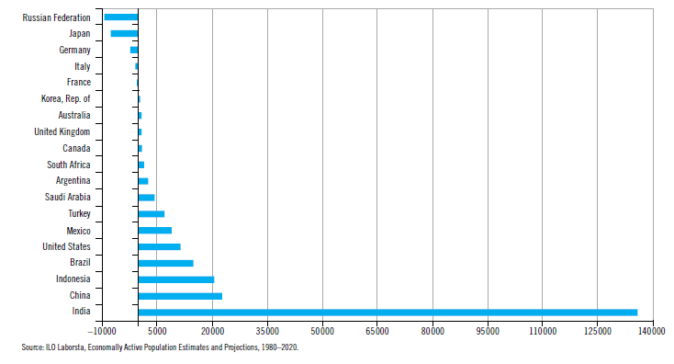
G20 Working Age Pop 2010-2020
Decline in working age population in economically advanced countries will necessitate massive import of workers.
World’s working age population will increase by 440 million by 2020.
India needs to create 30% of those jobs
Notes:
ILO projections for G20

Slide 5
Factors impacting Employment
Demography: population growth and increasing life expectancy
Rates of economic growth
Mechanization and automation
Transformation of work: from agriculture to manufacturing to services
Globalization of trade and outsourcing
International labor mobility
Labor policies
Public policies and regulation
Entrepreneurship
Self-employment
Virtualization of work
Income distribution
Patterns of investment – speculative vs. productive
Vocational training
Higher educational requirements & attainments
Freedom and social expectations
Social and organizational innovation
Legal and social justice

Slide 6
Right to Employment: Rationale
Employment is an essential basis for economic security, social stability and psychological well-being.
Human capital is our most productive, creative, precious and perishable resource.
In today’s highly structured society, access to remunerative employment opportunities is the economic equivalent of the right to vote in democracy.
Government that has power to regulate employment also has the responsibility to generate it.
The right to employment is not a privilege, it is a fundamental human right.
Notes:
Nagan, Winston. “Human Rights & Employment” Cadmus Journal, 1( 2010): 49.

Slide 7
Right to Employment: Precedents
Bill of Economic Rights, including right to employment, was proposed by US President Roosevelt during WWII.
US Employment Act of 1946 acknowledge the responsibility of national governments for generation of employment.
Universal Declaration of Human Rights (1948) art. 23 & 24 affirm right to work, protection against unemployment, free choice of employment.
‘International Bill of Human Rights’ (1960s) on civil, political rights, economic, and social rights.
ILO Declaration of Fundamental Principles & Rights at Work (1998).

Slide 8
Sustainable Employment Strategies
Redirect surplus to productive investments
Human Capital-intensive investment incentives
Raise mandatory minimum & tertiary levels of education
Vocational Training to closed the “skills gap”
Organizational Innovations – e.g. micro credit
Internet-based Self-Employment
Technological Innovation
Complementary currencies tap unutilized resources
Job Guarantee Programs – India’s MGREGS
Minimum guaranteed income & working hour adjustment
Global Norms for Minimum Wage
Notes:
India to train 150M youth by 2022

Slide 9
Summary of Conclusions
Pessimism regarding the future of work is neither new nor justified.
Full employment is essential for social stability, economic security and social development
Radical changes in the nature of work necessitate a new theoretical perspective and broader practical approach to the issue of employment.
Full employment can be achieved by comprehensive, integrated strategies based on the perspective of social development as a human process.
It cannot be achieved universally within the present framework and values.
Employment must be recognized as a fundamental human right.
Human-centered theory & policies needed that recognize human welfare as the central purpose & development of human capital as the driving force.
A global model of employment is needed that recognizes the transnational character of both the challenge and the opportunities for full employment.

Slide 11
Paradox of Unmet Needs & Untapped Social Resources
Unmet needs of 3 billion people living on incomes of less than $2.50 a day for food, clothes, housing, education, medical care.
World is a-flood with unutilized and underutilized resources.
  Daily $4-5 trillion searches the globe for speculative returns
  Since 1980, global financial assets have risen 20 fold, while real incomes grew just 2.7 fold.
  The share of corporate profits and financial investments is rising at the expense of labor.
  200+ million people are unemployed – 40% youth
  Billion+ involuntarily underemployed.
  Only a fraction of the world’s intellectual, technological and organizational resources harnessed for productive purposes.
This incalculable waste of Human Capital underlines the fallacy of current theory and policies.
Notes:
Wray, Randall. "Full Employment Through Direct Job Creation”, webcast presentation to the World Academy of Art & Science, November 10. 2009, Accessed October 4, 2010, http://www.worldacademy.org/files/Job%20Guarantee%20Wray%20presentation%20on%20Nov%2010%2009.pdf.

