Slide 1

Virtual University
Global Higher Education using
Internet & Communication Technology
Janani Harish Ramanathan
Research Associate, The Mother’s Service Society
Associate Fellow, The World Academy of Art and Science

Slide 2
Advantages of Education
Employability
Productivity
Insurance against poverty
Safeguard against extremism
Democracy
Environment
Vaccine against diseases

Slide 3
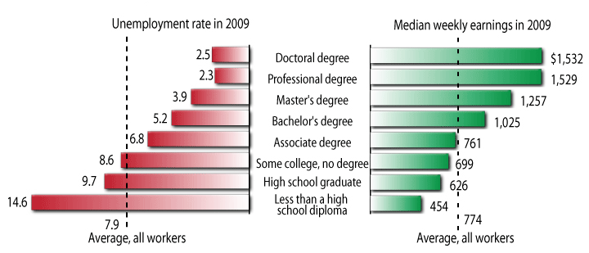
Education Pays - US
Source: Bureau of Labor Statistics

Slide 4
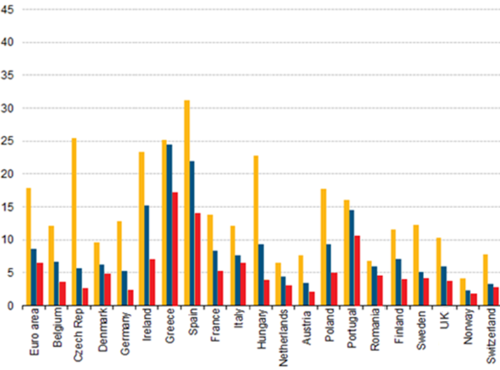

Education & Employment - Europe
%
Source: 2012, European Commission, http://epp.eurostat.ec.europa.eu

Slide 5
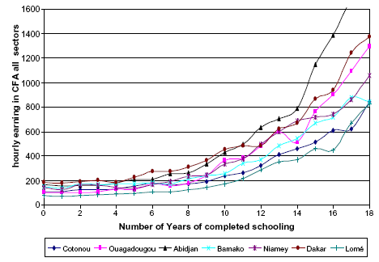
Education & Earnings - Africa
Source: http://wiego.org

Slide 6
Shortcomings in Education Today
Qualitative Gap
Quantitative Gap
Cost of Education
Educational Debt
Vacant Faculty Positions
Special Needs Education
Conflict Areas

Slide 7
Indian College Scenario
Faculty shortage - 54%
To raise enrollment from 19% to 95%,
95 million new students
132,000 more colleges (from 33,000)
4.1 million more lecturers (from .82 m)

Slide 8
World Scenario
College age population not enrolled in college
China: 85 million
Pakistan 17 million
Indonesia: 16 million
Brazil : 13 million
Bangladesh: 12 million
Nigeria : 12 million
Ethiopia: 7 million
Mexico: 7 million
World: Over 366 million
Source: UNESCO Institute for Statistics, http://stats.uis.unesco.org/

Slide 9
Virtual University – A Solution
Quality
Multimedia
Cost
Multi lingual
Expansion
Syllabus Updation
Special Needs
Customization

Slide 10
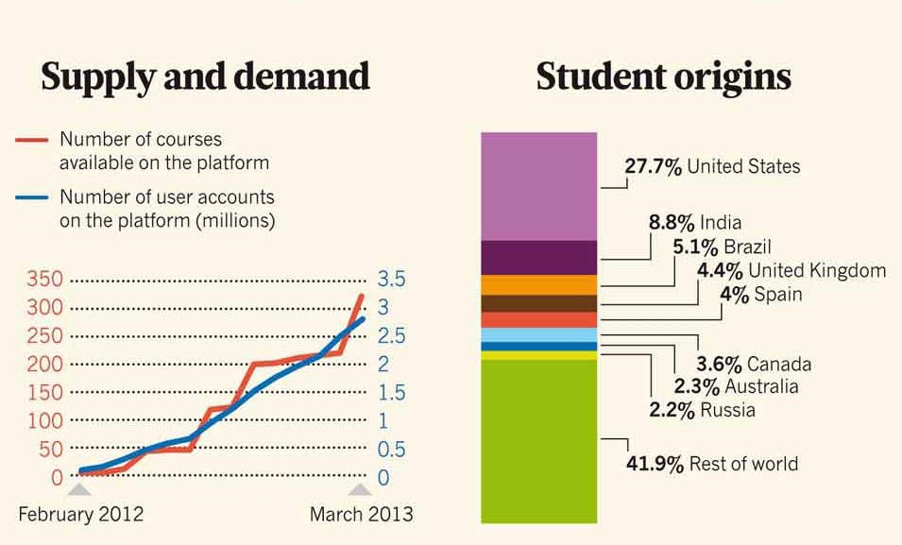
Demand for Online Studies
Image: Courtesy of Nature magazine

Slide 11
Virtual University
Enhancing Human Capital
through Online Education

