Slide 1
Biological, social, psychological and spiritual dimensions of society and individual life
Alberto Zucconi
Istituto dell’Approccio Centrato sulla Persona (IACP)
World Academy of Art and Science (WAAS)
World University Consortium (WUC)
IUC, Dubrovnick, August 25-30, 2014

Slide 2
    What is life? It is a material process, sifting and surfing over matter like a strange, slow wave.
    It is a controlled artistic chaos, a set of chemical reactions so staggeringly complex that more than eighty million years ago it produced the mammalian brain that now, in human form, composes love letters and uses silicon computers to calculate the temperature of matter at the origin of the universe.
    Lynn Margulis and Dorion Sagan

Slide 3


Slide 4
    As we have already underlined, human experience is socially and personally construed.
    Socio-cultural and personal constructs are the ways in which communities and individuals construe their experiences at the emotional and cognitive level. Social and personal constructs are interacting and influencing all the time with the social and individual dimensions.
.

Slide 5
    The consequences of the impact of the construing of experience on the biological, social, psychological and spiritual dimensions vary since the meaning-making can be structured functionally or not.
    What the social construction of reality is in a society or within a single individual can be protecting and promoting health, well being, equal opportunities, resilience and creativity.
    Dysfunctional constructions bring the opposite results.

Slide 6
    Effective ways of construing experience have these common factors:
    The constructs are conscious and available to restructuring and updating.
    Facilitate the awareness of basic needs and their satisfaction.
    Are flexible and changeable and allow learning from experience.

Slide 7
    Dysfunctional ways of construing
    experience have these common factors:
    The constructs are unconscious and not available to restructuring and updating.
    Do not allow the awareness of basic needs and their satisfaction.
    Are rigid and imperative and do not allow learning from experience

Slide 8
    The same is true of personality structures:
    There are individuals that have structured
    their personalities in functional ways and
    this enables them to function in a society
    and culture and be able to survive and
    prosper developing their potentialities to
    work, love and play and to cope with the
    ordinary and extraordinary stresses of life.

Slide 9

Resilient and creative people
are more capable
of effective crisis management than those who are poor cooperators. The latter are as a result more vulnerable and dysfunctional.

Slide 10
Research by Bandura, Kobasa, Maddi and others show that people that are more resistant to the damaging effects of chronic stress have some common denominators:
Optimism
High Self-esteem
Capacity to adapt to change
Trust to be able to cope with the unexpected
Effective coping
Capability to be in touch with their feelings and express them
Good communication capabilities
Capacity to ask for help in need
Have a good social support
Health and wellbeing behaviors
High productivity
Optimal use of resources
Have very few accidents
People that suffer more from chronic stress have the opposite common denominators

Slide 11
    This largely depends on the type of constructs and values.
    There are beliefs, social norms and cultures that are grounded on life affirming values, are tolerant and allow and respect differences. There are also other cultures that feel threatened and try to eliminate any difference in belief, religious faith, political or sexual orientation etc.
    At the individual level a mature person is not threatened by different people since she or he can accept the different part of himself/herself.

Slide 12


Slide 13
    Also scientists in their science making are
    construing their experiences:
    An important advance of the quantum revolution
    was that scientists achieved a new breakthrough in
    Self awareness regarding the creation of scientific
    Knowledge illustrated by the Heisenberg’ principle:
    the observer and the instruments she/he uses for
    observation interact with the phenomenon observed
    and co-construct it.

Slide 14
    Observations of Researchers and professionals in the health sciences are colored by their vision of human nature.
    If we compare an anatomic table based on allopathic
    medicine with one based on traditional Chinese medicine
    the different underlying views of human nature are clear.
    Likewise, every approach in the helping professions is
    based on a specific vision of human nature, which in turn
    is based on values.
    Those values determine the politics of the helping
    relationship and influence outcomes.

Slide 15
  The values of a therapeutic approach − implicit or explicit as they may be − determine the politics of the helping relationship and influence outcomes.
  To be trained in the biomedical reductionist model, or to be trained specifically as a Freudian analyst, the behaviorist or person centered psychotherapist is to enter into and belong to a construed world of values, to take on different roles, and to create clinical settings that actively promote different narratives.
  The definitions of disease, illness and cure, and the roles of therapist and clients or patients are all influenced by differences in therapeutic approach.

Slide 16
Humanistic Psychology, instead of focalizing only on pathology, has studied people that are particularly healthy and fully functioning, investigating the common denominators of those people.

Slide 17
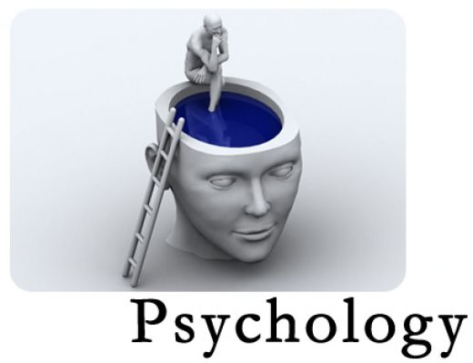
The vision of Human nature in Humanistic Psychology

Slide 18
From infancy to old age human beings strive to actualize their highest potentials, establish and maintain close mutual connections with others.
People possess enormous inner resources for self-regulation and self-healing which can be accessed in the service of recovery and growth.
Healing and self-actualization are facilitated by participation in relationships characterized by key interpersonal conditions: mutual respect, warmth, acceptance, genuineness and empathy.

Slide 19
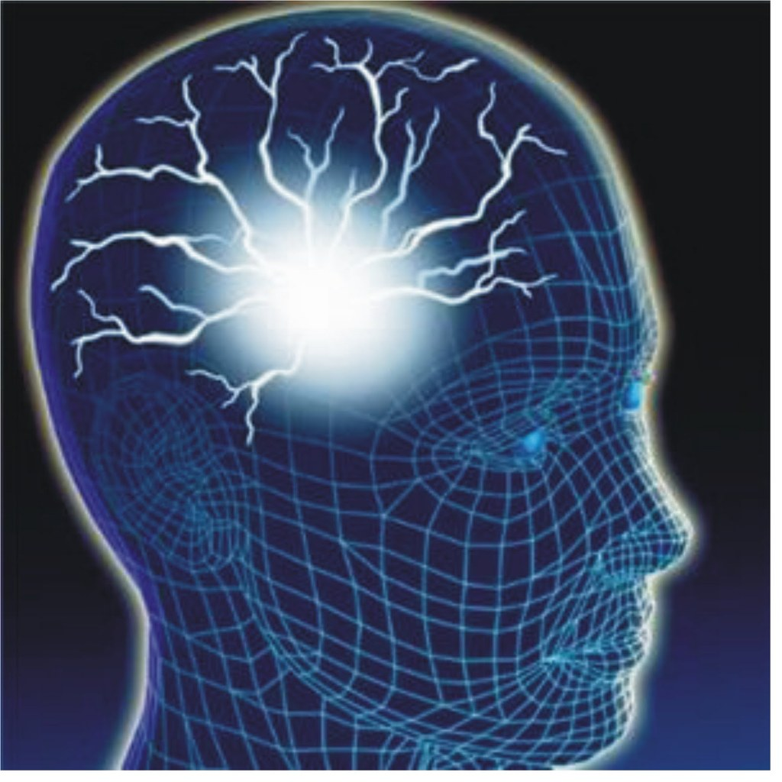
Theoretical Assumptions of Humanistic Psychology
The origins of psychological distress

Slide 20
All paradigms of psychotherapy are based on a vision of human nature, from which descends their own view of health and illness and the process of what creates disease and pain and what promotes healing, health and well-being.
The humanistic view is that people experience pain when spontaneous movement towards self- actualization and successful connections with significant others becomes cut off, blocked, violated or exploited.

Slide 21
If these disconnections or violations occur early in life, or persist over long periods, people develop defensive psychological coping mechanisms which further cut them off from the deeper organismic flow of life.
Self-awareness becomes interrupted and authentic interactions with others become impossible. When this happens vital life satisfactions become unavailable, causing further distress and alienation which then may spiral into deeper difficulties which frequently end up in a crisis.

Slide 22
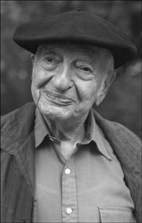
Kurt Goldstein described self-actualization as the tendency to actualize, as much as possible, the organism's individual capacities in the world.
The tendency toward self-actualization is the only drive by which the life of an organism is determined.

Slide 23
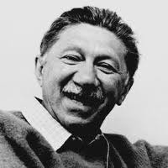
Abraham Maslow based his theory on his case studies of historical figures whom he saw as examples of self-actualized individuals including Albert Einstein, Ruth Benedict, Frederick Douglass, Jane Addams, Eleanor Roosevelt, Max Wertheimer, Henry David Thoreau….
Maslow examined the lives of each of these people in order to assess the common qualities that led each to become self-actualized.

Slide 24
In general he found that these individuals were accepting of themselves and of their life circumstances; very creative; focused on finding solutions to cultural problems rather than just concentrating on personal problems; open to others' opinions and ideas; had a strong sense of privacy, autonomy, human values and appreciation of life; and a few intimate friendships rather than many superficial ones.
They also all reported the frequent occurrence of peak experiences. These occasions were marked by feelings of harmony and deep meaning: feeling at one with the universe.

Slide 25
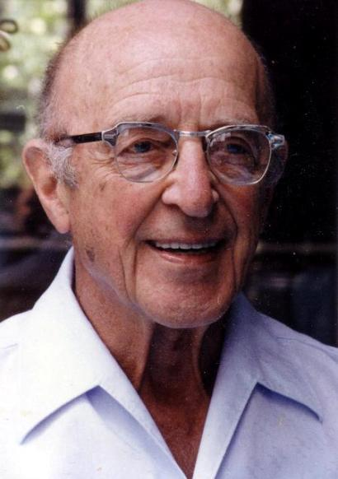
For Carl Rogers human nature has a fundamental tendency, the actualizing tendency where self-awareness generates self-regulation.

Slide 26
According to Rogers the human organism has an underlying "actualizing tendency", which aims to develop all capacities in ways that maintain or enhance the organism and move it toward autonomy.
This tendency is directional, constructive and present in all living things.

Slide 27
The concept of the actualizing tendency encompasses all motivations; tension, need, or drive reductions; and creative as well as pleasure-seeking tendencies and a drive to fulfill the genetic blueprint.
Each person thus has a fundamental mandate to fulfill their potential.

Slide 28
Carl Rogers found the following common denominators of the fully functioning person :
Self aware, integrated, in touch, deep, authentic, trusting, creative,
good capacity for affiliation and communication, balanced and realistic.
Psychological health, maturity, existential depth, effective self- regulation, respect for themselves and others.
Openness to experience (instead of the rigid defense stance of the person feeling under threat).
Personality: mature, fluid, absence of rigidity/fundamentalism.
Maximum adaptability.
Trust in themselves, their organisms, their intuition, feelings and values.
Sense of direction, purpose, leadership qualities.

Slide 29
The process of the fully functioning person is seen by Rogers as a challenge:
“This process is not, I am convinced, a life for the faint-hearted.
It involves the stretching and growing of becoming more and more of one's potentialities.
It involves the courage to be.”
(Carl Rogers, 1961)

Slide 30
Carl Rogers’ research over the last 70 years has identified specific qualities in relationships which promote the development of fully functioning people as well as the healing of partially functioning people:
Respect
Empathic understanding
Authenticity/congruence (deep contact)

Slide 31
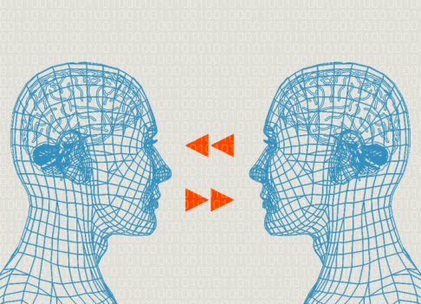
People that are related to in this nourishing way statistically tend to reproduce these qualities in their
new relationships.

Slide 32
Unfortunately, this also tends to hold true in the opposite case:
when people are related to in unhealthy, dysfunctional, demeaning, disrespectful and violent ways, statistically they tend to suffer from such mistreatment and tend to reproduce the same relational patterns with others;
their capacity of contact with their inner core is lost, self-regulation becomes impaired and as a result they become rigid and defensive and risk fragmentation.

Slide 33

We need to be aware of how we construe our experiences of what we call reality: the relationship with ourselves, the others, the world.

Slide 34
We need more people that relate to themselves, to others and to the planet with more
Respect
Empathy
Authenticity/congruence (deep contact)

Slide 35
How can we
protect and promote healthy and functional biological, social, psychological and spiritual dimensions?
By fostering awareness and by..

Slide 36
By fostering the conditions that protect and promote individuality in all the processes of the construction of reality, identity, social roles and behaviors.
By relating to others in respectful, empathic, genuine and congruent ways and applying them as the relational foundations in:
                Parenting
                Schooling
                Workplaces
                Community
                Society
                Culture

Slide 37
Alberto Zucconi
World Academy of Art and Science
www.worldacademy.org
World University Consortium
www.wunicon.org
Person Centered Approach Institute (IACP)
www.iacp.it
azucconi@iacp.it

