Slide 1
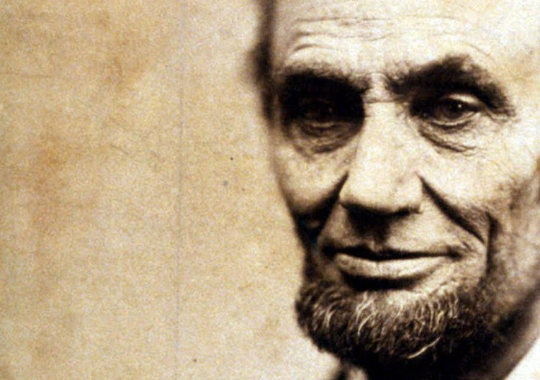
INDIVIDUALITY AND SOCIETY
Transdisciplinary Course on Individuality & Accomplishment
LECTURE 7
GARRY JACOBS

Slide 2
Contributing Factors
Accomplishment is a product of interactions between different levels of our existence
INDIVIDUALS
Capacities, Intentions
& Actions
ORGANIZATIONS & GROUPS
Formal & Informal
ENVIRONMENT
Geography & Spatial Relationships
SOCIAL & CULTURE MILIEU
Ideas, Beliefs, Values,
Attitudes & Ideals
LIFE EVENTS IN SPACE & TIME

Slide 3
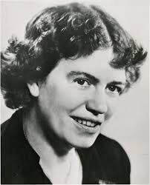
One Man can Change the World
“Never doubt that a small group of thoughtful, committed, citizens can change the world. Indeed, it is the only thing that ever has.”
Margaret Mead

Slide 4
America in 1861
Agrarian South vs. Industrial North
Southern cotton was vital for European Industry & Employment
Democrats supported Slavery & States Rights
Republicans supported Freedom & Unity

Slide 5
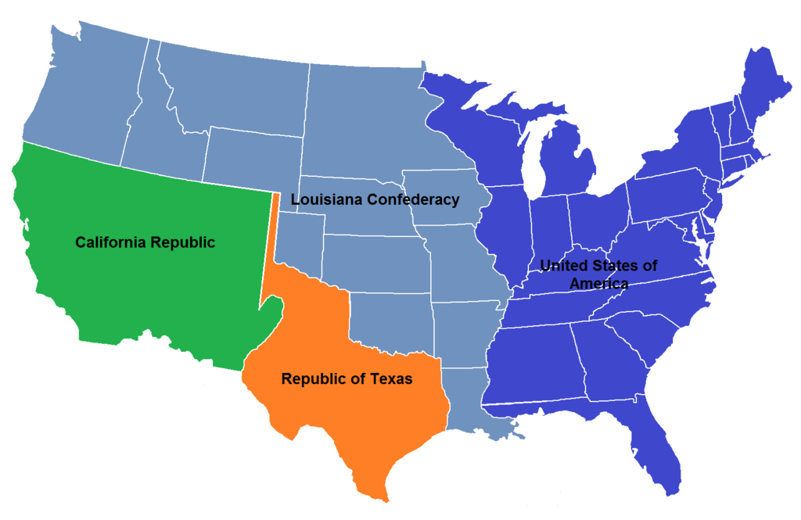
Manifest Destiny: American States
Texas (1845)
Florida (1845)
Wisconsin (1848)
California (1850)
Nevada (1854)
Oregon (1859)
Kansas (1861)
Homestead Act (1862): 160 acres of land to 600,000 settlers to settle in 6 ‘free” territories – Nebraska, Washington, Idaho, Montana, Wyoming, Dakotas

Slide 6
1861: A Nation divided & in peril
Most crucial turning point in American history
America was confederation with weak central govt
Ideal of equality remained a dream on paper
Few Americans favored real racial integration
Slavery legal in 11 of 33 states with plantation economies dependent on slave labor
Westward expansion opened up new territories
Slavery was in slow retreat throughout Europe
Europe needed Southern cotton for their industry
South wanted to extend slavery to new territories
1861 South formed CSA & started the war

Slide 7
Lincoln – The Man
Born in a log cabin in the wilderness in 1809
Raised in extreme poverty
Self-educated
Country lawyer, surveyor and post master
Entered politics opposing the spread of slavery
Elected to Congress for a single term in 1846
Ran for Senate and lost
Elected president by minority popular vote

Slide 8
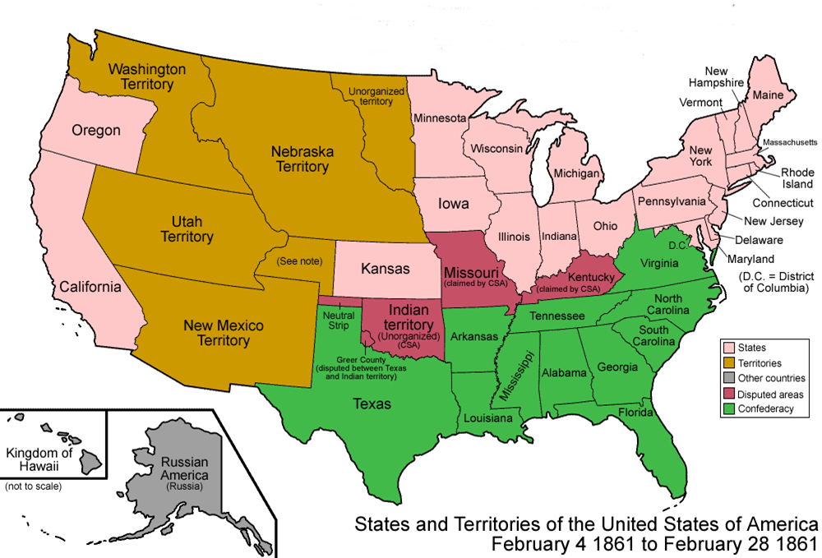
America in 1861

Slide 9
Lincoln – the President
Branded a second-rate country lawyer without experience
Thought to be weak, idealistic (unrealistic) and indecisive
New England elite looked down on the ‘commoner’
No support or respect in Washington
He formed bipartisan cabinet to preserve unity
Cabinet members thought they could control him
His military commander refused to obey his instructions
Abolitionists pressed for law banning slavery
Congress wanted end of war without abolishing slavery
When elected he was given one aide

Slide 10
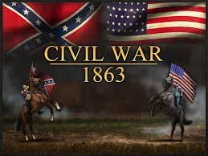
Military Situation
Confederacy controlled
  All federal agencies, forts, weapons in South
  Mississippi River – lifeblood of nation’s commerce
  All the experienced military leaders
Northern army of only 16,000 was scattered, disorganized and inexperienced, including many Southern sympathizers, and generals who competed with one another.
Lincoln’s chief of the army refused to engage the enemy and wanted to be next president
England and France secretly armed the South
South won all the early victories

Slide 11
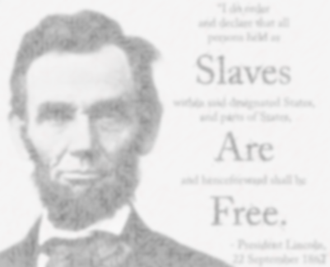
Turning Point
Country seemed to verge of be splitting apart
Lincoln waited with enormous patience
Lee invaded and then retreated from Maryland
Kentucky refused to support Southern invasion
Lincoln demanded McClelland attack Virginia
Immediately after the news of Northern victory,
he wrote the Emancipation Proclamation
Congress passes it by narrow margin
European abolitionists supported the North
The tide of the war turned

Slide 12
Outcome & Consequences
North won the war and USA was reunited
In 1865, Congress passed the 13th amendment abolishing slavery everywhere on US soil
By 1900 the US economy was larger in size than the UK, Germany and France combined – producing 1/3rd of total global output.
Had Lincoln failed, the country would have split into 2 or possibly a dozen pieces
Rise of USA to global economic and military supremacy would never have happened
Discrimination against blacks persisted in the South for another 100 years

Slide 13
Questions about Lincoln’s Achievement
How could one man influence the course of history so dramatically?
Where did he acquire that power?
?
What capacities of his made it possible?
What was the process by which he achieved it?
What made him so unique?
How did he convert extreme challenge into unimaginable opportunity for America?
Was it luck, chance, or ability that enabled him to overcome impossible circumstances?

Slide 14
Macrocosm and Microcosm
PHYSICAL WORLD
  An infinite macrocosm of planets, stars, solar systems, and galaxies
  An invisible microcosm of infinitesimal particles, atoms, molecules and cells
  Newtonian world we live in lies between them and interacts with both
HUMAN WORLD
  Outer social macrocosm of family, community, national and global society
  Inner psychological microcosm of thoughts, feelings, beliefs, opinions, aspirations, urges, impulses and sensation
  Individual human being lives between them with feet in both world

Slide 15
Accomplishment & Knowledge - 2 Processes
We achieve first, then we understand how
We learn largely by doing
We accumulate our learning and codify it
Later consciously transmit it to others as education, so they can learn before they act
Knowledge First, Then Accomplishment
Accomplishment First, Then Knowledge
We become conscious by experience
Then we organize for effectiveness

Slide 16
Consciousness & Organization
“Life evolves through growth of consciousness.
Consciousness evolves through greater organization and perfection of life: a greater consciousness means a greater life.”
SRI AUROBINDO

Slide 17
Consciousness
Growing awareness of self and world
Acquired personally by observation, experience and reflection
Transmitted through family, education, training, culture and experience

Slide 18
Living Organizations
Society is a complex living organization
Human personality is a complex organism
Both are organizations of energy, ideas, attitudes, emotions, intentions, capacities & power
Organization expresses the power of the human mind for orderly expression of consciousness
Organization is the capacity of mind to create order, structure and process

Slide 19
Organization of Social Energies
Social energy expresses in ACTS
The ACT is the basis unit of social energy
Acts are physical, interpersonal, mental, psychological
Acts are linked together to form chains & structures consisting of
Actions – Activities – Systems – Functions Coordination – Integration

Slide 20
Organization of Psychological Energies
Psychological energy expresses in psychological ACTS
The ACT is the basis unit of psychological energy
Acts are physical, perceptual, emotional, mental, spiritual
Perceptions, thoughts, emotions, desires, impulses are psychological acts
Energy is coordinated & integrated to form chains and structures
  Physical energies form Skill & Habits
  Vital energies form complex Traits
  Emotional energies form Attitudes, Sentiments & Motives
  Mental energies form Thoughts, Opinions & Ideas
  Spiritual energies form Ideals, Aspirations & Values

Slide 21
Social Capital
Society is a teeming ocean of human energies and capacities – unorganized but latent with unlimited productive potential
The organization of social energies and capacities converts social potential into social capital
Society is an infinitely complex network or
web of interrelation-ships
The enormous power of society for accomplish-ment issues from this organization

Slide 22
Human Capital
Each member of society is an unorganized reservoir of energies, aspirations and capacities
Organization of the energies and capacities of each member of society through family, education, training, culture & experience converts human potential into human capital

Slide 23
The Individual is the Link
The Individual is a freely formed self-organization of psychological energies and capacities positively integrated with the social organization
The formed Individual is the summit of social evolution where human capital & social capital intersect and become infinitely productive
[insert image of intersection]

Slide 24
Human & Social Complexity
The social macrocosm strikes our senses by its enormous size, variety, incredible speed and the complexity of the interactions between its component elements
The psychological microcosm consists of an uncountable number of thoughts, feelings, perceptions,, sensations, impressions, desires, impulses, urges, opinions, beliefs, sentiments cross our consciousness every day at lightning speed, too fast for us to even perceive most of them
All of them combine together in complex ways to define our conscious and unconscious experience and our behavior
Take away one or the other and what will we be left with?

Slide 25
Human Accomplishment
Every individual carries within the cumulative experience of all humankind in essence
Yet every moment individuals are altering that collective reality & adding to that experience
Human accomplishment is a product of this interaction

Slide 26
Individuals are Catalysts of Change
Individuals are products of society
Societies are products of individual initiative
Individual are the catalysts of social change
Human catalysts precipitate events

Slide 27

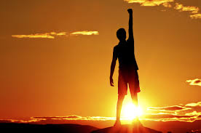
How do individuals access social power?
Lincoln identified with the aspiration of all Americans for freedom and unity
Sears & Rosenwald created an organization to fulfil the aspirations of the rural community
Fred Smith identified with the aspiration for speed & designed an organization to meet it
Google, Amazon, Facebook plugged into the power of social organization of the Internet

Slide 28
LINCOLN’S PERSONALITY
High idealistic values, honesty & integrity
Devoted to equal rights for all
Man ‘of the people’ sensitive to the will of the people
Respected others & related to all on equal basis
Determined to preserve the nation
Convinced that slavery was evil, must be abolished
Self-effacing humility many mistook for weakness
Inner strength & determination of his convictions
Forged alliances with antagonists
Character free of personal resentment
Capable of immense patience – knew when not to act
Continuously learning – 3Rs, law, military science

Slide 29
What was the source of Lincoln’s power to accomplishment?
The power he wielded belonged to the society
His one goal was to discern what the public will would sanction
He recognized that the primary aspiration of the country was unity
He acquired power by eliminating his ego and identifying with the will social

Slide 30
Lincoln’s Accomplishment
His personality became a channel for the deeper aspirations to become conscious
His actions enabled the abounding energies of a young nation to become organized as the strength of the expanding American nation
His accomplishment altered future aspirations, acting as inspiration for future initiatives

Slide 31
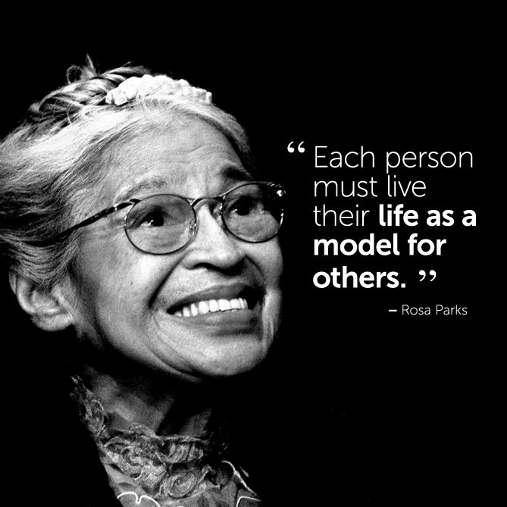
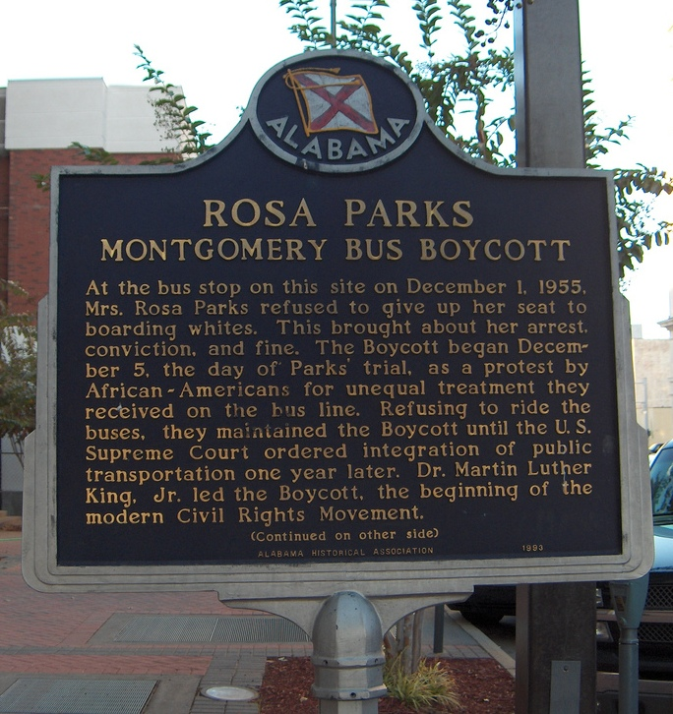
Rosa Parks – a sequel

