Slide 1
Transfer of Power
Janani Ramanathan
Associate Fellow, World Academy of Art and Science
Research Associate, Mother’s Service Society
Individual Accomplishment, Growth & the Character of Life
in Management, History, Literature, and Psychology

Slide 2

Transfer of Power
Authority and Conformity
Individual Accomplishment, Growth & the Character of Life in Management, History, Literature, and Psychology

Slide 3
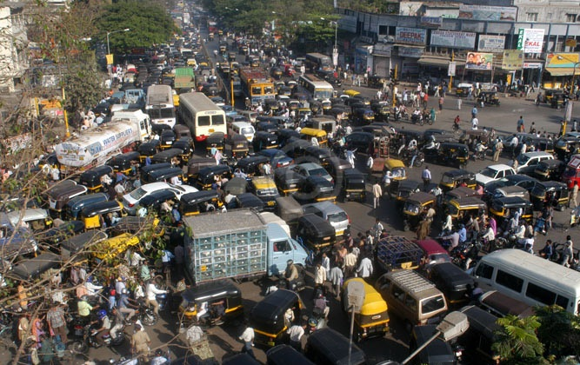
Transfer of Power
Role of authority in social development
Individual Accomplishment, Growth & the Character of Life in Management, History, Literature, and Psychology

Slide 4
Transfer of Power
Ways in which society imposes authority
Type of Authority | Negative Authority | Positive Authority
Physical | Physical punishment, exile | Rights of inclusion, protection
Emotional | Ostracism, subordinate status | Acceptance, prestige
Mental | Indifference, scepticism | Recognition, respect
Individual Accomplishment, Growth & the Character of Life in Management, History, Literature, and Psychology

Slide 5
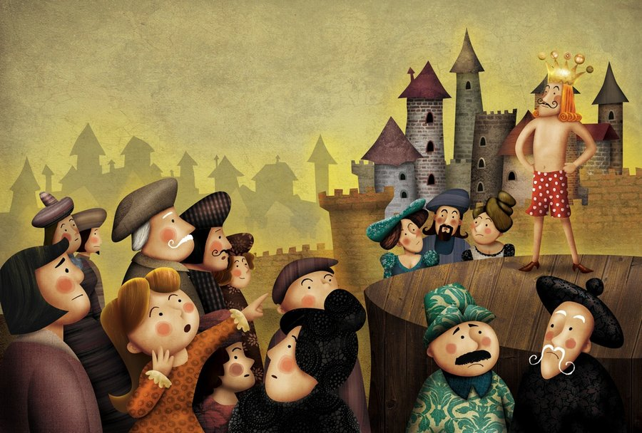
Transfer of Power
Conformity in the individual
Individual Accomplishment, Growth & the Character of Life in Management, History, Literature, and Psychology

Slide 6
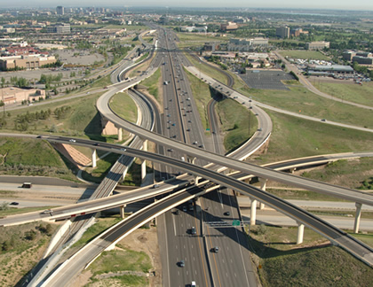
Transfer of Power
Role of Conformity
Individual Accomplishment, Growth & the Character of Life in Management, History, Literature, and Psychology

Slide 7

Transfer of Power
Beyond a point, rigid conformity stifles growth
Individual Accomplishment, Growth & the Character of Life in Management, History, Literature, and Psychology

