Slide 1
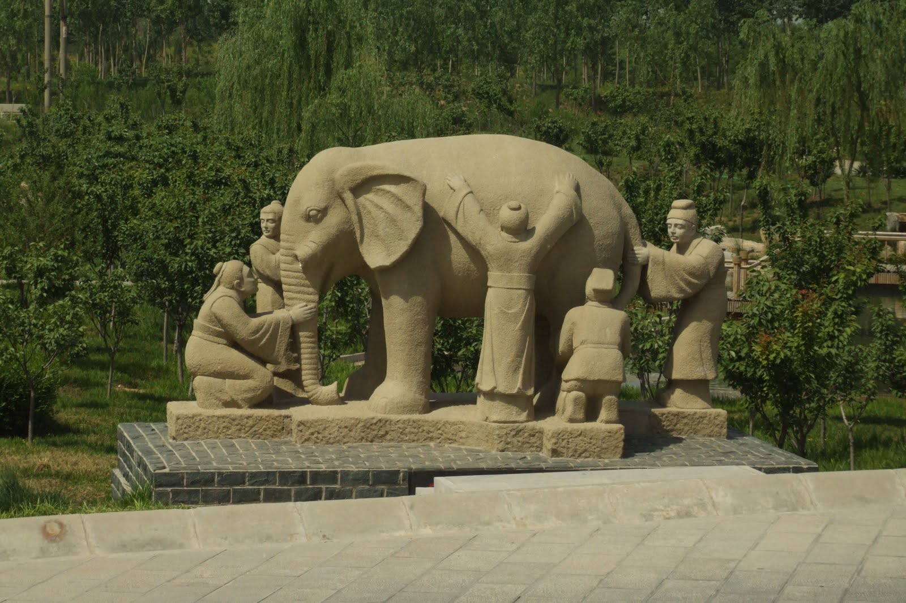
DIMENSIONS OF PERSONALITY
LECTURE 3
GARRY JACOBS

Slide 2
Great Depression – March 1933
25% of the American workforce unemployed
Farm prices down 60%
Banking panic led to closure of 6000 banks
Industrial production down 50%

Slide 3
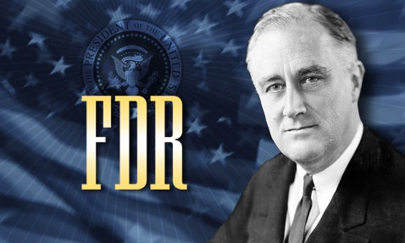
FDR’S LEGACY
Regulation of banking
Labor legislation & economic rights
Social welfare legislation
Conservation of Nature
Lasting peace in Europe
Founding of the UN
Abolition of colonialism

Slide 4
What is Personality?
HUMAN NATURE
CHARACTERISTICS
INDIVIDUALITY
What makes us all the same?
What makes us similar to one another?
What makes us each unique?

Slide 5
Constituents of Personality
PERSONALITY
Opinions, Beliefs, Attitudes
Habits, Skills, Abilities, Traits
Memories and Imagination
Needs, Desires, Motives, Urges, Impulses
Feelings, Emotions, Sentiments
Aspiration, Ideals, Values

Slide 6
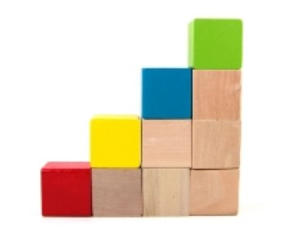
LEVELS OF CONSCIOUSNESS
FEELING emotional
PHYSICAL biological - sensation
PSYCHOLOGICAL & SPIRITUAL aspirations – ideals - values
MENTAL ethical – aesthetic - rational

Slide 7
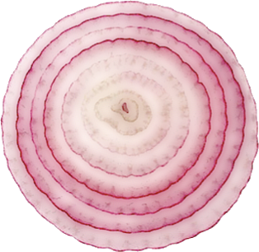
LAYERS OF PERSONALITY
External Manners
Conscious Behaviour
Subconscious Character
Creative Personality
Unique Individuality
MANNERS
INDIVIDUALITY

Slide 8
Organization of Personality
These constituents, levels and layers are arranged in relation to one another
Personality is the organization of psychological elements
Personality interconnects, coordinates and partially integrates different dimensions, functions and attributes
Integration is partial – because there can be many gaps, inconsistencies and conflicts

Slide 9
Organization of Personality is Complex
Not mechanical like a machine assembly
Not just like an onion with many layers
Not confined to a single level like a stone, a plant or a computer
More like a living web of interconnections – an organism
Not just like an orange with many separate sections under a common skin

Slide 10
Growth of Personality is Multi-dimensional
LINEAR: Each endowment and characteristic is capable of increasing
COORDINATION: Each is capable of increasing its coordination with the others
NETWORKING: Expanding network of subtle relations and interconnections
INTEGRATION: All are capable of increasing integration around central direction and driving forces motivate the person
Growth of personality is organic, multi-dimensional, spherical complexity

Slide 11
Personality is a Complex Conscious Living Organism
Capable of growing from every experience – positive or negative
Unlimited in its potential development
Infinite in variety and qualities
Unknowable in its totality and uniqueness
Perpetually evolving in consciousness and organization

Slide 12
Personality & Accomplishment
Personality supplies the driving force, direction and subtle organization for all human accomplishment

Slide 13
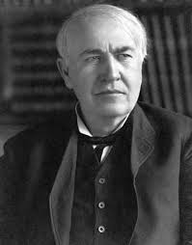
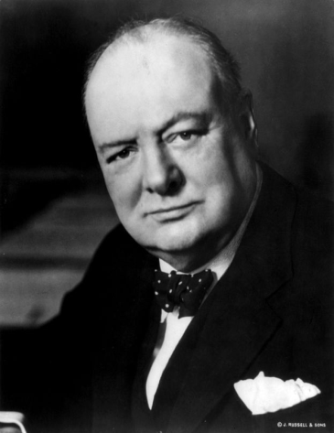
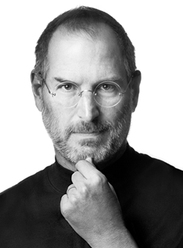
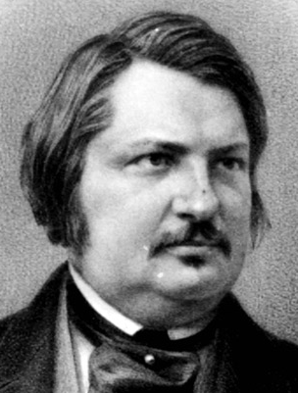
High Energy People
The single most striking attribute of high achieving individuals is the intensity of the ENERGY they exhibit

Slide 14
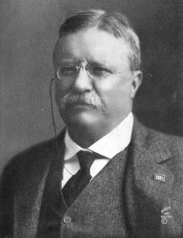
Theodore Roosevelt – Force of Nature
26th President of USA known for his exuberant personality, cowboy persona and robust masculinity.
Known as the trust-buster that broke up Standard Oil
Famous for his remark, “Speak softly and carry a big stick”
"Do you know the two most wonderful things I have seen in your country? Niagara Falls and the President of the United States, both great wonders of nature!"
"a perpetual flow of torrential energy, a sense of motion even in stillness ... thrilling to be near."

Slide 15
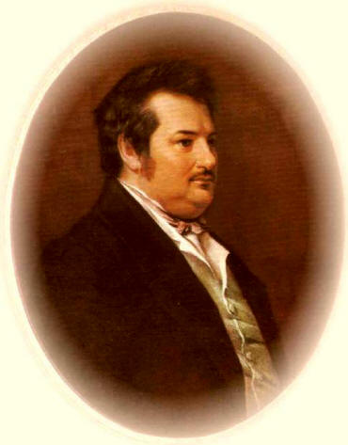
Honoré de Balzac – Creative Imagination
During 1830 and 1831 he poured out approximately 150 short novels, stories, articles, and commentaries—a feat unparalleled in the annals of literature—and over the next 20 years, he completed 40 full-length novels.
"Everything he did seemed to have a tenfold intensity. When he laughed the pictures on the walls trembled; when he spoke the words came cascading forth; ...when he worked there was no difference between day and night as he sat writing round the clock and blunted a dozen pens in the process."

Slide 16
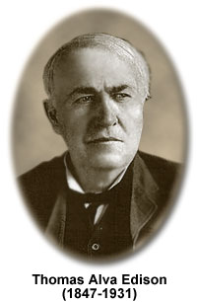
Thomas Alva Edison – Incessant Innovator
Developed 1,100 patentable inventions
Gave birth to several entirely new industries—the motion picture, phonograph and recording, and electric and household appliance industries.
Founded General Electric Company – world’s 7th largest corporation (Forbes)
Asked to write an autobiography at aged 60: "When I go into senile decay I may consider the autobiographical scheme, but as long as I can put in eighteen hours daily, I don’t want to waste any time on it."

Slide 17
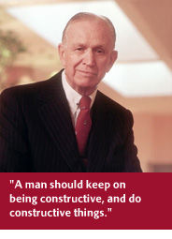
Willard Marriott – Entrepreneur
Founded his first drive-in restaurant in 1927 with $5000 and grew it into a national food service chain with more than 2000 facilities
Pioneered airline catering business in 1937
Entered hotels in mid 1950s and built what is today world’s largest hotel company with 4000 properties in 80 countries
Combined revenues of companies he founded is now + $16 billion
“His managers never knew what time of day or night he’d show up at the kitchen door and go bird-dogging almost at a half-run through the kitchen, the pantries, the storage rooms, the refrigerators, the restaurant itself, running a finger over the shelves to check for dust, checking under tables and in cutlery drawers, checking the ranges, the storage rooms, the trays about to be served, sampling the root beer, and raising hell if everything wasn’t spotless, neat, clean, bright, polished, done efficiently, done well.”

Slide 18
Corporate Intensity
Youthful enthusiasm of rapid growth – Apple 1984, Inc. 100
Dynamic exuberance – INTEL
Controlled power of a well-oiled machine – Merck
Vibrancy, charm and cheerfulness – Coca Cola
Intense warmth of a close-knit family – Delta
Quiet hum, very active & alert – North-western Mutual

Slide 19
Energetic Societies
Alexis de Tocqueville’s Democracy in America
Jules Verne’s characterization of the American West
Charles de Gaulle’s first impressions of New York
Harlan Cleveland’s “Revolution of rising expectations”
Resurgent Asia

Slide 20
Different Types of Energy
PHYSICAL – Genghis Khan, Michael “air” Jordan, Jackie Chan
VITAL-EMOTIONAL – Gandhi, Churchill, Martin Luther King
ENTREPRENEURIAL – Carnegie, Watson, Marriott
MENTAL – Socrates, Sherlock Holmes, Einstein
ARTISTIC – Leonardo, Shakespeare, Beethoven, van Gogh
SPIRITUAL – Buddha

Slide 21
ASPIRATION
Aspiration generates energy
Aspiration means intense seeking
Aspiration is a psychological exertion of will
Results from needs, challenges, opportunities
Powerful motive to achieve, dominate or rise in status
Commitment to an ideal, value or ethic
Intense joy for growth, mastery, self-actualization

Slide 22
Aspiration vs. Satisfaction
Satisfaction absorbs energy
Contentment with what one has achieved
Seeks to express energy for enjoyment, possession or domination, rather than for accomplishment
Usually grows with increasing levels of accomplishment

Slide 23
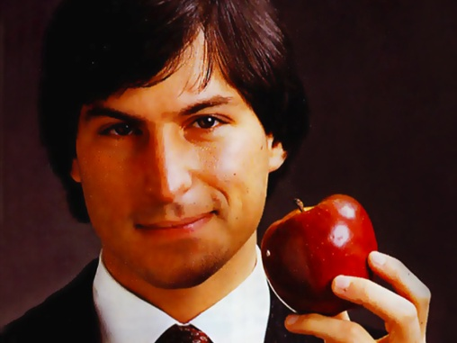
Sources of Steve Jobs’ Energy
Illegitimate child given for adoption at birth by his natural parents
Pampered and spoiled by his adopted parents
Rejected all authority – could never work for others
Strong urge to be an entrepreneur
Money was never a primary motive
Definitely not a people person
Passion for technology
Enjoyed dominating and being in the limelight
Loved to create new and better products
Inspired by a mission to create a new religion

Slide 24
Dimensions of Personality
ENERGY
SKILLS
KNOWLEDGE
LAYERS OF ORGANIZATION
ASPIRATION
LEVELS OF CONSCIOUSNESS
VALUES

Slide 25
What Binds Them Together
Organization of the whole person
Napoleon said of Goethe “At last, a man!”
Its many components and levels are like the subsystems of the human body
It expresses as strength or power of accomplishment

Slide 26
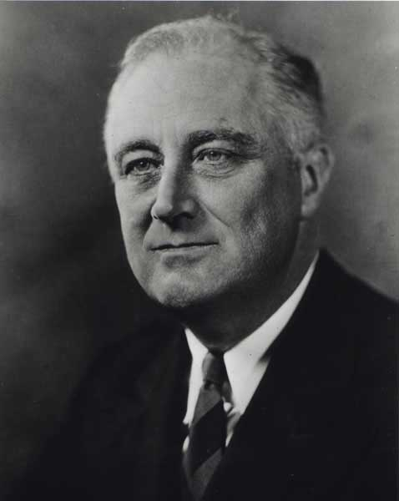
FDR’S PERSONALITY
Mental clarity of understanding
Courage to reject conventional wisdom
Skills of a great communicator
Charm, intimacy and magnetism
Values of an idealistic humanist
Adaptability to new challenges
Evoked trust and exuded confidence
Singular capacity tor remain calm, undisturbed
Paralysis engendered extreme humility & greater intensity

Slide 27
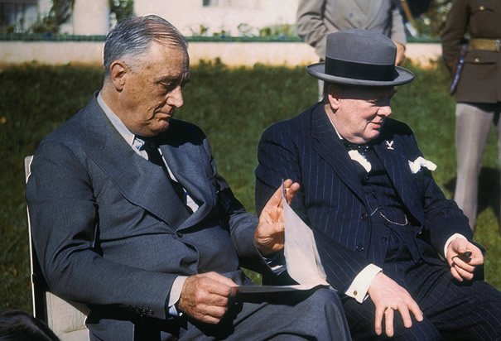
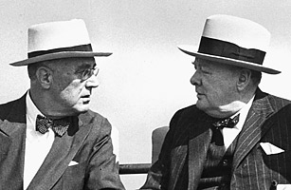
Churchill’s view of FDR
"To meet Roosevelt the president with all his buoyant sparkle, his iridescence, was like opening a bottle of champagne."

Slide 28
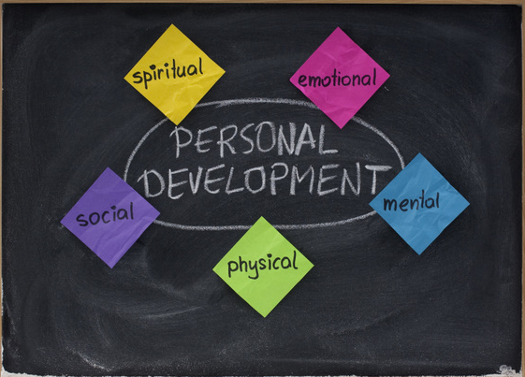
Self-organizing Personality
When personality matures, it acquires the capacity for self-organization and evolution
It acquires the capacity to convert every experience into an opportunity for inner growth and outer accomplishment
It becomes more integrated in itself and with the world around
It becomes self-organizing and creative

