Slide 1
Organization of Personality
Janani Ramanathan
Associate Fellow, World Academy of Art and Science
Research Associate, Mother’s Service Society
Individual Accomplishment, Growth & the Character of Life
in Management, History, Literature, and Psychology

Slide 2
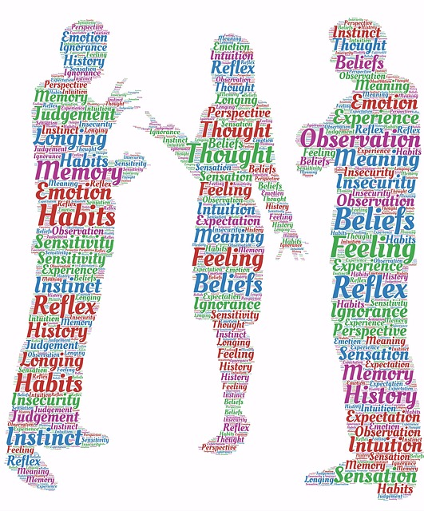
Organization of Personality
Internalizing Social Values
Individual Accomplishment, Growth & the Character of Life in Management, History, Literature, and Psychology

Slide 3
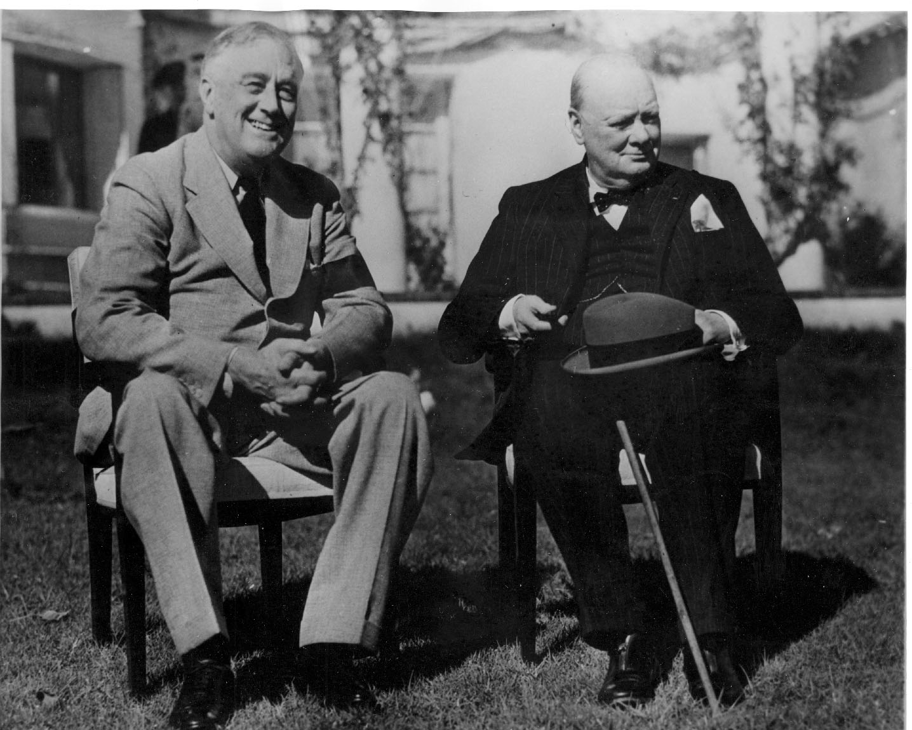
Organization of Personality
Level 1: Manners
Individual Accomplishment, Growth & the Character of Life in Management, History, Literature, and Psychology

Slide 4
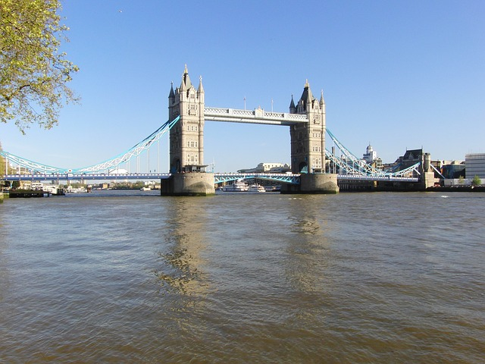
Organization of Personality
Level 2: Behavior
Individual Accomplishment, Growth & the Character of Life in Management, History, Literature, and Psychology

Slide 5
Organization of Personality
Level 3: Character
Individual Accomplishment, Growth & the Character of Life in Management, History, Literature, and Psychology

Slide 6
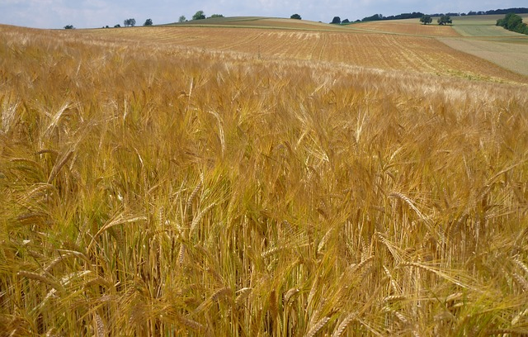
Organization of Personality
Level 4: Personality
Individual Accomplishment, Growth & the Character of Life in Management, History, Literature, and Psychology

