Slide 1

Mila Popovich
Inter-University Center, Dubrovnik, 2014
Courage of Conviction & Creative Vision
Personal Achievement and Self-Realization

Slide 2
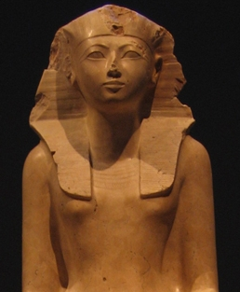
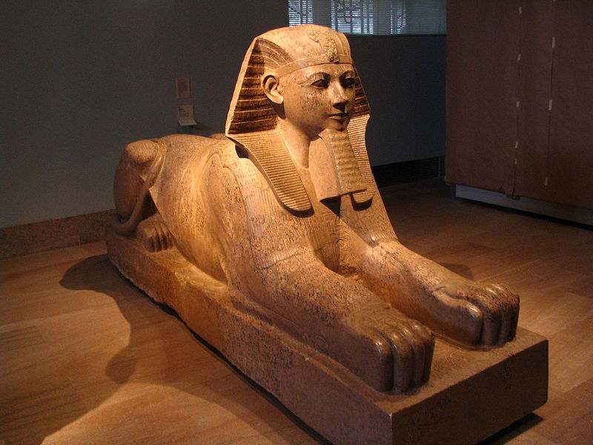
Hatshepsut (1479–1458 BC (18th Dynasty))

Slide 3
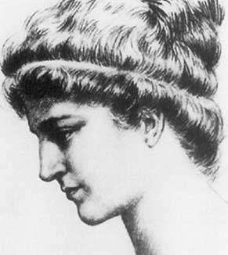
Hypatia of Alexandria (351/370-415)
AGORA, Alejandro Amenábar, 2009

Slide 4
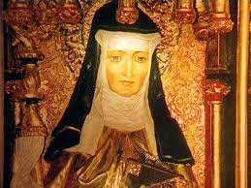
Hildegard of Bingen (1098-1179)
VISION, Margarethe von Trotta, 2009

Slide 5
Characteristics
COURAGE OF CONVICTION
CREATIVE VISION
LEADERSHIP AND STORYTELLING
TECHNICAL KNOWLEDGE AND SKILL

Slide 6
Kazimierz Dąbrowski
Personality-shaping through Positive Disintegration, 1967.
Polish psychologist, psychiatrist, and physician, Kazimierz Dąbrowski conceptualized Theory of Positive Disintegration which addresses breaking away from social norms, in particular, as staging of personal crisis which has the potential to lead to personal expansion and evolvement. Anxiety, depression, and psychoneurosis which are induced at such critical moments become hypersensitive responses to personal crisis. An individual driven to autonomy thus gets involved in a transformational process which requires multilevel perception to one’s own values, opinions, and choices. Such multilevel perception is in contrasted with crisis which tends to present us with predetermined choices and decisions in terms of either/or alternatives. Dąbrowski saw personality as existential and experiential processes of development and becoming; as a continual creation and re-creation in which emotional reactions are key guidance. He attributed most significance to the narrative in subject formation, autobiography in particular, and used it in his practice. Dąbrowski’s ideas contributed dramatically to the recognition of the gifted and talented.

Slide 7
Pathways and Processes
Emerging Worldview Unified Field
Exquisite Individuality Range / Scale
Refined Perception Vortex / Transformational Passageway
Mutual Recognition Empathic Vision
Deepened Self-reflection Inner Autonomy
The notion of passing and passageway – passing as expiring but also
as passing over into a different form, transforming.

Slide 8
THE WHEREWITHALL IS WITHIN
“You have the need and the right to spend part of your life caring for your soul. It is not easy. You have to resist the demands of the work-oriented, often defensive, element in your psyche that measures life only in terms of output -- how much you produce -- not in terms of the quality of your life experiences. To be a soulful person means to go against all the pervasive, prove-yourself values of our culture and instead treasure what is unique and internal and valuable in yourself and your own personal evolution.”
Jean Shinoda Bolen, MD

Slide 9
WHAT WE KNOW TODAY
Nothing in the universe can be still.
Everything moves and vibrates – Everything is a Vibration.
Nothing is wasted – Energy is never lost, only transformed. As energy, we never cease.
We are incomplete – we are imperfect, and that is a perfect guarantee of our continuity.
Everything is dynamic, relational, and becoming.
Every position, life form is an invaluable perspective that adds to the collective knowledge and evolution.
Divisions, contrasts, oppositions are means by which we make distinctions and refine our directions, desires, aspirations, and choices.

Slide 10
Stop acting so small. You are the universe in ecstatic motion. (Rumi)
“What is your spiritual practice?” “I dance.” “It makes sense.”
With a hungry heart and bare feet
I found our life
As great as our capacity to feel
Dance is our birthright
In the quickening of such grace
I dared
To bare the soul”
Mila Popovich

