Slide 1
Personality and individual accomplishments
Alberto Zucconi
Istituto dell’Approccio Centrato sulla Persona (IACP)
World Academy of Art and Science (WAAS)
World University Consortium (WUC)
IUC, Dubrovnik, August 27, 2014

Slide 2
Personality:
  A person’s distinct and relatively enduring pattern of feelings, thoughts, motives, and behaviors

Slide 3
Carl Rogers developed his theory of personality on how people can become "Fully Functioning" persons.
The "Fully Functioning" person according to Rogers is psychologically healthy, open to new experiences and aware of their own feelings and those of others.
Fully functioning persons live in the here and now, are fully immersed in their experience , capable of deep contact with their organism, able to symbolize all their experiences without suppressions and distortions and not restricted by conditions of worth or self-concepts.
They are not afraid to make decisions based on their own experiences, they trust their own feelings of doing what is right and are willing to accept the consequences.
They accept that life changes and welcome the opportunity to use their creativity in adapting to the changes.

Slide 4
When Carl Rogers and other founders of Humanistic Psychology started to advance new holistic/systemic approaches to psychotherapy, the health fields were dominated by the Biomedical Model.
The biomedical model is a disease-based paradigm, founded upon a mechanistic, reductionist view

Slide 5
People experience anxiety when their self-concepts are threatened.
To protect themselves from anxiety, people distort their experiences so that they can hold on to their self-concept.
People who have a high degree of incongruence are likely to feel very anxious because reality continually threatens their self-concepts.

Slide 6
Self-Concept: A person's perception of themselves is shaped by how others see them. The self is the central construct in this theory. It is based largely on life experiences, social evaluation and the attitude of the individual's significant other. If the individual experiences conditional positive regard from their parents, the individual develops their parents‘ values and conditions of worth. If self-concept is based on the values of the significant other this can give rise to incongruence between self and experience.
Self-concept and conditions of worth are linked together and are important. They are guidelines to how people behave towards others because people value their opinion of others above their own. This affects their decision making and can result in them doing things to please others rather than satisfying their own needs. Conditions of worth reduce people's self-confidence, trust in their own feelings and can affect their potential towards self-actualization (Rogers, 1986).
The Development of Incongruence between Self and Experience
The need for self-regard or approval is relevant. Children are influenced by their parents and strive for their approval by doing things to please them which make them feel more loved. However, if their behavior does not meet with their approval they feel less loved. They may then experience incongruence between self and experience and this may lead to psychological maladjustment hindering personal growth towards self-actualization.

Slide 7
Carl Rogers challenged his colleagues to ask themselves if they were aware of the social construction they were creating actively with each client or patient.
Rogers’ work contained the implicit challenging question:
As helping professionals, are we part of the solution or are we part of the problem?
It was a relevant contribution during his time and is still very important nowadays.
Rogers stated that labeling people who were asking for help as “patients,” and framing them with psychopathological labels, would contribute to their problems, not to solutions. He recognized that such socially constructed labels automatically would put people in a passive, dependent role, and would risk the creation of self-fulfilling prophecies.

Slide 8
The Epistemology of Carl Rogers is grounded in trust of human nature.
He viewed congruence as an essential source of knowledge, and emphasized the ultimate reliability of a congruent human organism’s self-experience.
…not as a scientist to an object of study, but as a person to a person. He feels this client to be a person of self-worth; of value no matter what his condition, his behavior or his feelings. He respects him for what he is, and accepts him as he is, with his potentialities. (Rogers, 1965, p.22)

Slide 9
    Every approach to health should be based on a view of human nature. If we compare an anatomic table based on allopathic medicine with one based on traditional Chinese medicine the different underlying views of human nature are clear. Likewise, every approach in the helping professions is based on a specific vision of human nature, which in turn is based on values. Those values determine the politics of the helping relationship and influence outcomes.

Slide 10
    Profound differences and results are created by different narratives of symptom reduction, health promotion and self-realization.
    As such, the significant variables to be measured should not be limited only to symptom reduction and the usage of health care services.
    World views rooted in different values, role models and ways of relating create vast differences in terms of impact on individuals. In all democratic societies there is continued negotiation around such issues.
    The helping relations community, along with other health professions , cannot afford to be unaware in this respect.
    Lack of attention to the issues of values and relational politics in psychotherapy settings before Rogers’ revolution was a reflection of the level of awareness of the time.

Slide 11
    ...at the basis of anything that a scientist undertakes is, first of all, an ethical and moral value judgment that he makes.
    Rogers, 1968, page 200

Slide 12
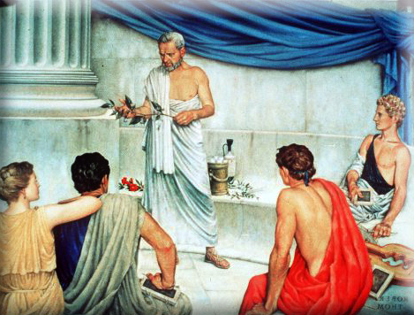
    Personal Accomplishments

Slide 13
    Personal Accomplishments
    Aristotle in the Nicomachean Ethics affirms that great personal achievements are facilitated by the beliefs that life has a purpose and that the function of life is to fulfill that purpose; by beliefs about transcendental goods and a sense of goodness, truth and beauty; and by beliefs that individuals can act efficaciously as individuals, and living in a culture that enables them to do so.

Slide 14

Resilient and creative people
are more capable
of effective crisis management than those who are poor cooperators. The latter, a a result, are more vulnerable and dysfunctional.

Slide 15
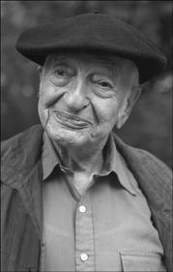
Kurt Goldstein described the tendency to actualize, as much as possible the individual capacities in the world, as the only way by which the life of an organism is determined.

Slide 16
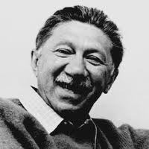
Abraham Maslow based his theory on his case studies of historical figures whom he saw as examples of self-actualized individuals including Albert Einstein, Ruth Benedict, Frederick Douglass, Jane Addams, Eleanor Roosevelt, Max Wertheimer, Henry David Thoreau….
Maslow examined the lives of each of these people in order to asses the common qualities that led each to become self-actualized.

Slide 17
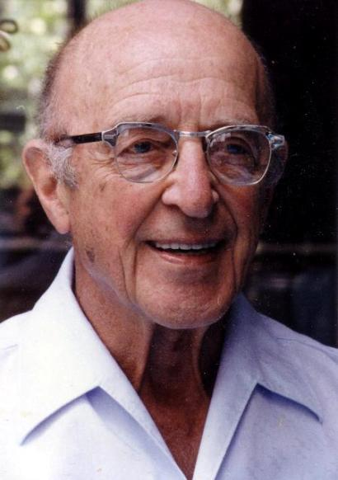
For Carl Rogers human nature has a fundamental tendency, the actualizing tendency where self-awareness generates self-regulation.

Slide 18
According to Rogers the human organism has an underlying "actualizing tendency", which aims to develop all capacities in ways that maintain or enhance the organism and move it toward autonomy.
This tendency is directional, constructive and present in all living things.

Slide 19
The concept of the actualizing tendency encompasses all motivations; tension, need, or drive reductions; and creative as well as pleasure-seeking tendencies and a drive to fulfill the genetic blueprint.
Each person thus has a fundamental mandate to fulfill their potential.

Slide 20
The fundamental principle of human achievement is expressed by Aristotle in the Nichomachean Ethics which is shared by philosophers and by psychologists:
human beings get pleasure from the exercise of their skills and capabilities since
“The pursuit of excellence is as natural as the pursuit of happiness.” (Murray 2003).

Slide 21

Hume affirms that the works of art pass the Test of Time, because they have the capacity to engage deep, permanent aspects of the human personality and will be appreciated over the ages.

Slide 22
Murray (2003) postulates four conditions for the highest realization of this innate impulse toward excellence. The sources of energy for accomplishment are:
a sense of purpose
personal autonomy
organizing structure
transcendental good

Slide 23
Purpose. Accomplishment “is fostered in a culture in which the most talented people believe that life has a purpose and that the function of life is to fulfil that purpose.” (Murray 2003)
Since accomplishment of excellence requires enormous levels of work, a sense of vocation is needed. It can be a belief that God has called them to a life of scientific or artistic endeavour, or, if they are not religious, in having a sense that they were put on earth to accomplish great things.

Slide 24
Autonomy. A culture that “encourages the belief that individuals can act effectively as individuals” will encourage human accomplishment.
Freedom for the individual and tolerance of non-conformity are positive variables to facilitate achievement.
Dictatorships and communities that discourage initiative, will have little accomplishments.
A culture that fosters individuality will produce more creative persons in art and science.

Slide 25
Organizing structure. “The magnitude and content of a stream of accomplishment in a given domain vary according to the richness and age of the organizing structure.” In the sciences, “the structure from the Renaissance onward has been an evolving scientific method.” In the arts, structures present themselves differently: sonata form, haiku, Pointillism, the novel, and the motion picture are all organizing structures. All can be richly elaborated. Some structures allow a limited range of elaboration; others are more allowing for diversity.
Historical bursts of creative activity are initiated by theories, styles, and techniques and the development of new instruments, such as the spectroscope in physics or the grand piano in music.

Slide 26
Transcendental goods. Accomplishment requires “a well-articulated vision of, and use of, the transcendental good relevant to that domain.”
These values are the true, the good, and the beautiful — the first central to science, the last to art, and the second to both science and art.
Without a coherent sense of these values to underpin them, science and art will not achieve excellence.
A culture without a sense that science can reveal truth will never develop a stream of scientific accomplishment; a culture without a sense that beauty is real will never enjoy a great epoch of art, literature, or music: such artistic cultures are likely, as Murray affirms, to be “arid and ephemeral.”
Galileo, Newton, Einstein, and Darwin in the sciences, Beethoven and Bach in music, Shakespeare and Schiller in literature, Michelangelo etc in painting are among the great achievers of enduring excellence.

Slide 27
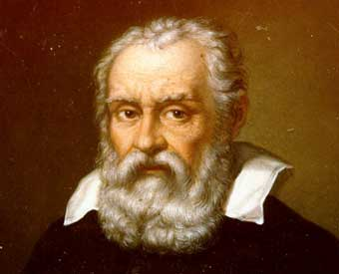

Slide 28
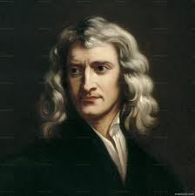

Slide 29
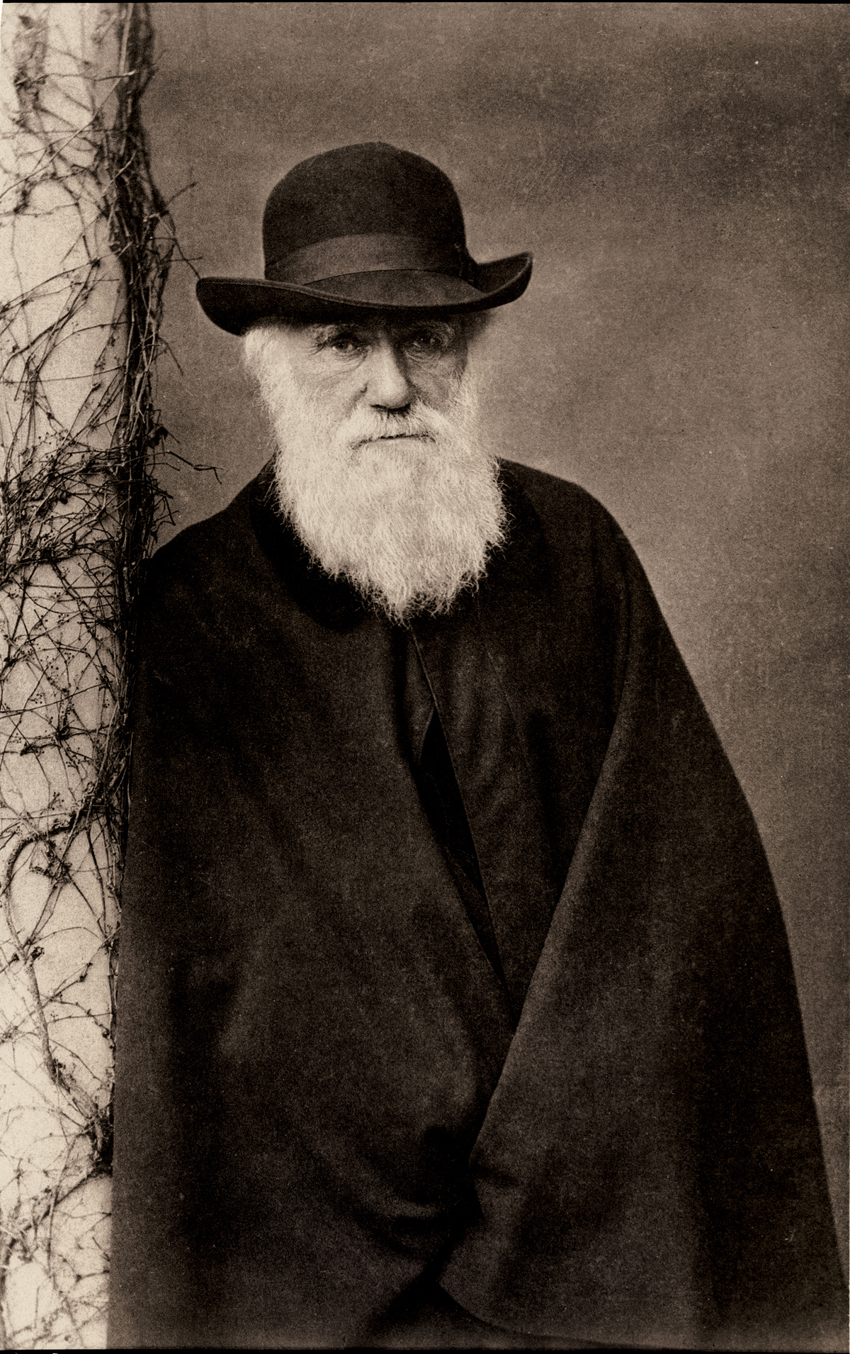

Slide 30
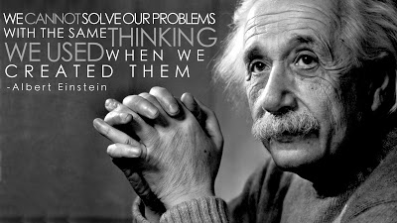

Slide 31
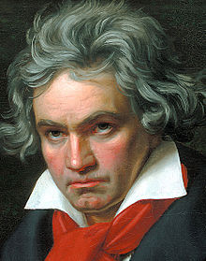

Slide 32
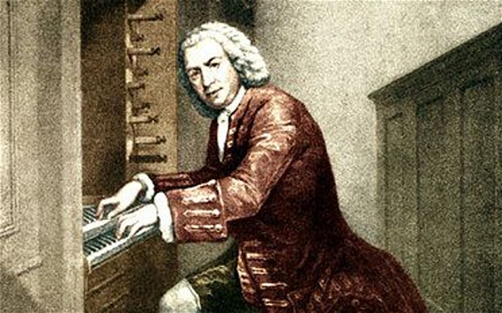

Slide 33
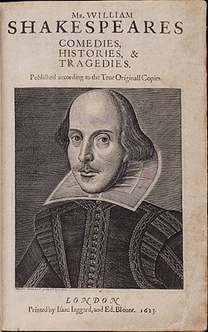

Slide 34
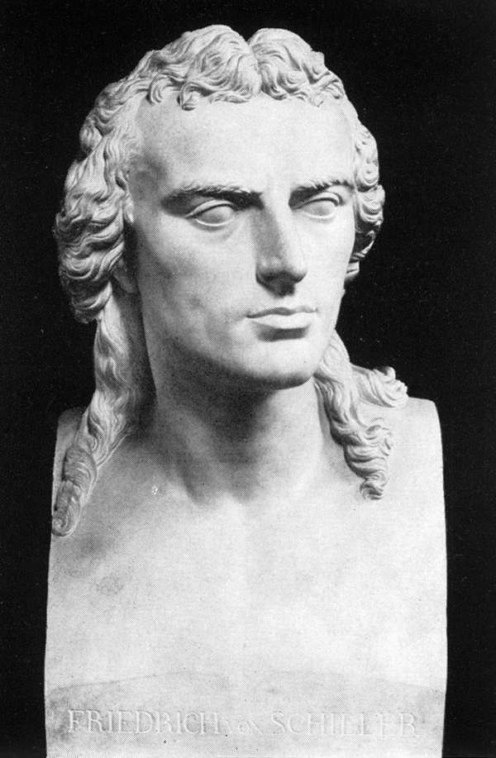

Slide 35
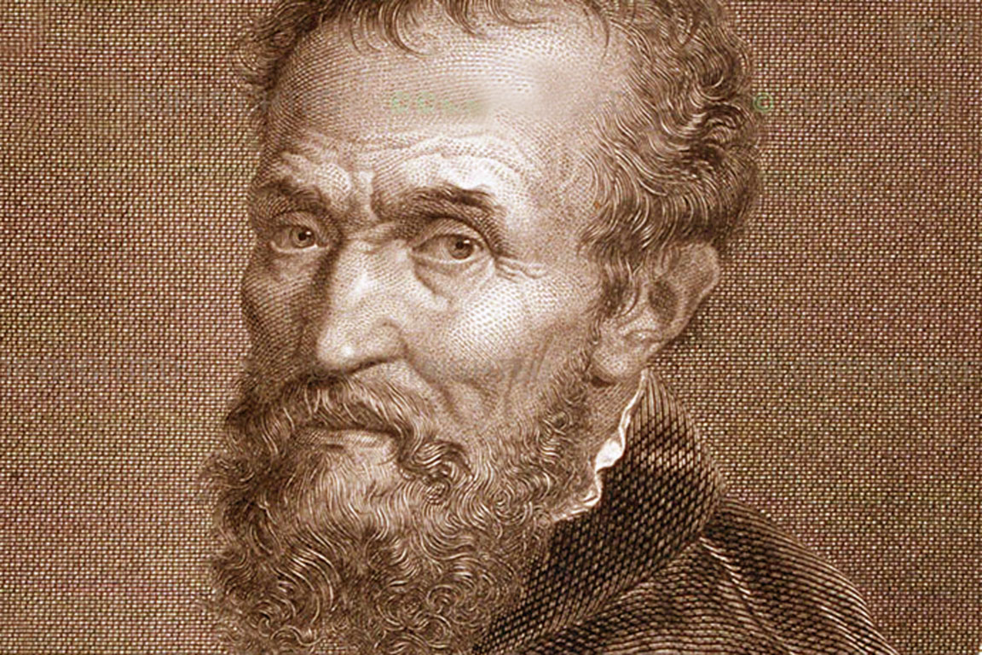

Slide 36
Alberto Zucconi
World Academy of Art and Science
www.worldacademy.org
World University Consortium
www.wunicon.org
Person Centered Approach Institute (IACP)
www.iacp.it
azucconi@iacp.it

