Slide 1
Psychology of Accomplishment
LECTURE 4
GARRY JACOBS
1

Slide 2
Process of Accomplishment
Human accomplishment is result of the interaction between
Individuals – Organizations – Society – Environment Life Circumstances
Process is essentially the same at micro and macro scale
Individual Achievement – Organizational Development
Social Evolution
Process is common to all levels & fields
Physical – Commercial, Social & Political – Artistic & Intellectual – Psychological, Cultural & Spiritual
2
Notes:
Process of Accomplishment
Human accomplishment is a fundamental human process
It is the result of the interaction between
Individuals
Organizations
Society
Environment
Life circumstances
The process is essentially the same at micro and macro scale
Individual achievement
Organizational development
Social evolution
The process is common to all levels
Physical
Social & Cultural
Artistic & Intellectual
Psychological & Spiritual

Slide 3
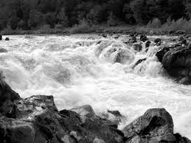
Human Energy is the Fuel for all Accomplishment
Energy is generated by need, aspiration or idealism
Energy is generated by responding to an opportunity
Energy is generated by confronting a challenge
Every human interaction is a potential source of energy
3
Notes:
Human energy is the fuel for all accomplishment
Every interaction between human beings is a potential source of potential energy
The potential energies of society are immeasurable
Imagine the possible combinations and mutations of interaction between 7 billion human beings
Energy is generated by perceiving an opportunity
Opportunity of freedom or free land in America
A new technology like Apple
A new market like Marriott
Eliza’s attraction to Wickham
Darcy’s admiration for her fine eyes
Energy is generated by challenges
Great Crash and Great Depression
Civil War threatening the nation
Business challenges
Wickham’s meeting with Darcy
Darcy’s tolerable – pride and prejudice
Energy is released by aspiration

Slide 4
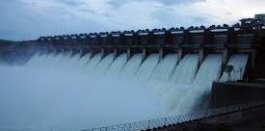
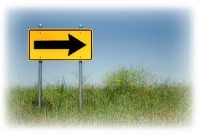
Direction Converts Energy into Force
Energy is not enough for high accomplishment
Energy needs to be focused by a clear direction
Direction is given by leadership
Clear goals, objectives and values convert energy into FORCE
4
Notes:
Energy is not enough for high accomplishment
The kindergarten children are full of energy
So is a mob and a city street at rush hour
Energy needs to be focused by a clear direction
The quest of the colonies for Independence
Churchill’s determination – never to surrender -- was a born military leader who knew his chosen calling
JFK’s challenge for moon landing and NASA
Jobs set out to revolutionize the world – a new religion
Direction is given by leadership
Newton was possessed by an insatiable quest to understand the laws of the universe
Of a person like Washington, Lincoln or FDR
An entrepreneur like Edison, Watson, Marriott or Jobs
Gandhi dedicated his whole life to Indian freedom and justice for the downtrodden
All of them channelled their energies focused like laser beams
Clear goals, objectives and values convert energy into FORCE
Independence
Freedom for slaves and Unity of America
Victory in WWII
World’s best computer or smartphone

Slide 5
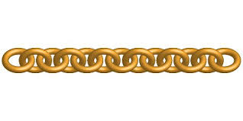
Organization Converts Force into Power for Action
Act is the basic unit of accomplishment
Organization consists of chains of interrelated acts
Organization links individual acts to form activities, systems, functions, and structures
5
Notes:
Hindu numerals – double entry book keeping – accounting – financial reporting – stock exchanges
Fighting skills, tactics, strategies, war plans
Fast Food restaurant -- SOPS
S

Slide 6
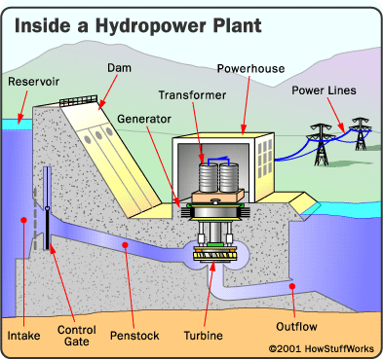
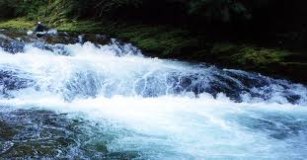
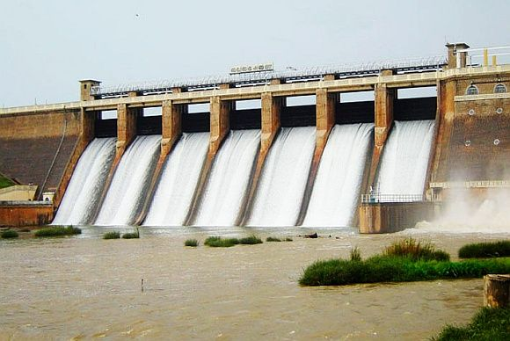
Organization Transforms Energy into Usable Power
6
Notes:
Raw energy is generated by people -- like small children at purposeless play
Google harnesses the energy of internet search terms to create the largest advertising empire in the world USD $42.5 billion in 2012.

Slide 7
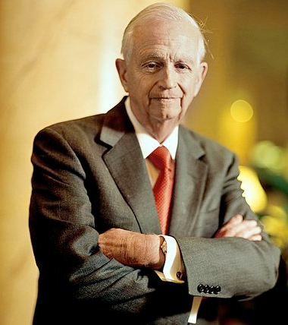
Organization channels and utilizes energy efficiently by differentiation of function
Bill Marriott
7
Notes:
Gladiator clip
Bill Marriott

Slide 8
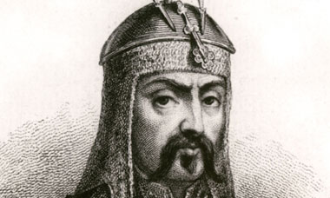
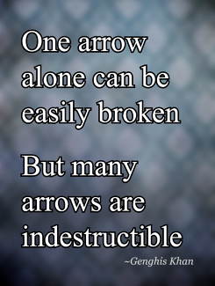
Organization coordinates energies and activities of many people and integrates them within a larger whole
Genghis Khan
8
Notes:
Genghis Khan
During the early 13th century the Central Asian plateau north of China was divided into numerous tribes or confederations – mostly organized to defend themselves against one another
Unable to unite they could only migrate continuously to escape the threat from the huge armies of Tartars and Chinese who occasionally came to dominate them.
Outcast from a small nomadic tribe, he united warring tribes of Mongolia into a single nation and the greatest military force of its time
Those who were excluded from any tribe lived without any protection and were victimized by any who found them.
His early successes enabled him to build the alliance from a few thousand warriors to 30,000 and later to 100,000 or more.
His conquest of Northern China made him the most formidable power in the region attracting more tribes to unite under his leadership
Later he turned his attention Westward to Uzbekistan, Persia, Afghanistan and conquered vast territories up to the borders of India.

Slide 9
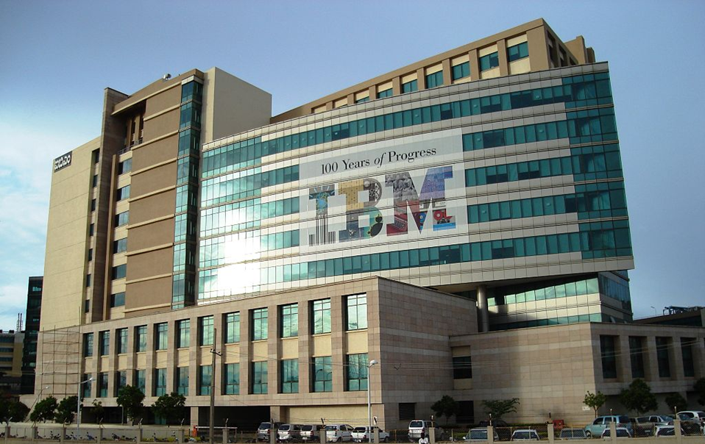
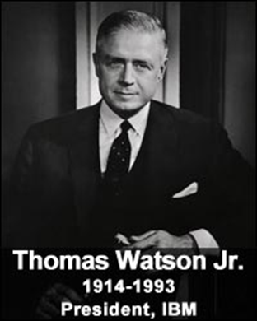
“Take away everything, but leave me my organization and I will be back on top in 10 years.”
9

Slide 10
Organization creates networks for interaction, interchange & cooperation
Language organizes communication
Market organizes exchange
Cities organize dense networks of activities
Money organizes social power & converts it into multiple forms
Technology organizes productive processes
Internet integrates all nodes, levels and types of social activity
10
Notes:
Genghis was a master of military organization based on mobile nomadic social structure
Perfected art of horse warfare with unmatched speed, skill, discipline and coordination
Highly structured hierarchy of tumans of 10,000 men with subunits of 1000, 100 and 10
Created the largest horse cavalry ever known
Sophisticated systems for YAM communication, intelligence, logistics spanning 5000 miles
He established orderly trade from the Mediterreanean to the Pacific along the entire Silk Road
His empire covered 1/5th of humanity – more than Alexander and Caesar
His descendants conquered all of China and extended the empire through Russia, Ukraine, Georgia into Europe as far as Spain.

Slide 11
Organization Magnifies the Energy it Transmits by Integration
Linking activities through positive feedback loops of information and learning multiplies the efficiency and increases the scope
11
Notes:
The city is a physical center for integration of all human activities
Urbanization has become a global phenomena because of the attraction generated by the intense energy of urban life

Slide 12
Evolution of organization creates Social Opportunity
Society is continuously evolving
The more we organize it, the faster society evolves
Each new link releases further energy and creates new needs and opportunities
Opportunity comes from identifying a missing link in the social organism and provide it
The gap between social advancement and social organization is a goldmine of opportunity
12
Notes:
Society is continuously evolving
The more we organize it, the faster society evolves
Organization can never keep pace
Today technological development outpaces our capacity for regulation
Each new link releases further energy and creates new needs and opportunities
Opportunity comes from identifying a missing link in the social organism and provide it
Sears did it by the money-back guarantee to instill trust
hotmail
iTunes
The gap between social advancement and social organization is a goldmine of opportunity
Sears mail order catalog
Fed X
Amazon
Google
Facebook

Slide 13
Organization supports growth and development of people
Continuous improvement and perfection
Development of specialized knowledge and skills
Fosters development of shared values and culture
Utilization of unique capacities of each member
Empowering the Individual
13

Slide 14
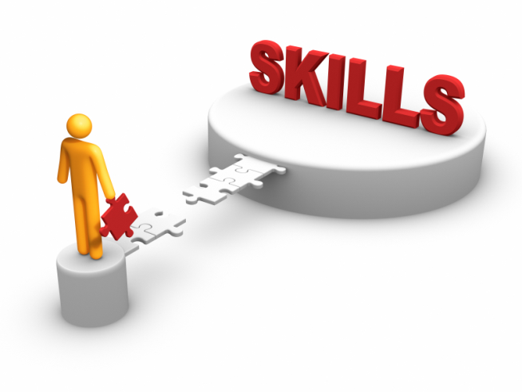
SKILLS ARE ORGANIZATION OF ENERGY
SKILLS
TECHNICAL
ARTISTIC
ORGANIZATIONAL
PHYSICAL
SOCIAL
MENTAL
14
Notes:
Physical
Technical
Wozniak
Artistic
Jobs’ product design – show images
Pixar Toy Story designer
Social
Sears
Gandhi salt march
Organizational
Marriott
Mental
Rosenwald

Slide 15
Attitudes are organizations of psychological energy
LEADERSHIP
PSYCHOLOGICAL
SPIRITUAL VALUES
15
Notes:
Like traffic signals green or red
Leadership
FDR -- trust
Washington -- courage
Churchill -- courage
Psychological
FDR – fireside chat – great communicator
Woolman’s charm – sleeping on the job
Spiritual Values
Lincoln – freedom and unity
Jobs – simplicity, ease of use

Slide 16
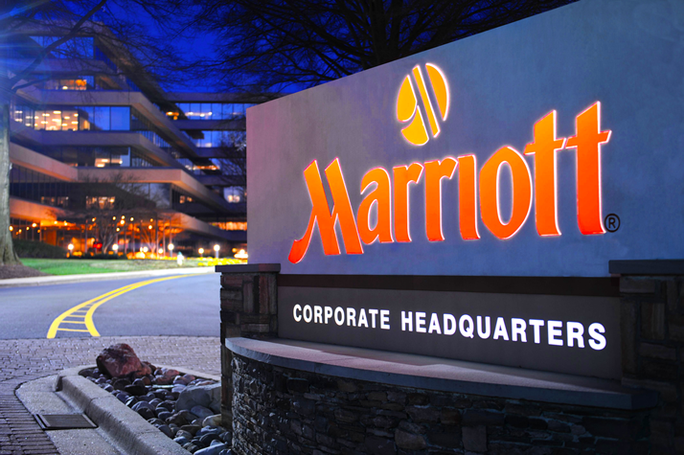
Organizations internalize skills & attitudes
16
Notes:
Marriott’s skill at site selection
Marriott’s attitude to employees
Sear’s attitude to customer

Slide 17
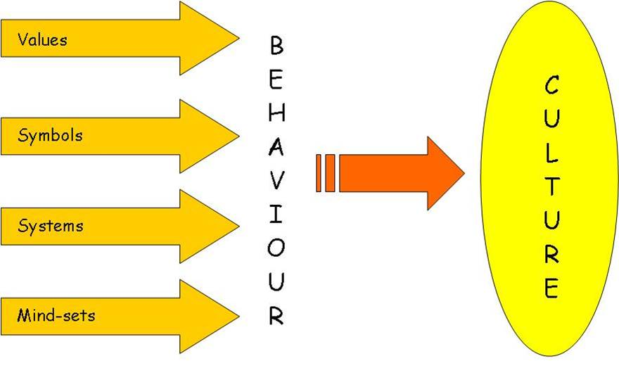
Culture expresses energy as social skills & attitudes
17
Notes:
German precision
American enterprise
Indian generosity
Japanese honor

Slide 18
Organization converts Force into Power
Skill is physical organization of physical energy
Attitude is vital organization of emotions
Understanding is mental organization of data and thoughts
Values is psychological organization of motives
18

Slide 19
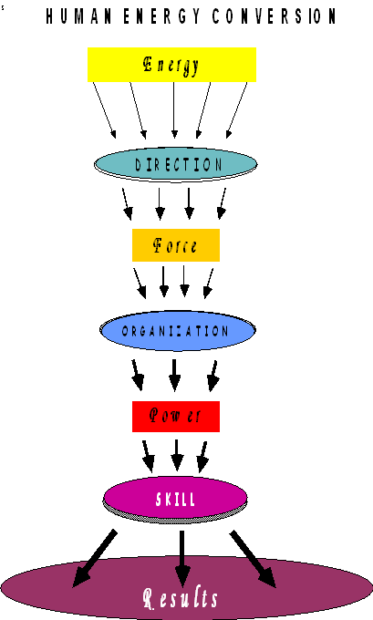
ENERGY CONVERSION
19

Slide 20
Washington’s Personality
ENERGY
Intensely aspired to be a wealthy plantation-owner
Rejected, he joined the colonial rebellion
DIRECTION
His ideal was to be an English gentleman
His goal a career in the British army
CHARACTER
Fearless in battle
Imparted discipline, character and courage to raw recruits
Refused to overstep the authority given by Congress
Implicitly trusted for impartiality
Refused payment for 8 years of service
ATTITUDES & SKILLS
A good listener
Exhibited a remarkable capacity for self-sacrifice
Concern for his men won their loyalty
Shunned attention and popularity
Patience and endurance
20

Slide 21
Washington’s Accomplishment
His idealism inspired his troops to incredible self-sacrifice
Ill-equipped, half-starving militia fought world’s best army
America outlasted the British by perseverance
Model for subordination of military to civilian rule
His personal values became those of America
21

Slide 22
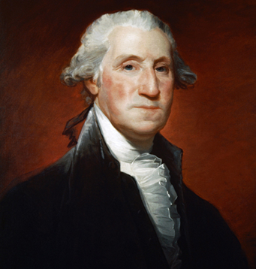
His Opponent’s Assessment
On conclusion of the war in 1783, Washington resigned his commission formally handing control of the military to the US Congress
George Washington
When told that Washington would return to his farm after winning independence, King George III replied incredulously, “If he does that, he will be the greatest man in the world.”
22

Slide 23
Cycle of Individual and Social Development
Progress of organization & society ultimately depends on the development of each of its individual members
The individual develops by raising his consciousness and organizing his personality at a higher level
Organization fosters the development of personality and capacity
The highest stage of organization of personality is what we mean by individuality
The formed individual is the catalyst of further social development
23

