Slide 1
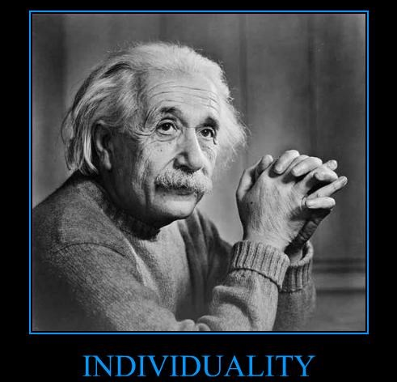
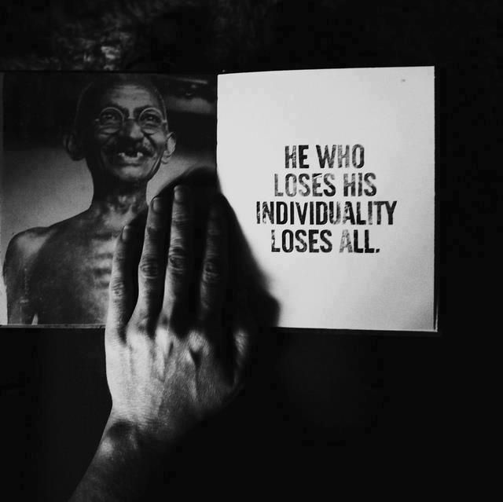
Individuality & Individuation
It takes different strokes for different folks. You may be in unchartered waters, not the community pool, so swim your course.
LECTURE 5
GARRY JACOBS

Slide 2
A Half-acre of Jasmine
He saw what others did not see
He dared to risk the little he had
His success evoked imitation
Imitation spurred him to greater innovation
Pursuing his own dream, he raised the whole village
The essence of individuality is to rise above social convention and the sense of limits

Slide 3
What is Individuality?
To think beyond conventional wisdom
To conceive of accomplishing what no one else has or believes can be accomplished
To rely on one’s own understanding, thinking, judgment, conviction
To decide for oneself, do what is right, stand by what we believe
To act according to one’s highest values and convictions
To make a unique contribution to society that changes something fundamental

Slide 4
Individuality & Social Power
Social power is the power to accomplish any social objective
The organization of social activities generates social power for accomplishment
Outstanding individuals act as catalysts for the development of the social collective enhancing its power for accomplishment
Individuality is the prime determinate of the capacity of a person to act as catalyst for social progress

Slide 5
J. P. Morgan – A One Man Federal Reserve
At the turn of the 20th Century there were 21,000 banks in US functioning without any coordination or regulation or common pool of reserves
Panic of 1907 rivalled in magnitude and intensity the Great Crash of 1929
No Federal Reserve, no global banking system, no strong federal government determined to stem it
Entire burden fell on one man’s capacities, strength & resourcefulness
Critical challenge was to identify which banks could be saved and to raise emergency funds to support them
He persuaded banks to pool $25 million to restore confidence just in time
His personality served the function of a national institution
His actions directly led to the creation of the US Federal Reserve
“Resistance to the organized mass can be effected only by the man who is as well organized in his individuality as the mass itself.” – Carl Jung

Slide 6
Definitions
INDIVIDUAL
A single member of the society, a separate person
INDIVIDUALISM
An outlook based on self-reliance, independence, and very often self-centred egoism; a social philosophy favouring individual freedom over state control
INDIVIDUALITY
That which does not depend on social authority or tend toward social conformity for its own sake; the capacity for original inspiration, creativity, uniqueness of expression
INDIVIDUATION
The process by which individuality develops in a person

Slide 7
Evolution of Individuality
History testifies to the existence of exceptional individuals who changed the world from the time of Moses, Buddha, Socrates, Confucius and Christ.
There have always been individuals. But societies have not always valued the development of individuality
Conformity to social tradition was the rule, individuality the rare exception.
Tradition conceived human beings in social terms and the natural life of men as institutionalized life of the society. To, Aristotle, a citizen belonged to the polis, not to himself.

Slide 8
Birth of Individualism in Hellenic Greece
INDIVIDUALISM
The individual became the natural unit, no longer the group
Freedom for the individual became the ideal
A great turning point in history
The inner life was valued as the genuine life
Ethics became the ethics of the individual – value of privacy, ideas of freedom
Education of the intellectual became important

Slide 9
Italian Renaissance Rediscovery of the Individual
Freedom of self-expression gained precedence over conformity
Individual faith was rediscovered – “Know yourself as a way to God”
Individual conscience won out over church authority
Inner repentance, individual confession, individual salvation, and individual interpretations of the gospel gained legitimacy
Classical emphasis on impersonality in art gave way to portrayal of personal details, individualized expressions and deepest feelings
Personal names became more common, stressing individual identity rather than family lineage or place of origin
The autobiography and attention to personal appearance and bathing came into vogue after centuries of ascetic neglect
The ideal of romantic love appeared in court literature

Slide 10
Rise of Individuality
The rise of individuality to the central place in Western culture
Printing Press
Protestant Reformation
The Enlightenment
Rise of Parliament
Declaration of Independence
French Revolution
Shift from property to money as the basis for wealth
Spread of Education
Universal suffrage
Rise of the Middle Class
“Century of the common man”
Universal human rights

Slide 11
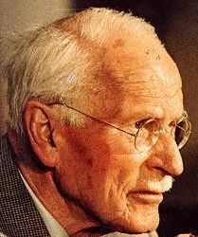
Process of Individuation – Carl Jung
Development of consciousness out of the original state of psychological identity with the collective
Transformation of personality to reach a higher level of consciousness
Differentiation by which an unformed social personality becomes aware of his own unique innate potentials

Slide 12
Relationship of Individual & Society - Jung
The Individual is one who chooses not to be limited by collective norms
The Individual does not live an isolated, separate existence, but as a pre-eminent member of the collective
Society is essential for human existence and for the flowering of Individuality
The Individual is indispensable for the development of the society
The Individual gives conscious expression to the needs and aspirations of the society through his actions.
Notes:
The Individual is one who chooses not to be limited by collective norms
The Individual does not live an isolated, separate existence, but as a pre-eminent member of the collective.
The self-realized Individual's very existence presupposes a positive relationship with the collective.
Washington, Lincoln, Morgan, Churchill, Gorbachev, Bata, Marriot
Society is essential for human existence and for the flowering of Individuality.
The Individual is indispensable for the development of the society.
The Individual gives conscious expression to the needs and aspirations of the society through his actions.
Jobs

Slide 13
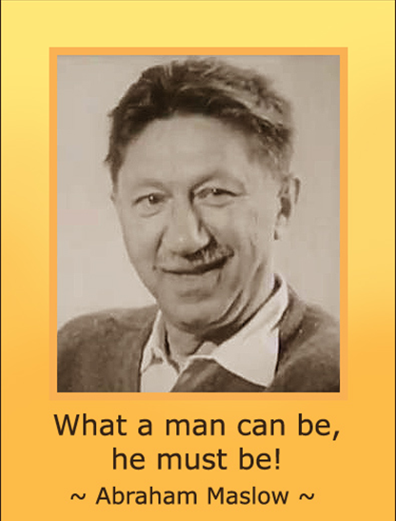
Individuation – Abraham Maslow
“It looks as if there were a single ultimate goal for mankind, a far goal toward which all persons strive. This is called variously by different authors self-actualization, self-realization, integration, psychological health, individuation, autonomy, creativity, productivity, but they all agree that this amounts to realizing the potentialities of the person, that is to say, becoming fully human, everything that person can be.”

Slide 14
Self-actualized Individual – Maslow
A self-actualized Individual is one who becomes aware of his potential and chooses to aspire for what he thinks is right with self-confidence and self-respect, even if it requires him to break with social conventions
The self-actualized Individual is not ego-centric and selfish
His central characteristic is uniqueness
The Individual and the Collective are complementary: the Individual lives in harmony with himself and the collective.

Slide 15
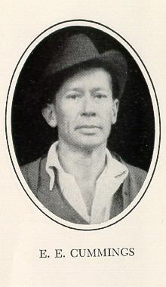
E. E. CUMMINGS
To be nobody but yourself in a world which is doing its best day and night to make you like everybody else means to fight the hardest battle which any human being can fight and never stop fighting.

Slide 16
Conformity, Rebellion & Individuality
Conformity is submission to the authority of social convention, whether imposed from outside or conditioned within
Non-conformity is the capacity to resist pressure to adopt society’s norms
Rebellion is a reaction against the pressure to conform – negative conformity
Individuality is the capacity to act freely, unconstrained by inner conditioning or external social pressure, according to one’s highest understanding, ideals, values and creative inspiration
The individual is neither self-centred nor rebellious, but operates by a personal value system

Slide 17
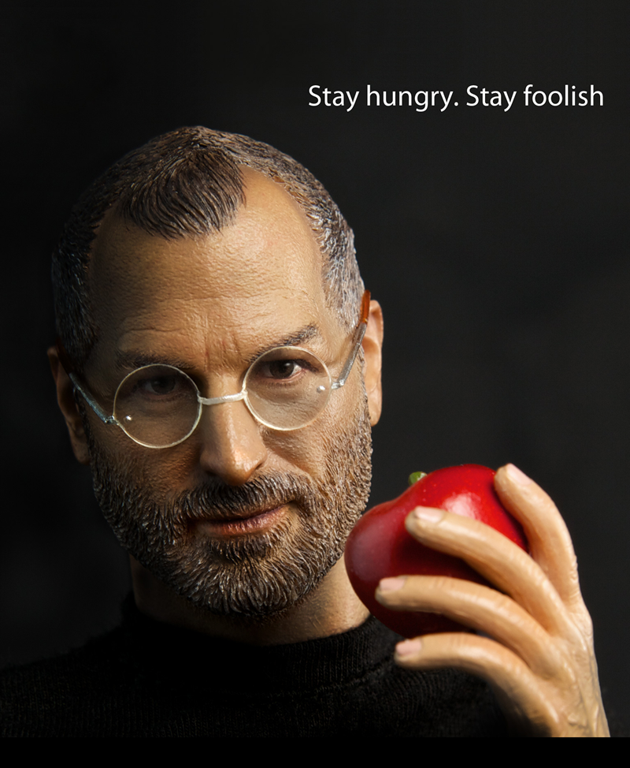
STEVE JOBS
“Your time is limited, so don’t waste it living someone else’s life. Don’t be trapped by dogma — which is living with the results of other people’s thinking. Don’t let the noise of others’ opinions drown out your own inner voice. And most important, have the courage to follow your heart and intuition. They somehow already know what you truly want to become. Everything else is secondary.”

Slide 18
Individuality & Authority
Individuality involves an internalization of authority – a shift from the authority imposed from outside or by conditioning to free choice based on one’s own understanding, beliefs and values
The individual internalizes society's values as his own or rejects them in favor of others based on his own judgment and choice without compulsion
The individual dares to question existing norms and beliefs and dares to think or believe what is either impossible or unacceptable to society
Individuals are able to see that the unrealized is not necessarily unrealizable
Notes:
Jobs iPod, Gorilla Glass, iTunes

Slide 19
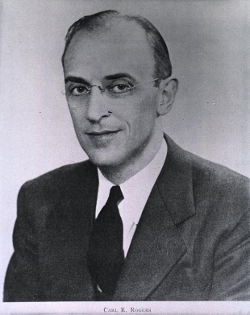
Carl Rogers on Individuality
Individuality is the ideal human condition – the fully functioning Individual
Self-aware, open to experience, avails of life’s opportunities
Makes conscious choices without being inhibited by restrictions
Refuses to conform to the collective urge. Dares to express his uniqueness.
Regulates and takes total responsibility for his actions, without seeking external authority
Guides his own life in a manner that's both personally and socially constructive
Harmonious in relationship with the collective and accepts social responsibility
Trusts his own inner urges and intuitions
Fulfils his potentialities by making his own decisions with self-reliance, autonomy, courage and persistence
Is neither selfish nor egoistic
He lives wholly and freely in each moment
“Individuation is an on going process that is an end in itself, the most profound truth about man.”

Slide 20
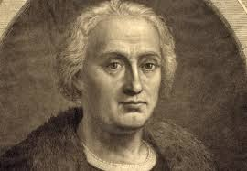
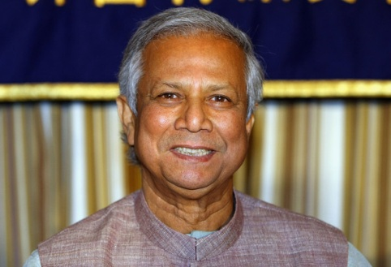
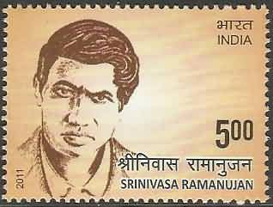
Types of Individuality
PHYSICAL
Explorer
VITAL
Entrepreneur
MENTAL
Scientist
Pioneer
Inventor
Leader
Poet/Artist
Original Thinker
Notes:
Physical
Physical Explorer – Columbus --
Pioneer
Inventor
Vital
Entrepreneur – Sears, Marriot, Bata, Mohamed Yunus
Leader – Churchill, FDR, Morgan, Napoleon
Mental
Scientist – Galileo, Copernicus, Darwin, Marx
Poet/Artist – Beethoven’s fugues, Leonardo
Original Thinker – Socrates, Einstein, Ramanujam, Shankara

Slide 21
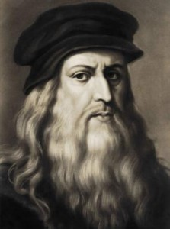
Leonardo da Vinci – Renaissance Polymath
Unquenchable curiosity and feverishly inventive imagination
One of the greatest painters of all time and perhaps the most diversely talented person ever to have lived.
Painter, sculptor, architect, musician, mathematician, engineer, inventor, anatomist, geologist, cartographer, botanist, and writer.
Anatomical studies combining science and art
Invented solar power, adding machine, flying machine, parachute, helicopter, tank, cannon and single span 220m bridge

Slide 22
Creativity & Objectification
All accomplishment and creativity are by a process of objectification
Leonardo’s Mona Lisa & Last Supper
Washington – Democratic America
Morgan - Stable Economy
Gandhi - Independent India
Marriott – Vibrant Company
Jobs – Perfect Products
Austen’s Pride & Prejudice
Beethoven’s Ninth Symphony
Rodin’s Thinker
The process of realizing one’s potential in form releases JOY. It is self-rewarding

Slide 23
Creative Individual taps unseen social potentials
Morgan united competitors for cooperative action
FDR tapped the faith, courage & confidence of the American people
Jobs unified computer, Walkman & ecommerce with music industry
Google unified user search needs with advertiser marketing

Slide 24
Experience, Growth, Personality & Individuality
Experience is the raw material for all human progress
Experience presents challenges that draw out unformed human potentials as a sculptor chisels a statue out of stone
Growth is the result of the interaction between the individual and the physical, social and mental environment
Personality organizes that experience
Individuality is its unique, creative, living spiritual essence

Slide 25
What is the source of the individual’s power?
The power of the individual IS the power of society
His energy comes from the society, the same way the politicians and entertainer’s energy comes from the support and admiration of his followers
He acquires that power by attuning or identifying himself with the aspirations and urges of the society and giving expression to them
The entire society can express its power through one individual

Slide 26
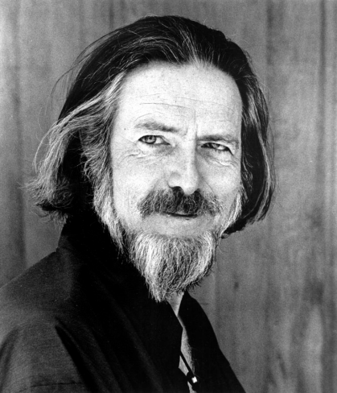
Individual & Universe
“Every individual is a unique manifest- ation of the Whole, as every branch is a particular outreaching of the tree. To manifest individuality, every branch must have a sensitive connection with the tree, just as our independently moving and differentiated fingers must have a sensitive connection with the whole body. Differentiation is not separation. The head and the feet are different, but not separate, and though man is not connected to the universe by exactly the same physical relation as branch to tree or feet to head, he is nonetheless connected—and by physical relations of fascinating complexity.”
ALAN WATTS

Slide 27
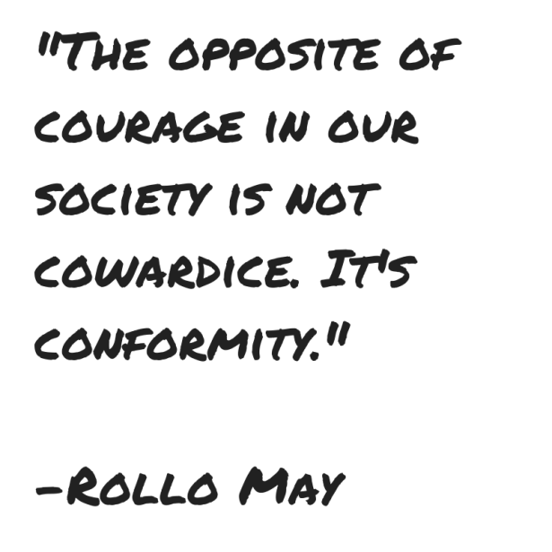
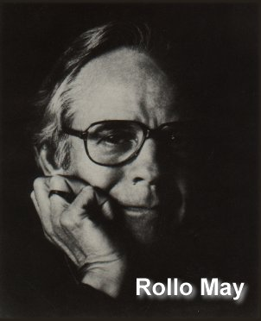
Evolution of Individuality – Rollo May
Human development is a continuum of differentiation from the "mass" toward freedom and integration as an individual
All evolution can be described as the process of differentiation of the part from the whole, the individual from the mass, with the parts then relating to each other on a higher level

Slide 28
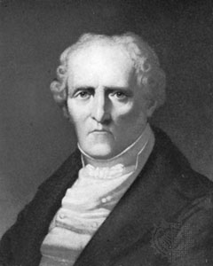
Is humanity evolving?
Charles Fourier, French philosopher envisioned a future in which the world has 37 million poets equal to Homer, 37 million mathe- maticians equal to Newton and 37 million dramatists equal to Molière

