Slide 1
Character of Life
Janani Ramanathan
Associate Fellow, World Academy of Art and Science
Research Associate, Mother’s Service Society
Individual Accomplishment, Growth & the Character of Life
in Management, History, Literature, and Psychology

Slide 2
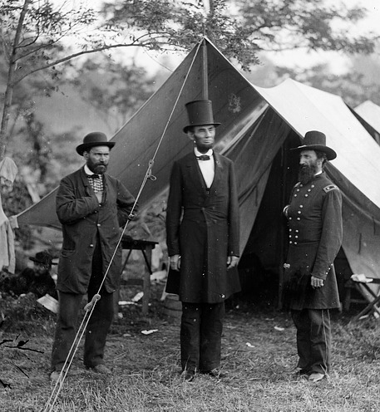
Character of Life
Three Cigars and the American Civil War
Individual Accomplishment, Growth & the Character of Life in Management, History, Literature, and Psychology

Slide 3
Character of Life
Fog over the East River
Individual Accomplishment, Growth & the Character of Life in Management, History, Literature, and Psychology

Slide 4
Character of Life
The Miracle at Dunkirk
Individual Accomplishment, Growth & the Character of Life in Management, History, Literature, and Psychology

Slide 5
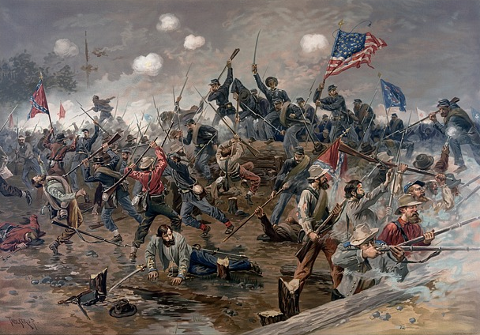
Character of Life
Benedict Arnold’s Hidden Plans
Individual Accomplishment, Growth & the Character of Life in Management, History, Literature, and Psychology

Slide 6
Character of Life
Striking Coincidences
The Dalai Lama of Tibet was held prisoner of the Communist Chinese in his own palace. He planned his escape one afternoon in 1959. Although Chinese troops surrounded the palace and huge searchlights were trained on the building, the Dalai Lama and 80 companions escaped under cover of a sudden sandstorm.
Moses Carlton, a wealthy shipping magnate from Maine, threw his gold ring into the Sheepscot River and boasted ‘There is as much chance of my dying a poor man as there is of ever finding that ring again’. A few days later, Carlton found the ring in a fish served to him in a restaurant. Soon after, US President Madison placed an embargo on American ships, causing Carlton to lose his fortune, and he died a poor man.
Individual Accomplishment, Growth & the Character of Life in Management, History, Literature, and Psychology

Slide 7
Character of Life
Striking Coincidences
In 1973, Jacqueline Novogratz was 12 and living in Alexandria, Virginia. As a gift, her uncle gave her a blue wool sweater with an African motif: two zebras at the foot of a mountain. She wrote her name on the tag; it became her favourite sweater. Later she donated it to charity. After graduating from college, she joined a non-profit in Africa that financed small businesses. In early 1987, she travelled to Kigali, Rwanda, to help establish a microfinance enterprise for poor women. While jogging one afternoon, she spotted a young boy on the road. He was wearing a familiar-looking sweater; it is made of blue wool, with zebras at the foot of a snowy mountain. She stopped him, turned down his collar—and saw her name written on the tag. It was the sweater she donated 11 years earlier.
Individual Accomplishment, Growth & the Character of Life in Management, History, Literature, and Psychology

Slide 8
Character of Life
Striking Coincidences
Actor Mel Gibson was mugged the night before his first screen test. He decided to go anyway. He found that the role called for someone who looked weary, beaten up, and scared. He got the part – the starring role in Mad Max. The movie became a top-grossing film, holding the Guinness record for the most profitable film for decades.
In the 1800s, Etienne Laine, a vegetable peddler who lived in Paris, France, came to the attention of the director of the Royal Academy of Music, when his shouts of ‘Buy my Asparagus’ shattered a window in the director’s office. The director was so impressed he made Laine a star tenor in the Paris opera.
Individual Accomplishment, Growth & the Character of Life in Management, History, Literature, and Psychology

Slide 9
Character of Life
Striking Coincidences
In 1892, whaling captain Georges Vesperin consulted a fortune-teller in Paris, in a last ditch effort to find his daughter who had been missing for 10 years. The fortune teller said that all would be revealed in her magic mirror. As soon as he saw the fortune-teller’s mirror, Vesperin recognized it as the same one he had given to his daughter years ago. He traced the mirror to a diver who had found it in the Indian Ocean while searching among the wreckage of a hip. Before long, Vesperin found his daughter living on an island in the Indian ocean.
Individual Accomplishment, Growth & the Character of Life in Management, History, Literature, and Psychology

Slide 10
Character of Life
Striking Coincidences
The Dora, originally a whaler from Port Townsend, Washington, was converted into a steamer by an Alaskan shipping company. In 1907, she lost her anchor in Cold Bay, Alaska, drifted without a compass for three months, and ended up at her old homeport in Washington. When the ship was taken out of the water, it was found that her hull had been badly damaged, and that the ship had been kept afloat by a rock wedged in the gaping hole.
Individual Accomplishment, Growth & the Character of Life in Management, History, Literature, and Psychology

Slide 11
Character of Life
How do we Explain these Events?
Individual Accomplishment, Growth & the Character of Life in Management, History, Literature, and Psychology

Slide 12
Character of Life
Does Life have a Character?
Individual Accomplishment, Growth & the Character of Life in Management, History, Literature, and Psychology

Slide 13
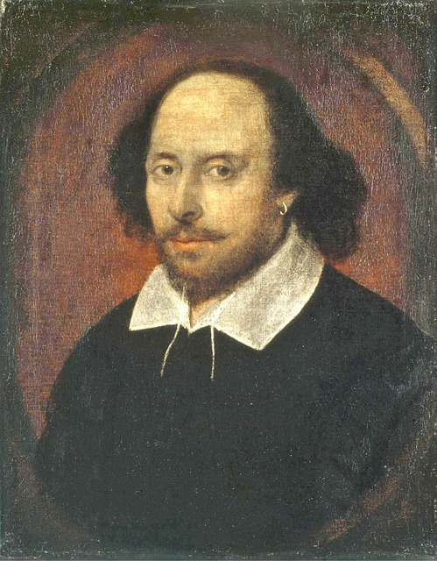
Character of Life
Literature
Individual Accomplishment, Growth & the Character of Life in Management, History, Literature, and Psychology

Slide 14
Character of Life
Testimony of High Achievers
Diligence is the mother of good luck - Benjamin Franklin, Founding Father of the US
The best luck of all is the luck you make for yourself - US General Douglas MacArthur
You can take away everything we have, but give me my organization and we’ll be back on top in 10 years - Tom Watson, founder of IBM
Shallow men believe in luck. Strong men believe in cause and effect - Ralph Waldo Emerson, American Writer
I feel that luck is preparation meeting opportunity - Oprah Winfrey, US TV Personality
Luck is not chance, it’s toil. Fortune’s expensive smile is earned - Emily Dickinson, Poet
Each misfortune you encounter will carry in it the seed of tomorrow’s good luck – Augustine Mandino, American author
Individual Accomplishment, Growth & the Character of Life in Management, History, Literature, and Psychology

Slide 15
Character of Life
Testimony of Science
When an inner situation is not made conscious, it appears outside as fate.
The outer opposition is an image of my inner opposition.
Everything that irritates us about others can lead us to an understanding of ourselves.
Synchronicity reveals the meaningful connections between the subjective and objective world.
Synchronicity is an ever present reality for those who have eyes to see.
Synchronistic events provide an immediate religious experience as a direct encounter with the compensatory patterning of events in nature as a whole, both inwardly and outwardly.
Individual Accomplishment, Growth & the Character of Life in Management, History, Literature, and Psychology

Slide 16
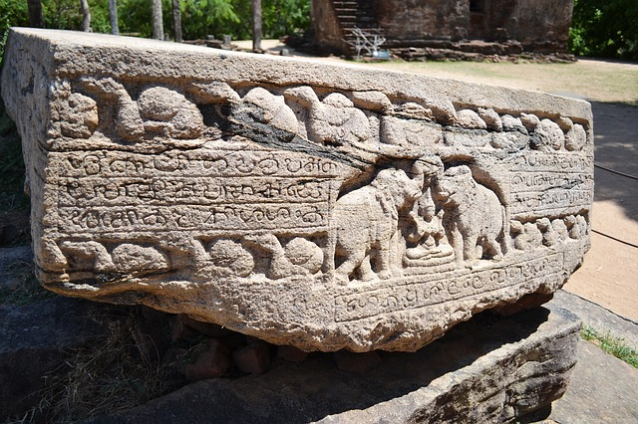
Character of Life
Testimony of Ancient Wisdom
Individual Accomplishment, Growth & the Character of Life in Management, History, Literature, and Psychology

Slide 17
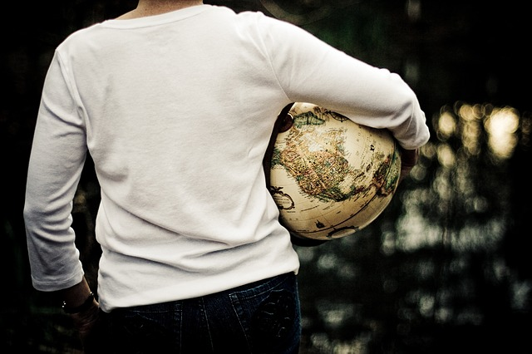
Character of Life
Principles of Life and Accomplishment
Individual Accomplishment, Growth & the Character of Life in Management, History, Literature, and Psychology

