Slide 1
Putting it all Together: Making Life Respond
LECTURE 7
GARRY JACOBS

Slide 2
What is Society?
Individualism tells us society consists of countless separate, independent human beings with some shared characteristics
Reductionism tells us society is an empty playing field on which we interact – as in a marketplace
Systems theory tells us we are not separate, unconnected independent persons at all.
We are not just similar to one another – we are intimately interrelated & interconnected.
Notes:
Western culture tells us that society consists of countless numbers of separate and independent human beings with some shared characteristics
Beliefs, values, customs, ways of life, shared aspirations, expectations, knowledge
Reductionism tells us that society is simply a playing field on which we interact – like in a marketplace
But we all know that a marketplace is not simply a passive field
Markets are active, dynamic movements of human attitudes, energy and action
A tiny shift in market sentiment can unleash a panic or a burst of irrational exuberance
We now understand that the reductionist view of society is a gross distortion of reality
We are not separate, unconnected independent persons at all
We are not just similar to one another – we are intimately related and closely interconnected
Emperor’s New Clothes
Panics
Hippy new fashion
In reality we discover that society is
an organization of individuals coordinating their activities
a complex highly integrated organization of systems
a living organism in which everything is connected to everything else – people, organizations, nations
a part of a wider organization or organism which includes all life and material nature on earth – GAIA
Science has uncovered many of the links and causal relationships between the different parts, levels and dimensions of the living organization on earth.
But there is much in Nature that remains unexplained
Monarch Butterfly
Non-locality in quantum physics contradicts our most fundamental concepts regarding the nature of reality
When it comes to human life, there is much more which defies explanation
Impact of Consciousness
For almost a century Physicists debate the impact of consciousness on the behavior of subatomic particles
It remains in controversy and unresolved
Past experience shows that unresolved contradictions usually point to deeper levels of relationship yet to be discovered and understood
Instead of persisting with explanations within the framework of existing knowledge, it is wise to impartially consider other explanations.

Slide 3
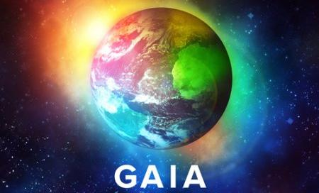
Society is
an organization of individuals coordinating their activities
a complex highly integrated organization of systems
a living organism in which everything is connected to everything else – people, organizations, nations
a part of a wider organization or organism which includes all life and material nature on earth – GAIA

Slide 4
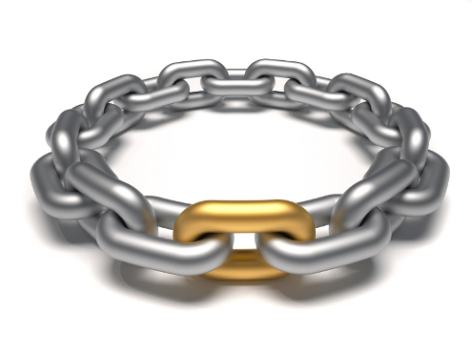
Filling in Missing Links
Science has uncovered many of the links and causal relationships between the different parts, levels and dimensions of the living organization on earth
But when it comes to human life, there is much which defies explanation
Unresolved contradictions usually point to deeper levels of relationship yet to be waiting to be discovered
Instead of persisting with explanations within the framework of existing knowledge, it is wise to impartially consider other explanations.

Slide 5
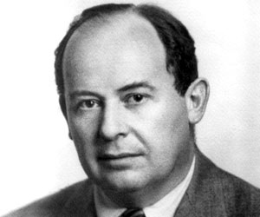
What is Life?
Historical events, biography, the testimony of high achievers, the writings of great authors and great thinkers point to the conclusion that there is a relationship between what people subjectively think and feel and what happens in the world around them
This conclusion is consistent with the von Neumann–Wigner interpretation of Quantum Theory that consciousness causes a collapse in wave particle behaviour
We may not be able to explain it by current concepts and theories, but that does not mean we should ignore it
It is not rational to ignore something just because we do not understand it
Moreover, we need not necessarily fully understand it in order to utilize the power that it suggests

Slide 6
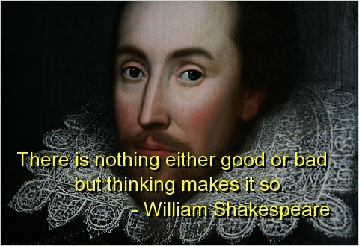
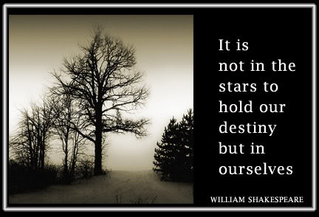
Hidden Connections between Objective & Subjective Reality
HAMLET
JULIUS CAESAR

Slide 7
Principles of Accomplishment

Slide 8
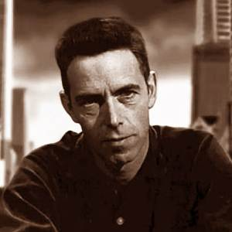
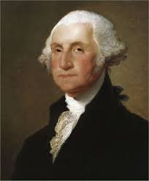
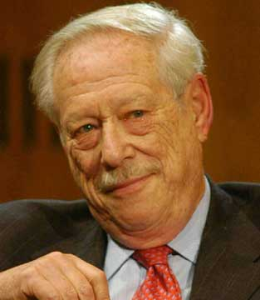
Learn from self-experience
Every experience at every moment offers us some knowledge for our growth
This is especially true of experiences we regard as negative
“What is discord at one level of your being is harmony at another level.” – Alan Watts
Washington was rejected by the British army
Michael Blumenthal struggled for survival in Shanghai
Steve Jobs was devastated by his ejection from Apple

Slide 9
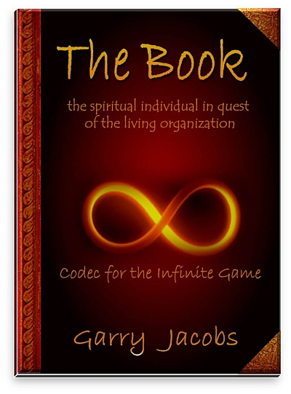
Aspiration
Aspiration releases energy and powerfully attracts what we seek
Every sincere aspiration evokes a response from life

Slide 10
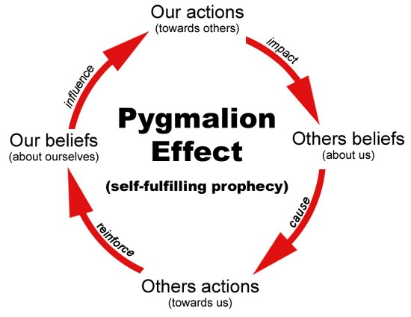
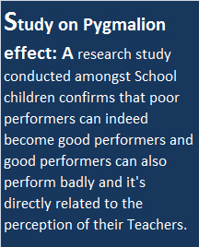
Pygmalion Effect
Attention is a primary power of human consciousness
Attention energizes the object that receives it
Positive attention brings out the best in people, objects and situations
Attention to problems energizes and aggravates them
Notes:
Attention is a primary power of human consciousness
“Concentrate on the field” – Legend of Bagger Vance
Attention energizes the object that receives it
Positive attention brings out the best in people, objects and situations
Pygmalion Effect in the classroom
Attention to problems energizes and aggravates them
Hypochondria

Slide 11
Power of Attitude
"Our doubts are traitors, and make us lose the good we oft might win, by fearing to attempt." – Shakespeare, Measure for Measure
“The greatest discovery of my generation is that a human being can alter his life by altering his attitudes.” – William James
“Attitude is a little thing that makes a big difference.” – Churchill
“Nothing can stop the man with the right mental attitude from achieving his goal; nothing on earth can help the man with the wrong mental attitude.” – Thomas Jefferson
“A positive attitude causes a chain reaction of positive thoughts, events and outcomes. It is a catalyst and it sparks extraordinary results.” – Wade Boggs, American professional baseball player

Slide 12
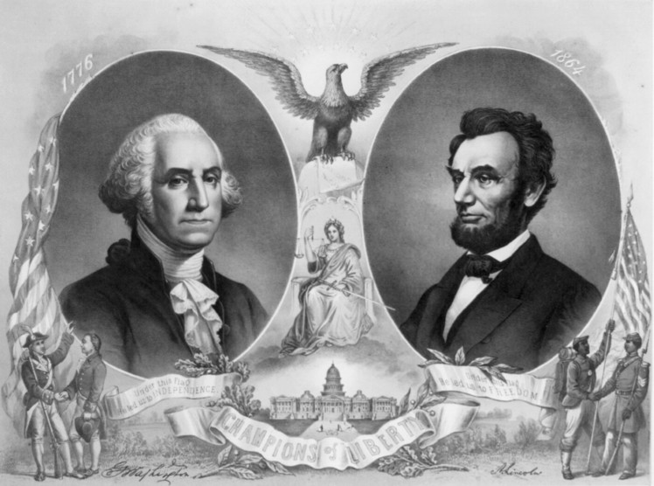
Give and Receive
Our capacity to receive is directly proportionate to our capacity to give to others
Giving expands our being, opens us to life and attracts opportunity
Washington’s selfless dedication led to his elevation
Lincoln’s denial of ambition raised him to highest office
Notes:
Need some examples from Give & Take or elsewhere

Slide 13
Goodwill
One of the most difficult things for most people is to feel genuinely happy when something good happens to another person
Yet there is no more powerful way to attract good to oneself than to feel goodwill for others

Slide 14
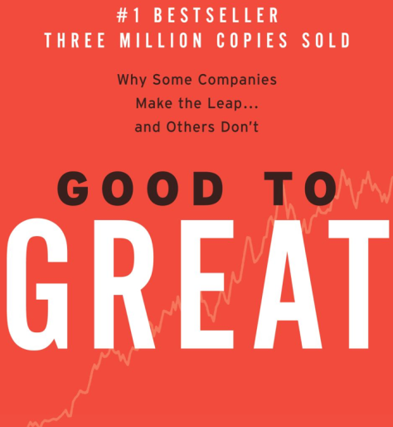
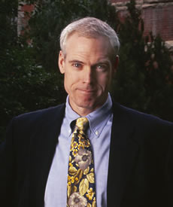
Humility
Great companies are headed by “Leaders who are humble, but driven to do what's best for the company… a paradoxical mix of personal humility and professional will.” – Jim Collins, Good to Great
Arrogance and egotism come from ignorance - knowing a little bit and assuming you know a lot.
Self-importance activates ego in others
Self-assertion makes others assertive

Slide 15
Truth is a reflection in the mirror
There is always truth in the other person’s point of view

Slide 16
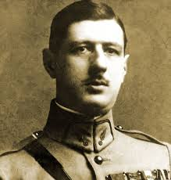
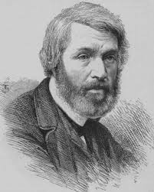
Silence
"Nothing more enhances authority than silence."
– Charles de Gaulle
"Silence is the element in which great things fashion themselves together; that at length they may emerge, full formed and majestic, into the daylight of Life, which they are thenceforth to rule."
– Thomas Carlyle

Slide 17
Silent Will
Asking for what we want often evokes resistance and opposition.
Silently aspiring for what we want prompts life to offer it.

Slide 18
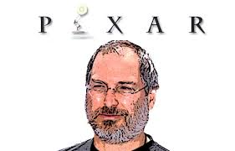
Token Initiative
There is great power in small significant acts
When you are pressed to the wall and your options appear severely limited, exhaust your present possibilities to the last drop, even if in doing so you are sure that it will fall far short of the requirement
Steve Jobs’ investment of $250,000 in Tiny Toy at a time when Pixar was bleeding cash

Slide 19
Non-reaction – Equality
“Reaction - a boat which is going against the current but which does not prevent the river from flowing on.”
– Victor Hugo
Men are disturbed not by events, but by their opinions about events.” – Epictetus
“What you react to in others, you strengthen in yourself . Non-reaction to the ego in others is one of the most effective ways not only of going beyond ego in yourself but also of dissolving the collective human ego.
– Eckhart Tolle
Notes:
Lincoln forgave past offenses
Churchill – fearlessness
Washington, Napoleon and Churchill cannot be hit by bullets

Slide 20
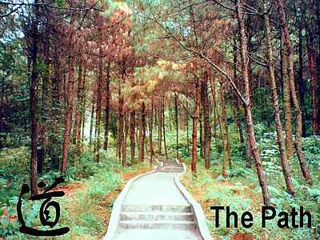
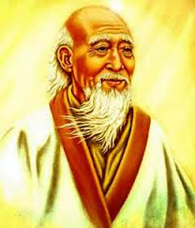
Non-initiative -- Patience
Our nature urges us to action. Our ego demands it. The capacity not to act has tremendous power to evoke action from life.
“The foolish expend a great deal of energy and time trying to do everything and end up achieving nothing. On the other end of the spectrum, the truly wise don't seem to do much at all and yet achieve whatever they want. This magic is possible, indeed unavoidable, when one is in tune with the Tao and acts without attachments.”
– Lao Tzu

Slide 21
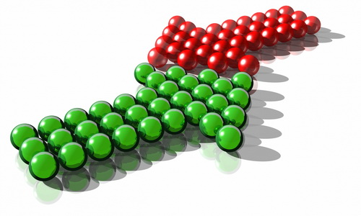
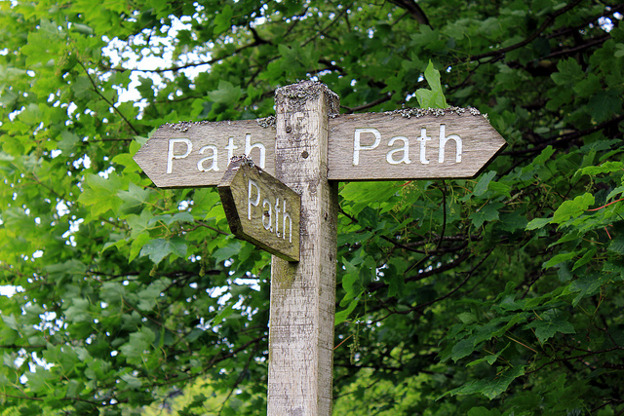
Reconcile Contradictions
Compromise is a half way meeting between two opposing alternatives.
When confronted with apparent contradictions that compel you to choose between opposite paths of action, step back and look for a third alternative which instead of compromising the interests of both sides leads to a better outcome for all sides.

Slide 22
Power of Decisions
Decisions are our most important acts we perform
What compelled these people to decide as they did?
Washington attacked Trenton against advice of his staff
Lincoln issued the Emancipation Proclamation against strong opposition
Bata cut prices 50%
Marriott expanded beyond six restaurants
Jobs decided to fund Tiny Toy at a time Pixar was failing

Slide 23
Successful Decision-making
Success is not simply a matter of just doing the right thing. It is even more a matter of doing what you do with total conviction, faith, commitment and determination

Slide 24
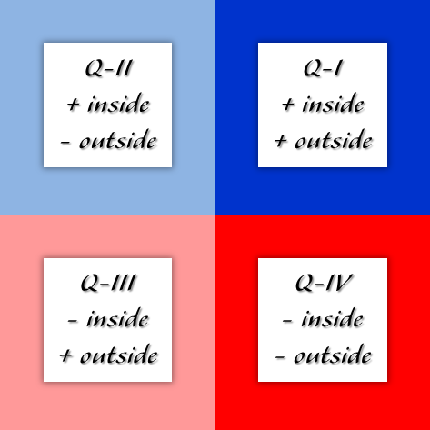
Decision-making Matrix

Slide 25
The Complete Act
Three psychological conditions need to be met for any act to fully accomplish its intended aims
Clarity of knowledge and full mental decision
Enthusiastic emotional endorsement
Skilled executive through positive attitudes
Notes:
Steve Jobs – Toy Story, iPod, iPhone
Phileas Fogg

Slide 26
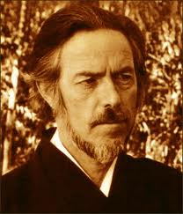
The Pure and Virgin Moment
“This is the real secret of life ― to be completely engaged with what you are doing in the here and now. And instead of calling it work, realize it is play.”
– Alan Watts
The present is the only place in which we can truly live, act, change ourselves and change the world
To be more and more conscious is both the path and the goal of all human accomplishment

Slide 27
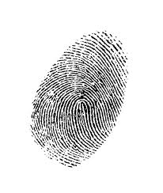
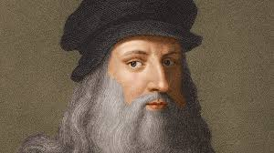
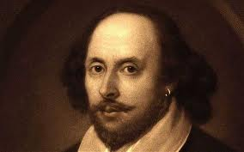
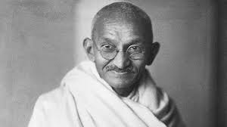
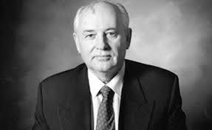
Destiny of the Individual
The incredible range, diversity and complexity of human personality defies comprehension
Human society is so vast and diverse that it blinds us to a truth of even greater consequence
One individual can change the world
Every individual has the power to change the world they live in
That power does not come from outside. It lies within us all
Notes:
From unique fingerprints to Leonardi, Shakespeare, Gandhi and Gorbachev

