Slide 1


We need to improve our education
to cope effectively with our present and
future challenges
Alberto Zucconi
World Academy of Art and Science (WAAS)
World University Consortium (WUC)
Person Centered Approach Institute (IACP)
azucconi@iacp.it
IUC, August 30, 2014, Dubrovnik
World Academy of Art and Science
World University Consortium

Slide 2
Nobel Prize recipient and World Academy of Art and Science (WAAS) Fellow Paul Crutzen reminds us that nowadays
“human activities are the main variable impacting on all planet’s life forms”
There are a mounting number of challenges to be faced; we need to foster new and solid bases for a sustainable global society, re-examining the dynamics of global economic, political, human, social and cultural constructs.
World Academy of Art and Science
World University Consortium

Slide 3
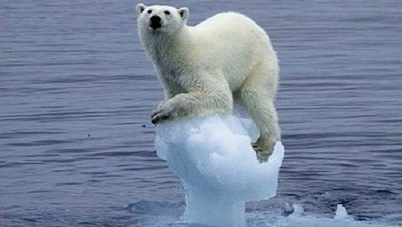
World Academy of Art and Science
World University Consortium

Slide 4
We cannot solve the problems of today with the same level of thinking we used when we created them. Albert Einstein
World Academy of Art and Science
World University Consortium

Slide 5

World Academy of Art and Science
World University Consortium

Slide 6
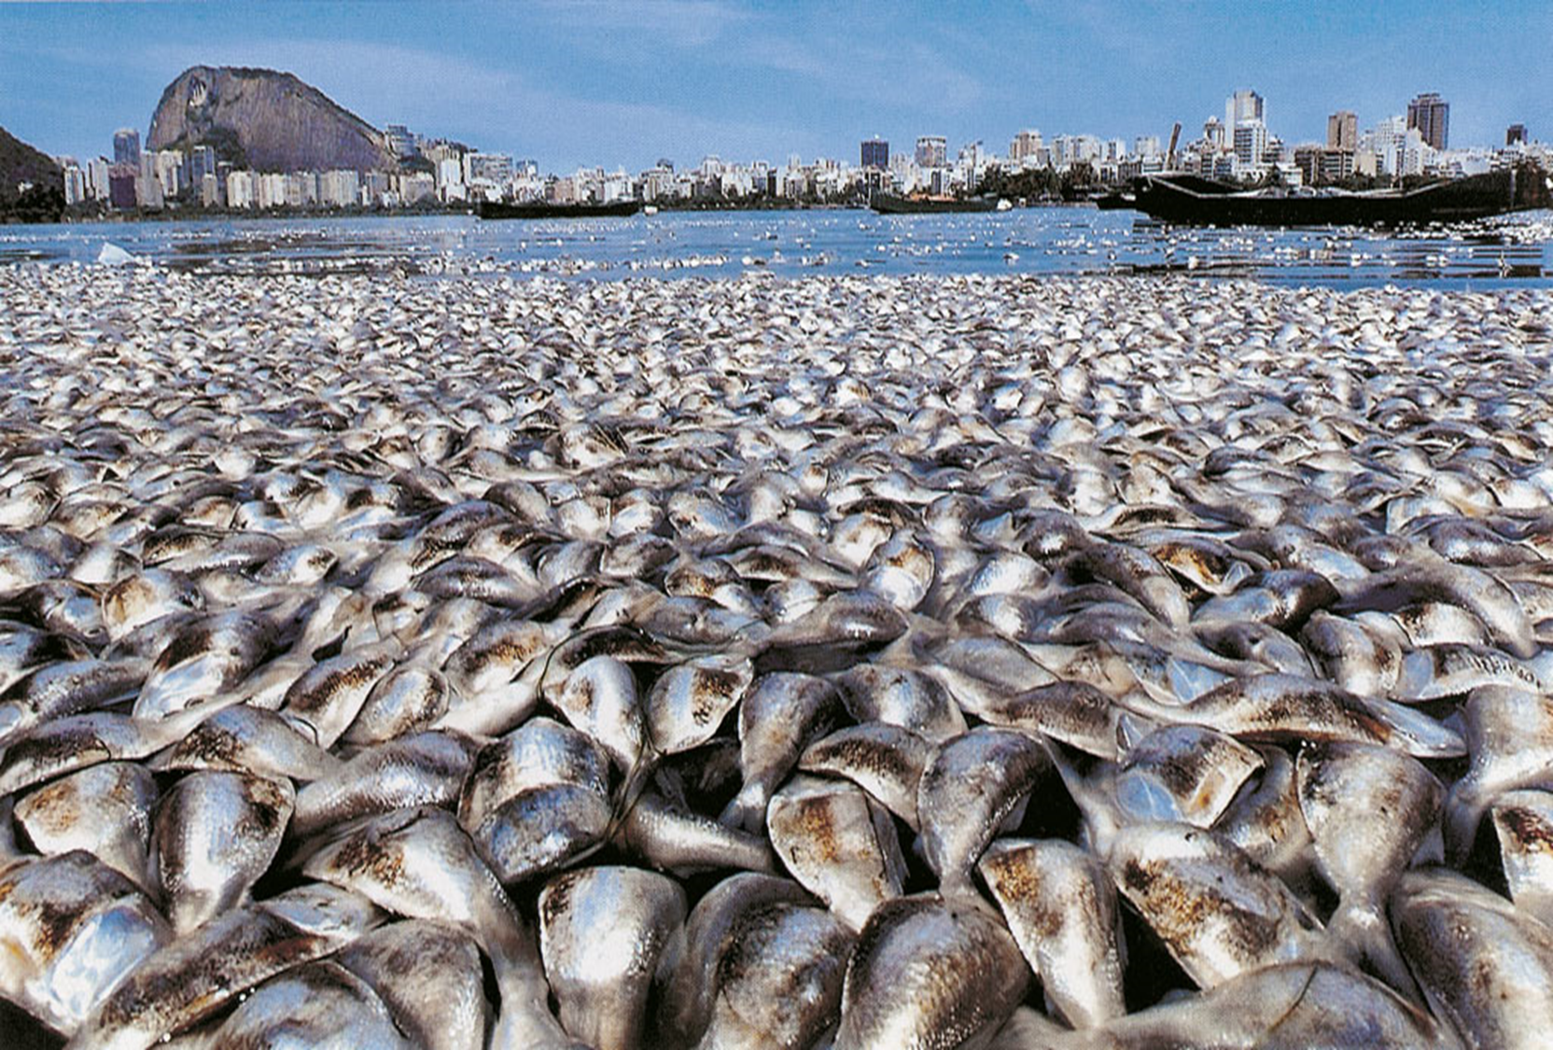

Slide 7
The world deeply needs to cope with the emerging challenges of the 21st century.
Knowledge is the sustenance of civilization and culture.
Education is the means by which each generation passes on to the next the cumulative knowledge and wisdom acquired in the past.
Of all the technologies developed by humanity, none is as powerful and sophisticated as the means we have fashioned to gather, organize, store, share and transmit knowledge.
Education is the instrument of
conscious human evolution
World Academy of Art and Science
World University Consortium

Slide 8
    There is ample scientific evidence that our relationship with ourselves, others and the planet we live in is the main variable influencing all the aspects of our lives.
    We need to see, think and act systemically, interdisciplinarily, intersectorially
World Academy of Art and Science
World University Consortium

Slide 9
Education plays a crucial role in the social construction of reality. It is more and more evident that we need a paradigm change in education in order to enable people to deal effectively with the mounting challenges facing humanity.
This retooling needs to start with our frames of reference. We need to create a new paradigm of education in order to enable education to serve people’s needs and to have relevance in public service, social responsibility and sustainable governance and development.
World Academy of Art and Science
World University Consortium

Slide 10
    We need to effectively protect and promote
    human and environmental capital
    We need to think globally and act locally in effective ways and to
    do so we need people to possess the knowledge, skills and
    competencies to operate at intersectorial and interdisciplinary levels
    Socio cultural
    Environmental
    Economic
    Psychological
    Spiritual
    How can professionals contribute to this?........
World Academy of Art and Science
World University Consortium

Slide 11
    Our social construction of professional competence is largely obsolete since various professions are still construed using the outmoded mechanistic reductionist divisions of traditional fields of expertise
    This situation reflects the limited knowledge of the world we had when the modern professional and scientific disciplines first emerged and continue to be stifled by the lines of jurisdiction in these traditional divisions of expert labor.
    This has little to do with offering the best services to society and much to do with the power struggles among the competing professional corporations or guilds
    (Andrew Abbott, 1988)
World Academy of Art and Science
World University Consortium

Slide 12
    Student numbers have been rising in many countries since the 1800s.
    UNESCO estimates there were half a million students enrolled in universities worldwide in 1900.
    A century later, there were around 100 million students.
    Are we sure that universities offer an effective education preparing people to really meet the present challenges?
    If we certify people as competent in their fields but in reality those professionals are still ineffectively trained with obsolete and mechanistic knowledge,
    we risk increasing just the quantity but not the quality, the level of competence
World Academy of Art and Science
World University Consortium

Slide 13
Education to become more effective needs to shift
from subject-centered to student-centered learning
from passive to active learning
from memorization or understanding to thinking and original thinking
from information or mental understanding to development of the whole person
from (academic) theoretical to life-centered knowledge
from fragmented knowledge to integrated knowledge
from creating standardized products to fostering the development of resilience, individuality and creativity
World Academy of Art and Science
World University Consortium

Slide 14
In the age of globalization and growing complexity to meet the challenges of our present and future new and effective ways to facilitate the capacity of integration of our ways of knowing are required:
System Theories
Bio-psycho-social paradigm
People-Centered and Person-Centered Approaches
World Academy of Art and Science
World University Consortium

Slide 15

World University Consortium
World Academy of Art and Science

Slide 16
We need to bring together not only top universities, but all the stakeholders for the creation of a process that will generate effective understanding and offer effective solutions to the problems society must face.
We need to develop a new paradigm in education, in order to develop updated and effective research, education, knowledge and best practices.
World Academy of Art and Science
World University Consortium

Slide 17
There are some signs in this direction: one of those is the recently founded World University Consortium (WUC) which aims to facilitate a process of knowledge creation and sharing through an interactive international network open to all the stakeholders, to benefit global society, to enhance diversity, to share ideas and expertise, and to learn international best practices from each other, with a commitment to shared values grounded on equal rights and opportunities, freedom, creativity and excellence in research, scholarship and sustainable education.
WUC aims to address cultural, environmental, social issues of common interest to world communities by promoting partnerships between universities, local governments, business communities and the non-profit sector.
World Academy of Art and Science
World University Consortium

Slide 18
WUC will create a safe space where universities and all the stakeholders can cross-fertilize and together respond more effectively to the urgent needs of society at the local and global levels.
Everybody will be empowered to effectively cooperate and create new knowledge and new opportunities to protect and promote human capital.
World Academy of Art and Science
World University Consortium

Slide 19
The World University Consortium’s main objectives
Global Forum: where all stakeholders can interact and create networks and partnerships.
Person-centered: emphasize self-guided learning, critical and original thinking, learning to learn, trans-disciplinary perspectives, learning by teaching and sharing, and experiential learning.
Best-practices: develop effective global models and strategies to improve accessibility, affordability, quality, innovation and relevance in higher education.
Hybrid Systems: new models designed to facilitate learning through teacher-student and student-student interaction.
Value-based: transcultural and culture-specific methods and content reflecting universal values.
Open Learning Systems: innovative systems and models to extend the reach of quality higher education to people of all age groups globally.
New Metrics: R&D on advanced instruments for evaluation of educational processes.
World Academy of Art and Science
World University Consortium

Slide 20
WUC will strive to create new models of cooperation in education, teaching, research, research application, project management and responsible leadership.
WUC will promote the largest project of action research and active learning ever carried out to promote effectiveness, scientific advancement, civil and social responsibility, empowering all the stakeholders to create and share new knowledge to improve human and environmental living conditions , building bridges across boundaries of diverse cultures, academic disciplines, promoting awareness of the frontiers of human understanding, creating new knowledge through collaboration in research, and innovation.
The WUC initiative is founded on the human rights principle that there is a human right to education. Additionally, WUC recognizes that education is an important base for the realization of all the other basic values in the International Bill of Rights. These rights cumulatively seek to realize the universality of universal human dignity. From an economic point of view, this coincides with a self-conscious educational development of human capital on a global basis. This initiative is an important effort to improve the state of human well being comprehensively.
World Academy of Art and Science
World University Consortium

Slide 21
WUC is
a nonprofit, non-governmental , international, interdisciplinary, intersectorial , international body dedicated to promoting the values and practices of the protection and promotion of human capital, human rights, reciprocal understanding, synergic collaboration, sustainable development, protection and promotion of biodiversity and diversity of people.
The WUC initiative is therefore timely, necessary, and a critical step in the next phase of higher education development.
World Academy of Art and Science
World University Consortium

Slide 22
WUC will promote
Synergy among all the stakeholders
Capacity Building
Protecting differences
Person centered approaches
Student centered approaches
Community centered approaches
People centered approaches
Protect and promote human rights
Intercultural emphatic understanding and respect. The educational curriculum that we seek to promote and defend is therefore global, comprehensive and value-conditioned.
Socially and environmental sustainable interventions
Collaboration with the UN and its agencies, Academies of Science and other organizations with similar values and aims
World Academy of Art and Science
World University Consortium

Slide 23

In the Anthropocene Era
facilitating the development of a new paradigm in effective education, fully functioning persons, families, groups, organizations and communities are not only
of vital importance for human welfare but also for the ecological and human integrity of the entire planetary community.
World Academy of Art and Science
World University Consortium

Slide 24

Grazie!
Thank you!
World Academy of Art and Science
World University Consortium

Slide 25
Alberto Zucconi
azucconi@worldacademy.org
World University Consortium (WUC)
www.wunicon.org
World Academy of Art and Science (WAAS)
www.worldacademy.org
Person Centered Approach Institute (IACP)
www.iacp.it
World Academy of Art and Science
World University Consortium

