Slide 1
Transfer of Power
Janani Ramanathan
Associate Fellow, World Academy of Art and Science
Research Associate, Mother’s Service Society
Toward a Trans-disciplinary Science of Society

Slide 2

Transfer of Power
Authority and Conformity
Society creates hierarchies as it evolves
Hierarchies are needed for the smooth functioning of society
Society has always demanded, or at least encouraged conformity
Security and stability of the collective are possible when there is subordination and obedience among its members
Conformity is not only a demand of the collective but also an urge of the individual
Toward a Trans-disciplinary Science of Society

Slide 3
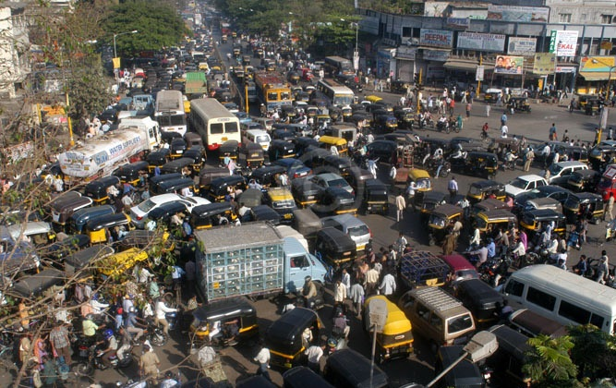
Transfer of Power
Role of authority in social development
Society needs authority over its members to survive
Societies cannot exist without some authority over its members
The power of society derives from the willingness of its members to conform and accept its authority
Society compels us all to adhere to a minimum standards
As society develops, it raises the standard required of its members
Toward a Trans-disciplinary Science of Society

Slide 4
Transfer of Power
Ways in which society imposes authority
Type of Authority | Negative Authority | Positive Authority
Physical | Physical punishment, exile | Rights of inclusion, protection
Emotional | Ostracism, subordinate status | Acceptance, prestige
Mental | Indifference, scepticism | Recognition, respect
Toward a Trans-disciplinary Science of Society

Slide 5
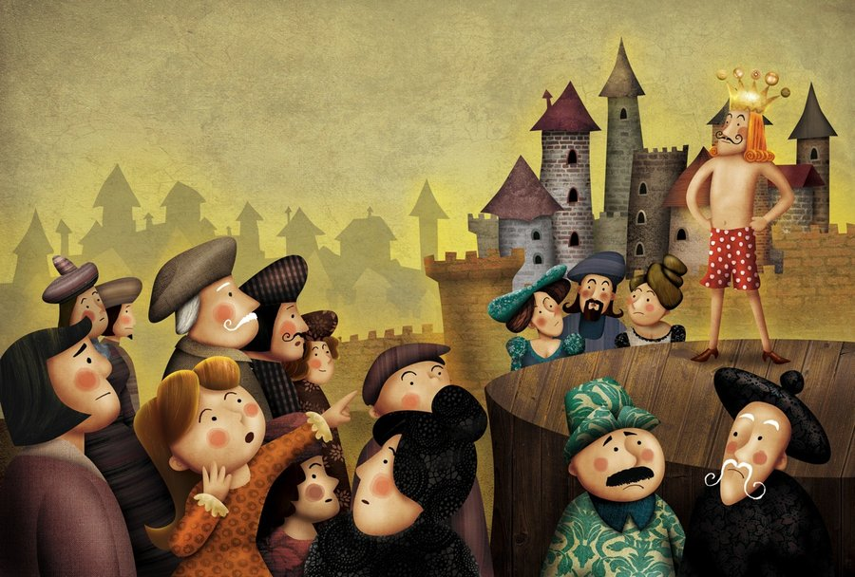
Transfer of Power
Conformity in the individual
Society exercises an invisible but powerful strength over everyone
Individuals are eager to conform to this authority
‘We are half ruined by conformity; but we should be wholly ruined without it’ - Charles Warner
Social conformity ensures the survival and growth of its members
Conformity in society defines the ordinary person
Toward a Trans-disciplinary Science of Society

Slide 6
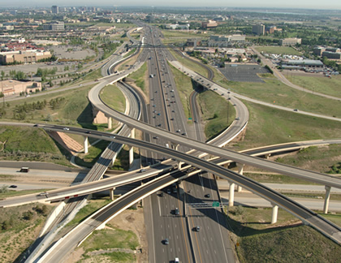
Transfer of Power
Role of Conformity
Authority is necessary when our own values are substandard. Conformity is the lower part of self discipline. It is necessary to raise the bottom level of society
Conformity is necessary not only to those with substandard values
We cannot live in a society without rules, we need for them for our survival
When we conform to society, we get more access to this power
Discipline and conformity help us accomplish far more than we can accomplish alone
Toward a Trans-disciplinary Science of Society

Slide 7

Transfer of Power
Beyond a point, rigid conformity stifles growth
Society honors its living conformists and its dead troublemakers
Conformists lend stability to society. Conformity has its place
There are limits to growth made possible by conformists and their conformity
When conformity is taken too far, they stifle growth beyond a point
Society caters to the average, just as a teacher caters to the average student
There are some who are not satisfied with average growth and accomplishment, those who do not need the security or support of society.
These are fully developed, strong individuals who do not dependent on society to lead them, but who can lead society instead.
Their story begins with stepping out of conformity.
Toward a Trans-disciplinary Science of Society

