Slide 1
Challenges and Opportunities
Janani Ramanathan
Associate Fellow, World Academy of Art and Science
Research Associate, Mother’s Service Society
Toward a Trans-disciplinary Science of Society

Slide 2
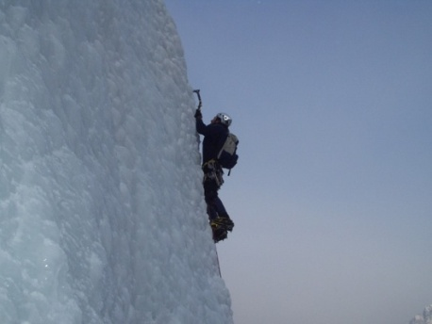
Challenges and Opportunities
Opportunities that arise from Challenges
Historically, great challenges have become opportunities
Bata Shoes after World War I
Unity and freedom after the American Civil War
Industrialization after World War II
Great people seem to appear on the scene during challenging times
American War of Independence - George Washington, Benjamin Franklin and Thomas Jefferson
World War II - Roosevelt, Churchill and Stalin
Indian Independence - Mahatma Gandhi, Jawaharlal Nehru, Sardar Patel
Toward a Trans-disciplinary Science of Society

Slide 3
Challenges and Opportunities
What do challenges do?
Challenges and our response to them release energy
Challenges change attitudes
New situations break resistances
Toward a Trans-disciplinary Science of Society

Slide 4
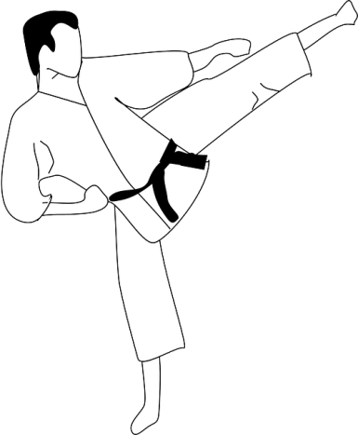
Challenges and Opportunities
What differentiates those who tide over a crisis from those who succumb to it?
The winners
Redirect the energy
Look out for the opportunity
Learn from mistakes
Think creatively and adapt
Toward a Trans-disciplinary Science of Society

Slide 5
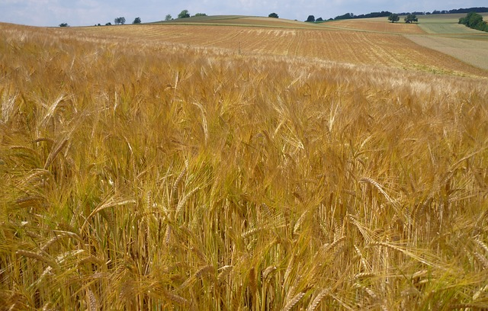
Challenges and Opportunities
Often, it is the greatest challenges that lead to the greatest human achievements
Our response determines the results
Is it possible that all challenges have concealed opportunities behind them?
Toward a Trans-disciplinary Science of Society

