Slide 1
Social Development as Network Dynamics:
An Economics Perspective
Zbigniew Bochniarz
University of Washington
Dubrovnik, September 3, 2014

Slide 2
Introduction 1. Social Development versus Economic Growth 2. What Roles play Networks in Social Development? 3. Examples of Effective Networks in Resource Allocation: a. Global Local & Regional Networks for Climate b. Industrial Clusters 4. Networks as Institutions 5. New Network Science
Notes:
This is my 1st of 3 lectures focusing on social development from an economics perspective. The next will be on SC and on Sustainability.

Slide 3
Social Development versus Economic Growth
Economic Growth – the most popular but the narrow concept referred usually as annual income measured by GDP increases.
Economic Development – larger concept defined as a process of increasing not only economic wealth but also quality of life, improving income distribution, productivity, competitiveness, and sustainability.
Social Development means a human-centered development process to higher standard of life, more empowerment, greater creativity and satisfaction.

Slide 4
Defining the Central Problem in Economics:
efficient allocation of resources to meet the population needs.
Two competing approaches – modes of coordination:
regulation by a government vs. self-regulation by market.
Both modes, particularly in their extreme forms, do not produce efficient solutions
=> government and market failures

Slide 6
THE NEW MODE OF COORDINATION
Third mode of coordination – the NETWORKS – gaining significance over last twenty years.
Networks – flat and voluntary organizations.
One of the most popular and efficient forms of coordination are industrial clusters related to certain location. The other is the International
International Council for Local Environmental Initiatives (ICLEI)
Notes:
Phenomenon of industrial agglomeration known since the late 1880s (Marshall), P. Krugman and M. Porter brought new inspirations for economic research

Slide 8
The Role of the Cities Networks in Climate Policy(1)
The movement of the local government leaders concerned with the global environment has a long tradition in North America.
=> A meeting of 35 Canadian and US leaders in Irvin, CA in December 1989 developed the initial concept of the ICLEI
=> The first World Congress of representatives of 200 LG leaders from 43 nations in September 1990 => Charter and Strategy.
=> 2003 the International Council for Local Environmental Initiatives became ICLEI—Local Governments for Sustainability.
=> Today this is the global largest organization of local government with over 1200 members from 84 countries.
=> The largest – more than half of the all members - and the most dynamic is the US chapter with over 600 members.

Slide 9
The Role of the Cities Networks in Climate Policy (2)
Contrary to the federal government the US LG leaders invested their time and resources to build organization, which responds to their communities’ needs and ambitions to tackle the CC, energy and sustainability issues.
Today this 25 years old organization with over 600 members representing cities and communities of about 30% of US population set the ambitious goals, objectives and targets that could serve as inspiring examples for federal government actions and international communities.
These are not easy-make pledges but real commitment scrutinized by rigorous process of quantification, performance monitoring and evaluation (ICLEI Annual Report 2009).For instance, participants of the CC mitigation program have to follow the Five Milestone process:
Milestone One: Conduct a baseline GHG emissions inventory and forecast
Milestone Two: Adopt an emission reduction target
Milestone Three: Develop and secure formal approval of a local climate action plan
Milestone Four: Implement the plan’s policy and measures
Milestone Five: Monitor progress, report results and re-evaluate the plan.

Slide 10
The Role of the Cities Networks in ACCP (3)
Based on the commitments of 84 LGs and 101 communities the cumulative emission reduction by the 2020 will reach 1.36 billion metric tones of CO2e and by 2050 6.8 billion tones CO2e.
Assuming that the cumulative reduction of 1.36 billion mt of CO2e will be equally distributed over 10 years ) 2010-2019) this would make approximately 2% of the annual total GHG emission of 2009 and about 2.2% of 1990 CO2e level.
Taking into account that according to Annex I the US should reduce GHG by 7% of 1990 in 2012, the contributions from only 84 LGs and 101 communities – presenting the most active but also a fraction of over 600 member organization - would make 31% of the KP reduction target.
These very simplified figures show huge potential allocated in the LG and communities that could be further mobilized and synergized by complementary state and federal policies. It is worth to mention about sources of the GHG reduction committed by LGs.

Slide 11
The Role of the World Largest Metropolis Networks in Climate Policy
=>In May 2007 C40 announced a $5 bln global Energy Efficiency Building Retrofit Program with CCI for more than 200 retrofit projects encompassing over 500 million sq ft of building space in more than 47 cities around the world
=>The CCI is a special program originated at the William J. Clinton Foundation oriented on three major areas:
increasing energy efficiency in cities,
catalyzing the large-scale supply of clean energy, and
working to stop deforestation (www. clintonfoundation.org/cci)
Joint concern of the CC and similarity of programs made the CCI a solid delivery partner for the C40 since 2006 helping cities to generate and utilized energy more sustainably and save money, create green jobs.
=> According to newly elected Chair of the Climate Leaders Group Mayor Bloomberg of NYC the stake for C40 is huge for CC policy – more than half of the world population lives in cities, which consume 75% of world energy and produce 80% of its GHG (C40 News, 20100910).

Slide 12
US Regional CC
Initiatives
spreading out
from the
Northeast
through Midwest
to the Western
States

Slide 13
Inspiring Role of the US Regional CC Initiatives:
in Canada:
4 Participating Provinces
3 Observing Provinces
in Mexico:
6 Observing States

Slide 14
ACCP States & Regions World Map

Slide 15
DEFINING CLUSTERS
Clusters - geographic concentrations of interconnected companies, specialized suppliers, service providers, firms in related industries, and associated institutions that can cooperate and compete in particular fields [Porter 2008, 213].
Clusters - more than supply chain =>
academic institutions (training, research, consulting) governmental agencies and non-governmental organizations (professional services).

Slide 16
Critical Relations
Porter identifies three ways in which clusters produce benefit:
Productivity is enhanced through innovation, and innovation is encouraged through co-location which promotes the types of learning that are “facilitated by the ease of making site visits and frequent face-to-face contact” (Porter, 1998, p. 4)
Clusters also act as conduits through which tacit information that signals market opportunity flows
Finally, clusters act to reduce risks associated with employee relocation

Slide 17
Functional Clusters, Clumps, and Working Clusters (D. Andreoli)
Functional Clusters are spatial networks of like and functionally linked industries
Clumps are groups of functionally linked firms in which the physical distance separating member firms does not prohibit the range of benefits that are made possible through frequent interactions
Working clusters are made up of firms and institutions which benefit from the types of integration and cooperation made possible through co-location

Slide 18
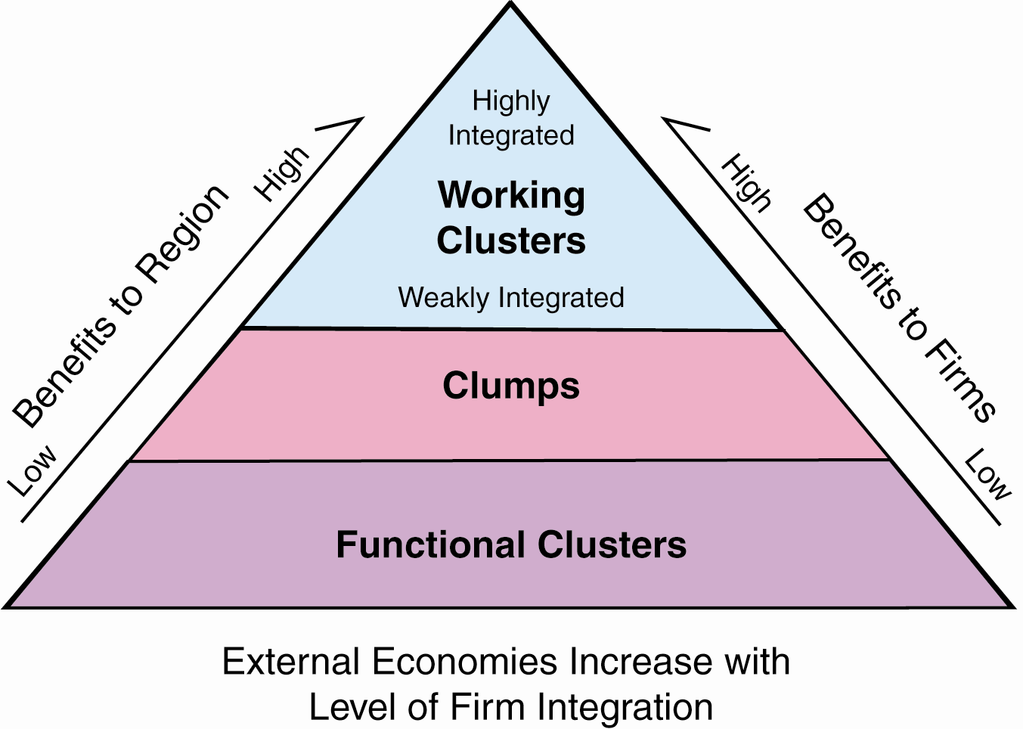
Functional Clusters, Clumps, and Working Clusters (D. Andreoli)
The goal of any cluster initiative is to promote economic development by encouraging the positive externalities that come from integration (i.e. promote integration)

Slide 19
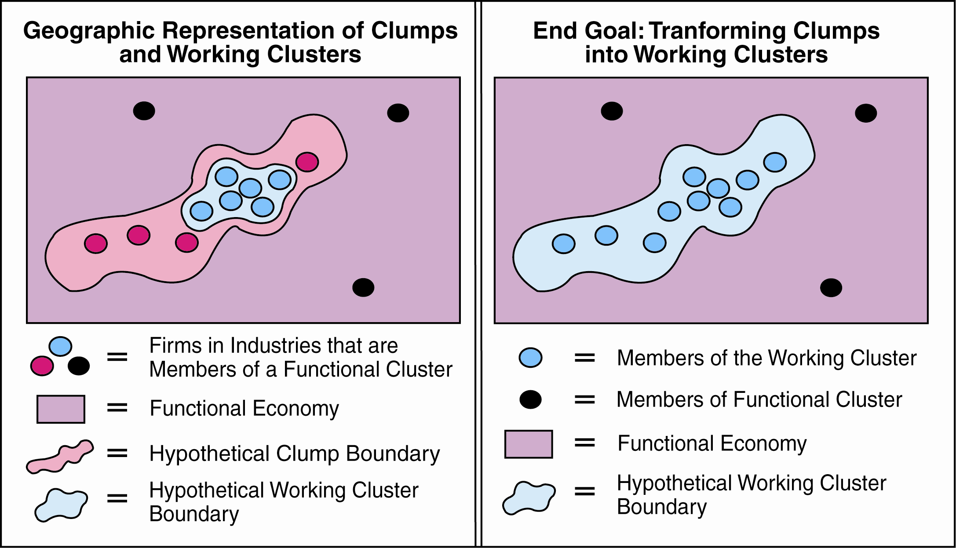
Functional Clusters, Clumps, and Working Clusters (D. Andreoli)
From a geographic perspective:

Slide 20
What Makes the Working Cluster?
Functional Cluster
Social Capital => Cooperation=> Synergy=>Positive Externalities=>
Knowledge Spillovers=>Innovations
Working Cluster

Slide 21
4. Networks as Institutions
INSTITUTIONS ARE "REPRODUCED SOCIAL PRACTICES"
PATTERNS OF INTENTIONAL HUMAN INTERACTION CARRIED OUT IN REPETITIVE FASHION OVERTIME
INSTITUTIONS IMPLY:
HISTORY
CONTROL
RULES
NORMS

Slide 22
Disciplines Interested in Institutions
Behavioral Sciences
Philosophy
Economics
Public and Business Administration
Political Sciences

Slide 23
Understanding the Basic Relations in Shaping Human Behavior
Behavior
Attitudes
Values

Slide 24
Institutions are patterns of social activity that give shape to collective and individual experience.... Institutions form individuals by making possible or impossible certain ways of behaving and relating to others. They shape character by assigning responsibility, demanding accountability, and providing the standards in terms of which each person recognizes the excellence of his or her achievements. Each person's possibilities depend on the opportunities opened up within the institutional contexts to which that person has access." (Bellah, et. al., 1991, p. 40)

Slide 25
BASIC ELEMENTS OF HUMAN INTERACTION INVOLVED IN THE DESIGN PROCESS
IDENTITY
ATTACHMENT
EXCHANGE
COMPETITION
COOPERATION
ALTRUISM
BONDING

Slide 26
BASIC CRITERIA OF INSTITUTIONAL SUSTAINABILITY
INCENTIVES
EFFICIENCY
SUBSIDIARITY

Slide 27
THE SUSTAINABILITY TEST -- INSTITUTIONS SHOULD INSPIRE:
Loyalty
Spirit and Energy
Perceived Fairness and Justice in Conflict Management
Mutual Help in Difficult Circumstances

Slide 28
THE DESIGN OF INSTITUTIONS IS ANALOGOUS TO A PROBLEM IN GAME THEORY
CAN A "GAME" [AN INSTITUTION] BE DEVISED WITH RULES PROVIDING AN APPROPRIATE MIX OF COOPERATION AND COMPETITION, BY WHICH PEOPLE ACTING IN THEIR OWN INTERESTS, BEHAVE IN SUCH A MANNER AS TO ENHANCE OR MINIMIZE DAMAGE TO THE [ENVIRONMENT] [COMMUNITY] [CULTURE] AND PLAN FOR THE CONSERVATION [OR SUSTAINABLE USE] OF ITS RESOURCES.
(AFTER HURWICZ, 1987)

Slide 29
BASIC ELEMENTS OF INSTITUTIONAL DESIGN
INCENTIVES
SOCIALIZATION
LEGITIMATION
MONITORING AND ENFORCEMENT
MEANS FOR CONFLICT RESOLUTION

Slide 30
Models of networks (Weiler 2012) :
Regular Lattice Model - Ising, one-dimensional, (1925) and Onsager, two-dimensional, (1944);
Random Network - the Erdos-Renyi Model (1959);
Scale-Free Model known as the BA Model called
after Barabasi & Albert (1999);
Small World Model - the Watts-Strogatz
algorithm (2008) .

