Slide 1
2 Toward a Paradigm Shift?
Roberto Poli

Slide 2
The Problem of the Future
Anticipation
Foresight
Forecast
Protension
Prospection

Slide 3
Anticipation
Philosophy Husserl
Biology Rosen
Brain studies Berthoz
Psychology Tolman
Sociology
Schutz
Anthropology Bennett
Economy Ansoff

Slide 4
Philosophy Husserl
Biology Rosen
Brain studies Berthoz
Psychology Tolman
Sociology
Schutz
Anthropology Bennett
Economy Ansoff
The Future as Cultural Fact,
Appaduray 2013
Anticipation
“Imagined Futures. Fictional Expectations in the Economy”, Beckert 2013
Prospection theory,
Seligman 2013

Slide 5
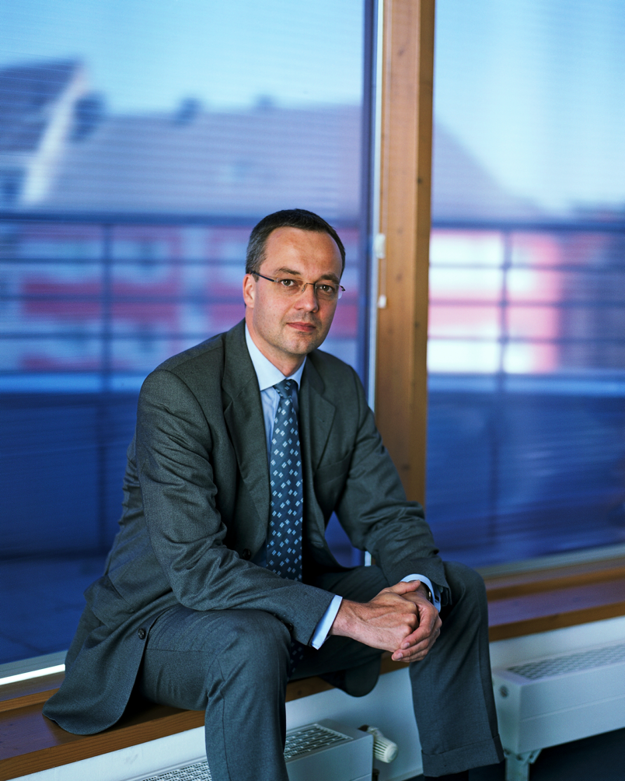
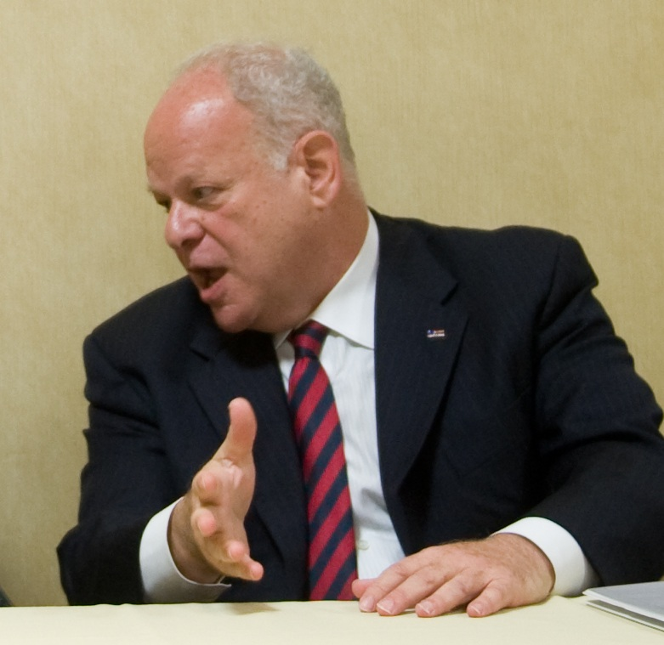
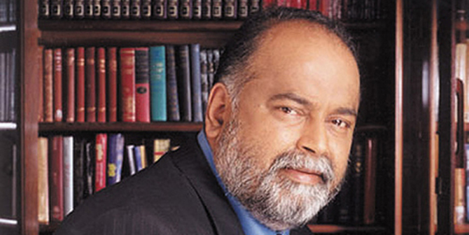

Slide 6
Seligman, M. E. P., Railton, P., Baumeister, R. F., & Sripada, C. (2013). Navigating Into the Future or Driven by the Past. Perspectives on Psychological Science, 8(2), 119-141.
Appadurai, A. (2013). The Future as Cultural Fact. London: Verso.
Beckert, J. (2013). Capitalism as a System of Expectations: Toward a Sociological Microfoundation of Political Economy. Politics and Society, 41(3), 323-350.

Slide 7
Seligman
Seligman’s paper is a major contribution to a new conception of psychology as a whole
As a matter of fact, during the past decade psychologists have begun systematic study of people’s orientation towards the future (for a non-technical introduction to time perception see Hammond 2012)
Seligman’s paper, however, has the nature of a paradigm shift, and it will likely provoke heated discussion

Slide 8
Seligman
Main aspects
Historical reconstruction of the development of psychology (behaviorism, cognitivism)
Empirical collection of data, especially on white rats
The prospective brain – analysis of its “default mode”
Other aspects
Comparison with and critique of Kahneman and Twersky’s “prospect theory”
Prospective reformulation of several psychological disorders
Analysis of memory, subjectivity, consciousness, and free will
While I shall have to be very selective, the paper is worth reading in its entirety

Slide 9
Abstract
Prospection … , the representation of possible futures, is a ubiquitous feature of the human mind. Much psychological theory and practice, in contrast, has understood human action as determined by the past and viewed any such teleology (selection of action in light of goals) as a violation of natural law because the future cannot act on the present. Prospection involves no backward causation; rather, it is guidance not by the future itself but by present, evaluative representations of possible future states. These representations can be understood minimally as “If X, then Y” conditionals, and the process of prospection can be understood as the generation and evaluation of these conditionals.

Slide 10
Abstract
… A wide range of evidence suggests that prospection is a central organizing feature of perception, cognition, affect, memory, motivation, and action. The authors speculate that prospection casts new light on why subjectivity is part of consciousness, what is “free” and “willing” in “free will,” and on mental disorders and their treatment. Viewing behavior as driven by the past was a powerful framework that helped create scientific psychology, but accumulating evidence in a wide range of areas of research suggests a shift in framework, in which navigation into the future is seen as a core organizing principle of animal and human behavior.

Slide 11
Quotations
“The past is not a force that drives them (needs and goals) but a resource from which they selectively extract information about the prospects they face. These prospects can include not only possibilities that have occurred before but also possibilities that have never occurred” (119)
“The prospective organism must construct an evaluative landscape of possible acts and outcomes” (120)
“The success or failure of an act in living up to its prospect will lead not simply to satisfaction or frustration but to maintaining or revising the evaluative representation that will guide the next act” (120)

Slide 12
Quotations
“At any given moment, an organism’s ability to improve its chances for survival and reproduction lies in the future, not the past. So learning and memory, too, should be designed for action. These capacities actively orient the organism toward what might lie ahead and what information is most vital for estimating this” (120)

Slide 13
Quotations
“Behaviorist learning theory did not even work for white rats in the laboratory” (121)
“Psychoanalysis … carefully done longitudinal studies … have found disappointingly small effects of childhood events on a range of adult behaviors” (123)
Ernst Bloch’s Principle of Hope distinguishes two different types of dreams: past-oriented dreams (Freud), future-oriented dreams (such as daydreaming)

Slide 14
Quotations
“The … acceptance of expectations … opens the way to a fundamental reorientation in thinking about how past experience influences behavior – not through the direct molding of behavior but through information about possible futures. Choice now makes sense … stretching well beyond actual experience and enabling them (the rats) to improvise opportunistically on the spot” (124)
“… attention to another core aspect of cognition that is oriented toward prospection: the active, selective seeking of information (“exploration”)” (124)

Slide 15
Quotations
“In this section, we offer an a priori argument for the centrality of expectation in current models of rational cognition and choice, and we then consider some striking evidence from ecology and neurophysiology that animals and humans might actually implement these models” (124)
“The good regulator theorem … suggests that for the brain to be a good regulator of interactions with the environment, both physical and social, it must build and use a model of that environment” (124)
Expectation → observation → discrepancy detection → discrepancy-reducing change in expectation → expectation …
“Family of feed-forward—feed-back models of learning and control” (124)

Slide 16
Quotations
“Generating simulations of the future can be conscious, but it is typically an implicit process … often not accessible to introspection, and apparently occurring spontaneously and continuously” (126)
“Much prospection appears to share the architecture of the optimal models developed a priori in philosophy, economics and system analysis (126)

Slide 17
Quotations – critical issues
“Start with the question of what component psychological mechanisms or capacities a creature needs to have in order to be free and autonomous. Build a catalogue that encompasses the full assortment of “design features” that make an agent free … then … are abstract metaphysical questions broached”
These “catalogues” do not exist for natural systems
Form the list of properties of say an apple – and I will show you something that has all those features and is not an apple
These catalogues may exist for simple (and closed) systems
Usual “downward” vision – from the whole to its parts (structural analysis)
No “upward vision” – from the whole to the higher-order wholes in which the former is embedded (functional analysis) – No idea of the presence of hierarchical cycles (self-referential or impredicative loops)

Slide 18
Anthropology
Anthropology has traditionally focused its research on non-industrial societies
Its main focus has been the cultural reproduction of identity, which for the most part means analysis of the ways in which societies develop their sense of the past
Claims no longer valid: anthropology has begun to focus on both industrial societies and the ways in which societies develop their sense of the future (Appadurai, 2013, 285)
Within anthropology, the recent debate on anthropology and the future has been ignited by Guyer (2007)
Here I will consider only two main contributions to this otherwise rich debate: namely the already-mentioned work Appadurai, together with Piot (2010).

Slide 19
Anthropology
Perhaps surprising from a European perspective, in West Africa Pentecostal churches are the main forces forging a new understanding of the future. By urging a break with the past, including rejection of the old structures of authority, these churches reshape temporality (Piot, 2010, p. 9)
Attention may be called to the fact that “US pastors are now traveling to Africa to be ordained – because they see African Christianity as a purer form – before returning ‘home’ to engage in ‘mission’ work” (Jenkins, 2002); (Piot, 2010, p. 63).
There is more than this, however. The issue is not limited to rejection of the past; the really intriguing issue is that “futures are replacing the past as cultural reservoirs” (Piot, 2010, p. 16). While our understanding of these pentecostal-mediated futures is remarkably poor (for an insider’s point of view, see (Heward-Mills, 2006)) the very possibility of using futures as cultural reservoirs is central to the idea of anticipation

Slide 20
Theology
The connection between religion and the future is not limited to the new Pentecostal churches
Within the Christian tradition, the issue is whether the entire doctrine is already explicit in the Scriptures or “points of doctrine not made explicit in the New Testament are able to emerge gradually in the historical tradition of the Church” (Love, 2010, p. 171)
Since John Henry Newman and his 1845 Essay on the Development of Christian Doctrine (1974), the idea that doctrine develops in history has become a guiding principle of dogmatic theology

Slide 21
Theology
It is worth noting, however, that according to Newman the “doctrine develops through the gradual influence of the past upon the present” in a way that “truth latent in the past is gradually made explicit at a later time” (Love, 2010, p. 174)
More recently, the question has been raised whether “doctrinal development really have to be wholly explicable in terms of the past”. In the words of Cyprian Love: “This is not to deny the major significance of the historical sources of doctrine in Scripture. But are these past norms the limit of the originating impulse behind doctrinal evolution?” (Love, 2010, p. 174)

Slide 22
Theology
From within the exegetic tradition making reference to Karl Rahner (see in particular his 1973) one may further add that “the future is not simply the prolongation of our past, nor merely the actualization or implementation of our present plans. Such an understanding of the future would be primarily a projection of a static present. The real future is ‘uncertain’ and is not just the unfolding of our present ideas or strategies. It is not simply a calculated human creation involving ‘plans plus time.’ Rather, the open future that comes to meet us brings surprises. That unforeseen future requires provisionality, since it cannot be calculated or controlled” (Prusak, 2004, p. 313).

Slide 23
Anthropology
Coming back to anthropology, Appadurai claims that, in order to develop a systematic understanding of the future, anthropologists should examine “the interactions between three notable human preoccupations that shape the future as a cultural fact, that is, as a form of difference. These are imagination, anticipation and aspiration” (Appadurai, 2013, p. 286)
… even if “we have not yet found ways to articulate how anticipation, imagination, and aspiration come together in the work of future-making” (Appadurai, 2013, p. 298)

Slide 24
Anthropology
Nevertheless, “as we refine the ways in which specific conceptions of aspiration, anticipation, and imagination become configured so as to produce the future as a specific cultural form or horizon, we will be better able to place within this scheme more particular ideas about prophecy, well-being, emergency, crisis, and regulation. We also need to remember that the future is not just a technical or neutral space, but is shot through with affect and with sensation. Thus we need to examine not just the emotions that accompany the future as a cultural form, but the sensations that it produces: awe, vertigo, excitement, disorientation” (Appadurai, 2013, pp. 286-287).

Slide 25
Anthropology
The capacity to anticipate the future is socially differentiated, however
On understanding that “‘the capacity to aspire’ is unequally distributed” and that “its skewed distribution is a fundamental feature, and not just a secondary attribute, of extreme poverty” (Appadurai, 2013, p. 289) one begins to grasp some of the deeper issues related to the future as a cultural reservoir. Not everybody has access to this reservoir.

Slide 26
Anthropology
As a step towards building a future reservoir where none is available, one may consider the productive role played by memory. “While state-generated archives may primarily be instrumental of governmentality and bureaucratized power, personal, familial, and community archives –especially those of dislocated, vulnerable, and marginalized populations—are critical sites for negotiating paths to dignity, recognition, and politically feasible maps for the future” (Appadurai, 2013, p. 288)
Put differently, without “the capacity to aspire as a social and collective capacity … words such as ‘empowerment’, ‘voice’, and ‘participation’ cannot be meaningful” (Appadurai, 2013, p. 289).

Slide 27
Anthropology
Anthropologists need to engage in a “systematic effort to understand how cultural systems, as combinations of norms, dispositions, practices, and histories, frame the good life as a landscape of discernible ends and of practical paths to the achievement of these ends
This requires a move away from the anthropological emphasis on cultures as logics of reproduction to a fuller picture in which cultural systems also shape specific images of the good life as a map of the journey from here to there and from now to then, as a part of the ethics of everyday life” (Appadurai, 2013, p. 292).

Slide 28
Anthropology
This effort will evidence the difference between what Appadurai calls ‘the ethics of possibility’ and ‘the ethics of probability’
The former is based on “those ways of thinking, feeling and acting that increase the horizon of hope, that expand the field of the imagination, that produce greater equity in what [he has] the capacity to aspire, and that widen the field of informed, creative, and critical citizenship”
Conversely, the ethics of probability deals with “those ways of thinking, feeling, and acting that flow out of what Ian Hacking called “the avalanche of numbers”… they are generally tied to the growth of a casino capitalism which profits from catastrophe and tends to bet on disaster” (Appadurai, 2013, p. 295

Slide 29
Beckert
Economics deals with the future in many different ways, at many different levels. Governments deal with forecasts on the inflation rate and the increase or decline in the Gross Domestic Product; almost any aspect of the strategic management of companies concerns the future: from calculation of the production of goods adjusted to seasonal variations to long-term decisions about producing entirely new goods or opening new factories. In turn, finance is entirely based on anticipations
Leaving aside all its remarkable technical complexities, the basic rule of finance is simple, almost trivial: buy assets that are going to grow in value, sell assets that are going to fall in value – both sides include unavoidable reference to the future
However, the vast majority of the ways to see into the future exploited by economists are severely constrained. There are entire realms of anticipation that have never been considered by economists
Even within economics, however, things are starting to change. Jens Beckert in particular is opening new avenues. Particularly worth mentioning is his endeavor to break down the walls that so far have isolated economics, political science and sociology from each other (Beckert, 2013a, p. 324).

Slide 30
Economics
In order to understand the micro-processes underlying macro-economic outcomes, one should focus on agents’ expectations. The economic activities that are pursued or avoided are established by expectations
The problem is that “under conditions of fundamental uncertainty, expectations cannot be understood as being determined through calculation of optimal choices taking into account all available information, but rather are based on contingent interpretations of the situation in the context of prevailing institutional structures, cultural templates, and social networks” (Beckert, 2013a, p. 325)
It is here that Beckert introduces the concept of ‘fictional expectation’ referring to “present imaginaries of future situations that provide orientation in decision making despite the incalculability of outcomes” (Beckert, 2013a, p. 325)
This means that fictional expectations are more imaginations about the future than they are forecasts

Slide 31
Economics
Like imaginations, fictions add creativity to the economy and contribute to the dynamics of capitalism (Beckert, 2013b, p. 220)
As Beckert explicitly declares, “the notion of fictional expectations is directed against the concept of ‘rational expectations’ constituting the micro-foundation of much of modern macro-economics” (Beckert, 2013a, p. 325, 2013b, p. 221)
The reason is clear: according to rational expectations theory, aggregate predictions are correct because individual errors are random. Therefore predicted outcomes do not diverge systematically from the resulting market equilibrium. As a consequence the uncertainty of the future becomes a predictable forecast, paving the way for the rational calculation of optimal choices. On the other hand, the true openness of the future makes it impossible to explain decisions as calculations of optimal choice (Beckert, 2013b, p. 221)

Slide 32
Economics
Despite all the objections raised against the just summarized train of thought, such as the role played by cognitive biases or true novelties, the ideology of the rational calculation of optimal choices is still the position defended by the vast majority of working economists. Apparently, economists tend to analyze uncertainty as if it were risk
As should be well-known, the distinction between the calculability of risk as opposed to the incalculability of uncertainty was introduced by Frank Knight as early as the 1920s (Knight, 1921). This notwithstanding, within economic thought there seems to be an unrestrainable tendency to blur their differences and to see everything as risk

Slide 33
Economics
Beckert’s intention is to reintroduce a difference between risk and uncertainty by raising the question of the nature of expectations under conditions of uncertainty
Here is his answer: “Structurally, expectations depend on cultural frames, dominant theories, the stratification structures of a society, social networks, and institutions. But the concept of fictional expectations gives the notion of expectations at the same time a political twist because expectations are seen as being open to the manipulation by powerful actors” (Beckert, 2013a, p. 326).

Slide 34
Economics
In order to clarify his concept of fictional expectation better, Beckert openly claims that “it is the future that shapes the present—or, to be more specific: it is the images of the future that shape present decisions” (Beckert, 2013b, p. 221)
The fact is that actors must develop expectations “among other things, with regard to technological development, consumer preferences, prices, availability of raw materials, the strategies of competitors, the demand of labor, the trustworthiness of promises, the state of the natural environment, political regulations, and the interdependencies among these factors”, despite the true unknowability of the future (Beckert, 2013b, pp. 221-222)

Slide 35
Economics
Hence expectations are real fictions – there is no chance of seeing them through the opposition between truth and falsehood; eventually, the proper opposition will be based on the difference between convincing as opposed to unconvincing expectations. Moreover, expectations are more than ‘mere fantasies’ because actors develop plans that are based on and include them
Finally, fictional expectation work on an ‘as if’ base: “fictional expectations represent future events as if they were true, making actors capable of acting purposefully with reference to an uncertain future, even though this future is indeed unknown, unpredictable, and therefore only pretended in the fictional expectations” (Beckert, 2013b, p. 226)

Slide 36
Anticipation
I have summarized three papers published in 2013
Their authors address different communities of scholars and different disciplines
Nevertheless, the main message is clear: human and social sciences should move from being primarility past-oriented sciences to become primarily future-oriented sciences
This raises the issue of the Discipline of Anticipation (next lecture)
So far, a systematic comparison among the many proposals concerning anticipation is lacking. The research-base is fragmented
However
For a preliminary surwey: R. Poli, “The many aspects of anticipation”. Foresight, 2010, 12(3), pp. 7–17.
Bibliography ≈100-pages: M. Nadin, “Annotated Bibliography Anticipation”. International Journal of General Systems, 2010, 39(1), pp. 35–133

Slide 37
Conclusion
The relevance and impact of both ongoing discussions and those that will hopefully arise require more than sound and clever arguments
At stake is the Zeroth Commandment and the implied need for a change of paradigm. Piecemeal adjustments will not do
On placing anticipation (or ‘prospection’ in Seligman’s terminology) at the top of the research agenda of the human and social sciences, a slew of new questions arise
Whilst futurists may not have the highest academic credentials, we have accumulated a body of experience with the futures that no other field, academic or otherwise, possesses
Therefore, the onus of contributing or even leading the emergent change is on us. Hic Rhodus, hic salta

