Slide 1
Process of Accomplishment
LECTURE 17
GARRY JACOBS
1

Slide 2
Process of Accomplishment
Human accomplishment is result of the interaction between
Individuals – Organizations – Society – Environment Life Circumstances
Process is essentially the same at micro and macro scale
Individual Achievement – Organizational Development
Social Evolution
Process is common to all levels
Physical – Commercial, Social & Political – Artistic & Intellectual – Psychological, Cultural & Spiritual
2
Notes:
Process of Accomplishment
Human accomplishment is a fundamental human process
It is the result of the interaction between
Individuals
Organizations
Society
Environment
Life circumstances
The process is essentially the same at micro and macro scale
Individual achievement
Organizational development
Social evolution
The process is common to all levels
Physical
Social & Cultural
Artistic & Intellectual
Psychological & Spiritual

Slide 3
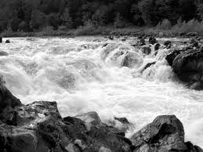
Human Energy is the Fuel for all Accomplishment
Energy is generated by need, aspiration or idealism
Energy is generated by responding to an opportunity
Energy is generated by confronting a challenge
Every human interaction is a potential source of energy
3
Notes:
Human energy is the fuel for all accomplishment
Every interaction between human beings is a potential source of potential energy
The potential energies of society are immeasurable
Imagine the possible combinations and mutations of interaction between 7 billion human beings
Energy is generated by perceiving an opportunity
Opportunity of freedom or free land in America
A new technology like Apple
A new market like Marriott
Eliza’s attraction to Wickham
Darcy’s admiration for her fine eyes
Energy is generated by challenges
Great Crash and Great Depression
Civil War threatening the nation
Business challenges
Wickham’s meeting with Darcy
Darcy’s tolerable – pride and prejudice
Energy is released by aspiration

Slide 4
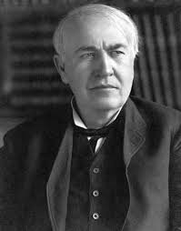
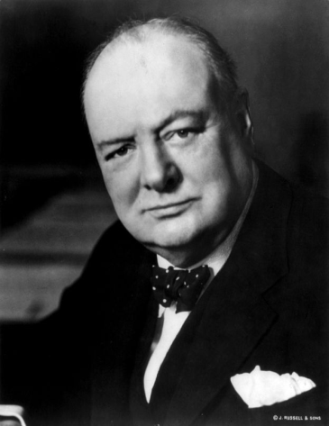
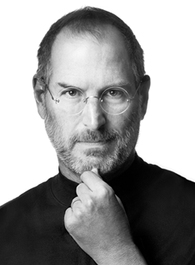
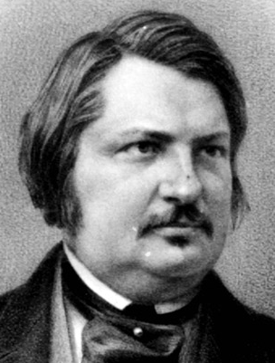
High Energy People
The single most striking attribute of high achieving individuals is the intensity of the ENERGY they exhibit

Slide 5
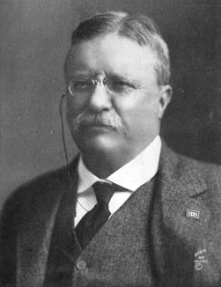
Theodore Roosevelt – Force of Nature
26th President of USA known for his exuberant personality, cowboy persona and robust masculinity.
Known as the trust-buster that broke up Standard Oil
Famous for his remark, “Speak softly and carry a big stick”
"Do you know the two most wonderful things I have seen in your country? Niagara Falls and the President of the United States, both great wonders of nature!"
"a perpetual flow of torrential energy, a sense of motion even in stillness ... thrilling to be near."

Slide 6
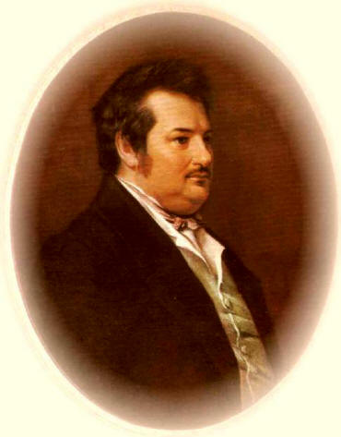
Honoré de Balzac – Creative Imagination
During 1830 and 1831 he poured out approximately 150 short novels, stories, articles, and commentaries—a feat unparalleled in the annals of literature—and over the next 20 years, he completed 40 full-length novels.
"Everything he did seemed to have a tenfold intensity. When he laughed the pictures on the walls trembled; when he spoke the words came cascading forth; ...when he worked there was no difference between day and night as he sat writing round the clock and blunted a dozen pens in the process."

Slide 7
Corporate Intensity
Youthful enthusiasm of rapid growth – Apple 1984, Inc. 100
Dynamic exuberance – INTEL
Controlled power of a well-oiled machine – Merck
Vibrancy, charm and cheerfulness – Coca Cola
Intense warmth of a close-knit family – Delta
Quiet hum, very active & alert – North-western Mutual

Slide 8
Energetic Societies
Alexis de Tocqueville’s Democracy in America
Jules Verne’s characterization of the American West
Charles de Gaulle’s first impressions of New York
Harlan Cleveland’s Revolution of Rising Expectations
Resurgent Asia

Slide 9
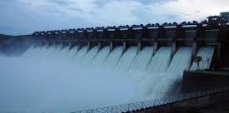
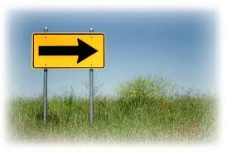
Direction Converts Energy into Force
Energy is not enough for high accomplishment
Energy needs to be focused by a clear direction
Direction is given by leadership
Clear goals, objectives and values convert energy into FORCE
9
Notes:
Energy is not enough for high accomplishment
The kindergarten children are full of energy
So is a mob and a city street at rush hour
Energy needs to be focused by a clear direction
The quest of the colonies for Independence
Churchill’s determination – never to surrender -- was a born military leader who knew his chosen calling
JFK’s challenge for moon landing and NASA
Jobs set out to revolutionize the world – a new religion
Direction is given by leadership
Newton was possessed by an insatiable quest to understand the laws of the universe
Of a person like Washington, Lincoln or FDR
An entrepreneur like Edison, Watson, Marriott or Jobs
Gandhi dedicated his whole life to Indian freedom and justice for the downtrodden
All of them channelled their energies focused like laser beams
Clear goals, objectives and values convert energy into FORCE
Independence
Freedom for slaves and Unity of America
Victory in WWII
World’s best computer or smartphone

Slide 10
Organization of Acts
Act is the basic unit of accomplishment
Each act is itself a subjective microcosm
Organization consists of chains of interrelated acts
Organization links individual acts to form activities, systems, functions, and structures
10
Notes:
Hindu numerals – double entry book keeping – accounting – financial reporting – stock exchanges
Fighting skills, tactics, strategies, war plans
Fast Food restaurant -- SOPS
S

Slide 11
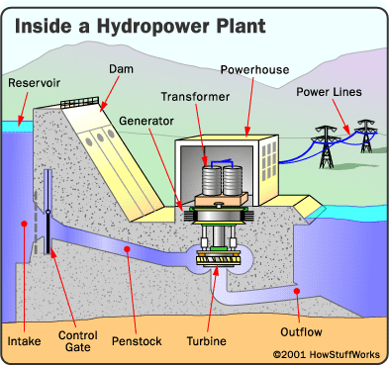
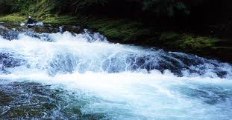
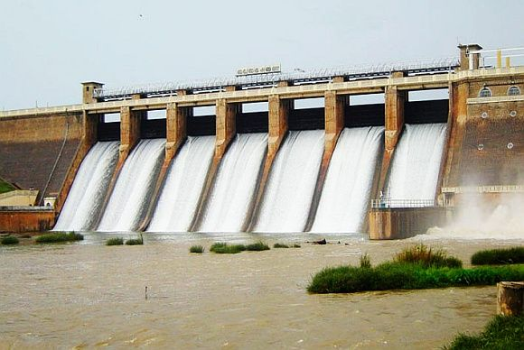
Organization transforms Force into usable Power
11
Notes:
Raw energy is generated by people -- like small children at purposeless play
Google harnesses the energy of internet search terms to create the largest advertising empire in the world USD $42.5 billion in 2012.

Slide 12
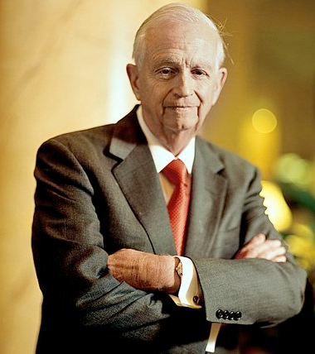
Organization channels and utilizes energy efficiently by differentiation of function
Bill Marriott
12
Notes:
Gladiator clip
Bill Marriott

Slide 13
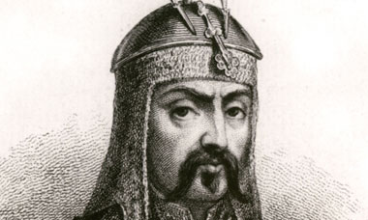
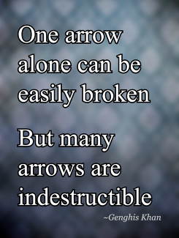
Organization coordinates energies and activities of many people and integrates them within a larger whole
Genghis Khan
13
Notes:
Genghis Khan
During the early 13th century the Central Asian plateau north of China was divided into numerous tribes or confederations – mostly organized to defend themselves against one another
Unable to unite they could only migrate continuously to escape the threat from the huge armies of Tartars and Chinese who occasionally came to dominate them.
Outcast from a small nomadic tribe, he united warring tribes of Mongolia into a single nation and the greatest military force of its time
Those who were excluded from any tribe lived without any protection and were victimized by any who found them.
His early successes enabled him to build the alliance from a few thousand warriors to 30,000 and later to 100,000 or more.
His conquest of Northern China made him the most formidable power in the region attracting more tribes to unite under his leadership
Later he turned his attention Westward to Uzbekistan, Persia, Afghanistan and conquered vast territories up to the borders of India.

Slide 14
Organization multiplies Interactions Interchange & Networking
Language organizes & energizes communication
Market organizes exchange & energizes production
Money organizes social power & makes it interconvertible
Technology organizes productive processes
Internet connects horizontally & integrates vertically all nodes, levels & types of social activity within a single global network
14
Notes:
Internet -- Wikipedia
Facebook
MOOCS
Coordinating horizontally and integrating vertically all activities, sectors, levels and spheres of global society as never before
Genghis was a master of military organization based on mobile nomadic social structure
Perfected art of horse warfare with unmatched speed, skill, discipline and coordination
Highly structured hierarchy of tumans of 10,000 men with subunits of 1000, 100 and 10
Created the largest horse cavalry ever known
Sophisticated systems for YAM communication, intelligence, logistics spanning 5000 miles
He established orderly trade from the Mediterreanean to the Pacific along the entire Silk Road
His empire covered 1/5th of humanity – more than Alexander and Caesar
His descendants conquered all of China and extended the empire through Russia, Ukraine, Georgia into Europe as far as Spain.

Slide 15
Organization magnifies the Energy it transmits by Integration
Linking activities through positive feedback loops of information and learning multiplies the efficiency and increases the scope
15
Notes:
The city is a physical center for integration of all human activities
Urbanization has become a global phenomena because of the attraction generated by the intense energy of urban life

Slide 16
Evolution of Organization creates Social Opportunity
Society is continuously evolving
The more we organize it, the faster society evolves
Each new link releases further energy and creates new needs and opportunities
Opportunity comes from identifying a missing link in the social organism and provide it
The gap between social advancement and social organization is a goldmine of opportunity
16
Notes:
Google, Wikipedia, Facebook,
Society is continuously evolving
The more we organize it, the faster society evolves
Organization can never keep pace
Today technological development outpaces our capacity for regulation
Each new link releases further energy and creates new needs and opportunities
Opportunity comes from identifying a missing link in the social organism and provide it
Sears did it by the money-back guarantee to instill trust
hotmail
iTunes
The gap between social advancement and social organization is a goldmine of opportunity
Sears mail order catalog
Fed X
Amazon
Google
Facebook

Slide 17
Organization supports growth and development of People
Continuous improvement and perfection
Development of specialized knowledge and skills
Fosters development of shared values and culture
Utilization of unique capacities of each member
Empowering the Individual
17

Slide 18
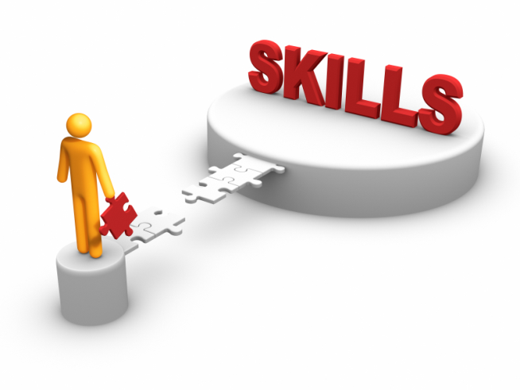
SKILLS ARE ORGANIZATIONS OF HUMAN ENERGY
SKILLS
TECHNICAL
ARTISTIC
ORGANIZATIONAL
PHYSICAL
SOCIAL
MENTAL
18
Notes:
Physical
Technical
Wozniak
Artistic
Jobs’ product design – show images
Pixar Toy Story designer
Social
Sears
Gandhi salt march
Organizational
Marriott
Mental
Rosenwald

Slide 19
Attitudes are organizations of Psychological Energy
LEADERSHIP
PSYCHOLOGICAL
SPIRITUAL VALUES
19
Notes:
Like traffic signals green or red
Leadership
FDR -- trust
Washington -- courage
Churchill -- courage
Psychological
FDR – fireside chat – great communicator
Woolman’s charm – sleeping on the job
Spiritual Values
Lincoln – freedom and unity
Jobs – simplicity, ease of use

Slide 20
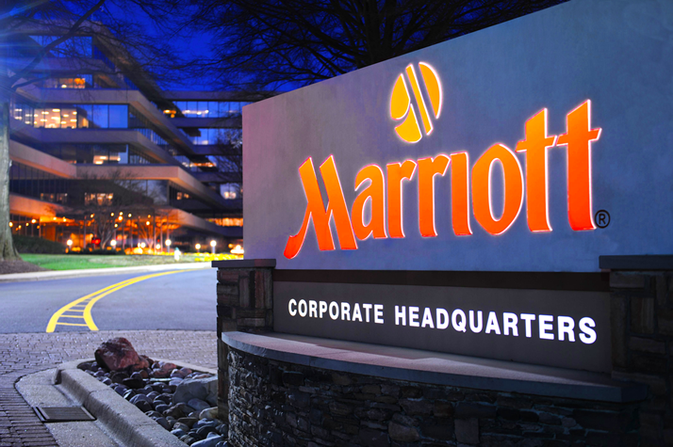
Organizations internalize skills & attitudes
20
Notes:
Marriott’s skill at site selection
Marriott’s attitude to employees
Sear’s attitude to customer

Slide 21
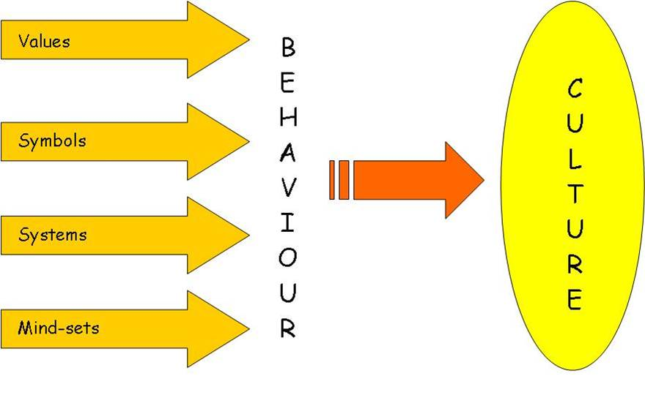
Culture expresses Energy as social skills & attitudes
21
Notes:
German precision
American enterprise
Indian generosity
Japanese honor

Slide 22
Organization generates Power
Skill is physical organization of physical energy
Attitude is vital organization of emotions
Understanding is mental organization of data and thoughts
Values are psychological organization of motives
22

Slide 23
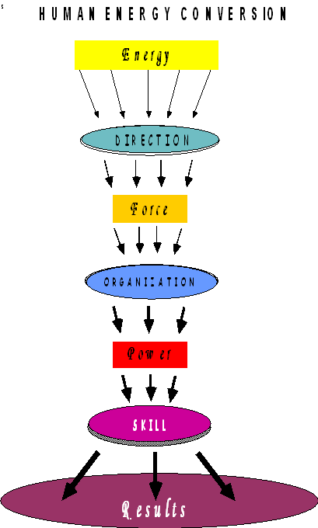
ENERGY CONVERSION FLOW DIAGRAM
23

Slide 24
Washington’s Personality
ENERGY
Intensely aspired to be a wealthy plantation-owner
Rejected, he joined the colonial rebellion
DIRECTION
His ideal was to be an English gentleman
His goal a career in the British army
CHARACTER
Fearless in battle
Instilled discipline & courage to raw recruits
Refused to overstep the authority given by Congress
Implicitly trusted for impartiality
Refused payment for 8 years of service
ATTITUDES & SKILLS
A good listener
Exhibited a remarkable capacity for self-sacrifice
Concern for his men won their loyalty
Shunned attention and popularity
Patience and endurance
24

Slide 25
Washington’s Accomplishment
His idealism inspired his troops to incredible self-sacrifice
Ill-equipped, half-starving, colonial militia fought the world’s best army to a stalemate
America outlasted the British by perseverance
He set a precedent for subordination of military to civilian rule in America
His personal values became those of America
25

Slide 26
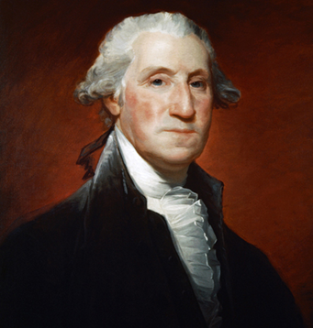
His Opponent’s Assessment
On conclusion of the war in 1783, Washington resigned his commission formally handing control of the military to the US Congress
George Washington
When told that Washington would return to his farm after winning independence, King George III replied incredulously, “If he does that, he will be the greatest man in the world.”
26

Slide 27
Cycle of Individual and Social Development
Progress of organization & society ultimately depends on the development of each of its individual members
The individual develops by raising his consciousness and organizing his personality at a higher level
The highest stage of organization of personality is what we mean by individuality
The formed individual is the catalyst for raising the consciousness and organization of society
27

