Slide 1
Trans-disciplinary Course on Science of Society IUC Dubrovnik September 1-6, 2014

Slide 2
Human Accomplishment
Accomplishment is a process of conscious purposeful human initiative leading to objectives sought after
Wealth, Status, Power
Peace, Prosperity, Harmony, Well-being
Knowledge, Truth, Beauty, Love
Self-realization and Spiritual Fulfilment

Slide 3
Human Accomplishment Two Perspectives
COURSE 1
Process of Individual Accomplishment
COURSE 2
Process of Social Accomplishment

Slide 4
Rationale for this Course
The multi-dimensional challenges confronting humanity today defy comprehension and resolution based on the prevailing principles and specialized knowledge developed by separate social science disciplines.
Knowledge which is power needs to evolve to keep pace with the evolution of society.

Slide 5
Multi-dimensional Social Evolution
Society is a rapidly evolving social context
Time: The pace of social development is unprecedented and accelerating
Space: Humanity is rapidly expanding from isolated and insulated local and national communities into a closely interconnected global community
Knowledge: These changes are driven by the expansion of knowledge of the world and our self-awareness as a species
Organization: Growing awareness at the collective level is spurring rapid development of social organization in all fields
Integration: Different fields and sectors of activity are becoming more closely integrated into a densely woven social fabric
Individuation: Human beings are becoming more individualized, i.e. the capacity of human personality is rapidly developing
Complexity: All these factors combine to increase social complexity of the challenges to understanding and effective action.

Slide 6
Multiple Forces
Social development is a product of interactions between multiple forces
INDIVIDUALS
Capacities, Intentions & Actions
ORGANIZATIONS & GROUPS
Formal & Informal
ENVIRONMENT
Geography & Spatial Relationships
SOCIAL & CULTURE MILIEU
Mental Concepts, Values & Ideals
LIFE EVENTS IN SPACE & TIME

Slide 7
Premises for a Science of Society
Mechanistic, reductionist, materialistic, compartmentalized social theory is inadequate to deal with the multi-dimensional complexity of social events and outcomes.
Society is a complex, open, multi-leveled, conscious, creative web of human relationships – a living organism.
Social science needs to unpack the significant characteristics that differentiate physical, biological and social systems.
The Individual occupies a unique position in society as both determinate and determination – as active pioneer and initiator of social novelty and as passive beneficiary of acquired social capacities.
An effective science of society would necessarily have to transcend disciplinary boundaries to identify principles & processes fundamental to all fields and forms of social activity, change, development and evolution.

Slide 8
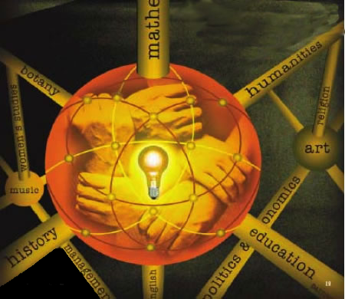
Trans-disciplinarity
“Concerns that which is at once between the disciplines, across the different disciplines, and beyond each individual discipline.”
Based on the premise that human society and individuality cannot be adequately understood in terms of positivism, reductionism, formalism and naturalism.
This implies that there are fundamental constructs, forces, processes and characteristics that underlie all social phenomena, knowledge of which can generate greater understanding and more effective action in the real world.
Notes:
B. Nicolescu,Manifesto of Transdisciplinarity, translated by K. Claire Voss(Albany:State University of New York Press, 2002),pp. 147-152.

Slide 9
Course Objectives
To look beyond the boundaries fixed by present concepts, theories and disciplines at the linkages and interdependences between different fields of social activity to identify points at which current theory can expand to encompass factors now regarded as externalities
To explore fundamental concepts, common principles and social processes applicable to all fields and levels of society
To clarity similarities and differences between the natural and social sciences that influence our approach to social science to draw relevant insights regarding the future development of social science
To integrate the role of the Individual in sciences of society
To re-examine assumptions about time and causality, including anticipation of the future
To develop common trans-disciplinary terminology, free as possible from discipline-specific terminology
To examine the prospects and requirements for evolving a trans-disciplinary science of society

Slide 10
New Paradigm in Economic Theory
Transdisciplinary Perspectives

Slide 11
Transdisciplinary Factors
Linkages between fields
Values
Knowledge – social construction of reality, rationality
Perception – trust, limits, opportunities & challenges
Social Power
Aspirations – energy
Relationships – Social Capital – social organization – networks -- subsidiarity
Human capital – Education – Skills
Individuality
Social Process of energy conversion
Limits to Rationality
Decision-making

Slide 12
Transdisciplinary Factors
Linkages between fields
Values
Knowledge – social construction of reality, rationality
Perception – trust, limits, opportunities & challenges
Social Power
Aspirations – energy
Relationships – Social Capital – social organization – networks -- subsidiarity
Human capital – Education – Skills
Individuality
Social Process of energy conversion
Limits to Rationality
Decision-making

