Slide 1

Social Capital: Theoretical and Practical Aspects
Zbigniew Bochniarz
University of Washington
Dubrovnik, September 5, 2014

Slide 2
Introduction
1. Defining Capital – Human and Social Capital
2. The Role of Social Capital (SC) in Economic Development?
3. How to assess or measure SC?
4. The Case of SC Assessment and Its Role in Regional Economic Development: The Aviation Valley Cluster/Network in Podkarpackie Region of Poland
Notes:
This is my 1st of 3 lectures focusing on social development from an economics perspective. The next will be on SC and on Sustainability.

Slide 3
Defining Capital
  From classical economists such as Adam Smith through neoclassical economists such G. Becker and T. Schultz – Capital is mainly defined as a stock of abilities to produce benefits – revenues, incomes or profits.
  In a comprehensive study on SC, Lin (2001) defines capital, as “investment of resources with expected returns in the marketplace” (Lin 2001:3).
  Four forms of capital: man-made (physical and financial), natural, human and social
Notes:
Human Capital is the ONLY creative capital – Khu – unique, genial artists or entrepreneurs; Khr – renewable; Khn- institutionized, non-renewable within one generation (well-established university, research institute)

Slide 4
Defining Human Capital - 1
  Human Capital (HC) presents the unique form of capital that has the ability to put other forms of capital – tools, infrastructure (man-made capital) and land (natural capital) in motion to produce goods & services and thus to create new values.
  The value of HC depends on the previous investments in developing new and useful knowledge, skills and attitudes.
Notes:
Human Capital is the ONLY creative capital – Khu – unique, genial artists or entrepreneurs; Khr – renewable; Khn- institutionized, non-renewable within one generation (well-established university, research institute)

Slide 5
Defining Human Capital - 2
  As any capital, it requires continuing investment in developing new knowledge and skills.
  Academia plays enormous role in building new human capital but its effectiveness depends on many other factors, including political system and culture, which could encourage or suppress critical thinking and creativity – the unlimited ability of this capital to create values.
Notes:
Human Capital is the ONLY creative capital – Khu – unique, genial artists or entrepreneurs; Khr – renewable; Khn- institutionized, non-renewable within one generation (well-established university, research institute)

Slide 6
Defining Social Capital - 1
Two basic approaches to Social Capital (SC):
  A private good [Bourdieu 1986, 1993, Coleman 1988, Portes 1998, Lin 2001]
  A collective or public good [Fukuyama 1997, 2000; Putnam 2000, 2003; Cook 2007; Huber 2008; Roman 2011]

Slide 7
Defining Social Capital - 2
  Private good [Bourdieu 1986, 1993, Coleman 1988, Portes 1998, Lin 2001]:
    For Bourdieu the social capital (SC) is a private investment in social networks that brings the owner expected benefits such as wealth, and “symbolic capital” – representing symbols of social position/strata.
    For Coleman as for the earlier sociologists the SC is first of all an individual good that could be however traded through the social networks for the advance of the human capital or get things done.
    Lin defines SC “investment in social relations with expected returns in the marketplace” (2001:19).

Slide 8
Defining Social Capital - 3
  A collective or public good [Fukuyama 1997, 2000; Putnam 2000, 2003, Huber 2008]:
    For Fukuyama the SC is “set of informal rules and ethical values common for social groups that enable them to act effectively.”
    For Putnam the SC does not belong to anybody but is a public good representing set of social norms and civic attitudes supporting common actions and trust – both interpersonal and in public institutions.
    Huber defines SC as “…resources embedded in social networks which can be potentially accessed or are actually used by individuals for action…” (Huber 2008:19).

Slide 9
Defining Social Capital - 4
Defining SC as a Public/Collective Good:
SC refers to “networks together with shared norms, values and understanding that facilitate cooperation within or among groups.” [OECD 2001]
SC capital is defined as “institutions, relationships, attitudes and values that govern interactions among people and contribute to economic and social development.” [Grootaert & van Bestelaer, World Bank 2002]

Slide 10
Defining Social Capital - 5
Defining SC as Collective/Public Good:
SC…”is defined as the application or exercise of social norms of reciprocity, trust and exchange for political or economic purposes.” [Cook 2007: 102]. He also stated that in knowledge-based industries businesses are more engaged in building and performing SC that the average industries.
SC – a system of social relationships based on trust and working according to well-known rules [Roman 2011]
Rosenfeld (2003) summarized the notion of SC in clusters that gives opportunities to “know-who” leading to build “know-how.”

Slide 11
Defining Social Capital - 6
SC is a special type of capital resulting from investments in building relations, institutions and networks that produce collaborative attitudes, shared norms and values, mutual understanding and trust – critical factors for cooperation with other types of capital and thus contributing to sustainable development.

Slide 12
Classifying Social Capital
  There is positive and negative SC [Rosenfeld 2007]:
  Positive SC create economic advantages that are major forces for clustering
  Negative SC could start developing when there are efforts to limit membership in clusters and cultivate insularity or lock-in (2007, 20).

Slide 13
The Role of SC in Economic Development: Clusters
  Defining clusters:
Clusters - geographic concentrations of interconnected companies, specialized suppliers, service providers, firms in related industries, and associated institutions that can cooperate and compete in particular fields [Porter 2008: 213].
Notes:
Organic clusters vs. constructed clusters <= natural economic process vs. designing; Clusters vs. Cluster initiatives.

Slide 14
The Role of SC in Economic Development: Clusters
Classifying clusters:
  Natural resource-based clusters
  Local clusters
  Trading clusters
Dynamics of cluster development:
  Functional cluster
  Working cluster
  Cross-fertilizing clusters
Notes:
From Marshallian through Porterian to Jacobsian externalities

Slide 15
Functional Clusters, Clumps, and Working Clusters (D. Andreoli)
Functional Clusters - spatial networks of like and functionally linked industries
Clumps - groups of functionally linked firms in which the physical distance separating member firms does not prohibit the range of benefits that are made possible through frequent interactions
Working clusters - made up of firms and institutions which benefit from the types of integration and cooperation made possible through co-location

Slide 16
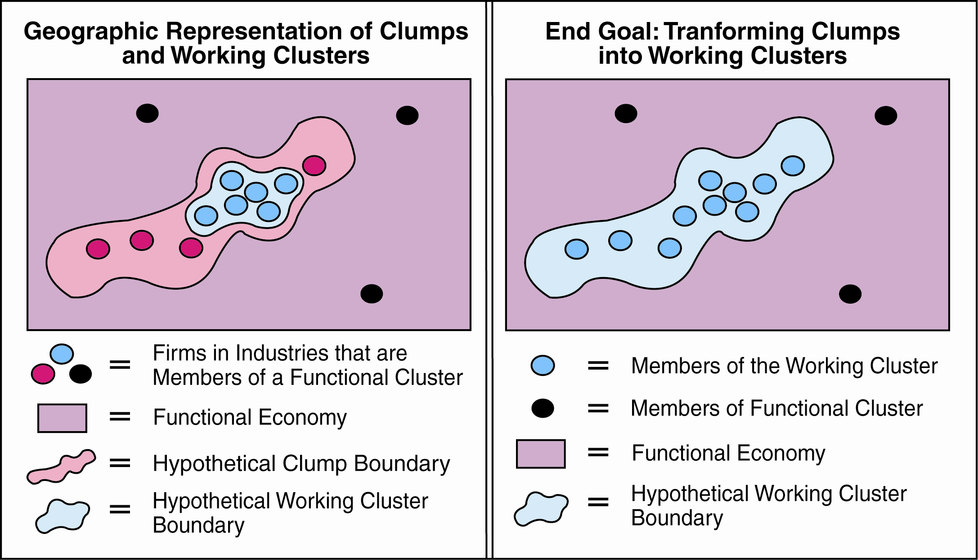
Functional Clusters, Clumps, and Working Clusters
(D. Andreoli)
From a geographic perspective:

Slide 17
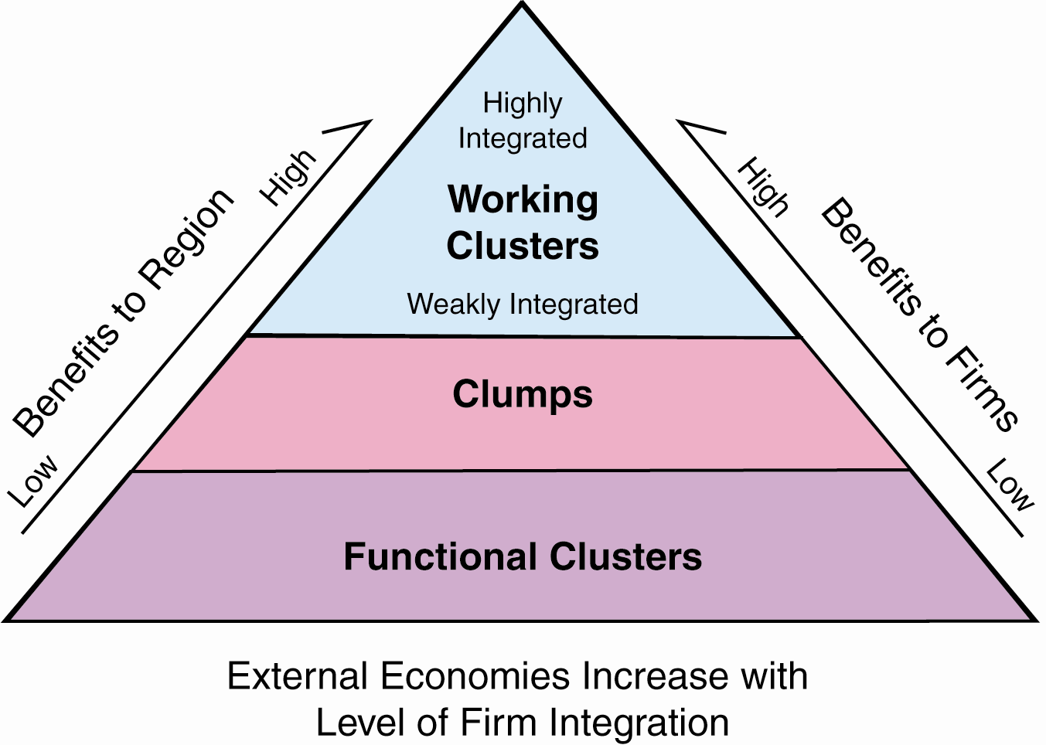
Functional Clusters, Clumps, and Working Clusters
(D. Andreoli)
The goal of any cluster initiative is to promote economic development by encouraging the positive externalities that come from integration (i.e. promote integration)

Slide 18
The Role of SC in Economic Development: Clusters
What Makes the Working Cluster?
• Functional Cluster
Social Capital => Cooperation=> Synergy=>Positive Externalities=>
Knowledge Spillovers=>Innovations
• Working or Effective Cluster

Slide 19
What Makes the Working Cluster?
• Functional Cluster
Social Capital => Cooperation=> Synergy=>Positive Externalities=>
Knowledge Spillovers=>Innovations
• Working or Effective Cluster

Slide 20
The Role of SC in Economic Development: Clusters
Working definition of an “effective cluster:”
Effective cluster is defined as a cluster, which is characterized by rich SC that enables all participants efficient cooperation among them leading to generating maximum of positive externalities coming not only from co-location (Marshallian externalities) but also from building collaborative synergy (Porterian externalities) and openness for cooperation with other clusters (Jacobsian externalities) leading to knowledge spillovers and innovations.

Slide 21
Measuring SC
The economic value of SC depends on time invested in developing institutions, networks, relations, attitudes and trust within the a certain group of people (from family, through firms, cluster, region, nation to global community) Bochniarz (2010)
Similar approach proposed C. Roman (2011) with a set of complex indicators assessing its value mainly through surveys
The project should adapt the concrete set of measures and apply in the Podkarpackie Region to verify its usefulness.

Slide 22
Measuring SC according to C. Roman

Slide 23
Four groups of indicators measuring SC:
  Indicators measuring associations.
  Indicators measuring trust.
  Indicators measuring existing institutions.
  Indicators measuring results.

Slide 24
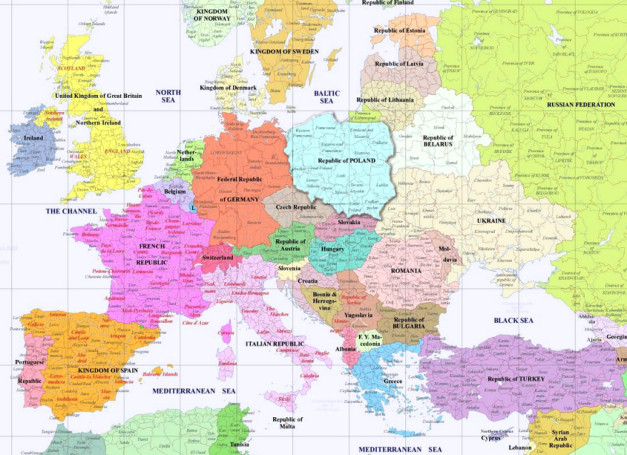

GEOGRAPHIC LOCATION
CENTRAL/EASTERN EUROPE

Slide 25
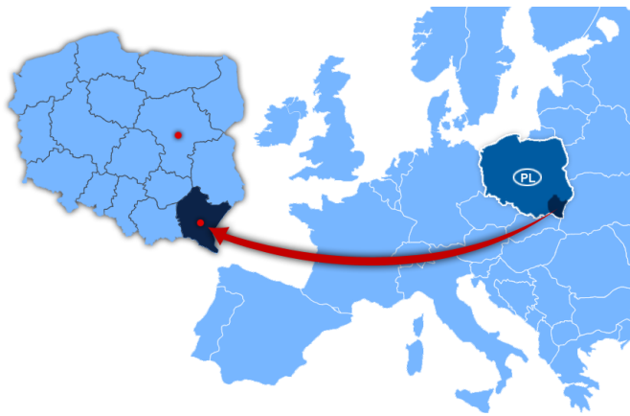

Slide 26
Statistics
Area: 17 846 km²
Population: over 2 million
Density of population: 113 pers./ km²
Urban population is 41,5% of the region’s population
Largest cities: Rzeszów (183 thousand), Przemyśl, Stalowa Wola, Mielec , Tarnobrzeg , Krosno
Population under the age of 25: 36 %
In total: 150,5 thousand enterprises
(small 94%, medium 5 %, large1%)
Average monthly salary (gross) in industrial sector: ca 1000$

Slide 27
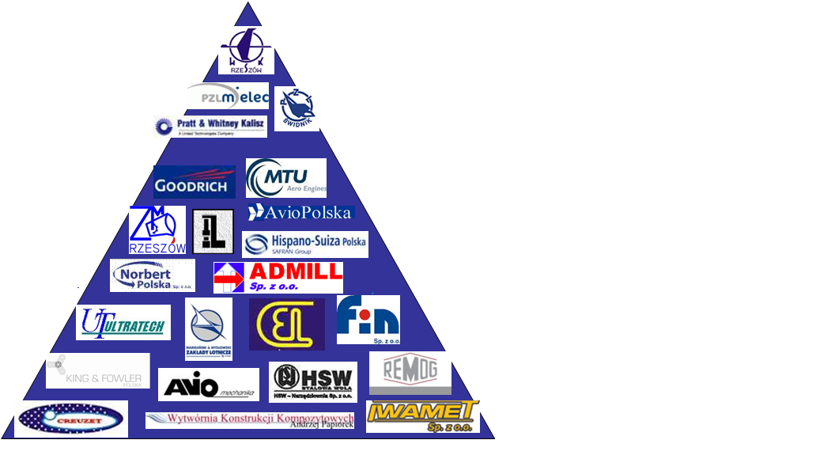
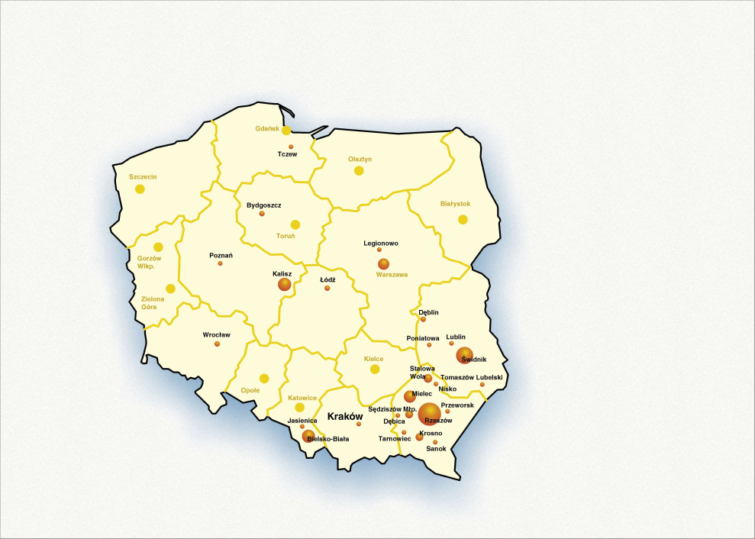

Aviation Valley cluster
> 1000 | 6
500 -1000 | 10
200 - 500 | 16
50 - 200 | 36
< 50 | 51
2003 2014
Number of enterprises 18 119
Employment 9 000 23 000

Slide 28

STRUCTURE
OEMs/ large aerospace
companies
Medium size production
companies
Small production
companies
R&D institutions/
engineering companies
General aviation
companies
Special processes companies
Flight schools/
personel trainning
Regional Development Agencies/
Technology Parks
Tooling companies
Consulting/ bussiness
support companies
Transport/ logistic
companies
Equipment/ material
suppliers

Slide 29
Three hypotheses to be verified:
Hypothesis 1: The process of cluster development from its functional stage to the stage of the effective cluster is strongly influenced by increases in social capital.
Hypothesis 2: The integration process of a cluster fueled by SC has a positive effect on its economic performance.
Hypothesis 3: The progress in cluster development accompanied by growing SC contributes to the sustainability of the regional economy.

Slide 30
Initial Research Results from the Podkarpackie Region
Hypothesis 1:
Top leaders invested 12.5% of their time for cluster activities – about $900,000 in 2013.
Regular monthly meetings, established many working groups to resolve emerging problems and/or respond to future challenges and opportunities.
The number of cluster members has increased from 18 in 2003 to 120 in 2014.
The total value of SC created in 2013 was 3,180,000PLN = $1mln
Conclusion: Investing in SC supports integration of the cluster and increases its synergies and positive externalities

Slide 31
Initial Research Results from the Podkarpackie Region
Hypothesis 2:
The cluster has been growing drastically, with sales quadrupling during the period of 2003–2008 (PAIZ, 2012).
This unprecedented dynamic is closely tied to FDI, since the majority of sales came out of companies that were privatized by large multinational corporations.
Conclusion: Progressing integration of the cluster improves its economic performance.

Slide 32
Initial Research Results from the Podkarpackie Region
Hypothesis 3:
The vast majority of the AV products and services were exported to the most competitive economies securing relatively high level of salaries of their employees and thus contributing to the wealth of their families
The prospering AV companies contribute systematically to regional communities.
The total sales of the AC exceeded $1 billion in 2012.
Conclusion: Progress in cluster development accompanied by growth of its SC contributes to sustainable development of the whole region.

Slide 33
Some of the Additional Questions
How the New Theory of Networking (NTN) contributes to building/strengthening SC and speeding up the process of transformation from Functional to Effective Cluster with maximum of synergetic impact?
Could we apply NTN to better measure SC and thus performance of clusters?
Using NTN could we develop a meta-methodology of cluster evaluation?

Slide 34
Thank you for your attention!
Questions please.

