Slide 1
Trans-disciplinary Course on Science of Society IUC Dubrovnik September 1-6, 2014

Slide 2
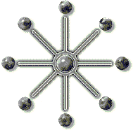
Rationale for this Course
The multi-dimensional challenges confronting humanity today defy comprehension and resolution based on the prevailing principles and specialized knowledge developed by separate social science disciplines.
Knowledge which is power needs to evolve to keep pace with the evolution of society.

Slide 3
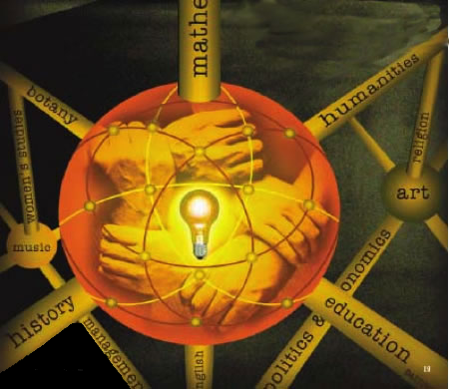
Trans-disciplinarity
“Concerns that which is at once between the disciplines, across the different disciplines, and beyond each individual discipline.”
Based on the premise that human society and individuality cannot be adequately understood in terms of positivism, reductionism, formalism and naturalism.
This implies that there are fundamental constructs, forces, processes and characteristics that underlie all social phenomena, knowledge of which can generate greater understanding and more effective action in the real world.
Notes:
B. Nicolescu,Manifesto of Transdisciplinarity, translated by K. Claire Voss(Albany:State University of New York Press, 2002),pp. 147-152.

Slide 4
Course Objectives
To look beyond the boundaries fixed by present concepts, theories and disciplines at the linkages and interdependences between different fields of social activity to identify points at which current theory can expand to encompass factors now regarded as externalities
To explore fundamental concepts, common principles and social processes applicable to all fields and levels of society
To clarity similarities and differences between the natural and social sciences that influence our approach to social science to draw relevant insights regarding the future development of social science
To integrate the role of the Individual in sciences of society
To re-examine assumptions about time and causality, including anticipation of the future
To develop common trans-disciplinary terminology, free as possible from discipline-specific terminology
To examine the prospects and requirements for evolving a trans-disciplinary science of society

Slide 5
Fundamental Questions
What are the similarities and differences between the natural and social sciences which impact on future development of the social sciences?
What is the nature of the relationship between the different fields of social science that are traditionally regarded as separate subjects?
How do developments in each field interact with its development in other fields?
What common underlying principles govern the operation and development of apparently separate and disparate fields of society?
What is the role of the individual in development of society?
What is the role of ideas and values in the development of society, by what process do they act, and what accounts for their remarkable power?
What is the relationship between objective external social reality and subjective human perception and will?
How do social constructions of knowledge, individual motives, differences in social attitudes and cultural values impact on diverse operations of society?
What are the stages in the growth, development and evolution of society?
What impact might an integrated science of society have on public policy and social strategies for addressing fundamental global challenges?

Slide 6
Summary of Conclusions
Mechanistic, reductionist, materialistic, compartmentalized social theory is inadequate to deal with the multi-dimensional complexity of social events and outcomes.
Society is a complex, open, multi-leveled, conscious, creative web of human relationships – a living organism.
Social science needs to unpack the significant characteristics that differentiate physical, biological and social systems.
The Individual occupies a unique position in society as both determinate and determination – as active pioneer and initiator of social novelty and as passive beneficiary of acquired social capacities.
An effective science of society would necessarily have to transcend disciplinary boundaries to identify principles & processes fundamental to all fields and forms of social activity, change, development and evolution.

Slide 7
Multiple Forces
Accomplishment is a product of interactions between multiple forces
INDIVIDUALS
Capacities, Intentions & Actions
ORGANIZATIONS & GROUPS
Formal & Informal
ENVIRONMENT
Geography & Spatial Relationships
SOCIAL & CULTURE MILIEU
Mental Concepts, Values & Ideals
LIFE EVENTS IN SPACE & TIME

Slide 8
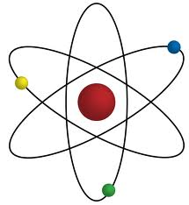
Is Accomplishment a Science?
Are their common underlying principles applicable to accomplishment in all fields?
Is there a common process applicable to all types of accomplishment?
What is the relationship between individual, the organizational and social accomplishment?

Slide 9
Faculty
Janani Harish
Alberto Zucconi
Mila Popovic
Ivo Slaus
Roberto Poli
Winston Nagan
Zbigniew Bochniarz
Ian Johnson
Karl Wagner

Slide 10
Panelists
Masa Anisic
Olena Bekreniova
Goran Bandov
Gadija Kahn
Ashok Natarajan
Sasa Popovic
Mura Palasek
Rodica Stephanescu
Dana

Slide 11
MSS Staff
Vasugi Balaji
M. Chandrasekaran
Latha Chandrasekaran
Shweta Rangan
Ranjani Ravi
Vani Senthil
Ranganayaki Somaskandan

