Slide 1
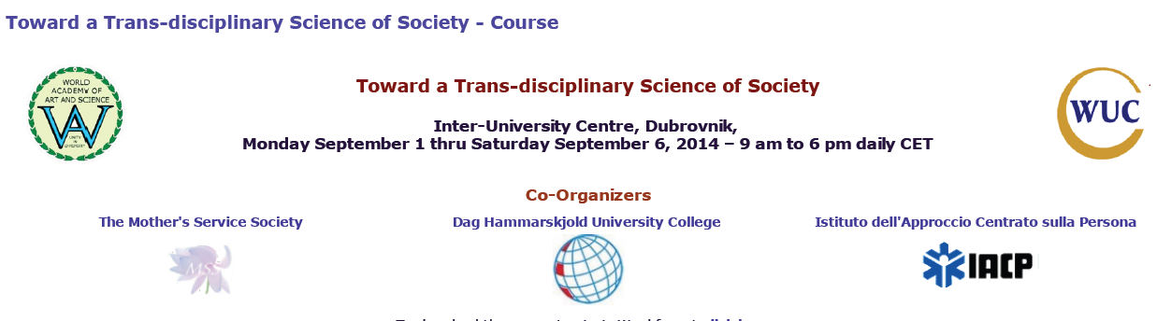
Sustainable Societies: Theory and Practice
Zbigniew Bochniarz
University of Washington
Dubrovnik, September 6, 2014

Slide 2
Introduction
1. Defining Sustainability, Sustainable Development (SD), Sustainable Business and Sustainable Societies
2. How to assess or measure SD?
3. The Case of Social Progress Index
Notes:
This is my 1st of 3 lectures focusing on social development from an economics perspective. The next will be on SC and on Sustainability.

Slide 3
What is Sustainability?
Often the term sustainability is used as:
  a substitute of sustainable development (Adams 2006)
  an intergenerational equity (Ott 2003)
In fact the sustainability applied in many disciplines means maintaining a state of a dynamic balance of a system with its major elements interacting with each others and its relations with the higher system

Slide 4
What is Sustainability?
In biological system sustainability is related to securing necessary diversity and reproductive capacity.
For the global environment sustainability means that that Earth basic ecosystems are dynamically balanced and life on the planed is secured.
For human beings, sustainability means the long-term maintaining their carrying capacity that secures their non-declining wealth and reproduction:
  limitation to natural endowments (natural capital) making the foundation for carrying capacity
  securing intergenerational equity (Pezzey & Toman 2002).

Slide 5
Defining Sustainable Development
Economists have addressed conceptual problems of sustainable development (SD) with respect to inter-generational equity (Solow, 1974; Hartwick, 1977), by requiring non-declining resource endowment and introducing the “Hartwick rule.”
The UN World Commission on Environment and Development report defined SD as “development that meets the needs of the present without compromising the ability of future generations to meet their own needs” (Brundtland, 1987, p.43)

Slide 6
Main Stakeholders of SD
Governments
Companies
NGOs
Academia
Media
Citizens
International Institutions

Slide 7
Defining Sustainable Business
Sustainable business (SB) often defined also as green business means an enterprise that is environmentally friendly – globally and locally- socially responsible and is economically sound
For that reason SB is also described as an enterprise that strives to meet the triple bottom line

Slide 8
Defining Sustainable Business
In popular definition endorsed by IUCN (Adams, Jeanrenaud 2008), the SB or green business should match the following four criteria (Coon 2009):
  (1) It incorporates principles of sustainability into each of its business decisions.
(2) It supplies environmentally friendly products or services that replaces demand for non-green products and/or services
(3) It is greener than traditional competition
(4) It has made an enduring commitment to environmental principles in its business operations

Slide 9
Defining Sustainable Business
From economic point of view, the SB means an enterprise that maintains its competitive advantage coming from its unique value chain (Porter 2008)
It requires strategic approach to SB including value chain and diamond of competition (Porter & Kramer 2006)

Slide 10
Two Types of Competitive Advantage (M. Porter)

Slide 11
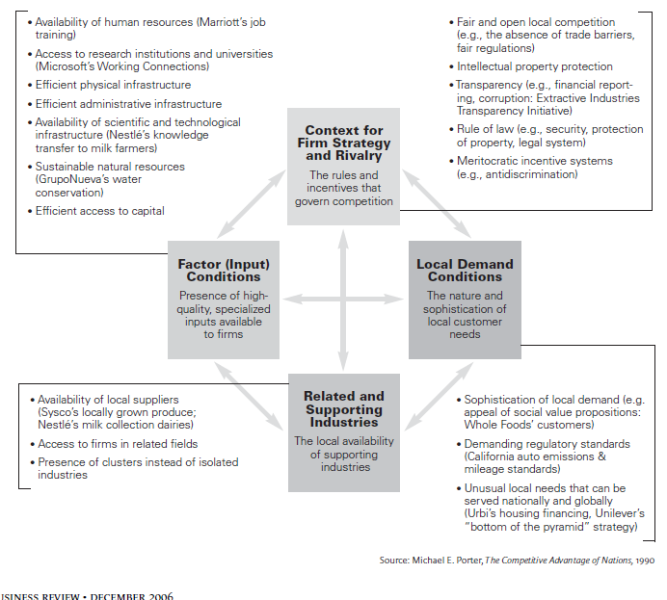
How to Teach Sustainability?

Slide 12
Defining Sustainable Business
From economic point of view, the SB means an enterprise that maintains its competitive advantage coming from its unique value chain (Porter 2008)

Slide 13
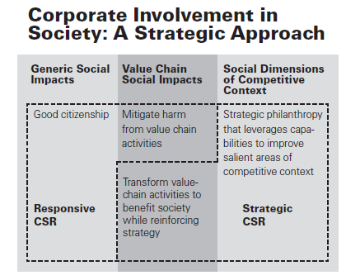
M. Porter & M. Kramer- Strategy & Society –HBR 2008

Slide 14
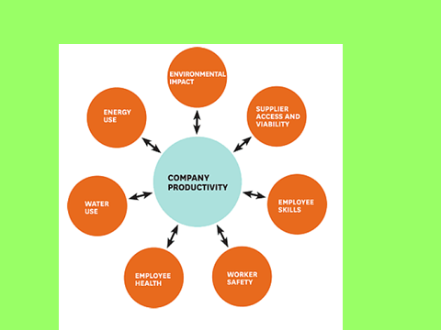
M. Porter & M. Kramer- The Big Idea: Creating Shared Value –HBR 2011

Slide 15
Sustainable Society
A sustainable society is one that ensures the health and vitality of human life and culture and nature’s capital, for present and future generations. Such a society acts to stop the activities that serve to destroy human life and culture and nature’s capital, and to encourage those activities that serve to conserve what exists, restore what has been damaged, and prevent future harm (Viederman 1993:34).

Slide 16
Two Basic Approaches to Assess Sustainability
Maximizing Wealth vs. Non-Declining Total Capital
Strong, weak and environmental sustainability
Applying John HARTWICK’s rule (1977): “constant level of consumption could be maintained perpetually if all the scarcity rents were invested in capital.” after Tietenberg 2008

Slide 17
Evaluating Sustainable Development: Non-Declining Wealth vs. Non-declining Total Capital
Non-declining Wealth:
  a. Non-declining income per capita (mostly GDP –PPP- per capita)
  b. Non-declining genuine (adjusted net) savings (GDS or ANS)
GDS indicator (Pearce 1994):
GDS = GDP – C - Kmf D + EdI - EngD – MinD – ForD – CDD
Where:
GDS genuine domestic savings
GDP gross domestic product
C annual consumption
Kmf D capital fixed depreciation
Ed I education expenditure (investment in human capital)
EngD energy resource depletion (depreciation of natural capital)
MinD mineral resource depletion (depreciation of natural capital)
ForD forest depletion (depreciation of natural capital)
CDD damage to the environment due to carbon dioxide emission (depreciation of natural capital)

Slide 18
ANS - the Adjusted Net Savings indicator,
GNS - Gross National Savings,
Dh - depreciation of produced capital,
CSE - current non-fixed capital expenditures on education,
Rπ,i - rent from natural capital depletion,
CD - damage from carbon dioxide emissions,
GNI - Gross National Income at market prices.
Notes:
The CEE10 achieved about 10% of their net savings – similar level as the EU15.

Slide 19
Assessing the Transformation Impact on Sustainability: Adjusted Net Savings

Slide 20
Assessing the Transformation Impact on Sustainability: GDP per Capita (PPP)

Slide 21
Assessing the Transformation Impact on Sustainability – Average Life Expectancy at Birth

Slide 22
Assessing the Transformation Impact on Sustainability: Social Aspects
Infant Mortality Rates

Slide 23
Assessing the Transformation Impact on Sustainability: Political Aspects based on the Freedom House Indexes

Slide 24
Evaluating Sustainable Development: Non-Declining Wealth vs. Non-declining Total Capital
Non-declining Total Capital
(Bochniarz & Bolan, 2005, expanding concepts of Solow,1974; Hartwick, 1977; and Pearce, 1989)
TK = Km + Kn + Kh + Ks = constant (non-declining)
Where:
  Km = Kmf + Kmo (man-made physical and financial)
  Kn = Knu + Knr (unique and renewable natural capital).
  Kh = Khi + Khr (institutionalized and renewable human capital)
  Ks = Kso + Ksn (old, inherited and new, needed at a current stage of development social capital).

Slide 25
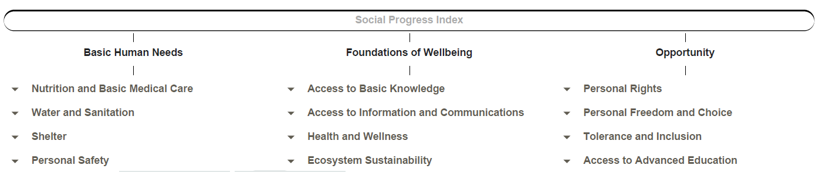
Notes:
Inspired by works A. Sen, D. North and J. Stieglitz – calculated by academic staff from MIT, Harvard and Columbia Universities.

Slide 26
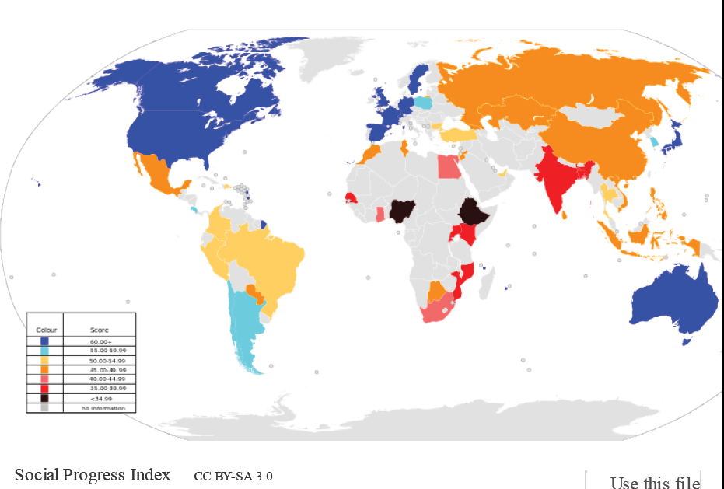
Notes:
From Wikipedia

Slide 27
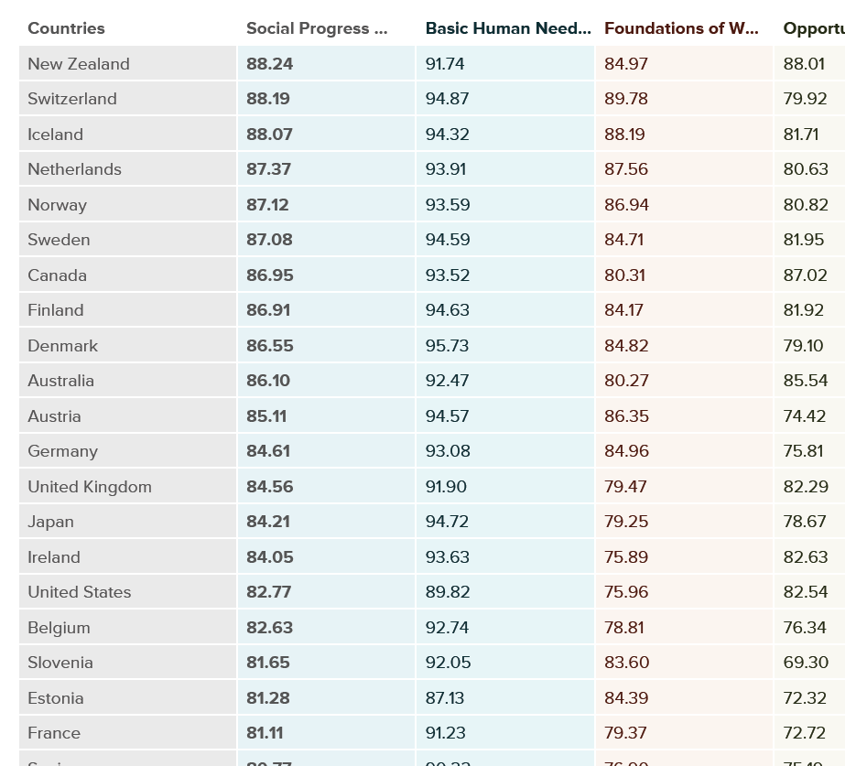

Slide 28
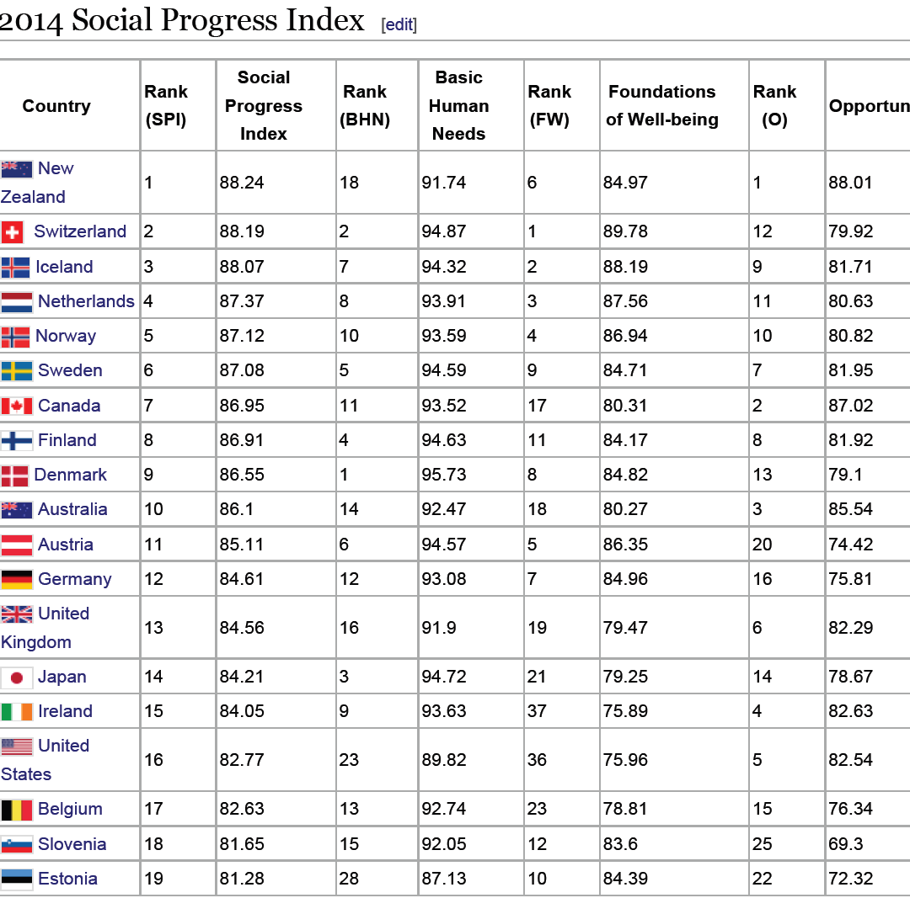

Slide 29
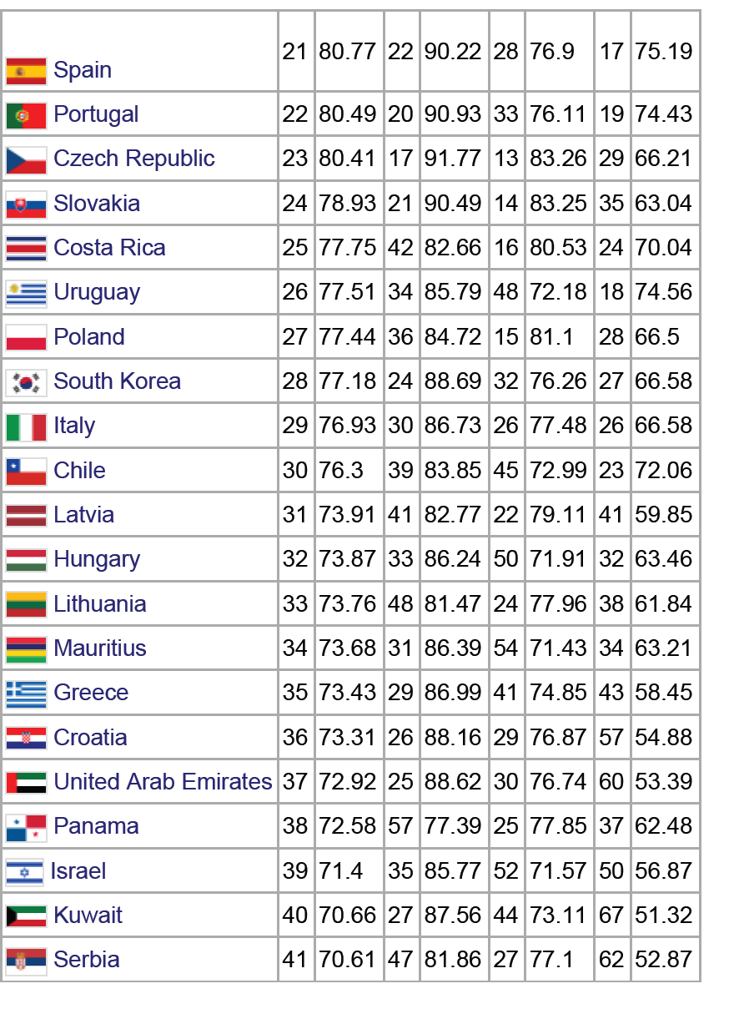

Slide 30
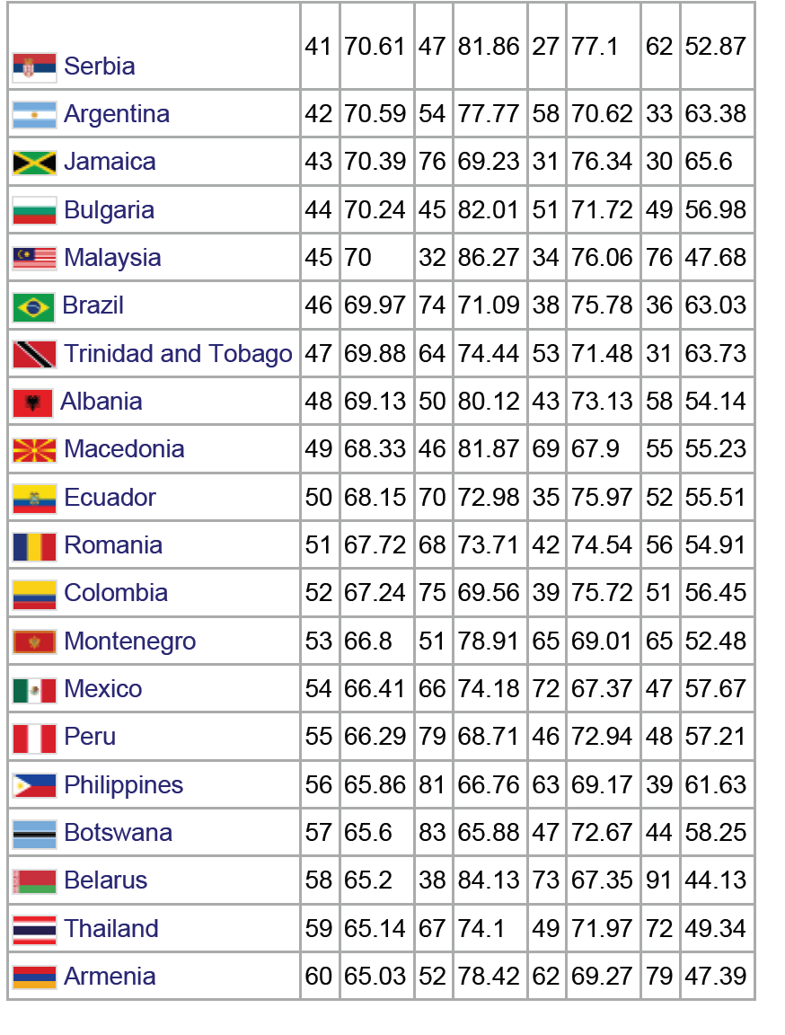

Slide 31
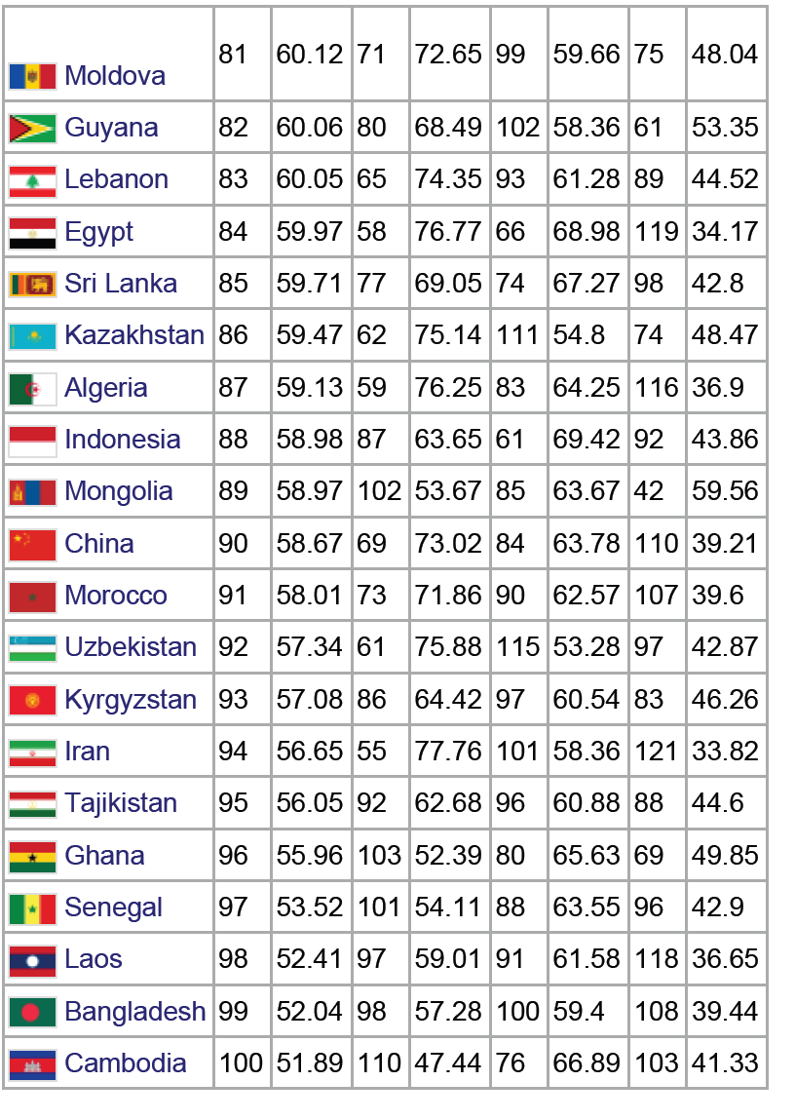

Slide 32
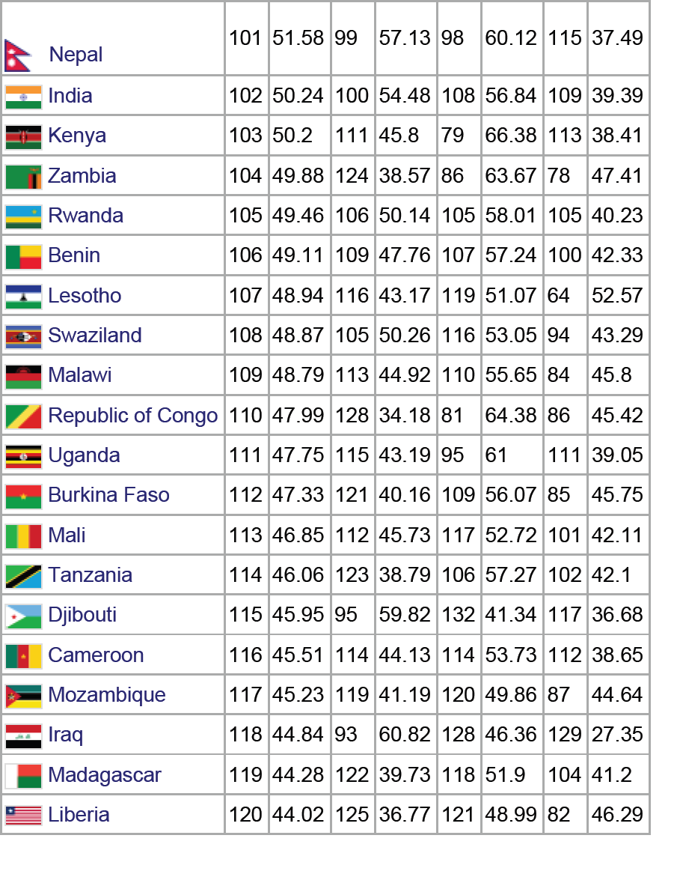

Slide 33
