Slide 1
A New Paradigm
Yes, but for what?

Slide 2
A New Paradigm
Yes, but for what?
Our Planet?
Human Civilization
All Human Civilizations
Our Civilization?
Our Culture?
The m/I Form of Civilization

Slide 3
A New Paradigm
Yes, but for what?
Our Planet? No, the planet is fine.
Human Civilization Yes, but don’t start here.
All Human Civilizations In time, but see above.
Our Civilization? Too vague to be useful.
Our Culture? In part, but not the core issue.
The m/I Form of Civilization YES.

Slide 4
Forms of Civilization
Co-Creative
Cultures
300 Years
?
Modern/Industrial
Cultures
1000 Years
?
Regional Empires
2,500 Years
?
Ag. Settled Cultures
5,000 Years
?
190,000 Years
Tribal Cultures
-200,000 -10,000 -/+ 2011 2200 2500

Slide 5
Perspective
We are facing a
paradigm change of our
modern/Industrial
form of civilization.
And…
we do not yet know this.

Slide 6
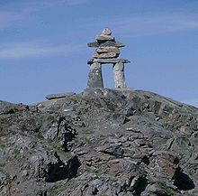
Over to YOU!
Our Future is in Your Hands, Minds and Hearts
Thank you

Slide 7
Contact
Ruben Nelson
Executive Director
Foresight Canada
29 des Arcs Road
Lac Des Arcs, AB, Canada, T1W 2W3
1-888-673-3537 = voice
403-673-2114 = fax
rubennelson@shaw.ca

