Slide 1
New Paradigm for Human Development Social Innovation November 7, 2014 by: Adam Koniuszewski, CPA, CFA

Slide 2
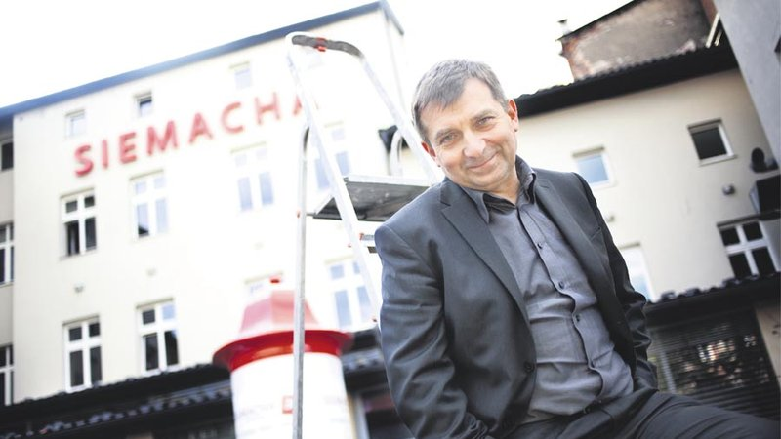
www.siemacha.org.pl

Slide 3
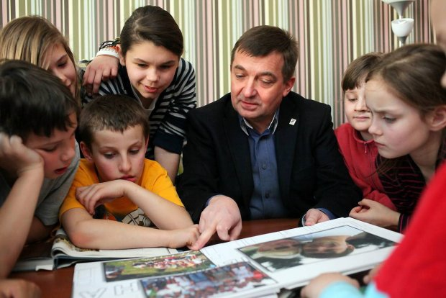

Slide 4
Siemacha Youth Centers
Education
Sport
Therapy

Slide 7
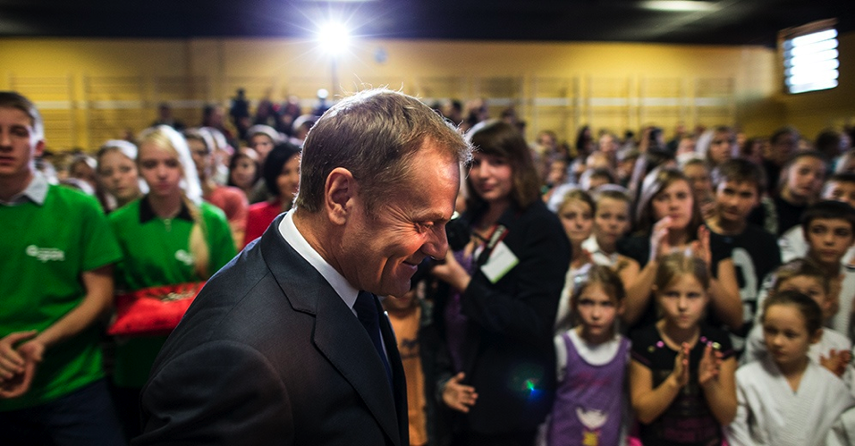
Polish Prime Minister visits “Siemacha”

Slide 8
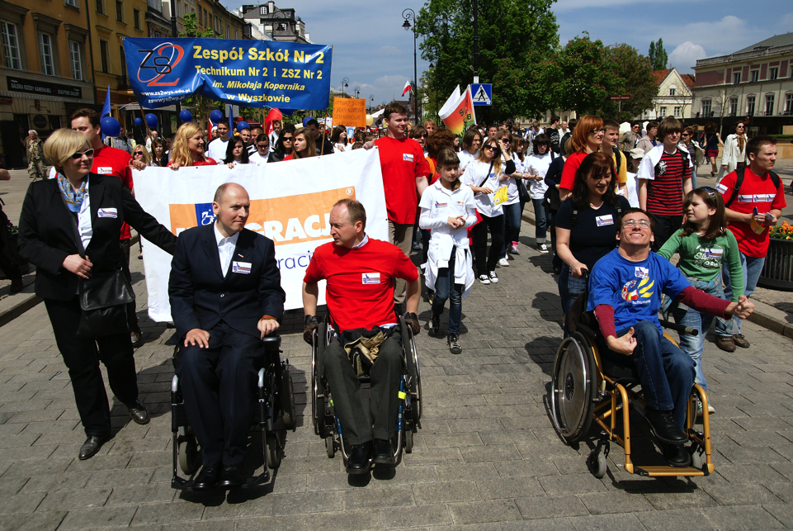
www.integracja.org

Slide 9
Tri-Sector Athletes
Private Sector
Civil Society
Public Sector
Passion, Commitment & Discipline
McGill University, Anita Nowak

