Slide 1
First International Conference on ANTICIPATION
5-7 November 2015, Trento (Italy)
Anticipation as the central element for the working of individual minds and whole societies
Knud Thomsen, Paul Scherrer Institut, Switzerland, knud.thomsen@psi.ch

Slide 2
Overview of the talk:
Ouroboros Model
sober Motivation & background
General layout
Consumption Analysis
Concept Formation
Attention as focused anticipation
Emotion as evaluated anticipation
Problem Solving using the past to anticipate the future
Envisioning the future relies on schemata from the past
Example: communication as dynamically shared and updated anticipations
Example: Justice shows importance of wide-ranging consistency
Shedding light on questions of a „Discipline of Anticipation“
Future

Slide 3
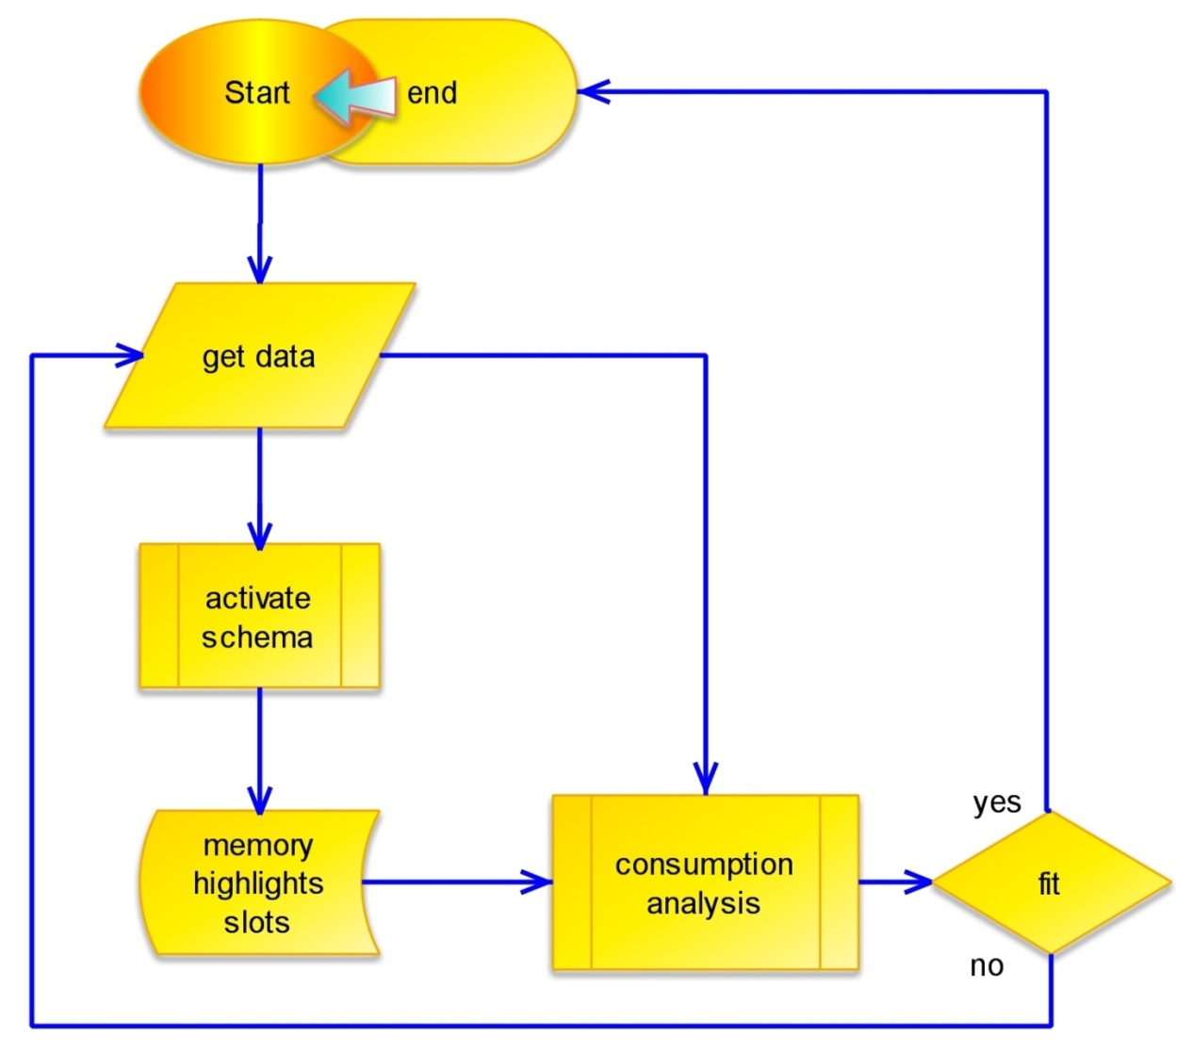
active !
Basic Loop Structure of the Ouroboros Model
Thomsen, K. The Ouroboros Model in the light of venerable criteria. Neurocomputing 74, 121-128, 2010.

Slide 4
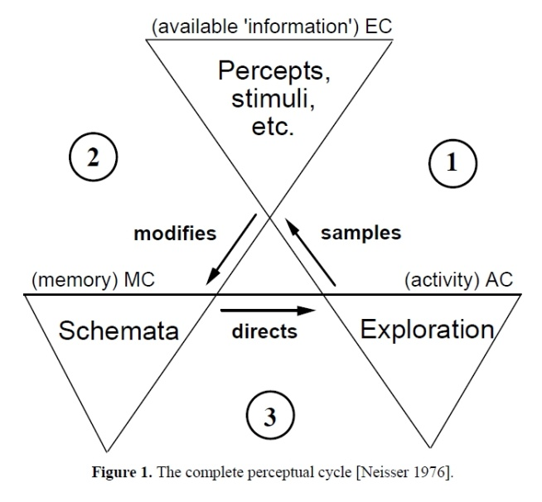
The Ourobors Model, Main Features, I
The Ouroboros Model proposes a dynamic and self-organizing cognitive architecture with the backbone of one fundamental recursive algorithm in the form of an
extended action / perception cycle :
.…anticipation,
action / perception,
evaluation,
anticipation,...
Not restricted to a single brain but applicable to groups and societies…

Slide 5
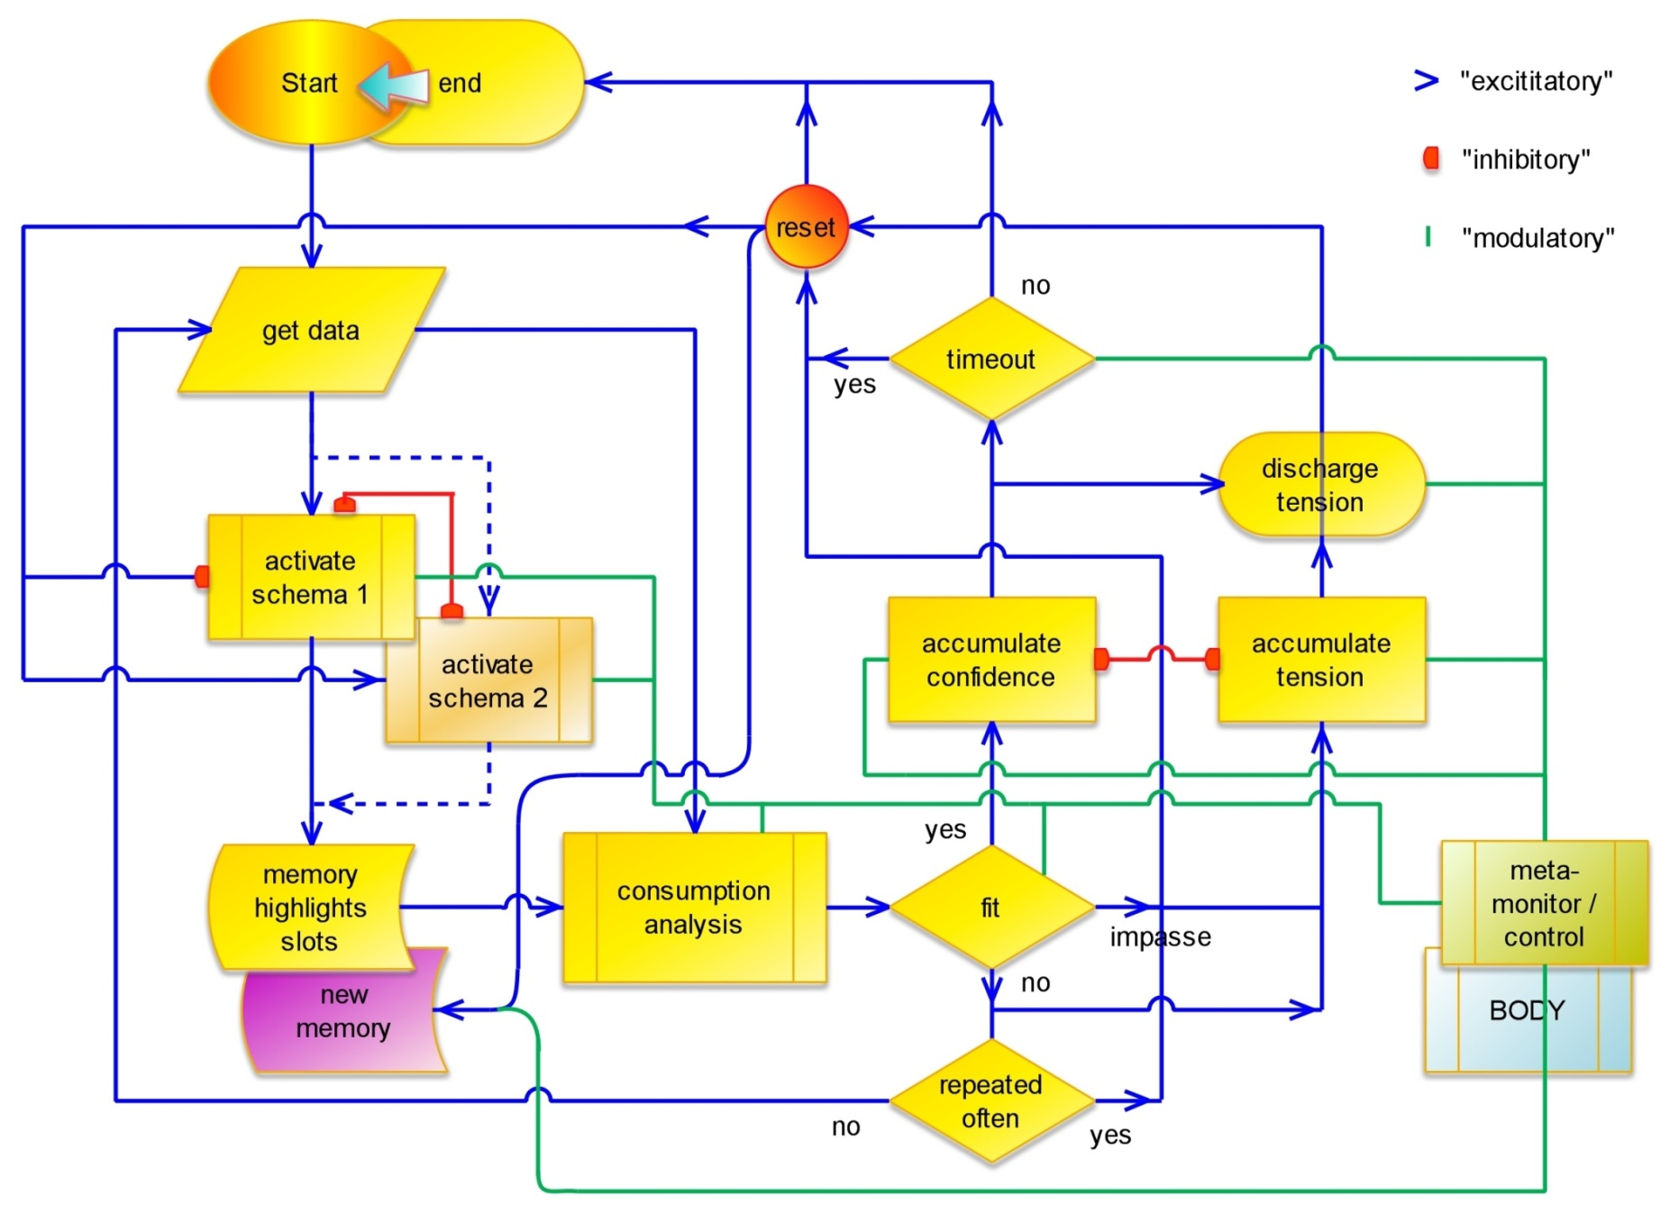
Loop augmented with mechanisms for flexible schema selection and the recording of likely useful new memories including self monitoring by keeping track of the current performance

Slide 6
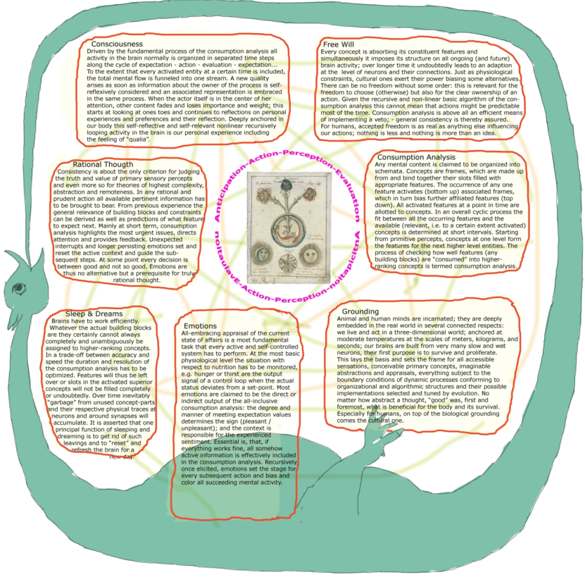
The Ouroboros Model, Main Features, II
All concepts are stored in (non-strict hierarchy of) SCHEMATA, i.e., frames.. with features linked together
Activation of any one feature biases associated ones, i.e. provokes expectations
A monitoring loop “CONSUMPTION ANALYSIS”
checks the fulfillment of these expectations
Expectations can be violated, met, exceeded;
feedback = EMOTIONS
Feedback directs Flow of Activity

Slide 7
Representations are being built up
3 Regimes, i.e. Outcomes of the Consumption Analysis:
„attentive“
Everything fits (=> new memory entry)
A good portion of all (relevant) activity
can be satisfactorily “consumed”
Nothing fits (=> new memory entry)
„attentive“
In addition are associations and categorizations
gradually distilled from the statistics of co-occurrences
(e.g. abstract concepts, similar to evolution, e.g. of apriori,
novel cateories can develop as “buds”),
„pre-attentive“
all of this similar for diverse levels of abstraction
Thomsen, K. Concept Formation in the Ouroboros Model, Third Conference on Artificial Gerneral Intelligence, Lugano, Switzerland, March 5-8, 2010.

Slide 8
In real life, i.e., in direct action in the world,
as well as in discourse (and thought):
Attention as focused anticipation:
Consumption Analysis highlights slots of the activated schemata and thus directs Attention to the most urgent issues
The general level of match together with inherited Importance give a measure for the Relevance of an issue.

Slide 9
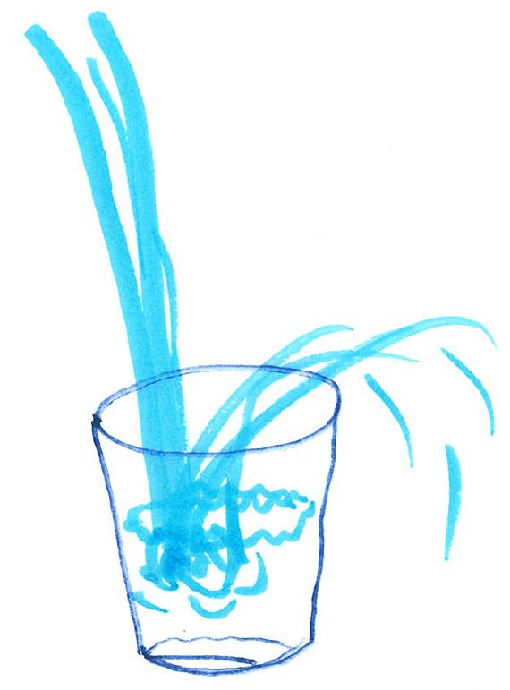
Emotions derived from evaluated anticipations:
When filling in anything into whatever structure, monitoring how it fits appears as the most obvious things to.
Feedback allows for optimization during the process, it sets the optimum stage for the next actions.
Feeling as a measure of the goodness of fit are the other side of the coin, a necessary ingredient for rational behavior!

Slide 10
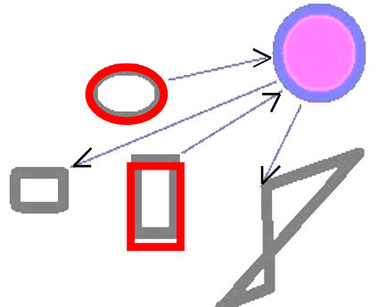
Problem Solving:
The Algorithm underlying the Ouroboros Model can be seen as a specific version of pattern matching and constraint satisfaction.
It can also be understood as an extension of production systems, any feature can serve as a starting point for activating a schema.
Combining this way prior Knowledge with new data yields Bayesian Performance.

Slide 11
Present
Present
past
future
„use the past to understand the present“
„use the future to understand the present“
use the past to anticipate the future
and the whole picture to act in the present

Slide 12
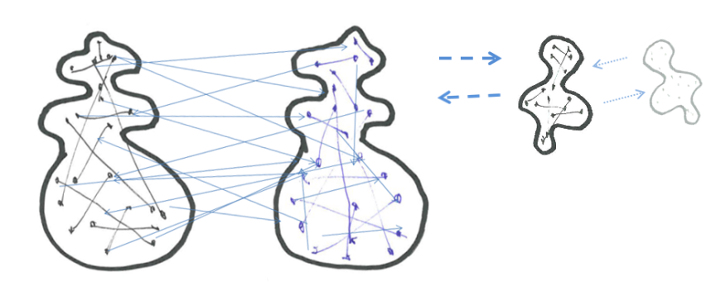
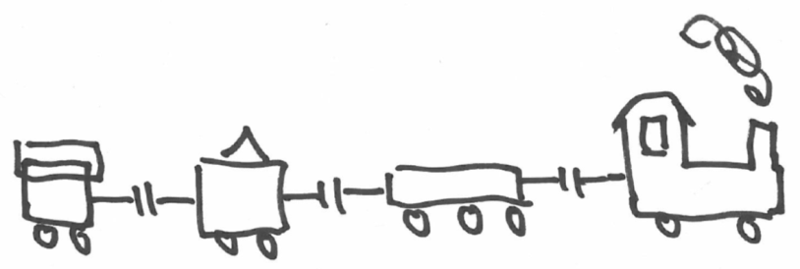
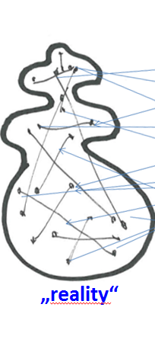
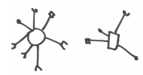
Example, Communication:
Interactive
situated & mainly involving
abstract representations
one
common
„reality“
All discourse takes place in nested loops and relies on some shared rules,
it cannot work without a minumum of common reference (and grounding)
Thomsen, Knud (2015), The Ouroboros Model embraces its sensory-motoric foundations and learns to talk, STUDIES IN LOGIC, GRAMMAR AND RHETORIC 41 (54): 105-125.

Slide 13
Example, Justice:
The Ouroboros Model sees justice as an abstraction from repeated occasions where human actions effecting other humans give the good feeling of a well-balanced exchange, relations and (social) structures
justice
What ought I to do ?
Kant’s answer, the Categorial Imperative,
in the light of the Ouroboros Model
is nothing else but
a general consistency condition,
with no particular preferred individual.
There is nothing like «Absolute Justice»,
decisive is the shared intention of improving, anticipating a common world with a general appreciation of personal dignity and actions compatible with survival and progress
(not «ought» can be derived from «is», but «ought not»)
Try to be consistent in the best, i.e. widest possible relevant frame…
Thomsen, Knud (2015), Gerecht und tolerant aus Vernunft und Eigeninteresse, feet firmly on the ground and the head in the sky, work in progress

Slide 14
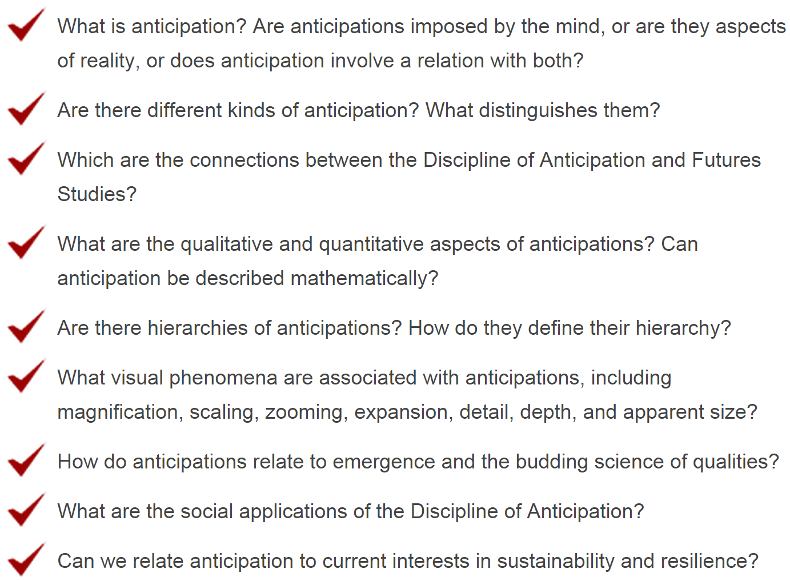
Key questions:
Proposals from the Ouroboros Model
All of this
not really
All is built on / with material from the past
Yes, to be worked out
Yes, heritage from schemata
All of these plus, e.g., priming
Work in progess, (positive) perspective is decisive !

Slide 15
The potential mental processing power of an agent is ground-laid in knowledge, i.e. the number, complexity
and elaboration of the concepts at her disposition
Schemata, their number of slots, the level of detail, the depth of hierarchies, degree of connection and interdependence of the building blocks, and the width,
i.e. the extent of main schemata and their total coverage from the grounding level to the most abstract summits, determine what can be thought of efficiently
quasi-global Adequacy, Coherence & Consistency are crucial
Sheer performance at a single point of time arises as a result of the optimum interplay between these structured data and the effective execution of all the described processing steps, in particular,
self-referential consumption analysis (..anticipation..)
..there are constraints from implementational details

Slide 16
In the Ouroboros Model inherent meta-cognition effectively allocates resources (no exotic metaphysics needed).
The Ouroboros Model is self-referentially consistent & autocatalytic, i.e., the proposed structures and effects are resulting from and also resulting in these very same concepts and consequences when implementing the proposed processes.
In particular, there is no problem with circularity:
The principal recursive algorithm progresses and evolves in time. When the snake bites its tail, the teeth and the tip of the tail belong to two distinctly different points in time. Starting with any basic set of expectations, discrepancies arising with actual input data can be determined and used for choosing and steering the following actions, including the establishment of revised structures & expectations / anticipations.
Widely separated questions can be tackled with just one approach; this is taken as one of the main arguments for the specific structures and processes of the Ouroboros Model.

Slide 17
Thank you for your attention !
and feel cordially invited
to collaborations

Slide 19
Approach of the Ouroboros Model:
Taking fresh look at the BIG PICTURE
Avoid getting bogged down in details
Observing different levels of analysis:
functional (‘computational’)
algorithmic
implementational (D. Marr)
Grounding provides the basis (embodied & embedded)
(S. Harnad, L. Barsalou)

Slide 20
The Ouroboros Model can be seen as a direct generalization of the Comparator Model where the comparison between expectations and actual data
happens on a component- / feature-level
All features linked together into one coherent schema
are considered in parallel, embedded into an overall serial process and progressing from one iteration to the next
The outcome of one cycle can most effectively be used for deriving a feed-back signal telling how well the overall process runs and whether the actor faces a new situation or a problem; subsequent steps are directed efficiently towards a relevant / promising goal
This self-steered principal activity cycle is the same when applied to external stimuli during perception as for active movements and as well for mental activity like memory retrieval or problem solving (top-down & bottom-up)

Slide 21
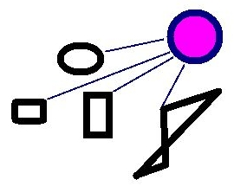
One concept with features
There are many of them
A whole concept gets biased,
empty slots are highlighted
Input excites some features

Slide 22
Checking for fitting input
Comparing result / expectation
EMOTIONS
EMOTIONS
Include highlighted features
in new input
Pointing out discrepancies
continue

Slide 23
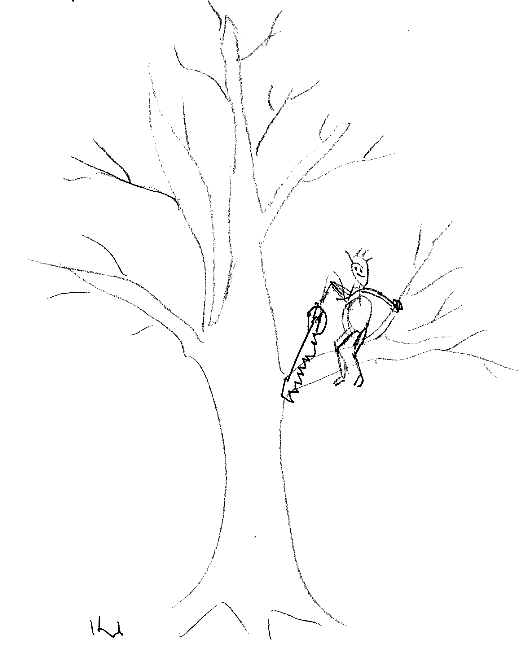
inspiration
(A lack in self-awareness can easily become costly to an agent in the real world)
An agent will be called stupid, if he unwittingly works against his (important) goals and self-interest, not considering information, which is (easily) available.

Slide 24
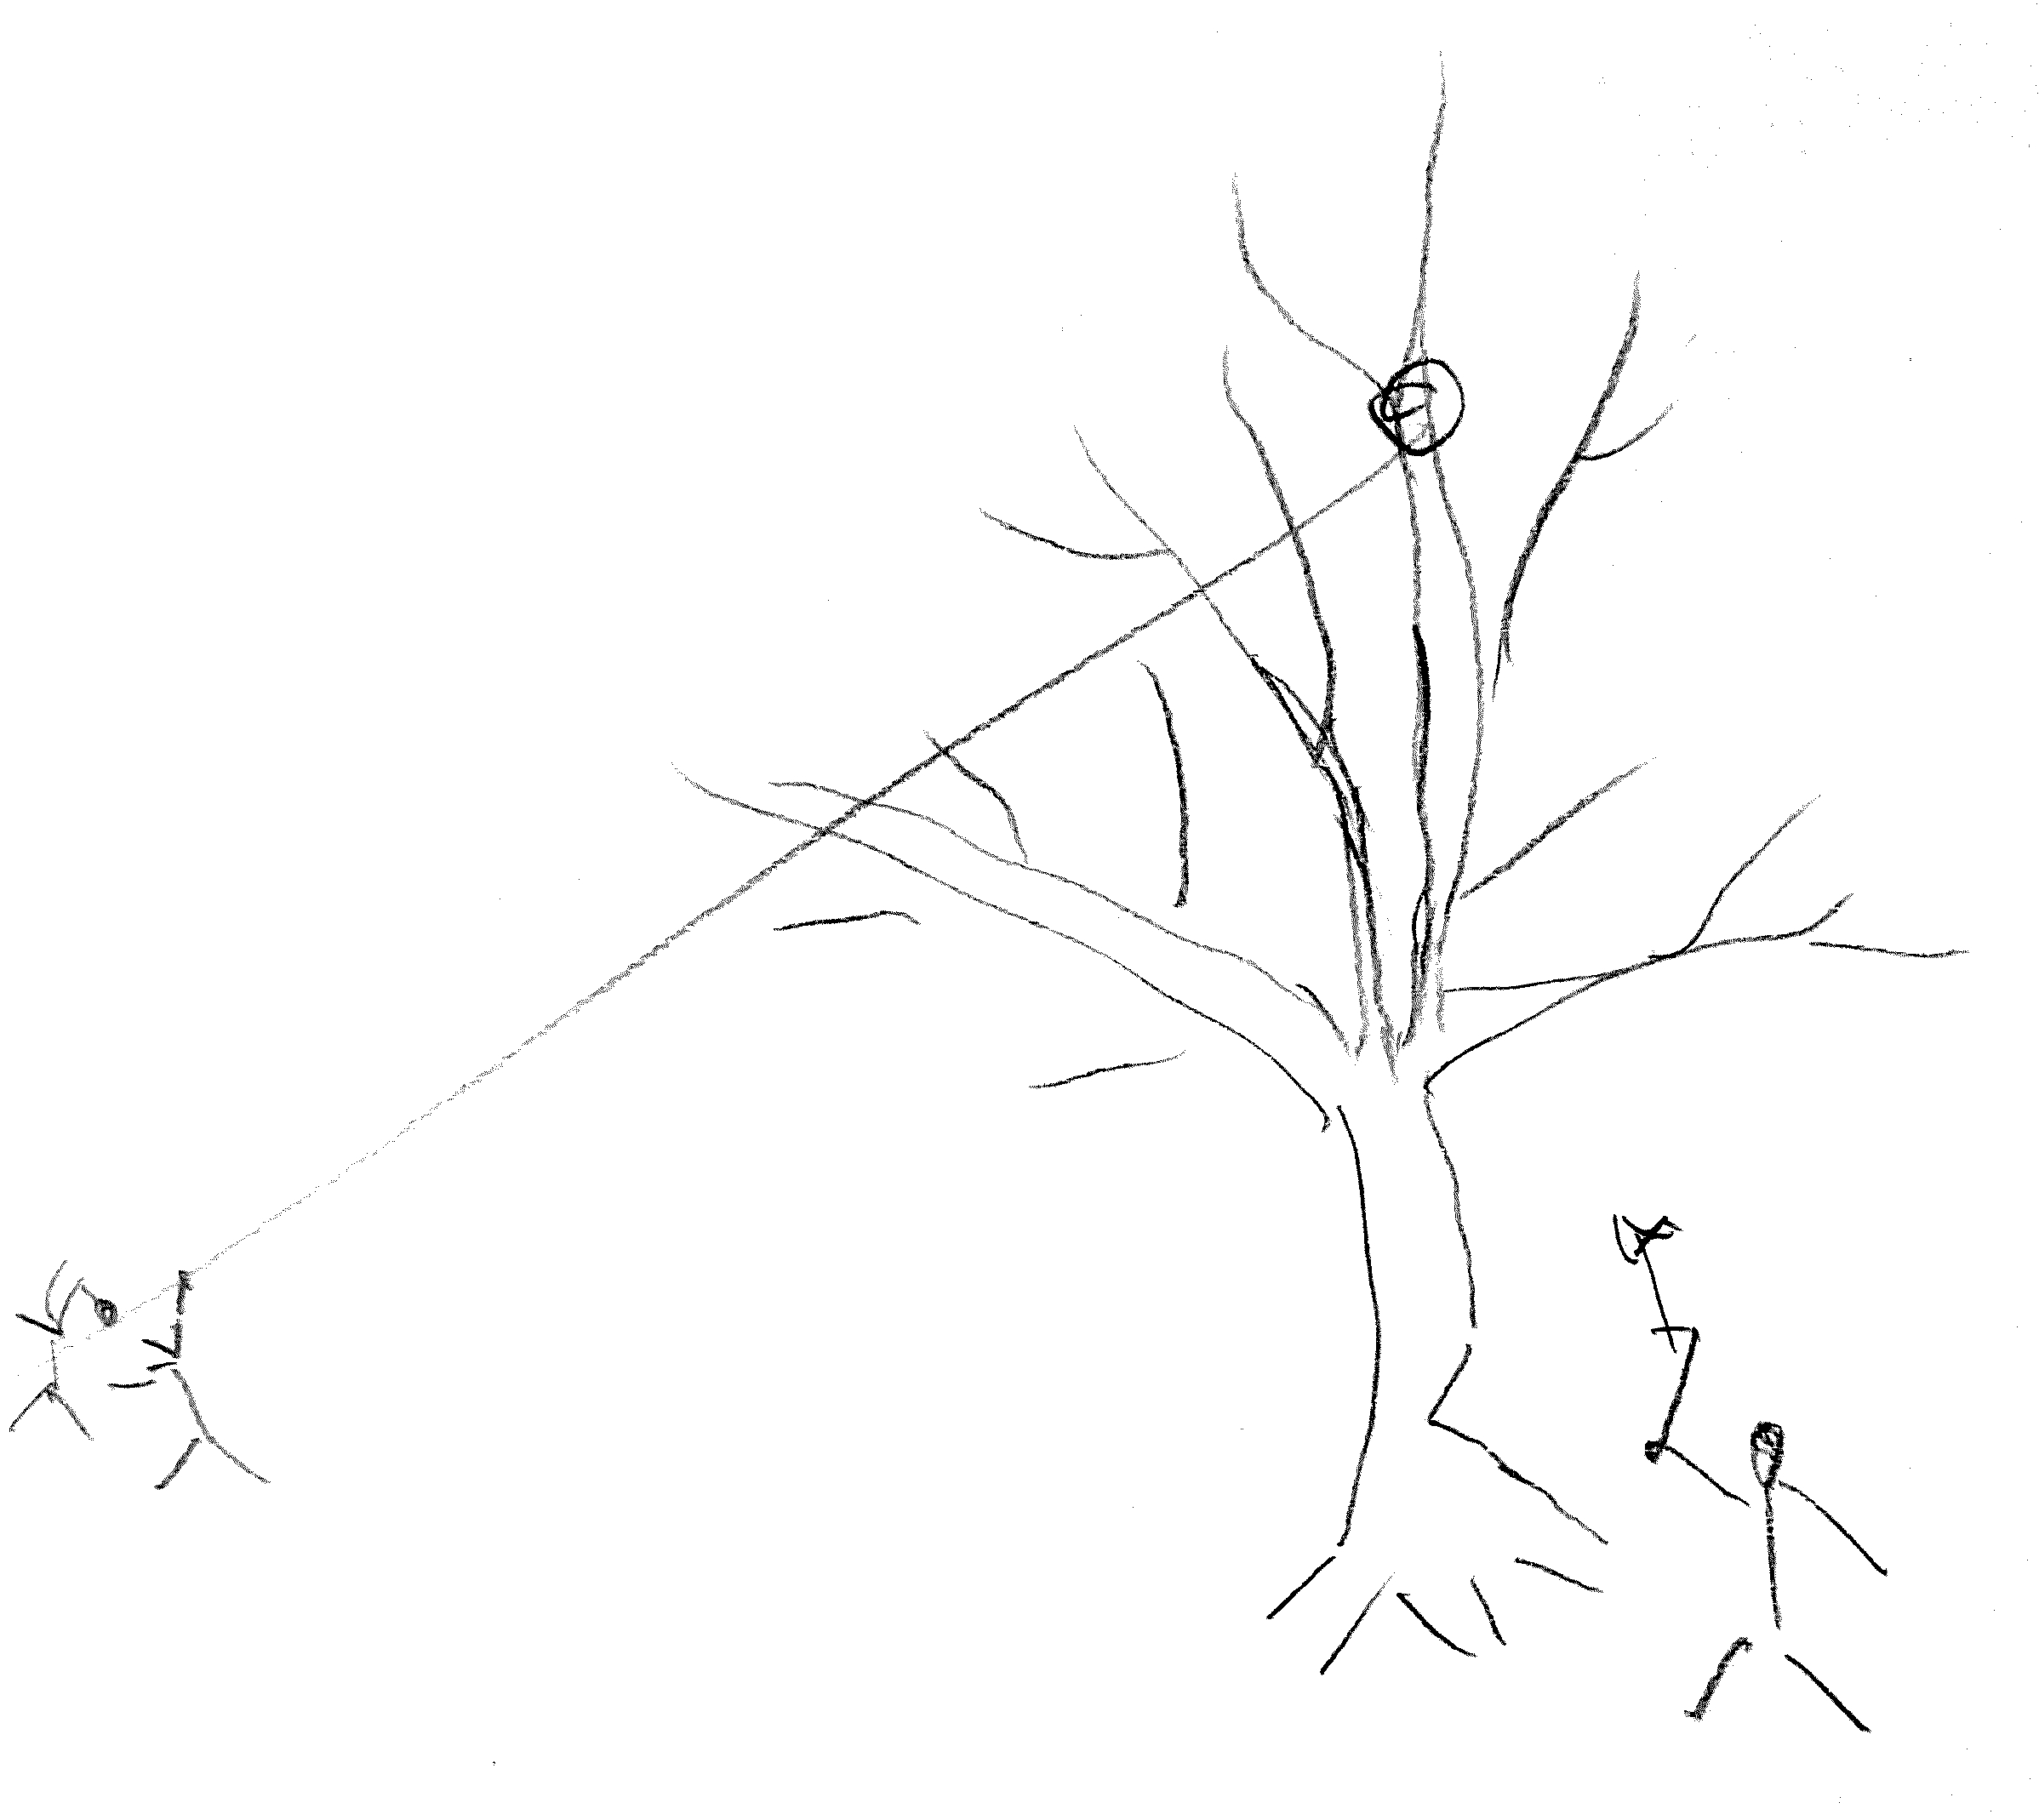
Clever is, who applies an understanding as wide as possible, chooses appropriate tools as available and accepts help from friends.

Slide 25
Learning, Cognitive Growth:
Attention, Concept Formation and –Refinement is directed to the topics where they are most needed.
The whole process is self-steered and self-controlled.
New concepts are grounded and meaningful, - for an individual actor.
By providing suitable opportunities, teaching can be made effective.

Slide 26
This account is claimed to explain these suggested effects & mechanisms:
Location priming
Semantic enhancement
Masking due to overlapping features
Negative congruency effects
Attentional blink
(resource depletion,
processing bottleneck,
temporary loss of control)
SOS (satisfaction of search = difficulty to detect 2nd target)
Thomsen, K. The Ouroboros Model, Selected Facets. In: C. Hernández et al. (eds.)
From Brains to Systems. New York Dordrecht Heidelberg London: Springer, 239-250, 2011.

Slide 27
This account is claimed to combine many suggested functions of emotions:
Alarm / ‚reset‘ function
Motivation
Body responses
Feeling
Impact on memory
Information to agent
Communication
(for agent herself and for others)
Thomsen, K. Cognition According to the Ouroboros Model, B. Hu et al. (Eds.): BI 2011, LNAI 6889, Springer-Verlag Berlin Heidelberg, 2011.

Slide 28
What can I know ?
The Ouroboros Model offers a comprehensive account
Thomsen, K. Knowledge as a Basis and a Constraint for the Performance of the Ouroboros Model, presented at a workshop at ZiF in Bielefeld, October 29-31, 2009.
Thomsen, K. Consciousness for the Ouroboros Model,
Journal for Machine Consciousness, 3, 163-17, 2011.

Slide 29
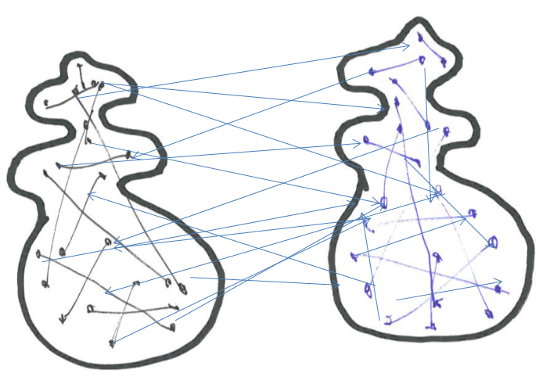
Each part of a schema, in particular, external structures (their percepts!) e.g. affordances can suffice to activate the full script (its representation!)
in tight interplay:
„representation“ – actor!
„reality“
„mind“
N. Hartmann (1935)
H. Haken (1977)
„life“
„things“
any of the links can be claimed as fundamental
all of this is in some sense „individual“
Multi-compound structures & representations are essential,
„models“ i.e. schemata determine what „exists“ (I. Kant)
The Ouroboros Model advocats some „enlightened realism“

Slide 30
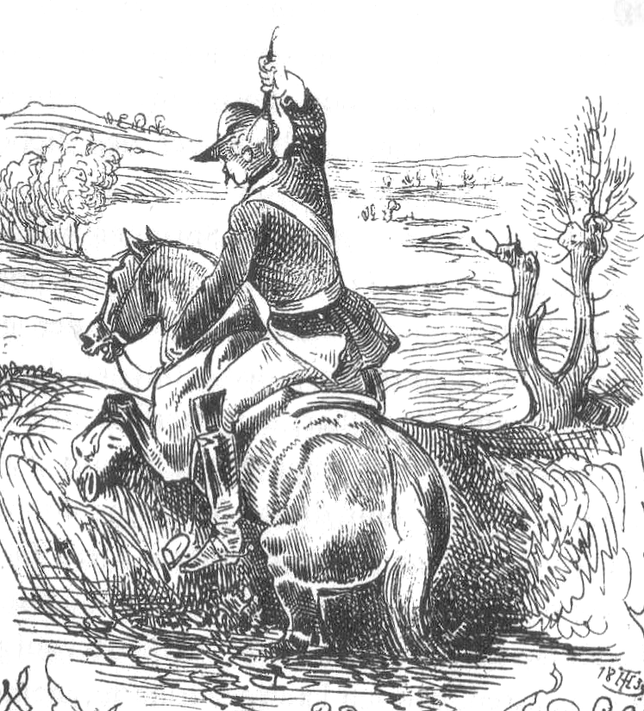
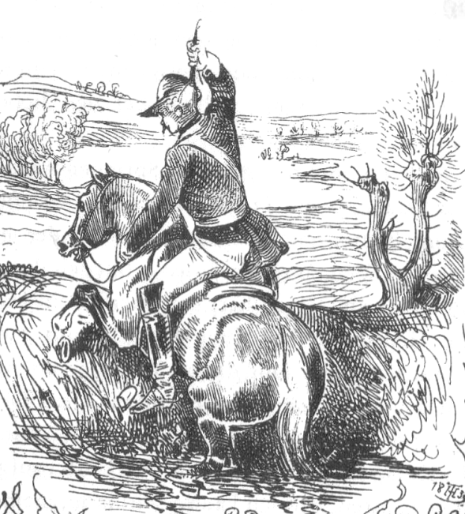

Slide 32
What is a human being ?
a humble attempt:
An autonomous agent, fostered by and reliant on a community of others building on heritage from uncounted generations before, endowed with at least the potential for a wealth of finely distinguished concepts and behaviors extending over vast realms with the ability of their recursive combination and reflection, errecting abstraction, expansion, rearrangement and novelty above abstraction, expansion, rearrangement and novelty, culminating in a universe of self-aware direct and inherited experience, adaptations, hopes, aims, dreams and ideas.
Nothing is less, and nothing is more than an idea

Slide 33
As one example, Immanuel Kant:
„Good Will is the only Absolutely Good“
very correct and clear
according to the Ouroboros Model:
Good Will
is per definition not taking into account conditions, means, effect or outcome
i.e. for this item with „inherited“ intrinsic positive valence consumption analysis is applied in the most restricted way only and thus yields a perfect fit by definition
(it looks like an analog applies to bad and evil will, e.g. malicious intentions)
Pflicht (duty) is established in the frame of the relevant community

Slide 34
For what may I hope ?
In times when no more guidance from an authorative and undisputed external deity can be resorted to, it is, again, consistency in a wide sense, which remains as guideline.
All-encompassing concepts can only be ranked according to their breath and depth, level of detail, applicability and effectiveness, usefulness. It is argued that thus the same bootstrapping applies to the "last questions" as what has been found for the distillation of apriori and, in principle, all other schemata.
One may hope mankind can agree on some level of mutual respect (a condition of weak consistency).
Make the hope happen and contexts promoting and cultivating it...

Slide 35
Key questions, for discussion:

