Slide 1
Anticipation
Roberto Poli

Slide 2
What is Anticipation?
Recent Developments

Slide 3
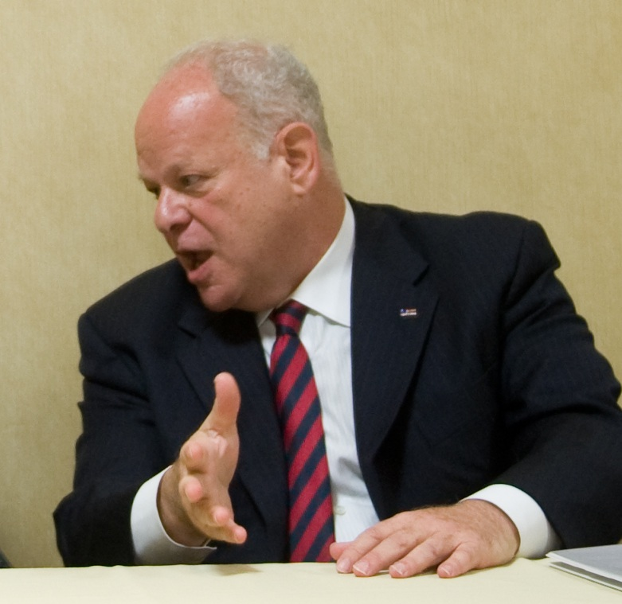
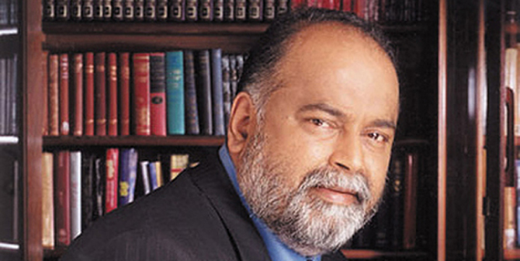
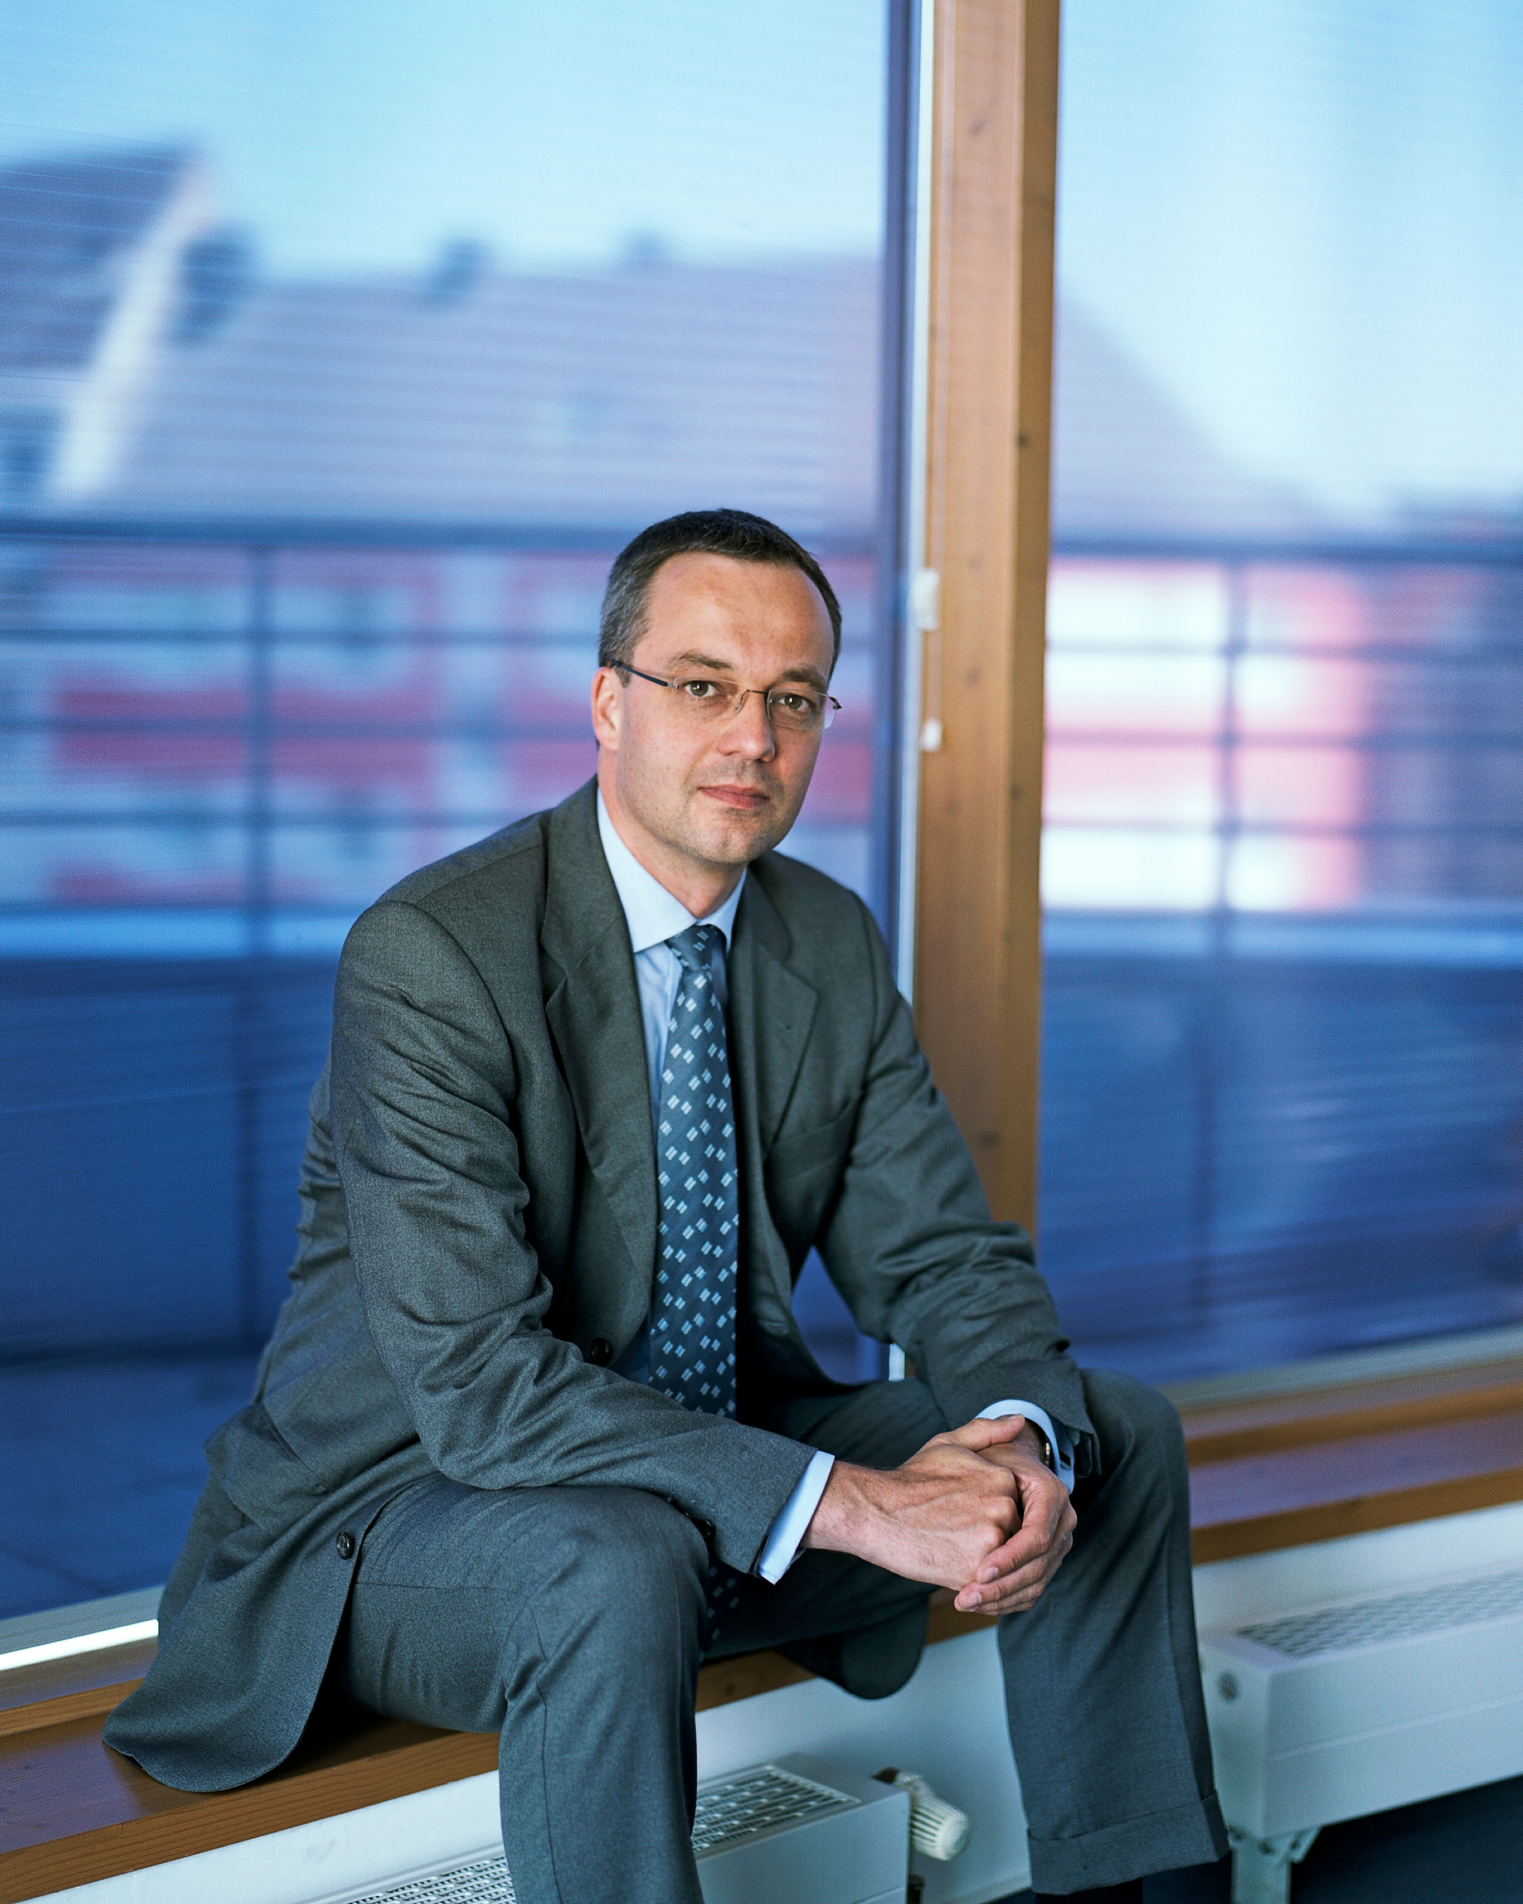
Recent developments
Seligman, M. E. P., Railton, P., Baumeister, R. F., & Sripada, C. (2013). Navigating Into the Future or Driven by the Past. Perspectives on Psychological Science, 8(2), 119-141
Appadurai, A., The Future as Cultural Fact. London, Verso, 2013
Beckert, J. (2013). Capitalism as a System of Expectations: Toward a Sociological Microfoundation of Political Economy. Politics and Society, 41(3), 323-350.
-- (2013). Imagined Futures: Fictional Expectations in the Economy. Theory and Society, 42(3).
-- (2015). Capitalist Dynamics: Fictional Expectations and the Openness of the Future. In P. Aspers & N. Dodd, eds., Re-imagining Economic Sociology. Oxford University Press

Slide 4
Future Moves, 63(2), 2015, ed. by M. Schulz (12 papers)
Schulz, M. S. (2015a). Future Moves: Forward-oriented Studies of Culture, Society, and Technology. Current Sociology, 63(2), 129-139
Hammershoj, L. G. (2015). Diagnosis of the Times vs. Description of Society. Current Sociology, Vol. 63(2) 140–154
Claisse, F., & Delvenne, P. (2015). Building on Anticipation: Dystopia as Empowerment. Current Sociology, 63(2), 155-169
Canto-Mila, N., & Seebach, S. (2015). Desired Images, Regulating Figures, Constructed Imaginaries: The Future as an Apriority for Society to be Possible. Current Sociology, 63(2), 198-215
(caricatural) Ruser, A. (2015). Sociological Quasi-labs: The Case for Deductive Scenario Development. Current Sociology, 63(2), 170-181
Schulz has been the coordinator of the RC07 “Futures Research” of the ISA. The present coordinator is E. O. Wright, past president of the ASA

Slide 5
Moreover …
Tavory, I., & Eliasoph, N. 2013, Coordinating Futures: Toward a Theory of Anticipation. American Journal of Sociology, 118(4)
Stawarczyk, D., Cassol, H., & D'Augembeau, A. 2013, Phenomenology of Future-oriented Mind-wandering. Frontiers in Psychology, 4
Gergen, K. J. (2015), From Mirroring to World-Making: Research as Future Forming. Journal for the Theory of Social Behavior
Tuomi, I. (2013). Next-generation foresight in anticipatory organizations. Background Study for the European Forum on Forward-Looking Activities (EFFLA): European Commission.
Miller, R., Poli, R., & Rossel, P. (2014). The Discipline of Anticipation. Exploring Key Issues: UNESCO; The Rockefeller Foundation.
Not to mention what’s happening in fields such as biology, brain studies, linguistics, family therapy, system engineering, …

Slide 6
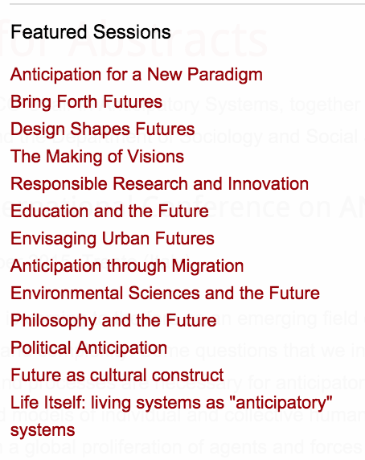

Slide 7
Stellenbosch Institute for Advanced Study
A group of scholars – both worldwide and local – have been convened to work on the interactions between complexity and anticipation
February-March 2016

Slide 8
Handbook of Anticipation (Springer) Editor: R. Poli
PART 1. INTRODUCING ANTICIPATION
PART 2. UNDERSTANDING ANTICIPATION (the encyclopedia section)
NATURAL SCIENCES & MATHEMATICS
Mathematics // Physics // Chemistry // Biology // Ecology
HUMAN SCIENCES
Medicine // Brain, behavior and mental health // Neuroscience // Psychology
SOCIAL SCIENCES
Anthropology // Sociology // Economy // Political Science // Law // Futures studies
HUMANITIES
Language // History // Education // Geography // Philosophy
ENGINEERING AND COMPUTER SCIENCE
System engineering // Computational modeling
ARCHITECTURE AND DESIGN
ARTS
PART 3. ENHANCING ANTICIPATION (the toolkit section – how to do, assess, improve and judge the use of anticipatory practice in different contexts, make mature and informed decisions about when different anticipatory tools are appropriately used)

Slide 9
So what?
The future is coming back to the research agenda
Reorientation of the research agenda from understanding “what is” to understanding “what is to become”
From primary past-orientation to primary future-orientation
Expect strong opposition from ‘traditional’ scholars
No awareness of FS
The few that show some awareness of FS, often misunderstand FS and what it is doing

Slide 10
Anticipation
Why now? – Because the human and social sciences are refocusing on the future
Why do this? (1) – to challenge the fragmentation of the human and social sciences; to help them to make a more significant contribution to the world (and, as a consequence: to empower citizens and social groups)
Why do this? (II) – this isn’t about guaranteeing a better way of living in the world, it is about the recognition of the empirical fact of anticipation in all systems – there is an empirical and theoretical challenge to understand how this works. It is also about building our capacity to reflect upon how anticipatory processes are working, and about broadening our repertoire and our sensitivity and reflexivity about this

Slide 11
What is Anticipation?
We understand anticipation as:
The process of using the future in the present, which includes a forward-looking stance and the use of that forward-looking stance to effect a change in the present
The three levels of FS
Forecast – the probabilistic attitude
Foresight – the exploratory attitude (scenarios)
Anticipation – futures are generated/consumed by our actions / design-based / FL / complexity

Slide 12
An exemplification
An anticipatory behavior is a behavior that ‘uses’ the future in its actual decisional process. Anticipation therefore includes two mandatory components: a forward-looking attitude and the use of the former’s result for action.
A weather forecast alone is not anticipatory in my sense. Watching (or producing) weather forecasts and as a consequence taking an umbrella before going to work is an anticipatory behavior.
Needless to say, taking with me the umbrella before going to work does not guarantee that it will rain. In this sense, anticipation is not a recipe for success.
It is my thesis that behavior is primarily anticipatory, and reactive behavior is only a secondary – albeit important – component of behavior.

Slide 13
The explicit consideration of anticipation opens new scientific perspectives. To mention but two apparently opposed and disconnected outcomes, anticipation both rehabilitates the Aristotelian theory of causes (including a version of the final cause) and generates an innovative understanding of complexity.
Our understanding of anticipation is still cursory, and the novelty of the perspective may conceal the difficulty implied by this otherwise refreshingly new vision.
Nonetheless, anticipation is increasingly at the heart of urgent contemporary debates, from climate change to economic crisis. Anticipatory capabilities of individuals and communities can enhance the overall sense-making process and improve decision-making, strategy formation and societal resilience.
A better and more complete understanding of anticipation and its effects will improve the capacity to understand individual and collective human behavior and its consequences.

