Slide 1
Coming Revolution in Higher Education
Biovision 2014 – Library of Alexandria
Garry Jacobs, Chief Executive Officer
World University Consortium www.wunicon.org
World Academy of Art & Science www.worldacademy.org

Slide 2
Global Challenges to Human Security
Political Freedom and Human Rights
Finance and Economy
Employment and Social Security
Energy & Ecology
Peace and International Security
Global Governance & Rule of Law

Slide 3
Education is essential to address each of these challenges
Education itself needs to evolve much more rapidly to keep pace with changing social needs
Notes:
Education is the means by which humanity passes on the cumulative experience of past generations to youth as essential knowledge so they need not endless repeat the past and rediscover what has already been learned

Slide 4
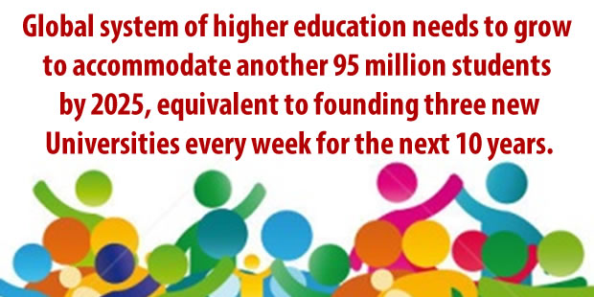
Soaring Demand
Notes:
Accessibility & Affordability
95 million more students -- 3 new universities a week for 10 years
360 million potential
India – needs to multiple 4x existing system
Cannot be achieved by existing technology
Quality – Ismail’s research
Massification has led to declining quality standards
Global shortage of qualified faculty
Content
Outdated ideas and concepts out of step with the challenges and opportunities of the 21st century
Economics of scarcity at a time when the world possesses capacity to produce all essentials in abundance
Political theory of national sovereignty at a time when humanity is becoming an integrated global society
Bridging the gap between academia and the world we live in
Skills gap
Preparing students for jobs that don’t exist instead of giving them capacity to create their own jobs
Double helix of education and work
Teaching facts through memorization when we should be teaching students how to think for themselves
Outmoded theories – especially in social sciences – incapable of coping with the complexity of modern life
Impersonal information when we should be trying to develop the personality of the student

Slide 5
Quality – Content – Relevance
Notes:
Education is needed to promote Democracy and human rights, Health, Employment, Wealth creation, Tolerance and cultural harmony
Social change has become so rapid that it imposes severe pressure on social fabric
Ironically, the evolution of the instrument of education lags far behind the evolution of the society it strives to promote
Education is one of the most traditional of social institutions
The number of subjects and depth of knowledge grown enormously
Technology of education remains largely unchanged for the past few 100 years
There is greater need than ever before for conscious evolution of the instruments of education to support the general evolution of society

Slide 6
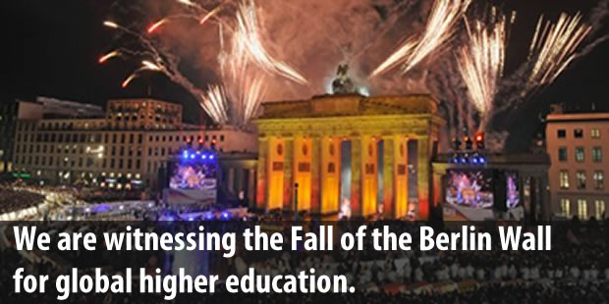
Revolutionary Transition in Global Higher Education
DEEP DRIVERS
Rising expectations for higher education
Democratization is universalizing access
Massification is standardizing the product
Commercialization is increasing competition
Unemployment is driving vocationalization
Public demand for Accountability
Technological innovation
Notes:
Yesterday Ismail spoke about the coming Knowledge Revolution.
Today we are hear to speak about the coming revolution in education.
Education is the technology that converts information into usable accessible knowledge
The Fall of the Berlin wall brought political freedom and human rights to hundreds of millions of people
Freedom of speech, religion, equal rights and action
Freedom no longer became a privilege enjoyed by only a ruling elite
We are now on the cusp of revolutionary transition in HE
This one will bring Freedom of Knowledge to all humanity
Knowledge will in future become as freely available as the air we breath
No longer need quality education be a scarce, exorbitantly costly commodity accessible to only the privileged
World-class education at all levels can be made available to everyone who seeks it
This revolution is fueled by deep driving forces
Double Helix of education and work
Technological innovation – penetrating the ivory tower
The revolution I speak of will be a revolution in
Accessibility & Affordability
Quality
Content
Relevance

Slide 7
Virtualization
from the classroom to the world

Slide 8
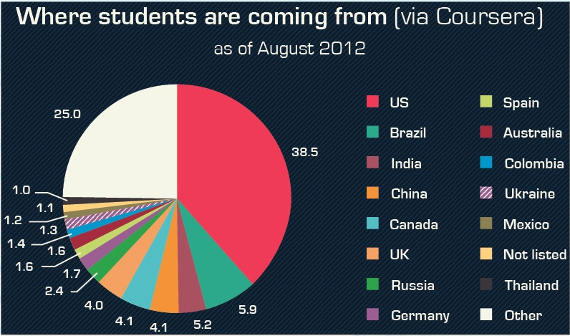
Coursera

Slide 9
Recent Trends
Non-English language platforms are growing fast
Research confirms efficacy of hybrid models
Shift from passive to active learning
Huge potential to raise quality of education globally
Imagine being able to access the world’s leading experts on every subject

Slide 10
Globalization of Learning
New knowledge partners are can now contribute to content development

Slide 11
Engaging other Stakeholders
Double Helix of Education and Employment

Slide 12
The Big Question

