Slide 1
Best practices:
Modern approaches towards achieving the objectives (goals)
WASA - Sarajevo, July 1st, 2014
Branko Matijevic, Slovenia

Slide 2
How the best organizations work
(why Best are The Best)
WASA - Sarajevo, July 1st, 2014
Branko Matijevic, Slovenia

Slide 3
Goals - Objectives
Goals are long-term aims that you want to accomplish.
Objectives are concrete attainments that can be achieved by following a certain number of steps.
Objectives are very concrete, whereas goals are less structured.

Slide 4
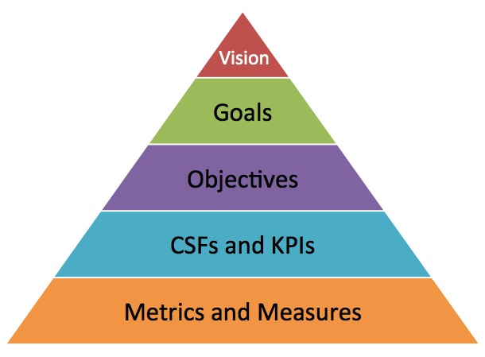
Vision - Goals - Objectives (What)
Critical Success Factors (CSFs) are the cause of your success,
Key Performance Indicators (KPIs) are the effects of your actions

Slide 5

Strategy (How)

Slide 6
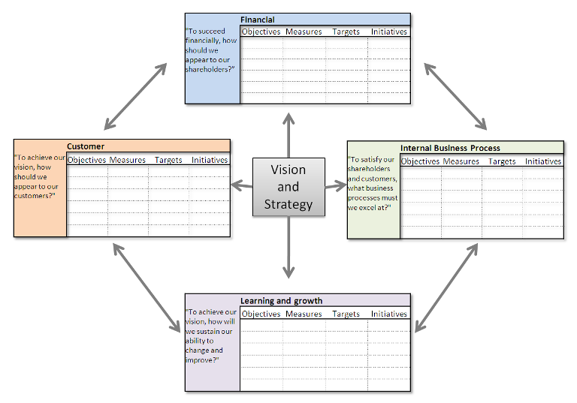
Traditional - Balanced Scorecard

Slide 7
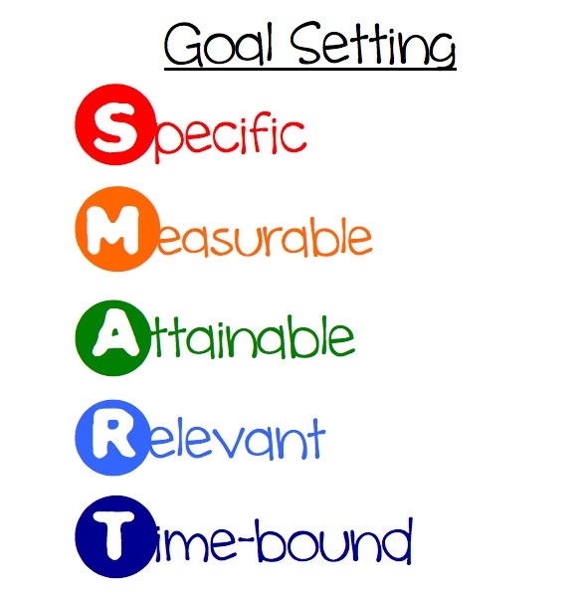
S M A R T

Slide 8
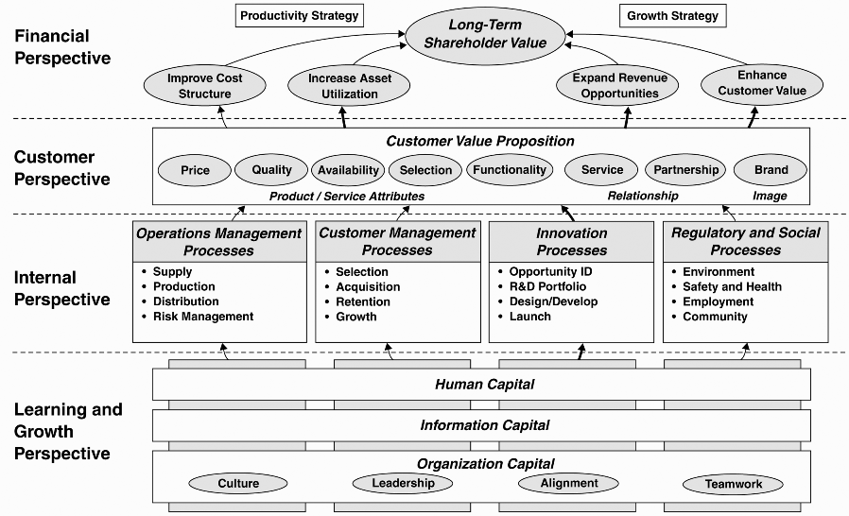
BSC Strategy Map

Slide 9

Blue Ocean strategy

Slide 10
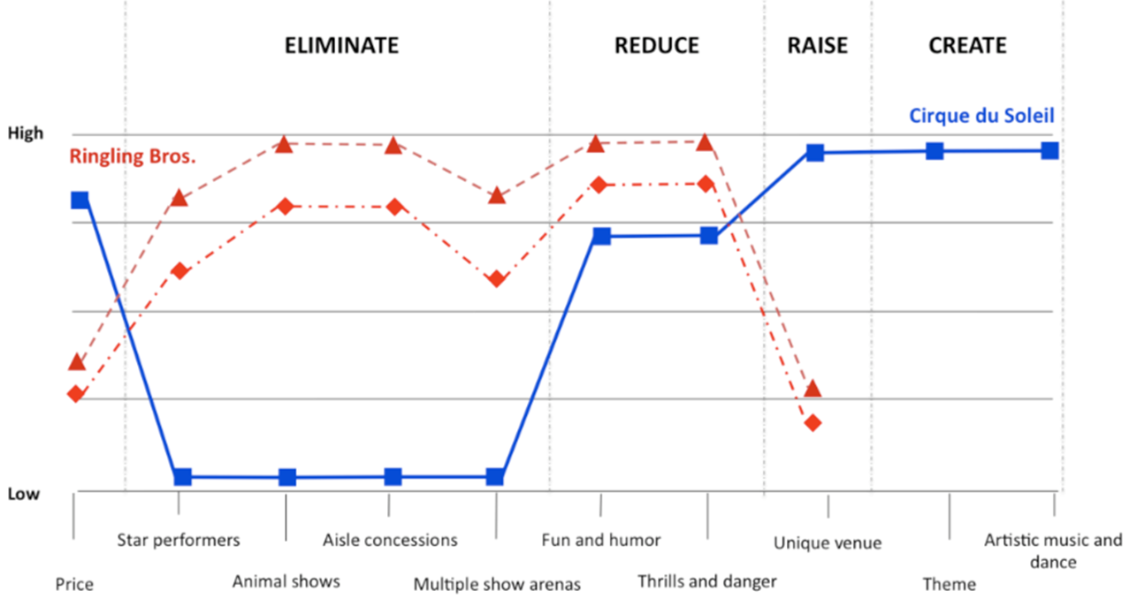
Blue Ocean strategy

Slide 11
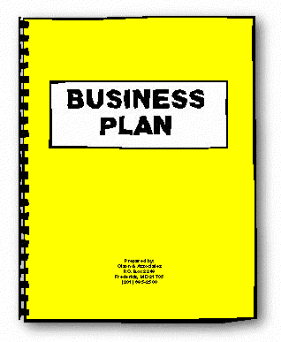
We Still Use This

Slide 12
No Business Plan survives first contact with customers

Slide 13
Any company
can be described in
9 building blocks

Slide 14
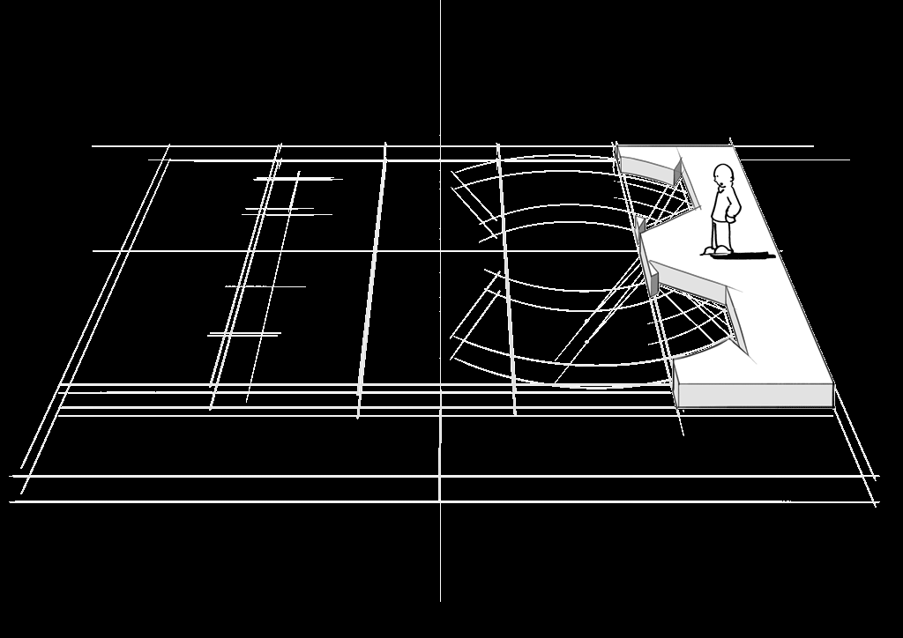
CUSTOMER SEGMENTS
which customers and users are you serving?
which jobs do they really want to get done?

Slide 15
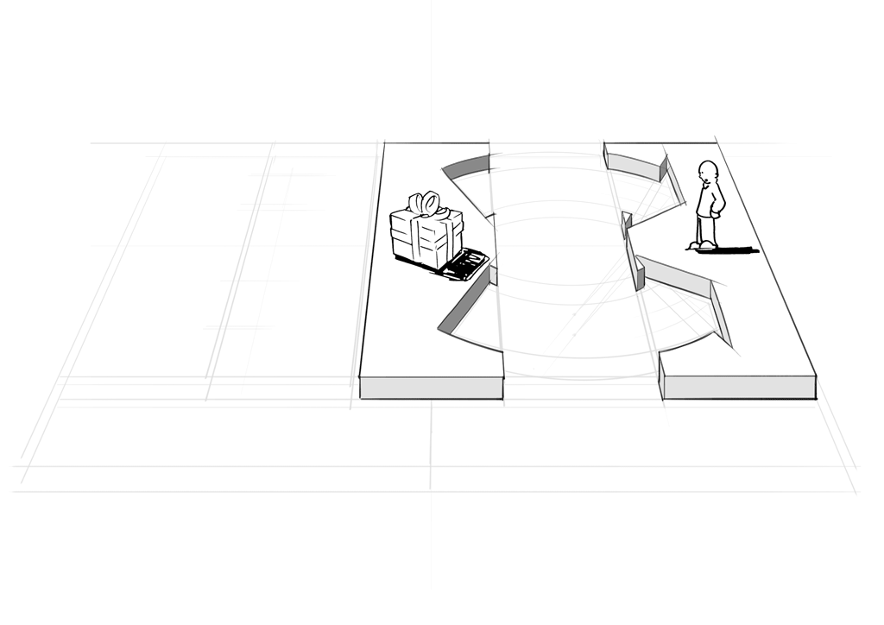
VALUE PROPOSITIONS
what are you offering them? what is that
getting done for them? do they care?

Slide 16
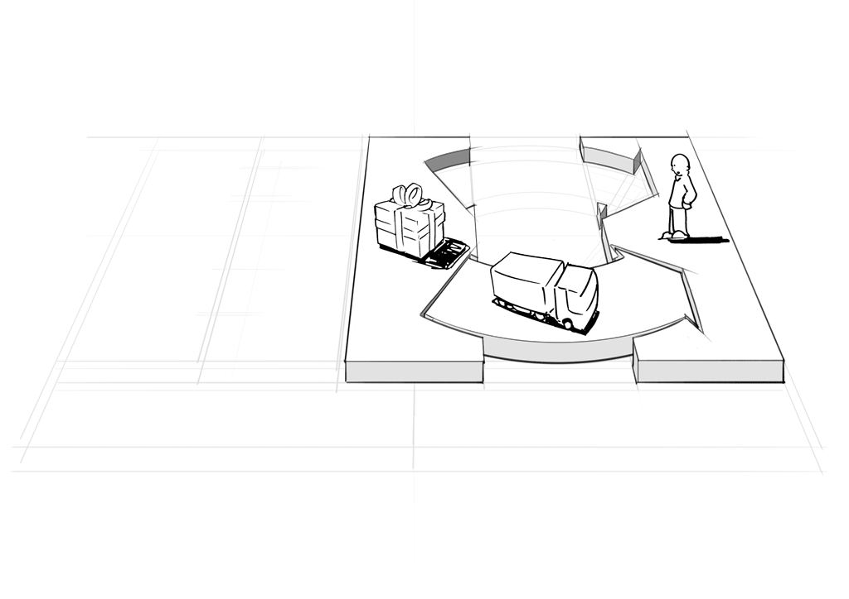
CHANNELS
how does each customer segment want to be reached? through which interaction points?

Slide 17
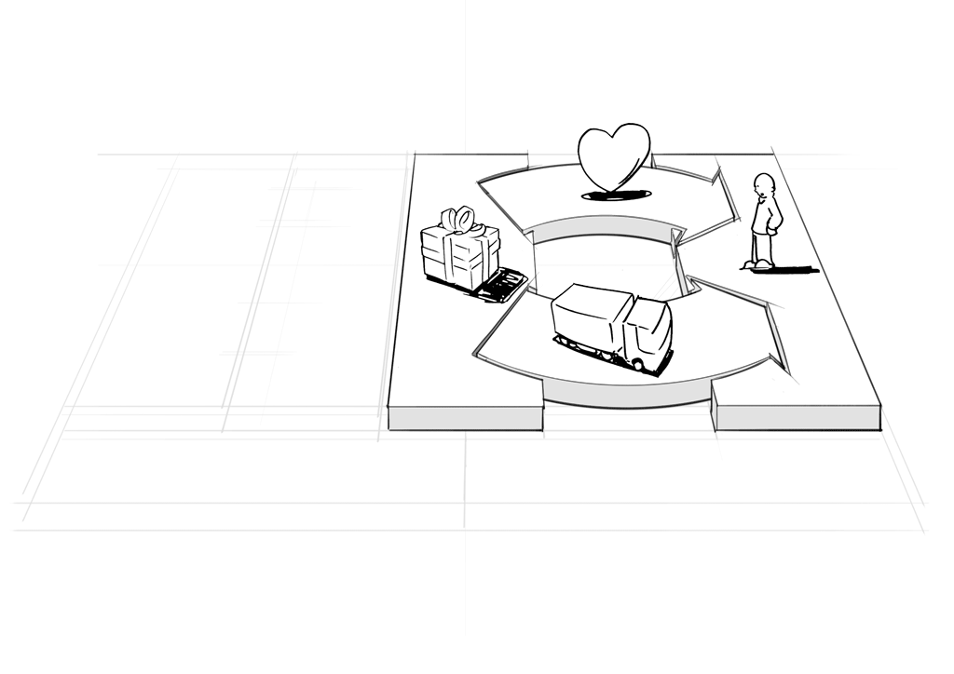
CUSTOMER RELATIONSHIPS
what relationships are you establishing with each segment? personal? automated? acquisitive? retentive?

Slide 18
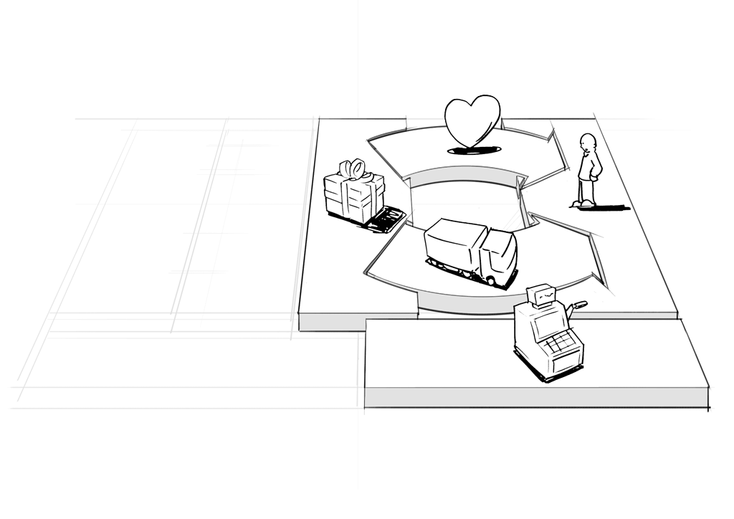
REVENUE STREAMS
what are customers really willing to pay for? how?
are you generating transactional or recurring revenues?

Slide 19
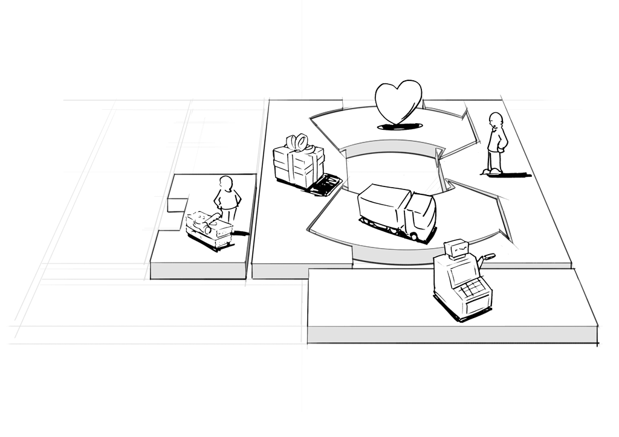
KEY RESOURCES
which resources underpin your business model? which assets are essential?

Slide 20
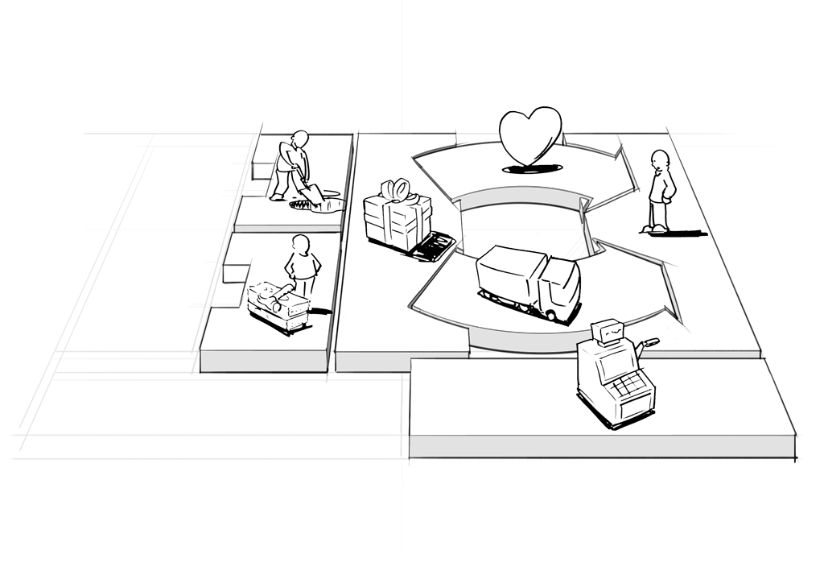
KEY ACTIVITIES
which activities do you need to perform well in your business model? what is crucial?
20

Slide 21
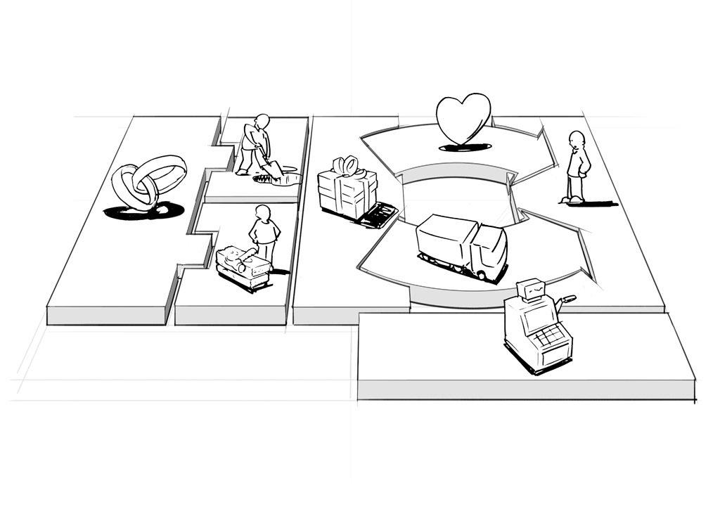
KEY PARTNERS
which partners and suppliers leverage your model?
who do you need to rely on?

Slide 22
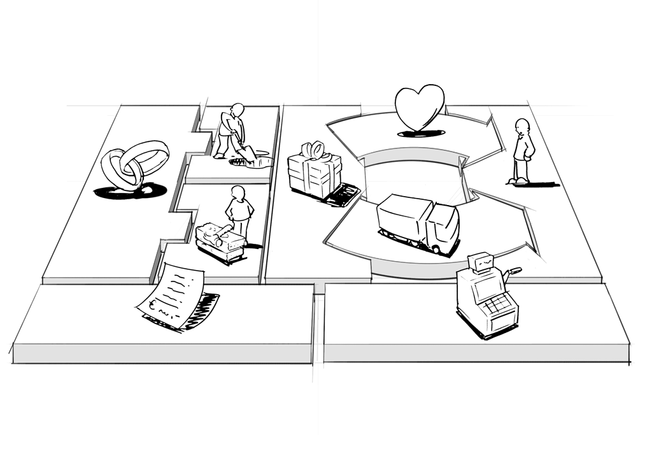
COST STRUCTURE
what is the resulting cost structure?
which key elements drive your costs?

Slide 23
key activities
value proposition
customer relationships
key partners
customer segments
cost structure
revenue streams
key
resources
channels
23

Slide 24
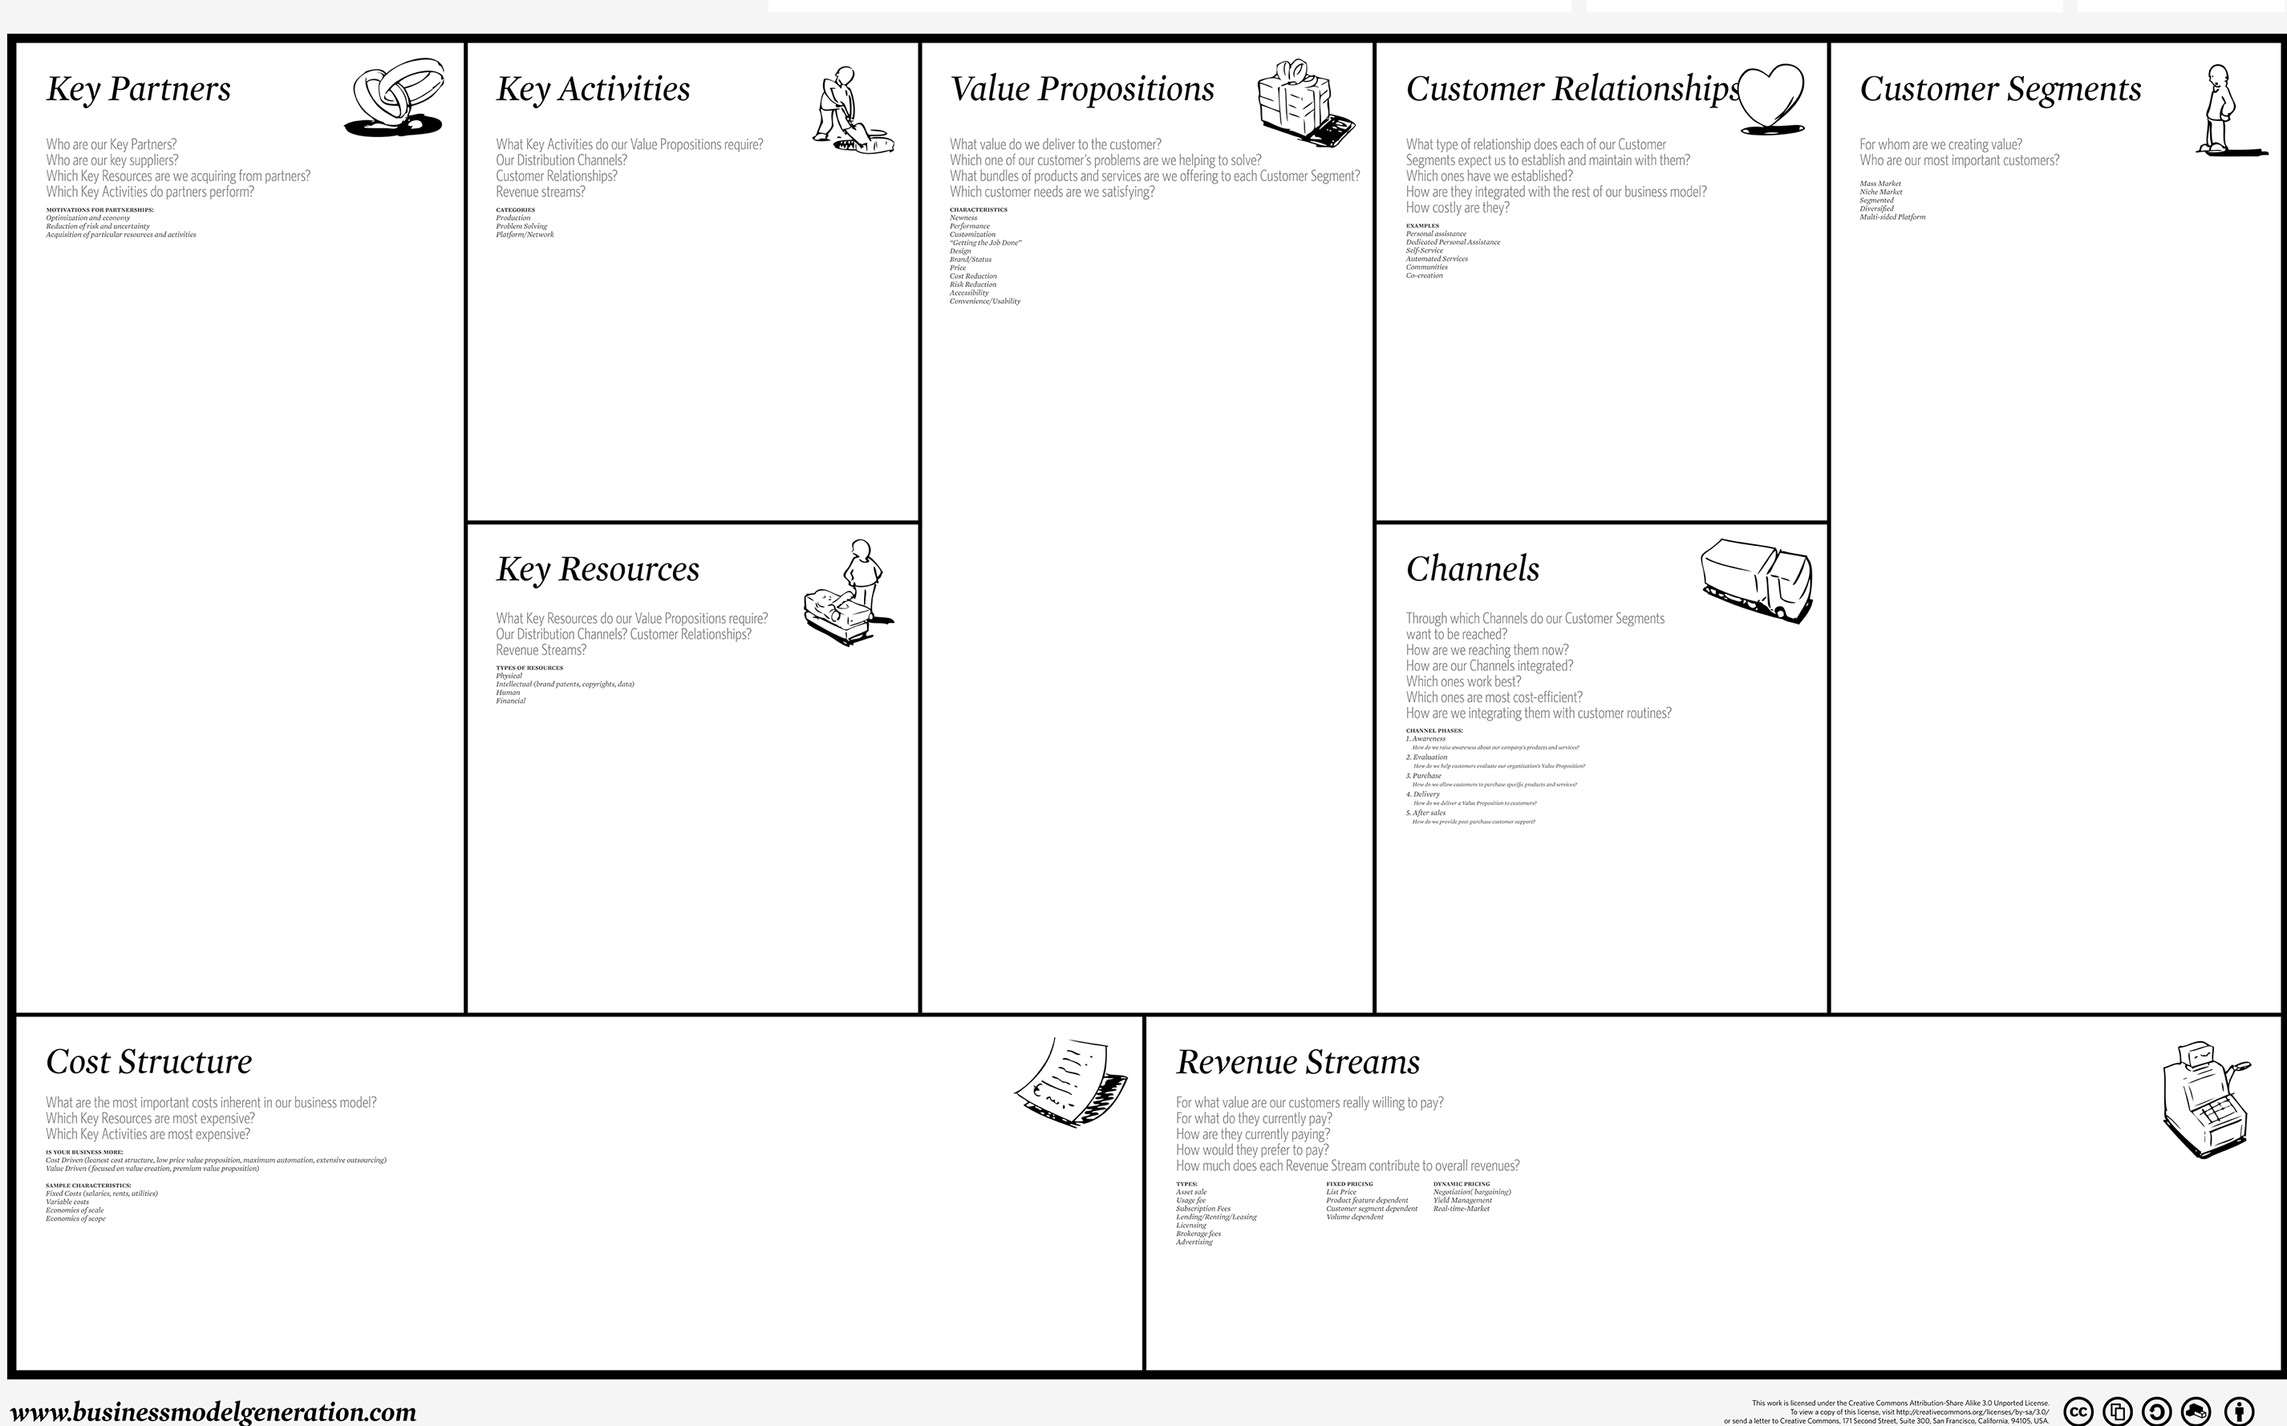
Business Model Generation canvas

Slide 25
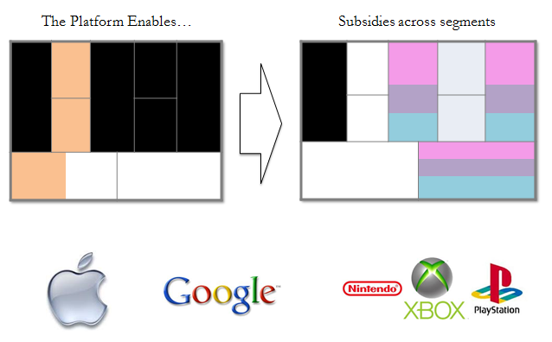
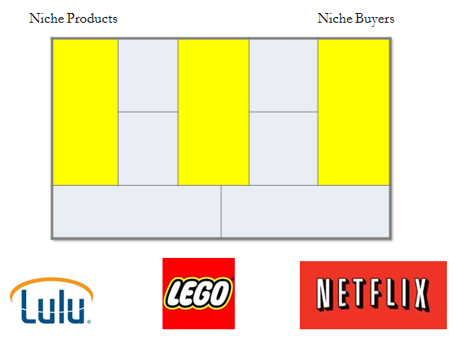
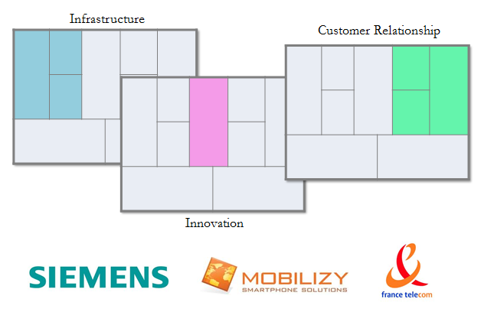
BMG is used by many

Slide 26
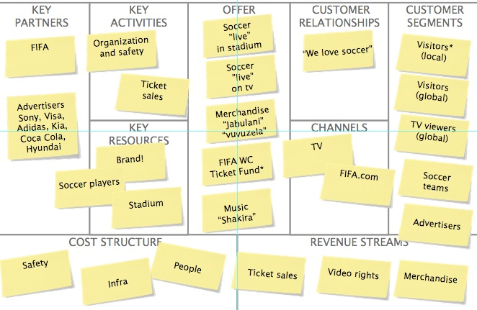
Example: football

Slide 27
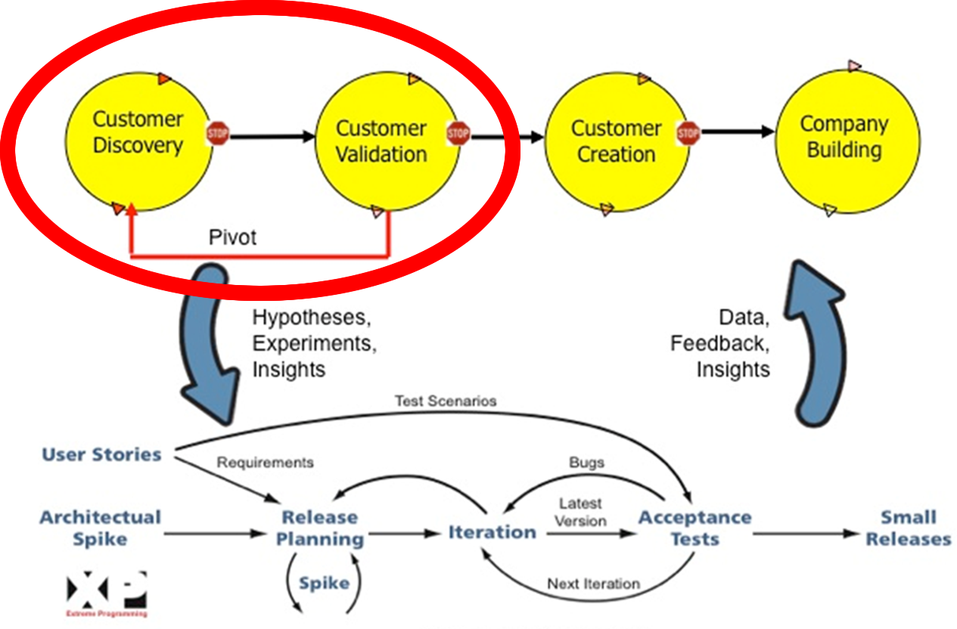
The Lean Approach
Stop selling, start listening
Test your hypotheses
Continuous Discovery

Slide 28
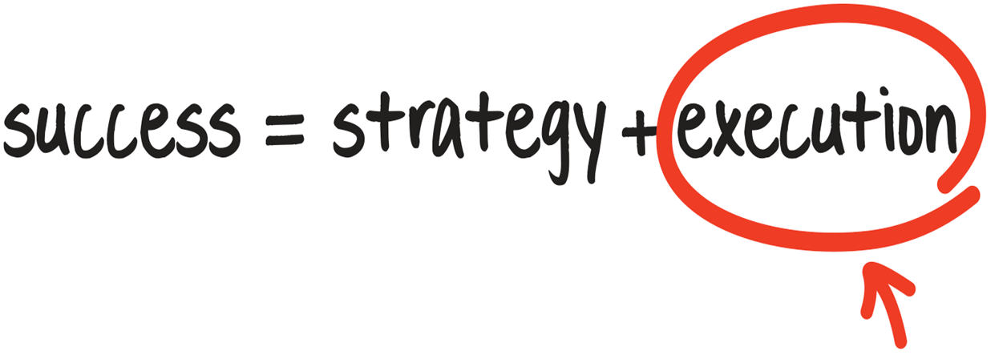
15%
85%
Due to Norton and Kaplan Article in Harvard Bisiness Review

Slide 29
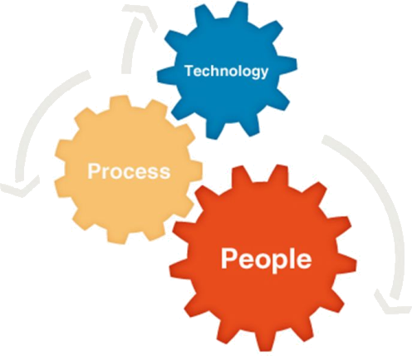
Critical Success Factors

Slide 30
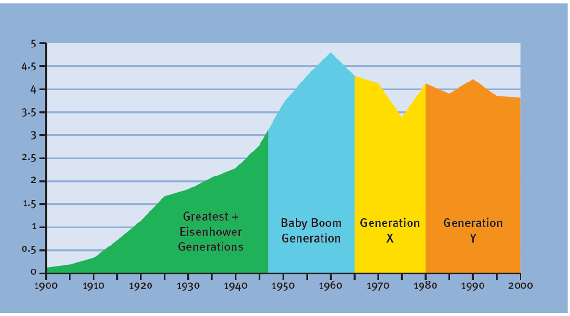
Workforce Generations
U.S. Census Bureau, 2000; U.S. Census Bureau, International Data Base, July 2003

Slide 31
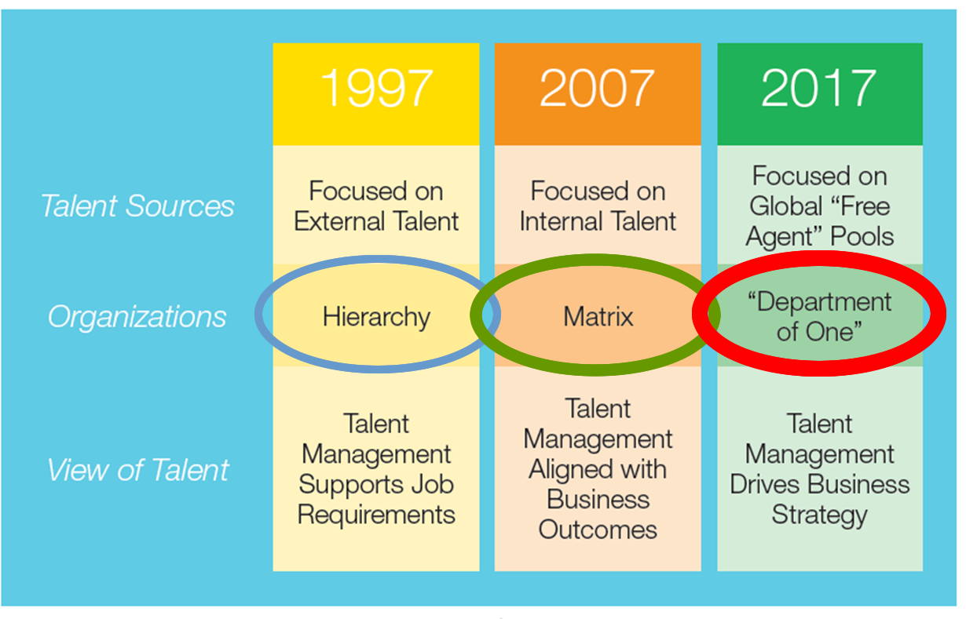
Talent Management Timeline
Talent Management 2017, Erik Berggren, Jason Corsello

Slide 32

Typical Company
% OPEX
Improvements
40%
Workforce
???
Marketing
G&A
Business Process
Re-Engineering
ERP
Cost Take Out
60%
Depreciation
Facilities
Travel & Entertainment
Outside Services
IT

Slide 33
HR is essential to business execution
95% of the workforce does not understand the company strategy and goals
84% of companies aren’t using their workforce to its full potential
50% of the average
workforce’s capacity
is wasted on non-productive work
Corporate Strategy Board Research: Measures that Matter
Norton & Kaplan
Saratoga Institute
You cannot optimize company performance without optimizing workforce performance

Slide 34















Talent Management
Optimize
Accelerate
Align
Employee Central

Slide 35
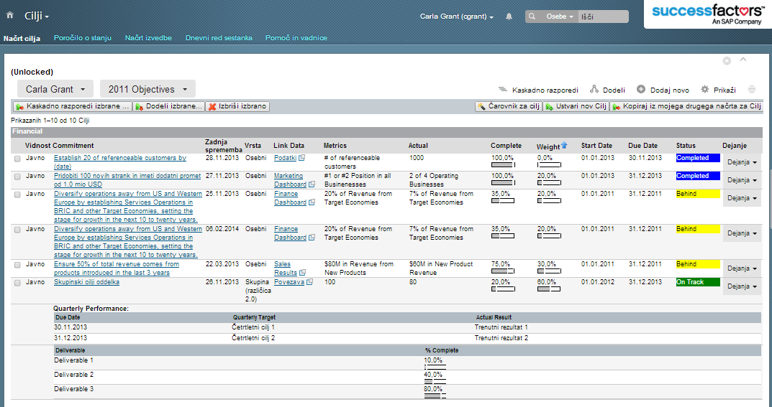
Goal Management

Slide 36
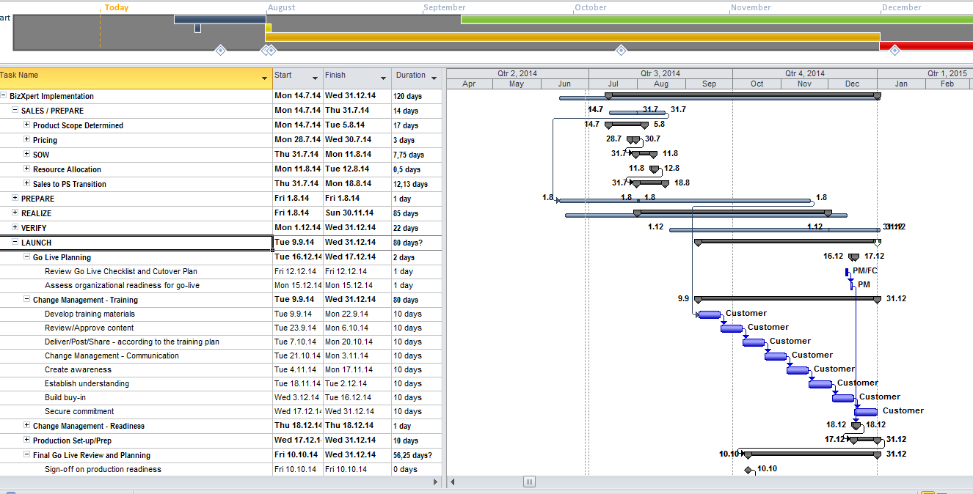
Not only Project Management

Slide 37
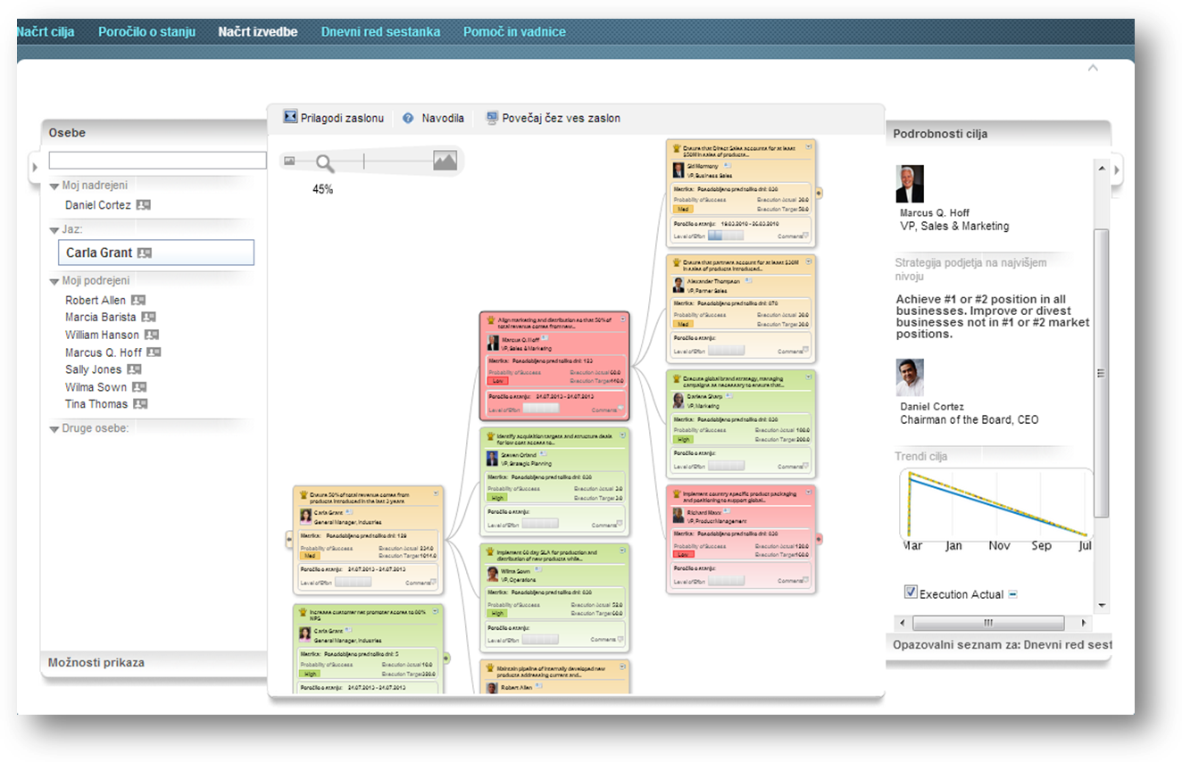
Predict & monitor execution

Slide 38
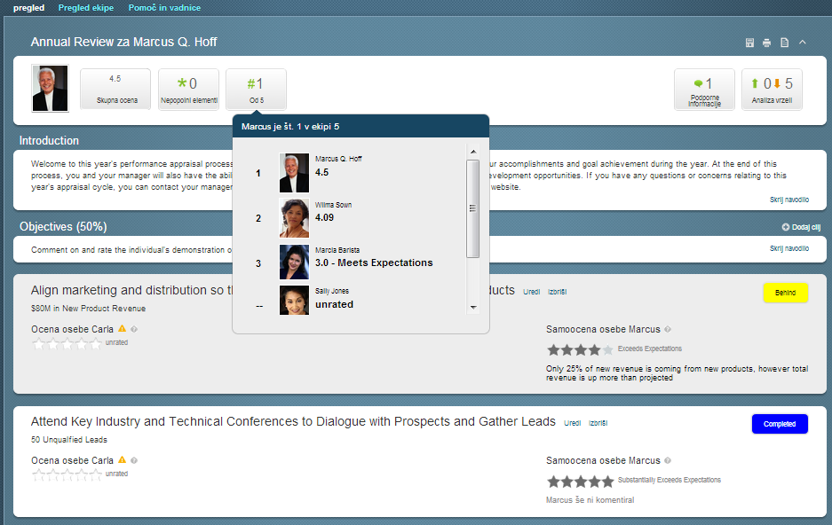
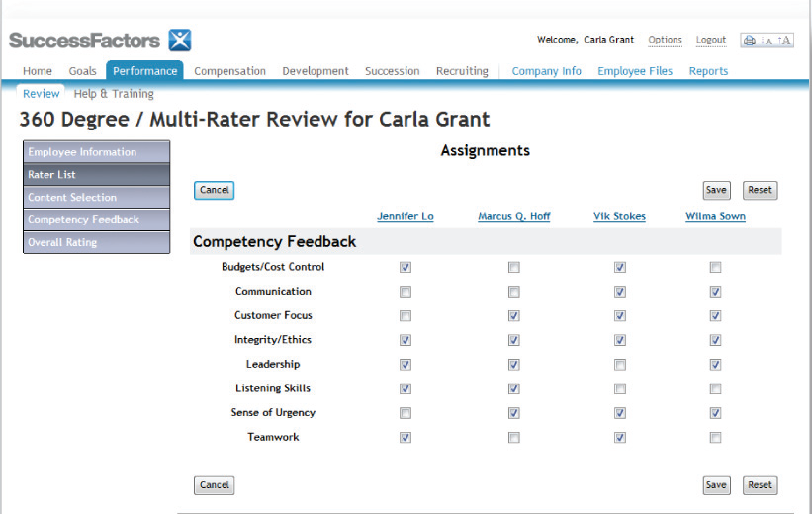
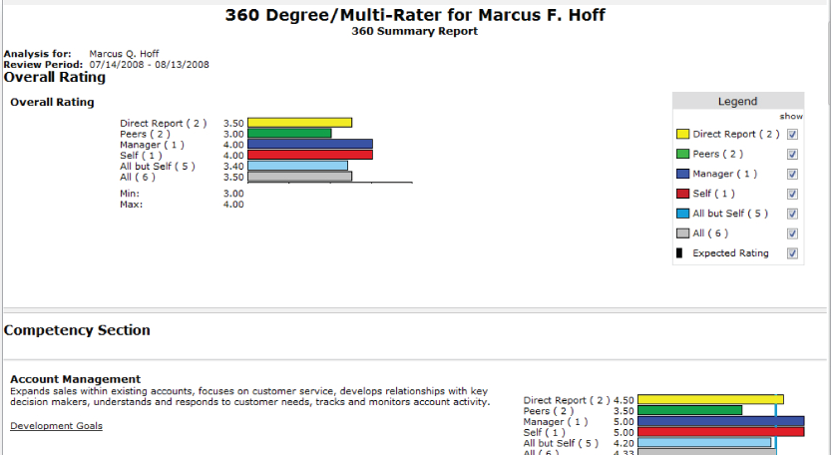
Performance Management

Slide 39
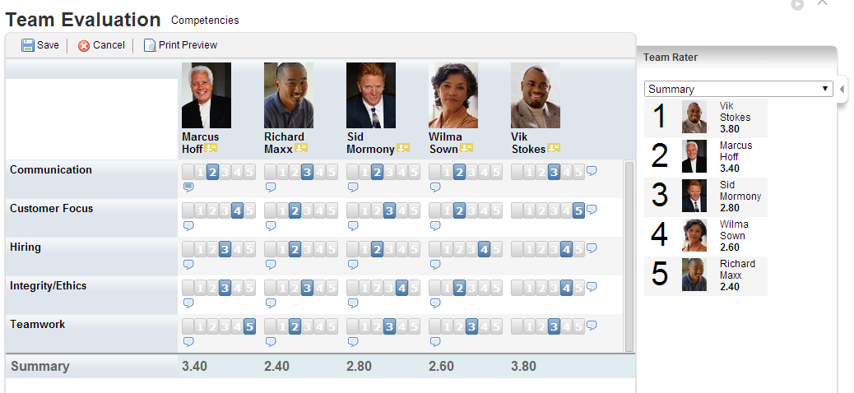
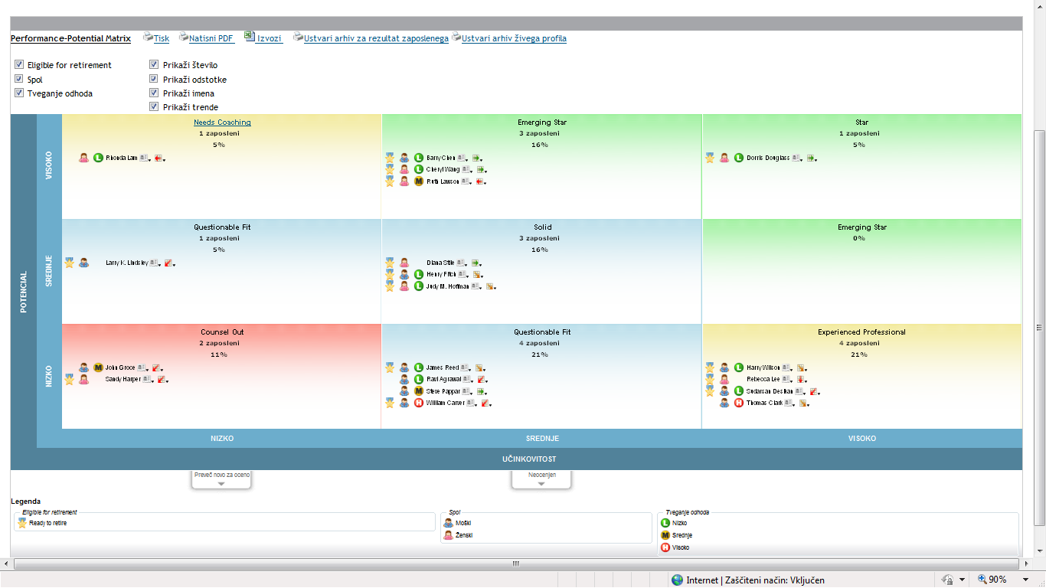
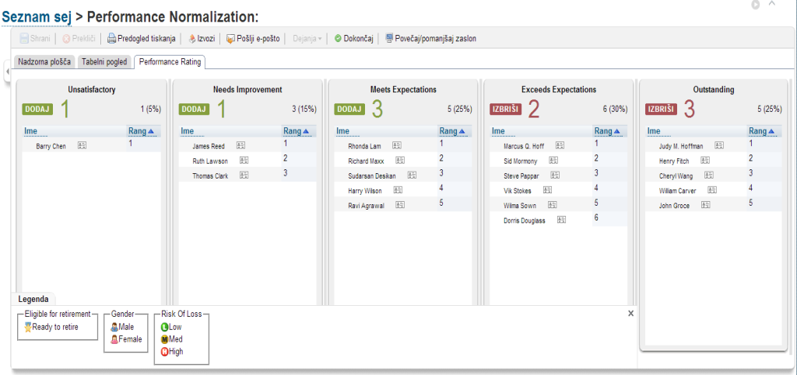
Business Execution (GM/PM)

Slide 40



Traditional Recruiting Solutions
Attract talent
Select the best
Mobile & Micro Sites
Military & Diversity
Sourcing Tools
Campaigns & Events
Referral Tracking
Job Boards
Head
Hunters
Social Recruiting
CRM
Unable to Measure
Don’t Know what works
Notes:
We believe successful and modern (cutting edge?) recruiting has three distinct phases that are all critically important to ensure that hiring is driving business results. Attract (find), engage and select candidates.
Your legacy vendors have focused almost exclusively on the selection piece.
But, in order to drive business results, you don’t want to be selecting from a pool of mediocre candidates – you need to be selecting from the best – which means that you need to find (or attract) them, then get them engaged – build a relationship with them before you’re ready to put them through your selection process (or even get them to apply).
There are all kinds of new tools on the market to Attract and Engage candidates – post to social sites, optimize Facebook, etc. But they are all disconnected from the process of applying and then selecting candidates. Many or most recruiters are overwhelmed with keeping track of the tools and how to use them, as well as trying to continually justify their sourcing budgets.
–

Slide 41




Full Recruiting Cycle
Attract talent directly to you
Engage and capture talent inside and out
Select the best faster and easier
Measure
Know what works
Notes:
We think that we have the tools to help you drive business results. We believe successful and modern (cutting edge?) recruiting has three distinct phases that are all critically important to ensure that hiring is driving business results. You need to: Attract (find), engage and select candidates.
Your legacy vendors have focused almost exclusively on the selection piece – which made sense when resumes were paper and there were no social channels to find candidates.
But, in order to drive business results, you don’t want to be selecting from a pool of mediocre candidates – you need to be selecting from the best – which means that you need to find (or attract) them, then get them engaged – build a relationship with them before you’re ready to put them through your selection process (or even get them to apply).
There are all kinds of new tools on the market to Attract and Engage candidates – post to social sites, optimize Facebook, etc. But they are all disconnected from the process of applying and then selecting candidates. Many or most recruiters are overwhelmed with keeping track of the tools and how to use them, as well as trying to continually justify their sourcing budgets.
–

Slide 42
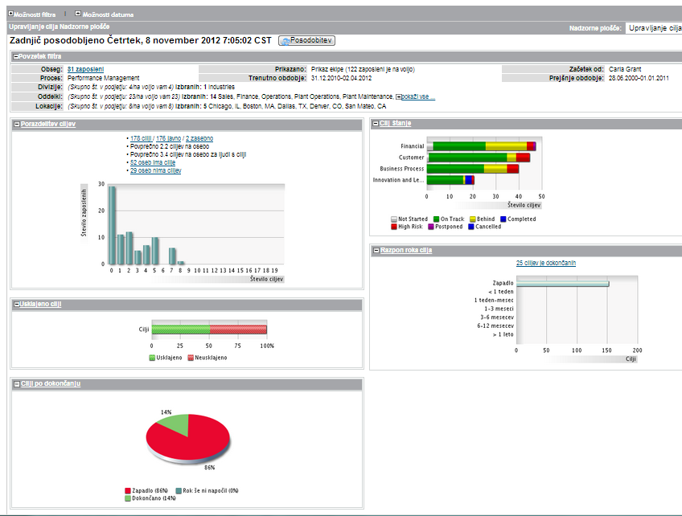
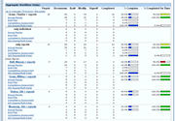
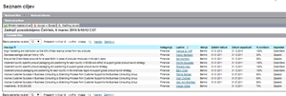
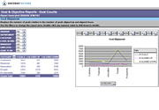
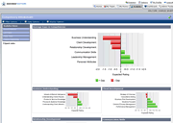
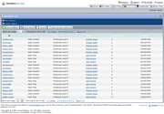
Reports & Measurements

Slide 43
















































Empresa Folha de Manha S.A.
Major US Automaker
Top 2 Bottling Co.
Leading
retailer
*
PPD Development LP
*
Leading
*
financial
services
*
company
> 300,000
users
> 50,000 do 300,000 users
*
> 25,000 do 50,000 users
> 10,000 do 25,000 users
> 3 do
10,000 users
* For internal use only

Slide 44














































* For internal use only

Slide 45
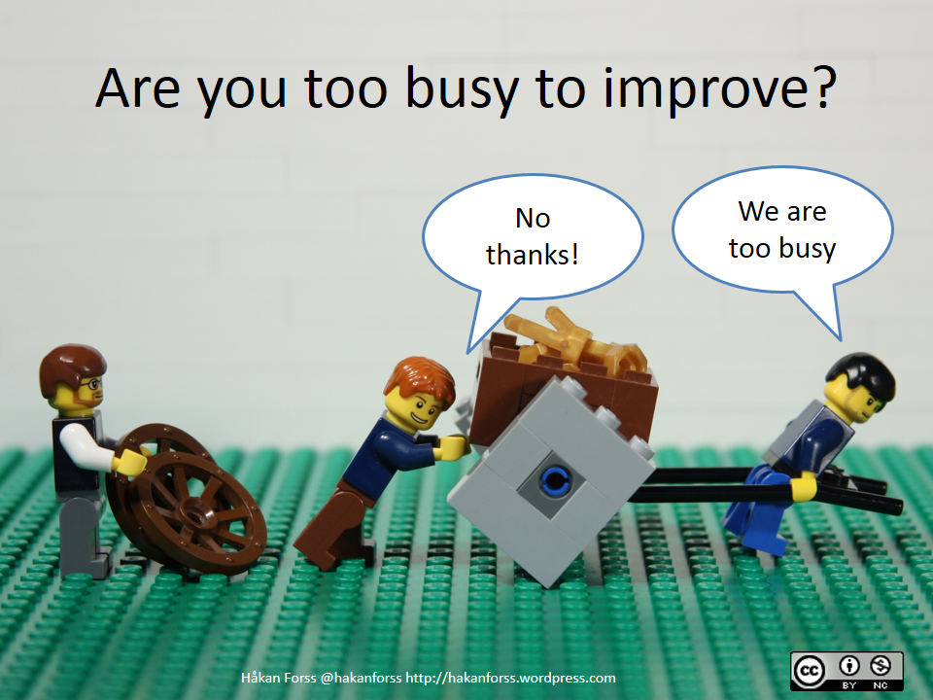

Slide 46


Impossible is Possible
(if you know how)
Branko Matijević
Dejavniki Uspeha d.o.o.
T: +386 1 500 8118
E: info@DejavnikiUspeha.si
W: www.DejavnikiUspeha.si

