Slide 1
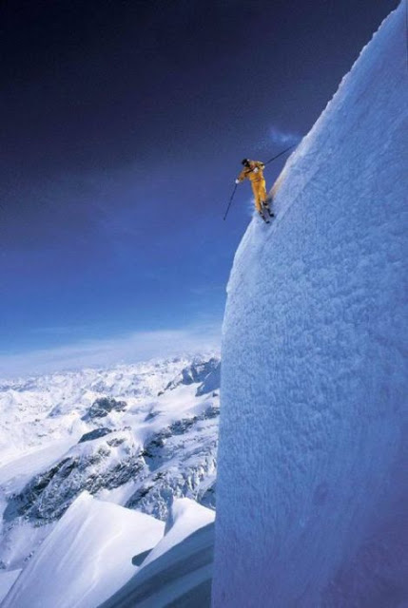

Knowledge and skills required by the local and global economy
and how can they used to
increase employment rate.
Janez Kolar, Slovenia/EU
WASA - Sarajevo, July 1st, 2014
Social
Capital
Convergence
Janez Kolar, Slovenia/EU
WASA - Sarajevo, July 1st, 2014
1
1
1
1

Slide 2
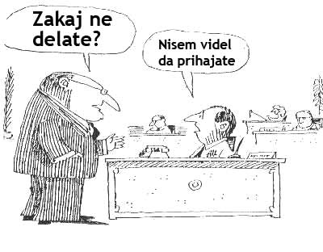
Why don‘t
you work?
I didn‘t see
you coming...

Slide 3
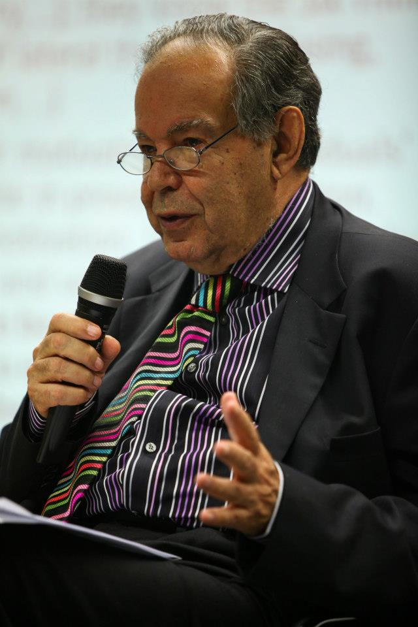
„A good employee
is someone
who knows,
what‘s to be
done and does it.“
Eduard de Bono
(Ljubljana, 2012)

Slide 4

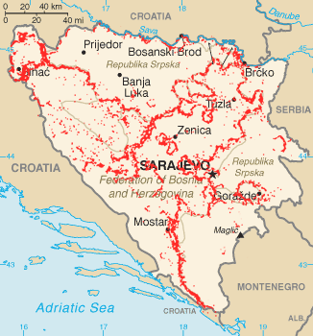
full
employment
Notes:
At the moment, Bosnia is quite far from full employment…

Slide 5
before organizing we need to know an
OBJECTIVE, we want to accomplish.

Slide 6
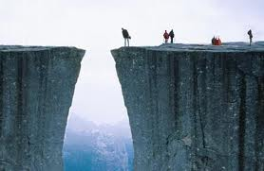
How to fill the gap between creativity & full employment?
CREATIVITY FULL
EMPLOYMENT

Slide 7
Route map on road to increased employment…
creativity
better/more/full
employment
entrepreneurship
development
new business
opportunities
networking
organizing
technology &
infrastructure &
social capital
Notes:
I beleive there‘s plenty of creativity in BiH, perhaps it just have to be more channeled and focused

Slide 8
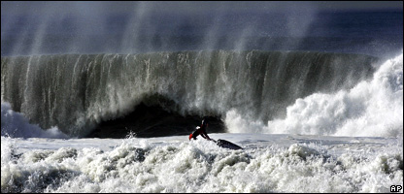
Notes:
Bosnia and Herzegovina has always been at the crossroads of different civilizations, cultures,
historical events, such as gavrilo Princip‘s act 100yrs ago…
When we are faced with REALLY BIG challenge, it is perhaps a little too late to start asking questions..

Slide 9

…a little too late for reading instructions

Slide 10
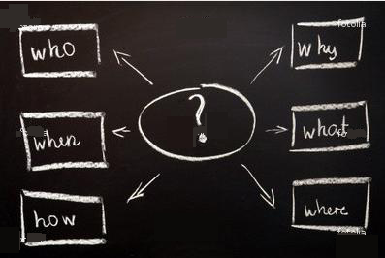
Ključna so vprašanja
full
employment
in Bosnia

Slide 11
Notes:
I am sure we would all agree that we want to teach people how to fish….

Slide 12
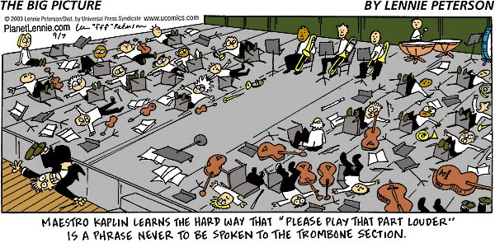
management is art / art is management
Notes:
We cannot afford the luxury to go the same road everybody else went and we do not have time to repeat other‘s mistakes but learn from them and learn smart!

Slide 13

think different, think BLUE…
ocean?
strategy?
Notes:
As (full) employment, especially among young people, is a big problem in the Europe today, there are no smiple solutions.
I beleive we should think different…
…and BiH does not have time to repeat mistakes from others

Slide 14
Route map on road to increased employment…
creativity
better/more/full
employment
entrepreneurship
development
new business
opportunities
networking
organizing
technology &
infrastructure &
social capital
Notes:
I beleive there‘s plenty of creativity in BiH, perhaps it just have to be more channeled and focused

Slide 15


Slide 16
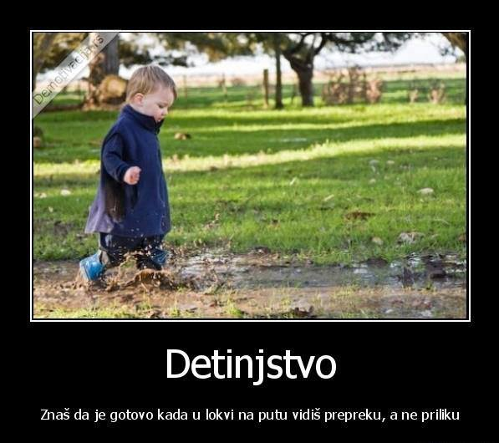
creativity, opportunities, …
Childhood
You know it‘s over, when in a puddle on your way
instead of OPPORTUNITY you see an OBSTACLE…

Slide 17
And we definitely don‘t them want to fell like

Slide 18
Route map on road to increased employment…
creativity
better/more/full
employment
entrepreneurship
development
new business
opportunities
networking
organizing
technology &
infrastructure &
social capital
Notes:
I beleive there‘s plenty of creativity in BiH, perhaps it just have to be more channeled and focused

Slide 19
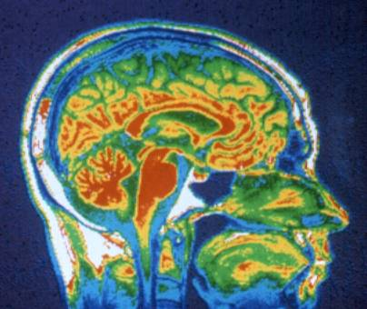
ENERGY flows where our FOCUS goes…

Slide 20
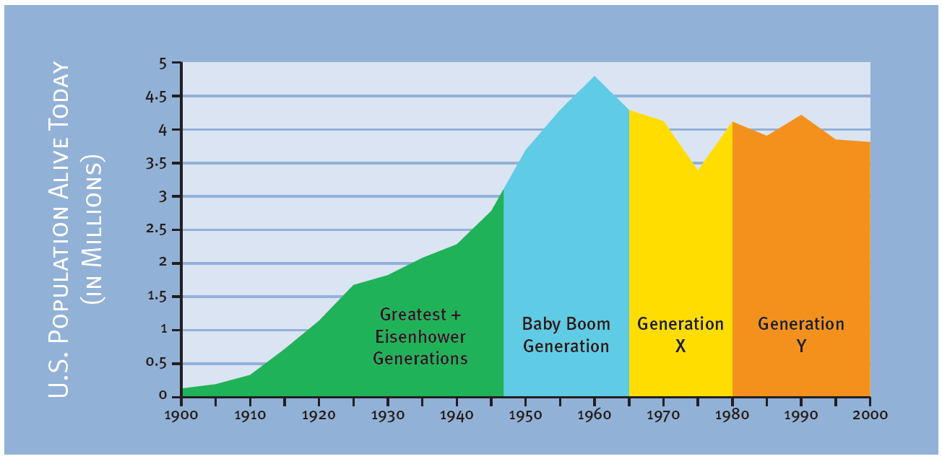
Who?

Slide 21
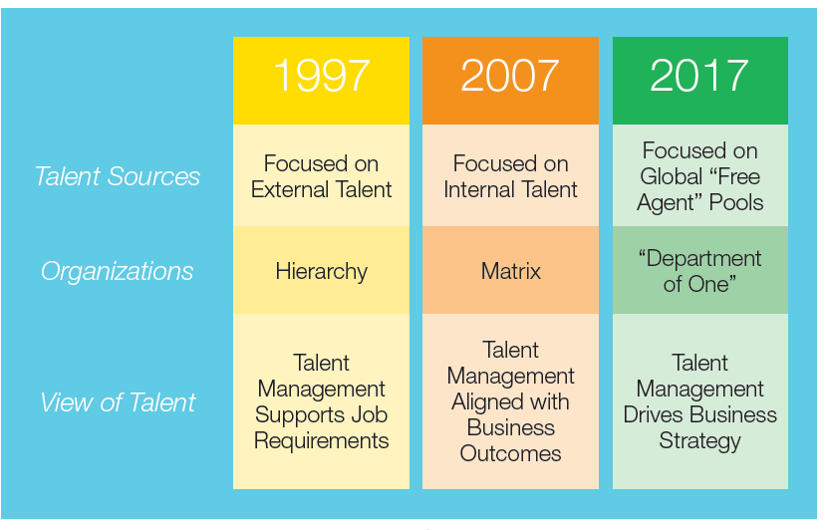
Change in focus…

Slide 22
Why do we do what we do…
(NLP)
Purpose
Beliefs/values
Capabilities
Behavior
Environment

Slide 23
entrepreneurial teaching/age
Source: Timmons

Slide 24
Route map on road to increased employment…
creativity
better/more/full
employment
entrepreneurship
development
new business
opportunities
networking
organizing
technology &
infrastructure &
social capital
Notes:
I beleive there‘s plenty of creativity in BiH, perhaps it just have to be more channeled and focused

Slide 25
Basic Model of SUCCESS
What we can
capabilities
knowledge
skills
ideas
energy
personality
What we want
motivation
needs
interests
expectations
habits
wishes
X

Slide 26

cultural diversity
+
-
goals
ambitions
skills
attitude
?
knowledge

Slide 27
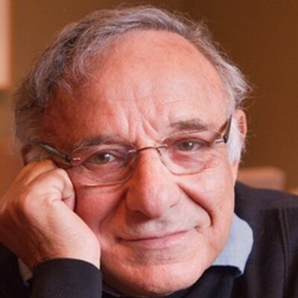
    „managerial code“ PAEI (I. Adizes)
    P - Producer
    A - Administrator
    E – Entrepreneur
    I – Integrator

Slide 28
Route map on road to increased employment…
creativity
better/more/full
employment
entrepreneurship
development
new business
opportunities
networking
organizing
technology &
infrastructure &
social capital
Notes:
I beleive there‘s plenty of creativity in BiH, perhaps it just have to be more channeled and focused

Slide 29
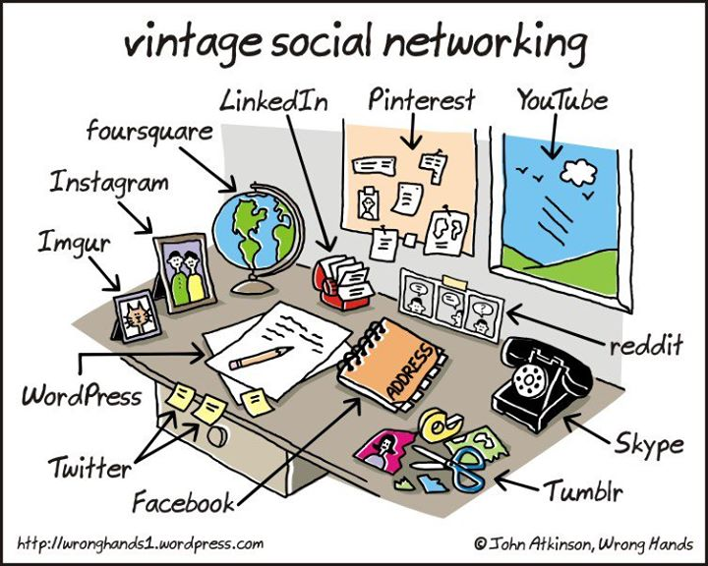
technology?

Slide 30
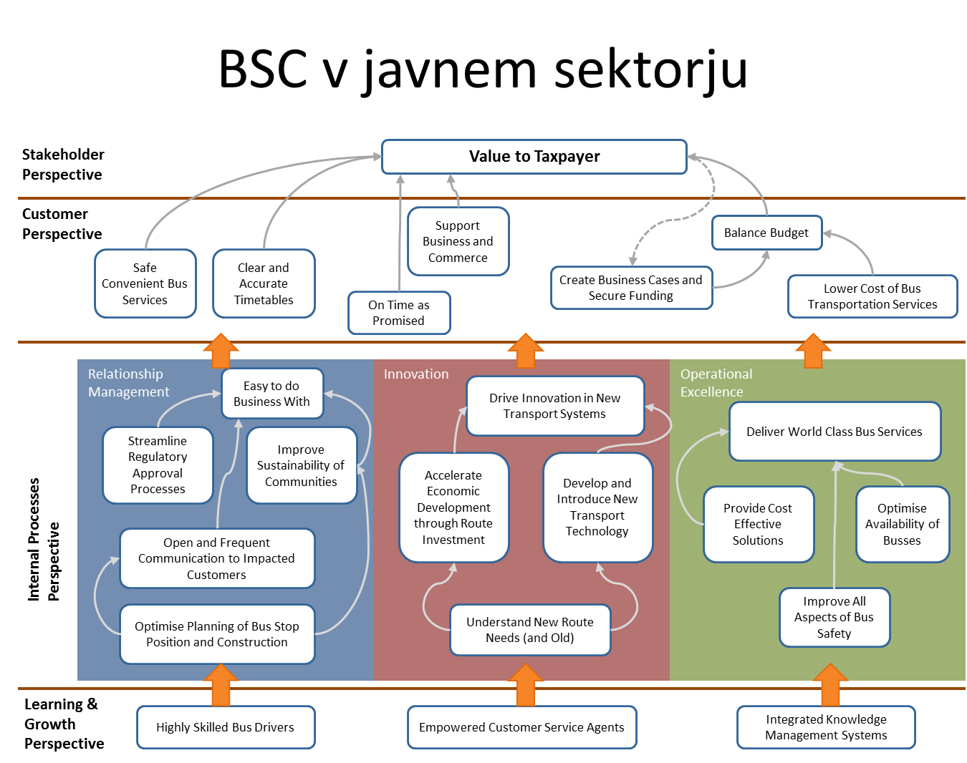

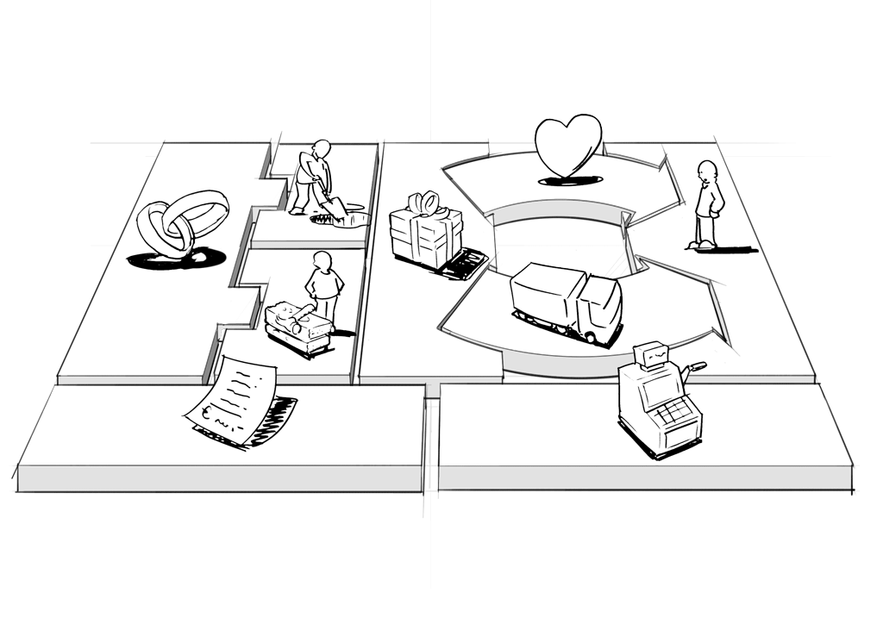
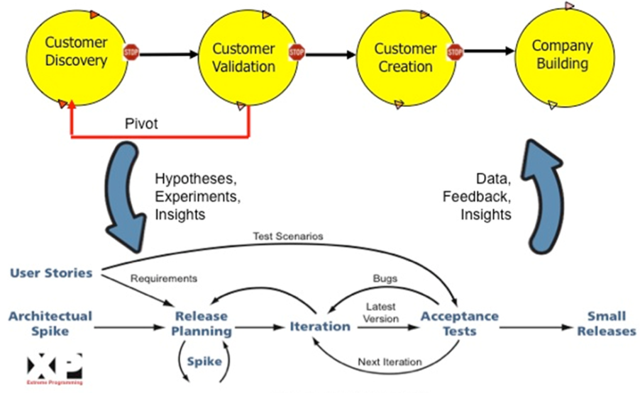
Blue Ocean strategija
tools?
NLP
Lean Startup
BMG

Slide 31

SOCIAL CAPITAL
strong ties /weak ties
TRUST
Notes:
Social Capital …. Trust, … weak/strong ties,

Slide 32
creativity
employment
entrepreneurship
development
new business
opportunities
networking
organizing
technology
infrastructure
social capital

Slide 33
Prioritising
A (imporant and urgent)
B (imporant)
C (urgent)

Slide 34
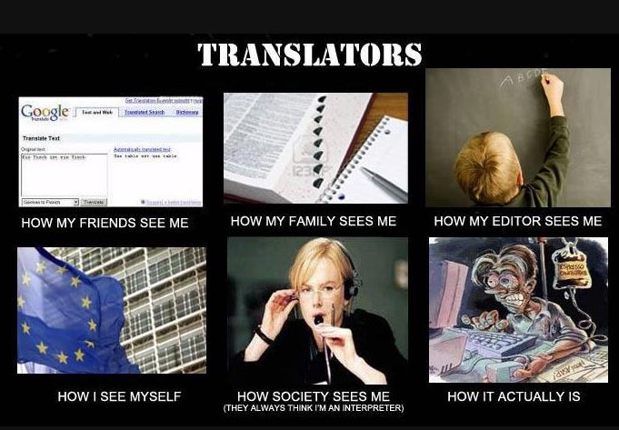
understanding other views…

Slide 35

creativity
full
employment
entrepreneurship
development
new business
opportunities
networking
organizing
technology
infrastructure
social capital

Slide 36
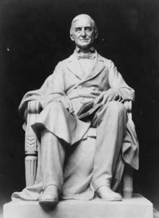
To laugh often and much; to win the respect of intelligent people and the affection of children... to leave the world a better place... to know even one life has breathed easier because you have lived.
This is to have succeeded.
- Ralph Waldo Emerson

Slide 38


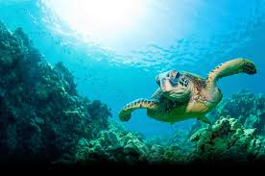


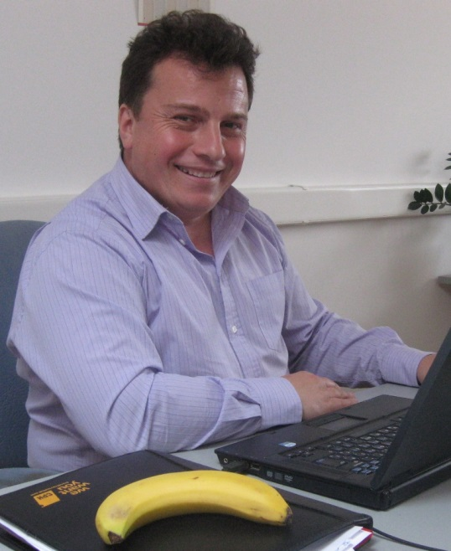
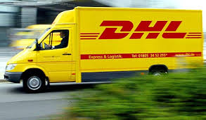

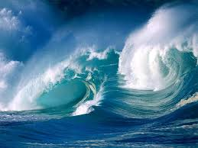


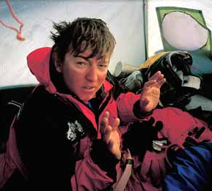


Janez Kolar
MORJE
VETER + VALOVI
1.
2.
3.

