Slide 1


ILO awarded practice in youth employment:
From student work to first employment
Vesna Miloševič Zupančič, M.A.,
Youth Employment and Student Work Consultant
at e-Študentski Servis
1. 7. 2014, Conference on Full Employment in Bosnia & Herzegovina

Slide 2
Student work in Slovenia
    Student work represents 3 % of the whole labour market (in 2013: 230 mio EUR)
    80 % of pupils & students work (at least 1 hour/year)
    Youth on average earn 185 EUR/month net earnings via student work (average monthly wage for employed is 1000.80 EUR/month net earnings).
    Students work to 1) earn some money 2) gain working experience

Slide 3
Process of mediation of student work
and the role of e-Študentski Servis
Employer
Employer / Company
e-Študentski Servis - employment agency (concession by Ministry)
Youth
Student or pupil
Get(s) a job
Demand for work, company needs students/pupils
Mediator

Slide 4
Effects of student work
    Enabling first contact with labour market for youth (limited – only until one is a student, not longer)
    Enabling first working experiences for youth
    Boosting young people’s employability and making them aware of their competencies and skills
    Smoothening young people’s transition from school to 1st employment
    Lowering informal (black) economy, paying taxes
    Lower “at-risk-of-poverty” rates
    Helping employers recruit best-fitting young employees in selection processes
    Helping employers “raise/create” their future employees

Slide 5
Student work leads to first employment
    Researches (Ninamedia 2010, Ministry of labour 2014) showed that: 64.6 % of the youth who performed student work during schooling (studies) were regularly employed at one of the companies where they worked as students after finishing school.
Student work
1st (regular) employment

Slide 6
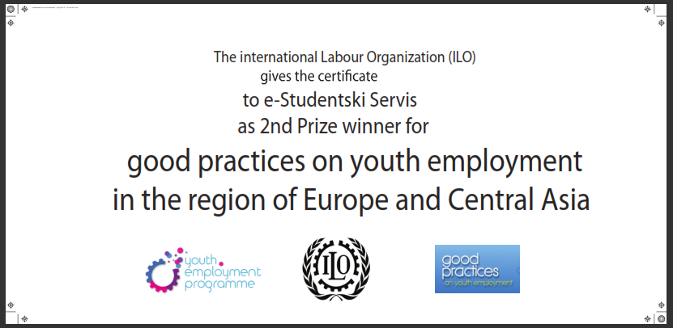
ILO awarded practice
“Moje izkušnje” – My experience (1)
    “Moje izkusnje (My experience)” has been the 2nd prize of the Call for good practices on decent work for youth, an initiative launched by the Youth Employment Unit (YEP) of the International Labour Organization (ILO) in 2014.
    Also recognized by Belgian (Flemish) Ministry of education in 2013

Slide 7
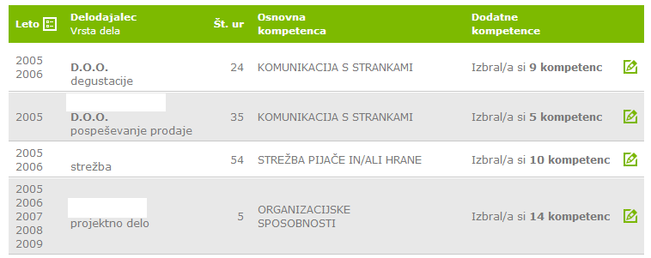
ILO awarded practice
“Moje izkušnje” – My experience (2)
    “Moje izkusnje (My experience)” = a tool for validation and recognition of working experience, gained by student work.
    Automatic, electronic, digital portfolio
    40 % employers
    135 000 young people in Slovenia

Slide 8
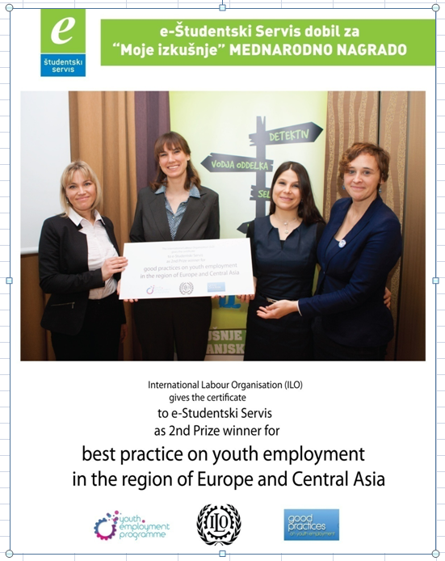

Slide 9

Thank you for your attention!

Slide 10
Contact
    Vesna Miloševič Zupančič, M.A.;
    Youth Employment and Student Work Consultant at e-Študentski Servis
    vesna.milosevic-zupancic@studentski-servis.com

