Slide 1
Job creation in Bosnia using
Social Trade Credit Circuits
Henk van Arkel
1st July 2014

Slide 2
Contents
Social Trade Organisation
Introduction
Immediate payment from the government to suppliers
Contra cyclical credit
Discussion and questions

Slide 3
Social Trade Organisation (1)
Social Trade Organisation (STRO):
R&D focussed on the development of monetary innovations that facilitates societies when needed.
Development of Cyclos payment software with the capacity to transfer money as a dedicated tool for development
Objective of the approach: to counter unemployment by introducing tools that tap unused capacities.

Slide 4
Social Trade Organisation (2)
2003: STRO developed for Banco Palmas the community-bank model. Today over 70 community-banks are active in Brazil.
STRO has been implementing and testing social currencies and commercial Barter in the 90-ties, C3 models in El Salvador (Puntotransaciones) and Italy (a.o. Sardex) since 2005.
Around 30 employees in Holland, Spain, Brazil and Uruguay.
Rewarded by the EU as IT-innovation for Digipay4Growth project under funding line Competitiveness and Innovation (part of FP7) with regional governments in Italy, Spain, England, Austria.

Slide 5


Cyclos 4 PRO software
Innovations possible thanks to Cyclos 4 PRO software, which was recently selected by the payment industry as the world’s most innovative e-pay solution (2014), specially suited for emerging economies

Slide 6
Introduction 1: The importance of the domestic economy
Exports can be improved with strong clusters of businesses
Productive clusters get stronger when they also produce for the local market. Local purchasing power targeting domestic production can thus improve exports.
Benefits and setbacks of the link to the euro
The link to the Euro provides stability
However, to maintain stable exchange rate and balanced government finances, a reduction of expenditures is often needed which also affects local production and consumption (example Greece)

Slide 7
Introduction (2): fighting unemployment by increasing governmental expenditures
Additional governmental expenditures to fight unemployment can
  boost the economy
  Increase tax income
  But increase debts
In a small open economy the additional purchasing power leaves the country before it results in enough taxes to pay off debts.
Solution: Spending through a dedicated digital payment environment that allows purchasing power to leave only after it results in enough additional tax-income.

Slide 8
Introduction (3): extra liquidity by paying suppliers of the government faster
A government that pays its invoices faster adds liquidity to the market
This can be done without additional costs using a dedicated digital payment environment where payments are not done with marks but with term marks.
Term marks are secured claims on marks (payment obligations) at a specific moment in the future
The digital payment environment where term marks are the means of exchange, facilitates a target group of Bosnian companies and consumers.

Slide 9
Introduction (4): cost-free credits for regular suppliers
Governments list trusted/regular suppliers
Suppliers on this list get a cost-free credit in term-marks the day the government receives their invoice
The date that the goverment will pay is registered by the software in term-marks
At that moment the government pays the invoice. With these marks the credit debt is met, while the marks are available for those that own the term-marks related to the invoice

Slide 10
Introduction (5): counter cyclic credits
Suppliers suffer if their clients do not get a credit
These suppliers are willing to support a guarantee fund if that would lead to additional sales
Using term-marks would allow the organisation of these contributions and the guarantee that they are actually paid, which make these credits cheap and available
Once spare capacity and unemployment figures drop, the suppliers no longer want to contribute to the guarantees of their clients and the approach goes dormant

Slide 11
Challenges for the economy of Bosnia
Negative trade balance
Bosnian mark fixed exchange rate with euro
High unemployment (around 45%)
Public debt around 45%
Consumers should get the information on what their choices to buy foreign products over domestic ones would cost them in terms of less future income and less money for their government to spend in favour of them.
Special payment systems can bring the gains of local sales forward in time

Slide 12
Exports based on strong local clusters of businesses
In local economies that underperform, foreign companies compete with local businesses for the scarce purchasing power available locally
Local enterpreneurs often lack the conditions to compete, amongst these access to credit and scale.
Many countries have tried to protect ‘infant industries’, with varying results. China undervalued their currency.
Evidence shows that specialised clusters of local businesses are key to exports.
Can these clusters be reinforced by tools adequate to the Bosnian reality?

Slide 13

The Greek tragedy
Because of sharing their currency with others, the Greek currency did not devalue as would be logical from the point of view of the relative high inflation rate compared with Germany
Financial markets lost faith in the Greek economy
The Greek government reduced
its expenditures radically
As an unwanted side-effect
the domestic production for
local consumers diminished
This resulted in an unnecessary
loss of jobs and tax income and
weakening of the productive clusters.

Slide 14
The need for governments to spend less and more at the same time
Each government needs a certain percentage of its expenditures to return as taxes.
As long as the governmental expenditures leave the country before delivering enough taxes, unemployment can become structurally high…..
Gov
National economy

Slide 15
Government paying suppliers late
Problem: Government paying their suppliers late.
Result: These suppliers are paying their suppliers too late or do not even spend: less work and less taxes.
If invoices are paid immediately this would result in extra tax income and more jobs.
However government lacks funds and procedures to pay invoices immediately. Let’s say that on average the Bosnian governments pay the invoices they get after 70 days.
How can these invoices be paid faster?

Slide 16
Modern technologies allow to dedicate/ condition flows of money
Cyclos software can deliver a dedicated digital payment environment in which the means of exchange can be allowed to stay for a certain amount of time in the local environment.
During this period in which the payments are not able to leave the dedicated environment, marks are not even necessary yet. Claims on marks in the future, term-marks, can be an effective payment tool.
During the term the purchasing power can only be used inside Bosnia. This results in a higher multiplier, more local production and consumption, reenforcing the productive clusters and providing jobs and income. And as a result, more tax income.

Slide 17
Dedicated Term-Marks
Term-marks in a digital local payment circuit
Term Marks are a digital means of exchange that at a well defined moment can be exchanged for real Marks
Term Marks are circulated within dedicated current accounts, an additional type of current account where other rules count compared to the normal Mark current accounts
One application of the use of term marks is that the government provides term marks as a credit the very day their suppliers invoice them. Only after the normal payment period has passed and the invoice has proved to be correct, the government pays the invoice to whoever holds the claims at that moment

Slide 18
Government paying suppliers: the solution
Regional companies are offered a free term-mark Social Trade account on one or more cooperating banks or in a circuit specifically created with that objective.
When regular suppliers sell to the government, they immediately receive a credit in Term Marks (TM)
They can only spend these TMs as if they were Marks to other accountholders, who are Bosnians.
If the invoice proves correct the government pays after the normal 70(?) days the invoice in Marks, to those members of the Social Trade Circuit that own at that moment the Term Marks related to the invoice.
With this payment the credit of the supplier is repaid.

Slide 19
Objectives of the Bosnian Social Trade
More effective circulation of existing purchasing power
Credit for SMEs that are presently not facilitated.
Increase the national multiplier – more local production and sales
More tax income
The opportunity to stimulate the economy as long as there is unemployment without uncontrollable risk on inflation

Slide 20
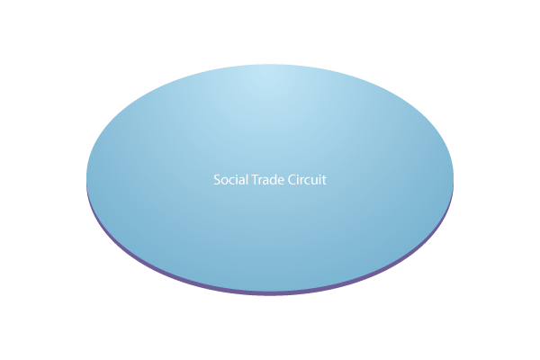
Step 1: Government creates a whitelist of regular suppliers
Government
Notes:
Termijn moet hier 365 dagen zijn
Die lev > De leveran

Slide 21
Step 2: Government pays supplier A with term marks
Government
A
  Company A has provided goods or services to the government.
  Company A sends an invoice
  If A is on the whitelist, the government pays company A within 1 day and pays with term marks that can be exchanged for marks in 70 days.
Notes:
Termijn moet hier 365 dagen zijn
Die lev > De leveran

Slide 22
Step 3: The TMs are circulating within the regional Bosnian network
X
Y
Government
B
Z
A
  Company A spends the term-marks in the circuit at B. B spends at X, etc.
Notes:
Termijn moet hier 365 dagen zijn
Die lev > De leveran

Slide 23
Suppliers paid with term-marks
  Government pays invoice of TM 10.000, (T = 70 days).
  After 15 days TM 10.000 is spent again. (T = 55).
  After 40 days TM 10.000 has a term (T = 30)
  After 70 days
  TM 10.000 can be exchanged (T = 0).
  The government pays TM 10.000 to a supplier that has delivered to them goods or services.
  The payment is done in a digital payment channel that tags the TM and tracks the time to circulate in the Bosnian Network.
  After 70 days those account holders that have TMs with T=0 can exchange them for Marks with the government.

Slide 24
Step 4: After 70 days the TM can be exchanged for marks
After 70 days
Government
Mark
B
Z
  Pretend the government pays A’s invoice after 70 days with marks.
  After these 70 days companies B and Z own the TMs with an `age` of 0 days.
  So they get the Marks while the credit of A is repaid

Slide 25
Advantages
Government does not need Marks immediately and can provide the supplier ultra fast with liquidity.
Government suppliers do not have to wait to receive purchasing power until their invoices get paid. Neither is there a need for expensive factoring
This purchasing power can only be spent within the Bosnian Social Trade Circuit: There is a guarantee it circulates in at least 70 days within the Bosnian economy.
On the accounts a (non) circulation fee is charged in order to use the purchasing power more often. The effect is a faster circulation and a higher multiplier.

Slide 26
Objectives of the Bosnian Social Trade
Counter cyclical Credit for SMEs that are presently not facilitated.

Slide 27
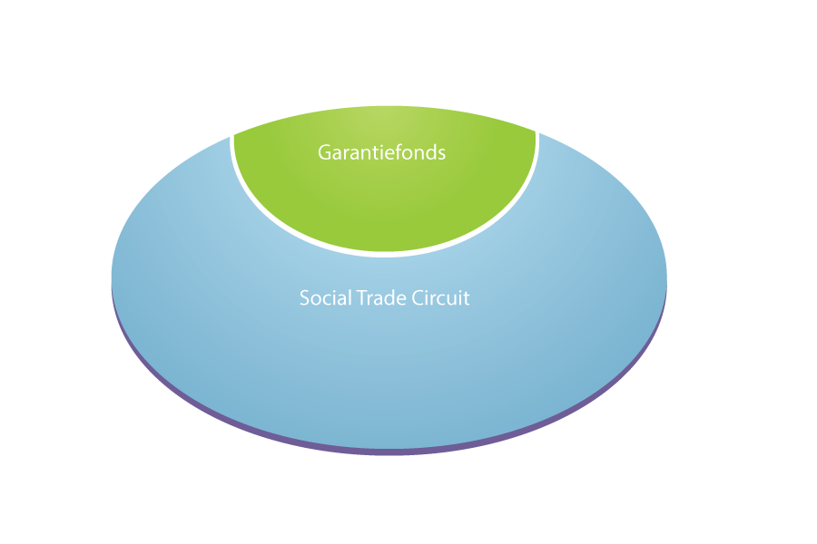
Credit
Term = 365 days
Oinarri
Evaluation OK
TM10.000
Alternativa3
Notes:
Termijn moet hier 365 dagen zijn
Die lev > De leveran

Slide 28
How risks are covered
The bank Oinarri evaluates the risks of each application for credit.
When risks are less than 10%, credit is provided.
These 10% risks are mainly backed by the guarantee fund of the Social Trade Circuit.
This fund is filled by those members that benefit from the new and additional purchasing power introduced by the Circuit.
They can easily afford that because any income for additional demand above the variable costs is profit.
Oinarri can thus accept far higher risks than it would have accepted without organising a dedicated circuit.

Slide 29
Term = 355 days
2. Contribution first supplier to the Guarantee fund R€ 800
Unico
Alternativa3
1. Payment TM 10.000
3. arriving R€ 9.200 on the account of Unico
1. Alternativa3 pays TM 10.000 to Unico.
2. The software makes Unico contribute 8% automatically to support the credit.
3. Unico thus receives net TM 9.200. The profits on marginal sales are sufficient to make it profitable to contribute 8% to enable credit.

Slide 30
Term = 0 days
X
Y
Treval
Z
Unico
Engrunes
Alternativa3
TM 4.000 earned;
debt TM 10.000
Unico spent at Treval and company Y;
Treval spends at X;
X spends at Y and Engrunes, etc.
Some buy at Alternativa3 , which thus earns part of its own term-marks back. At the moment A3 needs to repay, it has TM 4.000 in its account.

Slide 31
During the whole year
X
R€ 534
Y
Treval
Z
Unico
Engrunes
Alternativa3
Notes:
Elk bedrijf dat Res op haar rekening heeft, dankzij het krediet van Alter3, draagt dagelijks etc

Slide 32
TM 1.134 for guarantees thanks to the first supplier and the rest of the supply chain
Term = 0 days
X
Y
Treval
Z
Unico
Engrunes
Alternativa3
TM 4.666 in the account
TM 4.000 on the account and a debt of TM 10.000
Notes:
…… en omloopheffing samen

Slide 33
Term = 0 days
TM 4.000
Alternativa3
- TM 0 in the account
- Debt TM 6.000

Slide 34
Term = 0 days
M 6.000
Alternativa3
- TM 0 in account
- Debt TM 0

Slide 35
Term = 0 days
M 4.666
TM 4.666
Engrunes
TM 0 in account
€ 4.666 in account
Notes:
Eventueel de eerste pijl al samen met de tekst in de eerste fase laten samen gaan

Slide 36
Term marks and credit
  Credit of TM 10.000, that has to be repaid after 365 days (T = 365).
  After 15 days the TM 10.000 is spent
  (T = 350).
  After 215 days TM 10.000 (T = 150) still circulates rapidly because of fee.
  After one year
  TM 10.000 has to be repaid in Marks
  (T = 0).
  Alternativa3 can borrow TM 10.000, based on the payback in one year. On the digital account these units are marked as such
  Alternativa3 spends the TM 10.000 within the Social Trade Circuit at Unico.
  Alternativa3 sells both within the Circuit and outside (earning marks or euro). After the year A3 repays the credit of TM 10.000 with the TMs earned and the rest in marks.

Slide 37
Bijlage: het huishoudboekje van de coöperatie
Alternativa3 borrows TM 10.000
+ claim TM 10.000 on Alternativa3.
- Participants have a claim TM 10.000 on the organisation of the Circuit.
Result = 0
Unico pays 8% commission
+ Claim of TM 10.000 on Alternativa3
- Participants have a claim of TM 9.200 on the Circuit.
Result = TM 800
Circulation fee: TM 534
+ Claim of TM 10.000 on Alternativa3
- Participants have a claim of TM 8.666 on the Circuit.
Result = 800 + 534 = TM 1.334
Alternativa3 repays TM 4.000
+ claims of TM 6.000 on Alternativa3
- Participants have a claim of TM 4.666 on the Circuit.
Result = TM 1.334
Alternativa3 repays M 6.000
+ €6.000
- Participants have a claim of TM 4.666 on the Circuit.
Result = € 1.334
Exchange TMs, costs Oinarri
+ 6.000 – 4.666 - 150 = €1.184
- Participants have a claim of TM 0 on the Circuit.
Result = €1.184
This is available for future defaults in the Guarantee fund.
Notes:
37

Slide 38
Result
Oinarri earned because of evaluation and insurance
X additional turnover
Y: additional turnover
X
Y
The Social Trade Circuit enabled credit and trade + by filling the Guarantee fund
Treval
Z
Treval additional turnover
Z additional turnover
Unico
Engrunes
Unico got a marginal client
Alternativa3
Engrunes additional turnover + extra cash
Alternativa3 get the credit to buy at Unico

Slide 39
More information
STRO: www.socialtrade.org
Cyclos www.cyclos.org
Digipay4Growth www.digipay4growth.eu
Email info@socialtrade.org
Facebook www.facebook.com/socialtrade
Twitter www.twitter.com/socialtradeorg

