Slide 1
CONFERENCE ON EMPLOYMENT GROWTH-
ON A ROAD TO RECOVERY
Sarajevo, July 1, 2014
Based on “BACK TO WORK: Growing with jobs in Europe and Central Asia (ECA)” by Omar Arias & Maria Davalos
The World Bank

Slide 2
The jobs challenge is the most daunting in
Bosnia and Herzegovina
Employment Rate (population aged 15+, first quarter 2013)
Notes: *denotes data for 2012. Data is not seasonally adjusted.
Source: ILO and ECA Regional Jobs Report (2013).

Slide 3
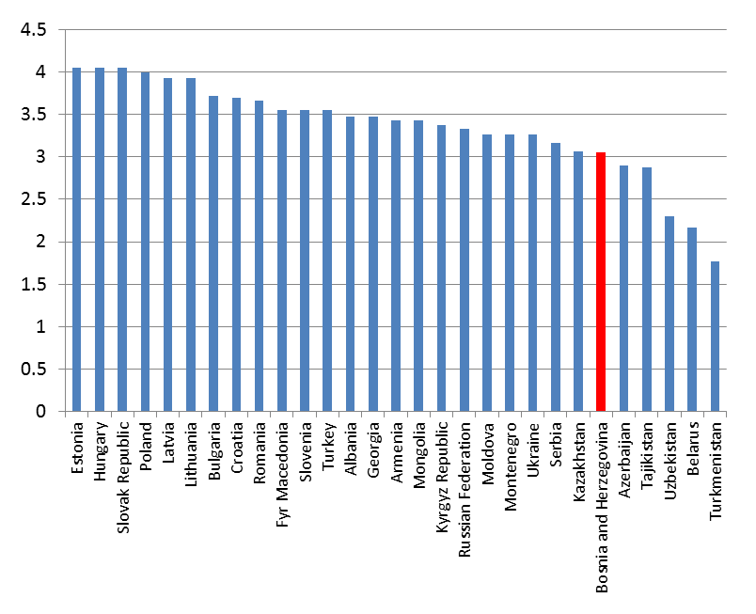
Two contextual factors:
(1) Transition legacy and speed of modernization
Strongest reform record among middle income regions…
… with significant variation in implementation speed of reforms across ECA countries
Doing Business Indicator (Gap to Frontier)
Transition Index (EBRD 2012)
Notes: ECA = Europe and Central Asia; LAC = Latin America and the Caribbean; EAP = East Asia and Pacific.

Slide 4
Two contextual factors:
(2) Impact of demographics on the labor force
ECA Countries: Change in 15+ Population 2010 - 2030 (%)
Younger countries also face demographic pressures:
Out-Migration, youth bulge, and long-run aging
Source: Back To Work: Growing with Jobs in Europe and Central Asia (2013).

Slide 5
Meeting the Jobs Challenge in ECA:
Three policy goals
1
Resuming Sustained Growth:
    Ensure macro fundamentals for economic recovery and regain the pre-crisis reform momentum
2
Enabling Private Sector-led Job Creation:
    Enable business creation and expansion, tap on entrepreneurship
3
Preparing Workers for Jobs:
    Helping workers acquire skills for the modern workplace
    Making (formal) work pay by removing disincentives and eliminating barriers to the labor market
    Removing obstacles to internal labor mobility

Slide 6
Enabling Private Sector-led Job Creation
A small segment of “super star” firms (Gazelles) account for most job creation almost everywhere
As % of all firms and all jobs created during 2004-08
Notes: The number above each country represents the average growth rate of employment per year
Source: Back To Work: Growing with Jobs in Europe and Central Asia (2013).

Slide 7
Preparing Workers for New Jobs - Skills
But inadequate response from education and skills training systems
Too many youth fall behind in basic cognitive skills
% of 15-year olds who are functionally illiterate, scoring “below level 2” on PISA reading test 2009
Source: Based on OECD PISA 2009.

Slide 8
Preparing Workers for New Jobs– Incentives and barriers
There is still room to improve work incentives:
Labor taxation remains relatively high in Bosnia and Herzegovina and, critically, not very progressive
Source: World Bank based on OECD Tax and Benefit Models.

Slide 9
Key policy directions of a diverse Jobs-centered policy agenda - sequencing
Combination of short and long term policies
  Short term:
    Macro/fiscal policy to ensure fundamentals for economic recovery
  Longer term:
    Growing superstar firms – Eliminate barriers to business expansion and entrepreneurship
    Making workers more adaptable - Generic skills and market-driven, life-long learning
    Making (formal) work pay – Removing disincentives and barriers to work
    Making workers more mobile – Removing impediments to labor mobility

Slide 10
What does this mean for
Bosnia and Herzegovina?
Continue strengthening macro-economic stability and policies that foster economic growth
Business climate reforms to facilitate firms’ growth and tap into world markets:
  Business climate reform for private sector development. Priorities are:
    Make it easier to start a business, including entry into and exit out of entrepreneurship
    Rationalizing regulations and rethinking the overall structure of taxation
    Improving infrastructure, especially electricity
  Deepening economic integration, regionally, with the EU and globally
Skills: Equipping workers with market-relevant and adaptable skills
  Ensuring strong generic skills foundations (from ECD to quality basic education)
  Market-driven VET and quality assurance in higher education
  Revamp adult training systems, life-long learning and on-the-job training to make them market-driven

Slide 11
What does this mean for
Bosnia and Herzegovina?
Better balancing worker protection and job creation, with regards to
  Collective agreements, minimum wages and severance costs that can affect disproportionately women, youth and older workers
  Disincentives stemming from labor taxation and the design of social benefits, particularly for low-wage earners, to make (formal) work pay
  Barriers to employment that affect women, youth and older workers, e.g., provision of child and elderly care services and options for flexible work arrangements
  Strengthening the social dialogue on jobs - government, employers, trade unions, youth and civil society at large

