Slide 1


People: The best natural resource for every nation
Alberto Zucconi
World Academy of Art and Science (WAAS)
World University Consortium (WUC)
Person Centered Approach Institute (IACP)
azucconi@iacp.it
Conference on Employment Growth-On a road to recovery- Agenda Parliamentary Assembly building, Sarajevo, June 12-13, 2014,
World Academy of Art and Science
World University Consortium

Slide 2
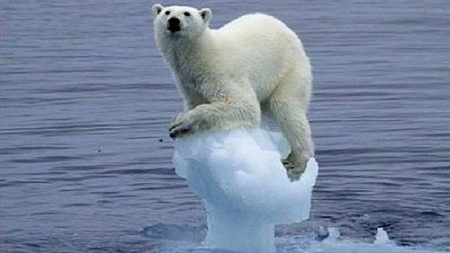
World Academy of Art and Science
World University Consortium

Slide 3

World Academy of Art and Science
World University Consortium

Slide 4
We cannot solve the problems of today at the level of thinking at which they were first created
Albert Einstein
World Academy of Art and Science
World University Consortium

Slide 5
We are blind:
we cannot see clearly how we create
the problems afflicting us.
We are impotent :
we are lacking effective ways to
manage the challenges facing us
World Academy of Art and Science
World University Consortium

Slide 6
    In a period of globalization
    and of growing complexity
    we need new and effective
    ways to cope to meet our
    present and future challenges:
    A new paradigm
World Academy of Art and Science
World University Consortium

Slide 7
    There is ample scientific evidence that our relationship with ourselves, others and the planet we live in is the main variable influencing all the aspects of our lives.
    We need to see, think and act systemically, interdisciplinary, intersectorially
World Academy of Art and Science
World University Consortium

Slide 8
We need to foster a new psychological literacy and psychological resilience
for the citizens, a sort of a
psychological compass:
a more aware and grounded way of being and relating with ourselves, others and the world in order to navigate in the rippling currents of change.
World Academy of Art and Science
World University Consortium

Slide 9
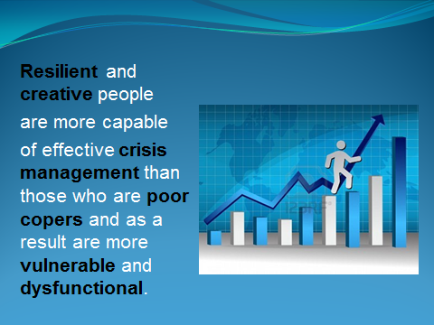
World Academy of Art and Science
World University Consortium

Slide 10
    …But we need to change what does NOT work….
    Our social construction of professional competence is largely obsolete since various professions are still construed by using the outmoded mechanistic reductionist divisions of the traditional fields of expertise
    This situation reflects the limited knowledge of the world we had when the modern professional and scientific disciplines first emerged and continue to be stifled by the lines of jurisdiction in these traditional divisions of expert labor.
    Andrew Abbott, 1988
World Academy of Art and Science
World University Consortium

Slide 11
Education to become more effective needs to shift:
from subject centered to human-centered learning
from passive to active learning
from memorization or understanding to thinking and original thinking
from information or mental understanding to development of the whole person
from academic theoretical to life-centered knowledge
from fragmented knowledge to integrated knowledge
shift from creating standardized products to fostering the development of resilience, individuality and creativity
Education should be explicitly value-based and related to the comprehensive agenda of fundamental human rights
World Academy of Art and Science
World University Consortium

Slide 12
The World Academy of Art and science (WAAS)
&
The World University Consortium
Together with other organizations aware of the present quagmire in which the world is stuck
Are working to create a new paradigm offering effective
ways & means to change to all the stakeholders:
from being part of the problem
to
becoming part of the solution
World Academy of Art and Science
World University Consortium

Slide 13

World University Consortium
World Academy of Art and Science

Slide 14
Education is Key Driver of Economy
Higher the education = lower the unemployment
Higher the education = higher the incomes and consumption patterns
High correlation between tertiary enrollment and per capita GDP
An extra year of school is associated with a 30% increase in per capita income
Education raises the productivity of the workforce
It postpones the entry of new workers into the workforce
It creates new jobs in education and allied sectors - as publishing, media, construction etc.
World Academy of Art and Science
World University Consortium

Slide 15
Benefits of Cutting US Drop-outs 50%
Create 54,000 new jobs in education
Increase demand for homes and cars by $20 billion
Generates $7.6 billion more in earnings per year
Boosts state tax revenues by $713 million a year
Raises college enrollment and graduation rate
World Academy of Art and Science
World University Consortium

Slide 16
Education + Skills = Employment
Expanding & upgrading the educational system is the most powerful strategy to generate youth employment and self-employment opportunities.
Higher levels of education are essential for changes in public policy & culture.
This requires a new paradigm: a shift from conventional education based on rote learning to original thinking that promotes innovation, self-employment and individuality.
World Academy of Art and Science
World University Consortium

Slide 17

A revolution in on-line learning technology can extend affordable, world-class, quality higher education to all

Slide 18
Recommendations
Establish an online system of vocationally oriented higher educational courses in collaboration with World University Consortium and other stakeholders
Introduce American Community College system of vocationally oriented higher education in collaboration with a US counterpart
Mentoring: Launch on-line Skills Exchange to transfer knowledge and skills of the experienced workers to the younger generation
Drop the drop out rate: Introduce special programs to reduce school drop-out
Introduce Khan Academy hybrid learning models in primary & secondary schools combining on-line, self-paced instruction with classroom interaction
Raise the mandatory minimum level of education to EU levels
Empower your émigrés to contribute to the prosperity of Bosnia Herzegovina
World Academy of Art and Science
World University Consortium

Slide 19
Hvala! Thank you! Grazie!
Alberto Zucconi
azucconi@worldacademy.org
World University Consortium (WUC)
www.wunicon.org
World Academy of Art and Science (WAAS)
www.worldacademy.org
Person Centered Approach Institute (IACP)
www.iacp.it
World Academy of Art and Science
World University Consortium

