Slide 1



Opportunities to promote entrepreneurship and self employment
Notes:
Good evening everyone.
My name is Ines Avdić and I will present the IT wonderland we’re building in Sarajevo.

Slide 2
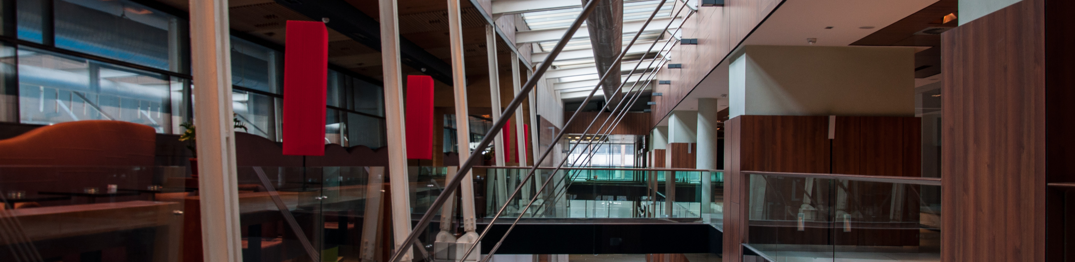
IT park which strengthens the local IT eco system.
Whole IT industry under the same roof to attract bigger, more interesting IT projects.
Notes:
Hub387 is an information technology (IT) park whose main goal is to create an environment which will strengthen the local IT eco system, promoting culture of collaboration and shared knowledge.
HUB387’s vision is to kickstart the local IT and entrepreneurial ecosystem and become the IT place in the region, to connect and rally the currently fragmented IT industry under one roof, to create a platform to promote Bosnia and Herzegovina as the IT place to be in order to attract bigger, more interesting IT projects.

Slide 3
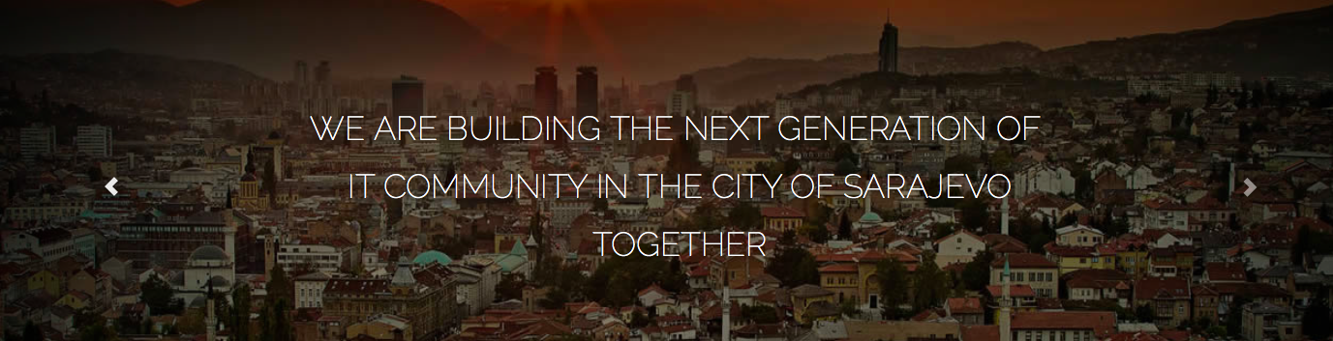
Bosmal City Center
Revived the Promenada space which has been empty for 12 years
Shopping center redefined

Slide 4
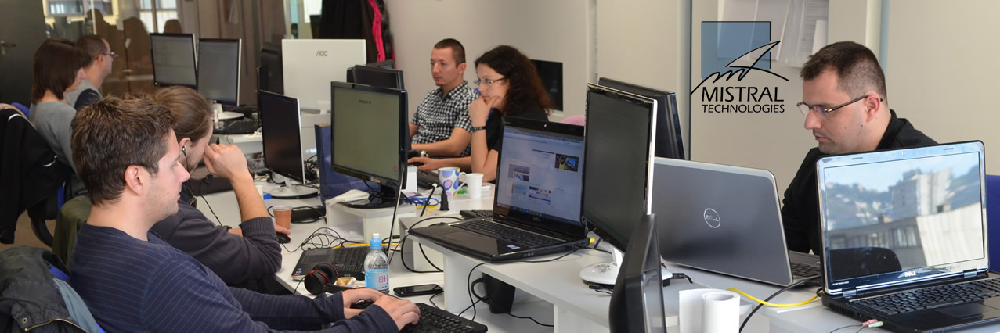
Over 20 cutting edge companies, 95% export
Expertise: IT architecture design, backend, front end, UI/UX design,
digital marketing, 3D animation and production
Notes:
HUB387 is now the home for over 20 cutting edge production, developement, design and 3D&Video companies.
Their expertise ranges from IT architecture design, backend, front end, user interface/user experience design, digital marketing, 3D animation and production.

Slide 5
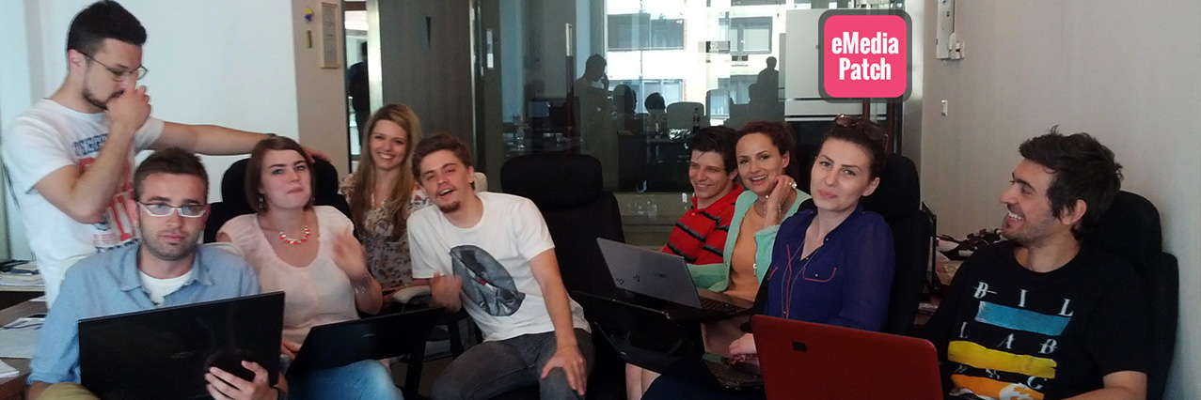
Incubate knowledge and know how
Create new job opportunities
Form a critical mass of talent pool

Slide 6
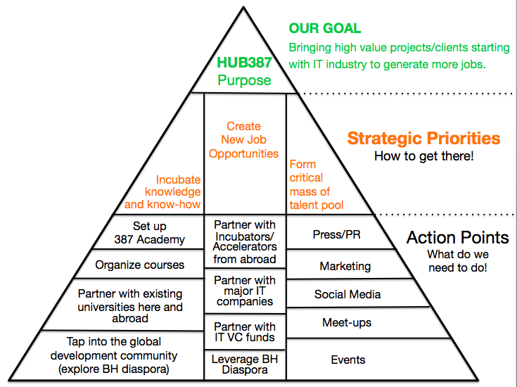
Notes:
How did we plan to do this? We’ve opened up a first Co-working space in Sarajevo, NEST71, where we’ve given working space to all freelancers in Sarajevo and an opportunity to work together on bigger and more interesting projects! That’s how we formed a critical mass of talent pool. We’ve also partnered up with more than 20 IT firms from Sarajevo, which have clients like AT&T, BMW, Revlon International, Graf Diamonds, Mixed in Key, Vapiano, NCR, VarDynamics, ENI Gas, Degordian and many others. We’ve teamed up with Startupbootcamp Berlin and we’re organizing a pitch day for startups on May 17 (come, pitch your startup!).

Slide 7
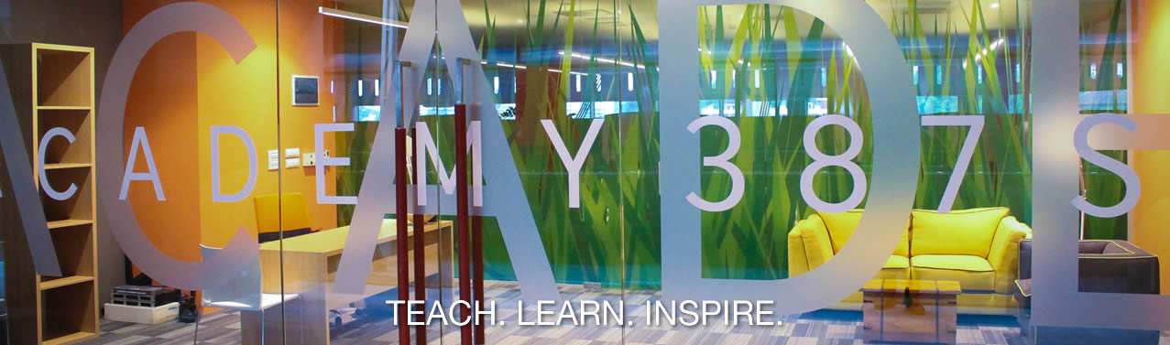
Universities can’t keep up with technology development
Educational framework with short-term, hands on courses led by industry experts
Goal: incubate knowledge and know/how
IT Bootcamp for high schoolers
Reeducation of personelle
Notes:
Hub387 is also the home for a new IT academy! We are all well aware that the classic education system cannot keep up with the pace technology is evolving. ACADEMY387 is addressing the huge demand for IT skilled work force.
ACADEMY387 has been envisioned as an educational framework focusing on organizing serious of short-term, hands on, praxis oriented courses with duration between 2 and 12 weeks. Demand driven and led by industry experts our goal is to provide the skills necessary and incubate knowledge on a new level.

Slide 8
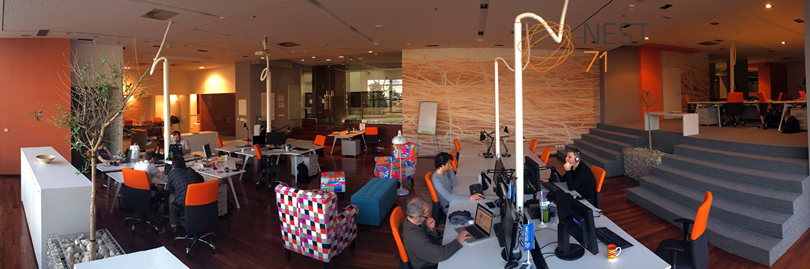
Open, bright, warm, shared office space
Provides collaborative and creative atmosphere to foster new projects
Embraces co-working style
Notes:
NEST71 is a shared office space located within HUB387 created for experienced and ambitious IT entrepreneurs. It provides collaborative and creative atmosphere to foster new projects and new ideas, innovation and modern creative process for new emerging businesses. It embraces new style of work called co-working.

Slide 9
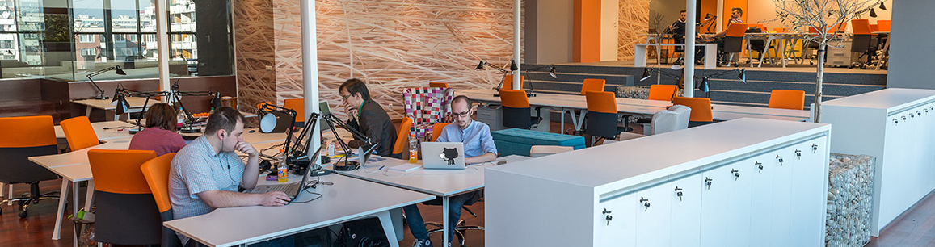
Incubation program
4 startups in 18 months
Seed funding
Mentorship layer
Notes:
NEST71 is a shared office space located within HUB387 created for experienced and ambitious IT entrepreneurs. It provides collaborative and creative atmosphere to foster new projects and new ideas, innovation and modern creative process for new emerging businesses. It embraces new style of work called co-working.

Slide 10
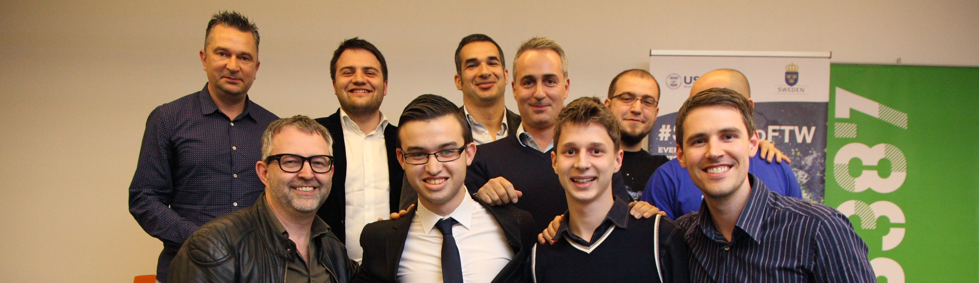
#SarajevoFTW
Featured in TechCrunch
StartupBootcamp
In negotiations with American - Chinese investors
First startup fund negotiations with VC’s from Izrael
Notes:
Hub387 is also the home for a new IT academy! We are all well aware that the classic education system cannot keep up with the pace technology is evolving. ACADEMY387 is addressing the huge demand for IT skilled work force.
ACADEMY387 has been envisioned as an educational framework focusing on organizing serious of short-term, hands on, praxis oriented courses with duration between 2 and 12 weeks. Demand driven and led by industry experts our goal is to provide the skills necessary and incubate knowledge on a new level.

Slide 11
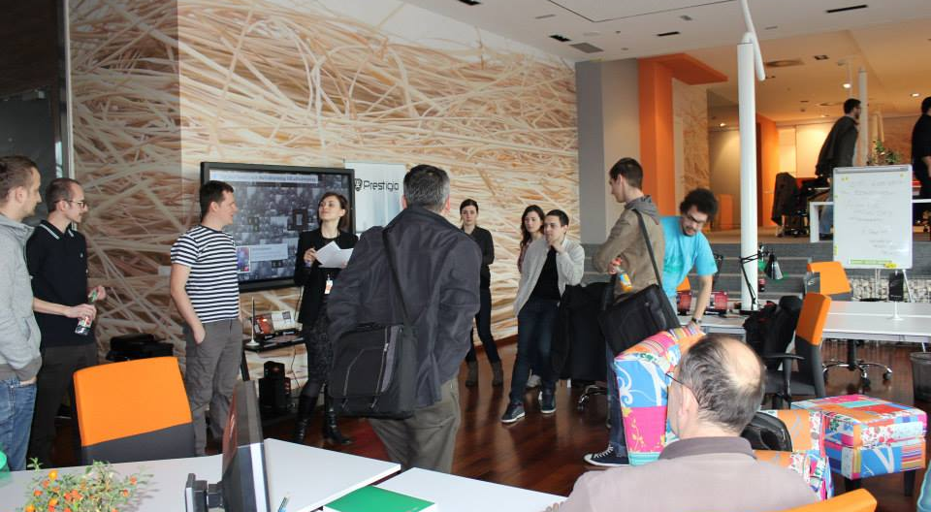

Slide 12
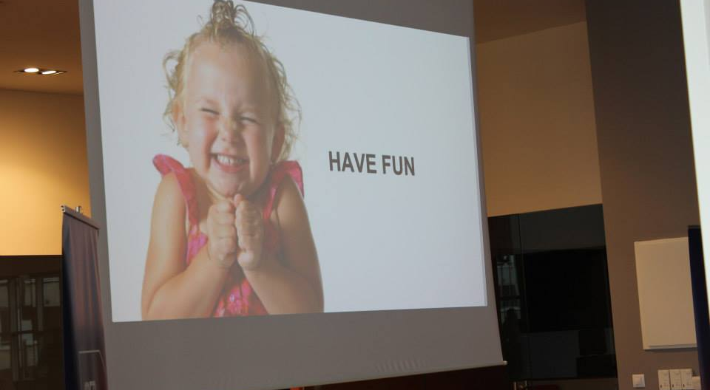

Slide 13
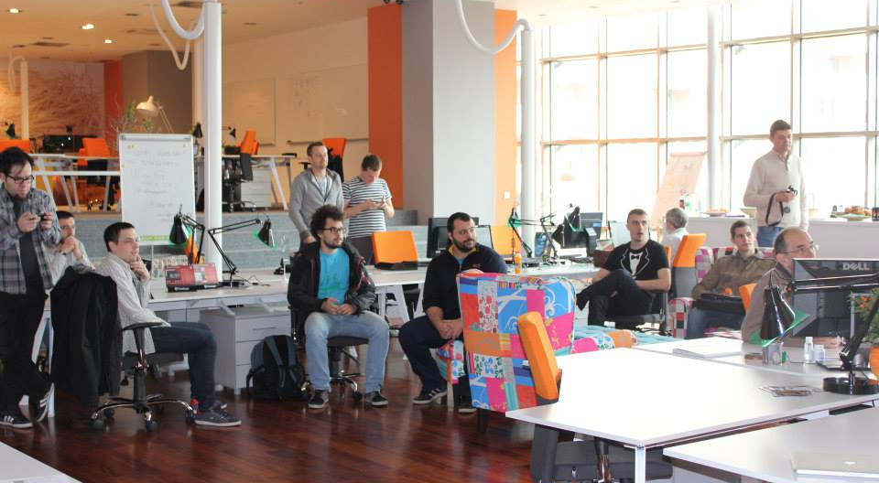

Slide 14
