Slide 1



School of Industrial and Information Engineering
Campus Leonardo
Department of Electronics, Information and
Bioengineering
Post-Graduate Certificate Course at Inter-University Centre, Dubrovnik, Croatia
Mind, Thinking & Creativity
April 12-15, 2016
Deep Learning
Implications for Education
Rodolfo A. Fiorini, DEIB-Politecnico di Milano, Italy
Rodolfo A. Fiorini, http://www.linkedin.com/pub/rodolfo-a-fiorini-ph-d/45/277/498

Slide 2
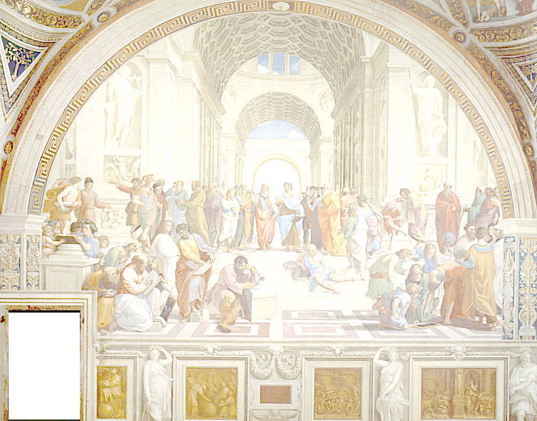
Deep Learning
Implications for Education
« Le seul véritable voyage
ce ne serait pas
d'aller vers de nouveaux paysages,
mais d'avoir d'autres yeux… »
Valentin Louis Georges Eugène Marcel Proust (1871-1922)
from La Prisonnière (1923).
Rodolfo A. Fiorini, http://www.linkedin.com/pub/rodolfo-a-fiorini-ph-d/45/277/498

Slide 3
Deep Learning
Implications for Education
« Observer
c’est pour la plus grande part, imaginer ce que l’on s’attend à voir. »
Ambroise-Paul-Toussaint-Jules Valéry (1871-1945)
from "Degas, Danse, Dessin",
in Oeuvres de Paul Valéry (Librairie Gallimard, 1960), II, p. 1169.
Rodolfo A. Fiorini, http://www.linkedin.com/pub/rodolfo-a-fiorini-ph-d/45/277/498

Slide 4

Presentation Outline
1. Introduction (18)
Current Information & Learning
Ontological Uncertainty
2. Overcoming The Cartesian Duality (18)
Different Learning Approaches
Eulogic Thought
3. Deep Learning Approach (23)
Robert Rosen Modeling Relation
Deep Learning As Nondualistic Learning
Rodolfo A. Fiorini, http://www.linkedin.com/pub/rodolfo-a-fiorini-ph-d/45/277/498

Slide 5
1. Introduction (00)
Paradigma Sistemico di Riferimento
1. Introduction (18)
Current Information & Learning
Ontological Uncertainty
Rodolfo A. Fiorini, http://www.linkedin.com/pub/rodolfo-a-fiorini-ph-d/45/277/498

Slide 6
1. Introduction (01)
Mankind’s best conceivable worldview is at most a partial picture of the real world, a picture, a representation centered on man. We inevitably see the universe from a human point of view and communicate in terms shaped by the exigencies of human life in a natural uncertain environment.
Although there are many sources of uncertainty, two basic areas of uncertainty that are fundamentally different from each other were recognized as traditional reference knowledge: natural and epistemic uncertainty.
Intrinsic randomness of a phenomenon (e.g. throwing a dice) or natural uncertainty cannot be reduced by the collection of additional data and it stems from variability of the underlying stochastic process (if any).
Unlike natural uncertainty, epistemic uncertainty can be reduced by the collection of additional data. Statistical and applied probabilistic theory is the core of traditional scientific knowledge; it is the logic of "Science 1.0"; it is the traditional instrument of risk-taking.
Main epistemic uncertainty sources can be referred to three core conceptual areas: a) Entropy Generation (Clausius-Boltzmann), b) Heisenberg Uncertainty Principle and c) Gödel Incompleteness Theorems.
Rodolfo A. Fiorini, http://www.linkedin.com/pub/rodolfo-a-fiorini-ph-d/45/277/498

Slide 7
1. Introduction (02)
Entropy Generation (Clausius-Boltzmann): The term entropy was coined in 1865 by Rudolf Clausius based on the Greek "εντροπία" (entropía), meaning "turning toward." There are two physical related definitions of entropy: the thermodynamic definition (Clausius, in the 1850s) and the statistical mechanics definition (Boltzmann, in the 1870s). In Quantum Statistical Mechanics (QSM), the concept of entropy was developed by Hungarian-American mathematician and polymath John von Neumann (1903–1957) and is generally referred to as "von Neumann entropy". In classic Information Theory, entropy is the measure of the amount of information that is missing before message reception and is sometimes referred to as "Shannon entropy." The concept was introduced by Claude E. Shannon in his 1948 paper "A Mathematical Theory of Communication". The link between thermodynamic and information entropy was developed in a series of papers by American physicist Edwin Thompson Jaynes (1922–1998), beginning in 1957.
Heisenberg Uncertainty Principle: The more precisely the position of some particle is determined, the less precisely its momentum can be known, and vice-versa.(Elion et al., 1994) The original heuristic argument that such a limit should exist was given by German theoretical physicist Werner Karl Heisenberg (1901–1976) in 1927, after whom it is sometimes named, as the "Heisenberg principle."
Gödel Incompleteness Theorems: Gödel's incompleteness theorems are two theorems of mathematical logic that establish inherent limitations of all but the most trivial axiomatic systems capable of doing arithmetic. The theorems, proven by Austrian American logician, mathematician, and philosopher Kurt Friedrich Gödel (1906–1978) in 1931, are important both in mathematical logic and in the philosophy of mathematics. They prove the open logic approach of Mathematics. (Licata, 2008)
Rodolfo A. Fiorini, http://www.linkedin.com/pub/rodolfo-a-fiorini-ph-d/45/277/498

Slide 8
1. Introduction (03)
Fundamentalist vs. Evolutive Mindset
Rodolfo A. Fiorini, http://www.linkedin.com/pub/rodolfo-a-fiorini-ph-d/45/277/498

Slide 9
1. Introduction (04)
Human Ability to Change in the Light of Experience is called
Plasticity
Rodolfo A. Fiorini, http://www.linkedin.com/pub/rodolfo-a-fiorini-ph-d/45/277/498

Slide 10
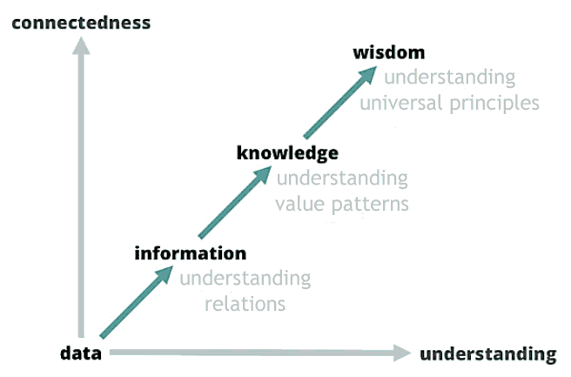
1. Introduction (05)
Information Evolutive Scale
Rodolfo A. Fiorini, http://www.linkedin.com/pub/rodolfo-a-fiorini-ph-d/45/277/498

Slide 11
1. Introduction (06)
Information Concept
is quite recent
vs.
Matter and Energy Ones
by a classical Physics perspective.
Rodolfo A. Fiorini, http://www.linkedin.com/pub/rodolfo-a-fiorini-ph-d/45/277/498

Slide 12
1. Introduction (07)
Value Knowledge Concept
is even quite more recent
than
Data Knowledge Concept
by Classical Information Science perspective.
Rodolfo A. Fiorini, http://www.linkedin.com/pub/rodolfo-a-fiorini-ph-d/45/277/498

Slide 13
1. Introduction (08)
Traditional Cartesian Duality
World of Substance
(Embodied, Valued, Subjective)
vs.
World of Appearance
(Shared, Formal, Objective)
Rodolfo A. Fiorini, http://www.linkedin.com/pub/rodolfo-a-fiorini-ph-d/45/277/498

Slide 14
1. Introduction (09)
Traditional Cartesian Duality
"Warm Data" Approach
(Embodied, Valued, Subjective)
vs.
"Cold Data" Approach
(Shared, Formal, Objective)
Rodolfo A. Fiorini, http://www.linkedin.com/pub/rodolfo-a-fiorini-ph-d/45/277/498

Slide 15
1. Introduction (10)
Traditional Information Concept Cybernetics Links
Claude Shannon (1916–2001) – Binary Code Uncertainty Probabilistic Evaluation.
Gregory Bateson (1904–1980) – The Difference that Makes the Difference.
Heinz Von Foerster (1911–2002) – Observer Plays the Key Role.
Shannon entropy (usually denoted by H(X) or Sh(X)) is the average unpredictability in a random variable, which is equivalent to its information content. Therefore Shannon entropy is a stochastic measure of probabilistic information uncertainty. The concept was introduced by Claude E. Shannon in his 1948 paper "A Mathematical Theory of Communication". Shannon entropy provides an absolute limit on the best possible lossless encoding or compression of any communication, assuming that:
the communication can be represented as a sequence of independent and identically distributed random variables.
Rodolfo A. Fiorini, http://www.linkedin.com/pub/rodolfo-a-fiorini-ph-d/45/277/498

Slide 16
1. Introduction (11)
Information Concept Modeling in Math
has been approached by
Two Large Theoretical and Operative Areas
interlinked by
Irriducible Complementarity.
Continuous Probabilistic Approach (Stochastic Measure)
Well Developed and Applied in all Scientific Areas.
(Infinitesimal Calculus + Stochastic Analysis).
Discrete Deterministic Approach (Combinatorially Based)
Less Developed and Applied in a few quite specific Scientific Areas.
(Finite Difference Calculus + Combinatorial Calculus).
Rodolfo A. Fiorini, http://www.linkedin.com/pub/rodolfo-a-fiorini-ph-d/45/277/498

Slide 17

1. Introduction (12)
The Root of the Problem for Multi-Scale System Modeling
TD
POV
BU
POV
Rodolfo A. Fiorini, http://www.linkedin.com/pub/rodolfo-a-fiorini-ph-d/45/277/498

Slide 18
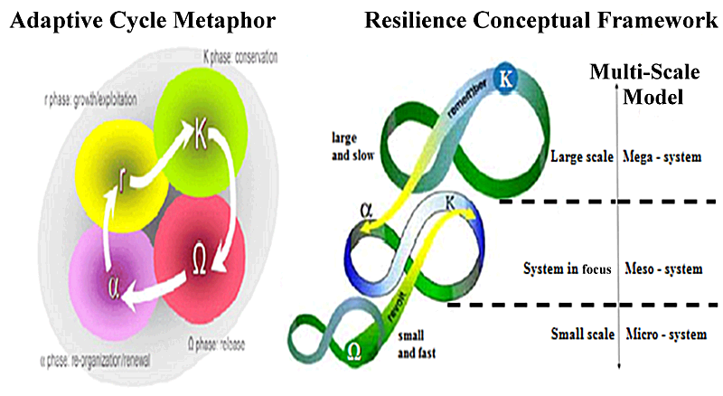
1. Introduction (13)
Multi-Scale Modeling and Adaptive Cycle
Gunderson & Holling and Walker (2002, 2006)
Rodolfo A. Fiorini, http://www.linkedin.com/pub/rodolfo-a-fiorini-ph-d/45/277/498

Slide 19
1. Introduction (14)
Major Problem with Statistical Approach
In 2004, University of Michigan physicist Mark Newman, along with biologist Michael Lachmann and computer scientist Cristopher Moore, applied Shannon’s approach to electromagnetic transmission.
Specifically, they show that if electromagnetic radiation is used as a transmission medium, the most information-efficient encoding format for a given message is indistinguishable from blackbody radiation.
So, paradoxically if you don't know the code used for the message you can't tell the difference between an information-rich message and a random jumble of letters (noise as “unstructured information” concept).
Rodolfo A. Fiorini, http://www.linkedin.com/pub/rodolfo-a-fiorini-ph-d/45/277/498

Slide 20
1. Introduction (15)
Major Problem with Combinatorial Approach
In 1951, Cybernetician Ross W. Ashby (1903 –1972) has shown that a few symbolic computational strategies are practically unachievable (“combinatorial explosion” concept).
E.g. A 20 by 20 LED grid (you can turn them on and off) is associated to 2⁴⁰⁰ different patterns, i.e. 2⁴⁰⁰ > 10¹⁰⁰ different combinations.
A brute force approach strategy to find a specific pattern is going to fail: an “Earth-sized computer”, computing since our contemporary estimated Universe creation, (according to our best measurement of the age of our universe, as of 22 March 2013 (13.798 ± 0.037 billion years (4.354 ± 0.012 × 10¹⁷ seconds) within the Lambda-CDM concordance model), would be unable to achieve the desired result (to find our desired pattern).
Rodolfo A. Fiorini, http://www.linkedin.com/pub/rodolfo-a-fiorini-ph-d/45/277/498

Slide 21
Ontological Uncertainty
1. Introduction (16)
Global complex socio-economic-ecological systems, formed by a large number of parts at different scales of more or less hierarchical systems, produce emergent patterns and unintended consequences at various scales.
A key feature of such complex interactions is that outcomes are inherently uncertain and big data cannot reduce this uncertainty.
In 2005, Lane and Maxfield coined the term "ontological uncertainty" to refer to situations where human agents must make decisions in a context where not only the future trajectory of an entity is uncertain but also its future interactions with other entities and those with each other.
It can also be called radical uncertainty and is the type recognised by Keynes in his well-known remarks in the General Theory.
Rodolfo A. Fiorini, http://www.linkedin.com/pub/rodolfo-a-fiorini-ph-d/45/277/498

Slide 22
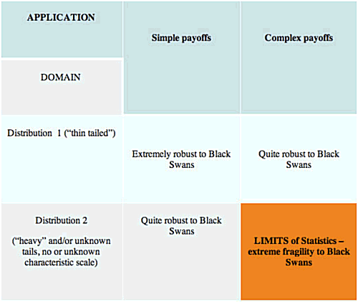
Statistics Can Fool You, Unfortunately
1. Introduction (17)
(N. Taleb, 2014)
Rodolfo A. Fiorini, http://www.linkedin.com/pub/rodolfo-a-fiorini-ph-d/45/277/498

Slide 23
1. Introduction (18)
Fundamentalist vs. Evolutive Approach
Rodolfo A. Fiorini, http://www.linkedin.com/pub/rodolfo-a-fiorini-ph-d/45/277/498

Slide 24
2. Overcoming The Cartesian Duality (00)
2. Overcoming The Cartesian Duality (18)
Different Learning Approaches
Eulogic Thought
Rodolfo A. Fiorini, http://www.linkedin.com/pub/rodolfo-a-fiorini-ph-d/45/277/498

Slide 25
2. Overcoming The Cartesian Duality (01)
Learning according to Confucius (551 – 479 BCE)
If I hear I forget,
If I see I remember,
If I do I understand.
Rodolfo A. Fiorini, http://www.linkedin.com/pub/rodolfo-a-fiorini-ph-d/45/277/498

Slide 26

2. Overcoming The Cartesian Duality (02)
Learning according to Tenzin Gyatso,
the 14th Dalai Lama (1935-)
Because we all share this small planet Earth, we have to learn to live in harmony and peace with each other and with Nature. That is not just a dream, but a necessity.
Rodolfo A. Fiorini, http://www.linkedin.com/pub/rodolfo-a-fiorini-ph-d/45/277/498

Slide 27
2. Overcoming The Cartesian Duality (03)
Learning according to Bateson and von Foerster
Quest for the difference that makes the difference, probing by probing...
Gregory Bateson (1904 - 1980)
… where the fundamental role is played by Observator viewpoint.
Heinz von Foerster (1911 - 2002)
Rodolfo A. Fiorini, http://www.linkedin.com/pub/rodolfo-a-fiorini-ph-d/45/277/498

Slide 28
2. Overcoming The Cartesian Duality (04)
Remembering that "The map is not the territory"
Gregory Bateson (1904-1980), in "Form, Substance and Difference", from Steps to an Ecology of Mind (1972), has elucidated the essential impossibility of knowing what the territory is, as any understanding of it is based on some representation.
Polish-American scientist and philosopher Alfred Korzybski (1879-1950), developer of the "Theory of General Semantics", coined the dictum "the map is not the territory", encapsulating his view that an abstraction derived from something, or a reaction to it, is not the thing itself.
Another basic quandary is the problem of accuracy. Jorge Luis Borges's (1899-1986) "Del rigor en la ciencia" (1946) describes the tragic uselessness of the perfectly accurate, one-to-one map.
Rodolfo A. Fiorini, http://www.linkedin.com/pub/rodolfo-a-fiorini-ph-d/45/277/498

Slide 29
2. Overcoming The Cartesian Duality (05)
Today, we know that incredibly small groups of atoms, much too small to display exact statistical laws, do play a dominating role in the very orderly and lawful events within a living organism.
The great revelation of quantum theory (QT), discovered by Max Planck in 1900, is that features of a discreteness were discovered in the Book of Nature at system microscale (nanoscale) level ("discreteness hypothesis“, DH), in context in which anything other than continuity seemed to be absurd, according to the views held until then at macroscale level.
Furthermore, in 1924 de Broglie introduced the idea in QM of a wave description of elementary systems. Later QFT emerged from a major ontological paradigm shift with respect to Classical Physics which still provides the framework of the vision of nature of most scientists currently.
Rodolfo A. Fiorini, http://www.linkedin.com/pub/rodolfo-a-fiorini-ph-d/45/277/498

Slide 30
2. Overcoming The Cartesian Duality (06)
Quantum Field Theory
The traditional QFT description of a physical system is given in terms of a matter field, which is the space-time distribution of atoms/molecules, coupled to the gauge field with the possible supplement of other fields describing the nonelectromagnetic interactions, such as the chemical forces.
According to the QFT principle of complementarity, there is also another representation where the phase assumes a precise value. This representation which focuses on the wave-like features of the system cannot be assumed simultaneously with the particle representation.
The relation between these two representations is expressed by the uncertainty relation, similar to the Heisenberg relation between position and momentum:
ΔN ΔΦ ≥ 1/2
connecting the uncertainty of the number of quanta (particle structure of the system) ΔN and the uncertainty of the phase (which describes the rhythm of fluctuation of the system) ΔΦ.
Rodolfo A. Fiorini, http://www.linkedin.com/pub/rodolfo-a-fiorini-ph-d/45/277/498

Slide 31
2. Overcoming The Cartesian Duality (07)
Quantum Field Theory
Therefore, a complex system involves two kinds of interaction:
(A) If ΔN = 0, the number of quanta is well defined, so that we obtain an atomistic description of the system, but lose the information on its capability to fluctuate, since ΔΦ becomes infinite. An interaction similar to that considered by Classical Physics, where objects interact by exchanging energy. These exchanges are connected with the appearance of forces. Since energy cannot travel faster than light, this interaction obeys the principle of causality (Science 1.0 approach).
(B) If ΔΦ = 0, the phase is well defined, we obtain a description of the movement of the system, but lose the information on its particle-like features which become undefined since ΔN becomes infinite. An interaction where a common phase arises among different objects because of their coupling to the quantum fluctuations and hence to an e.m. potential. In this case there is no propagation of matter and/or energy taking place, and the components of the system "talk" to each other through the modulations of the phase field travelling at the phase velocity, which has no upper limit and can be larger than c, the speed of light. The system is termed "coherent" (QFT approach).
Rodolfo A. Fiorini, http://www.linkedin.com/pub/rodolfo-a-fiorini-ph-d/45/277/498

Slide 32
2. Overcoming The Cartesian Duality (08)
System Decoherence Modeling
Decoherence offers a way to understand system classicality as emergent from within the quantum formalism.
(W.H. Zurek, 2005)
Rodolfo A. Fiorini, http://www.linkedin.com/pub/rodolfo-a-fiorini-ph-d/45/277/498

Slide 33
2. Overcoming The Cartesian Duality (09)
Rational Human Thinking is like a solid archipelago emerging from an ocean of intuitions.
Rodolfo A. Fiorini, http://www.linkedin.com/pub/rodolfo-a-fiorini-ph-d/45/277/498

Slide 34
2. Overcoming The Cartesian Duality (10)
Human brain is an harmonization machine fed by unaware intuitions to produce learning and rational awareness.
Rodolfo A. Fiorini, http://www.linkedin.com/pub/rodolfo-a-fiorini-ph-d/45/277/498

Slide 35
2. Overcoming The Cartesian Duality (11)
Human brain as an Harmonization Machine
EULOGIC THOUGHT
PALEOLOGIC THOUGHT
Intelligent
Coupled
Relational
Teleologic
Harmonization
Surviving
Deterministic
Open Logic
Learning from Experience
Subjective
NEOLOGIC THOUGHT
Rational Thinking
Analytical
Metacognitive Abstraction
Free Will
Symbolic Reasoning
Learning To Learn
Focused Attention
Closed Logic
Body Independent
Shared (Objective)
HUMAN CREATIVITY
Rodolfo A. Fiorini, http://www.linkedin.com/pub/rodolfo-a-fiorini-ph-d/45/277/498

Slide 36
Ontological Uncertainty Management (OUM)
2. Overcoming The Cartesian Duality (12)
Epistemic and aleatory uncertainties are fixed neither in space nor in time. What is aleatory uncertainty in one model can be epistemic uncertainty in another model, at least in part. And what appears to be aleatory uncertainty at the present time may be cast, at least in part, into epistemic uncertainty at a later date.
They can be thought as an irreducible complementary ideal asymptotic dichotomy only.
Rodolfo A. Fiorini, http://www.linkedin.com/pub/rodolfo-a-fiorini-ph-d/45/277/498

Slide 37
2. Overcoming The Cartesian Duality (13)
Two Irreducible Subsystems based on Ideal Asymptotic Dichotomy
Learning Operative Point can emerge as a new Trans-disciplinary Reality Level, based on an irreducible complementary ideal asymptotic dichotomy: Two Complementary Irreducible Coupled Information Management Subsystems.
Rodolfo A. Fiorini, http://www.linkedin.com/pub/rodolfo-a-fiorini-ph-d/45/277/498

Slide 38
2. Overcoming The Cartesian Duality (14)
To grasp a more reliable representation of reality and to get more resilient and antifragile techniques, researchers and scientists need two intelligently articulated hands: both stochastic and combinatorial approaches synergically articulated by natural coupling (Science 2.0 Approach).
In order to take robust and reliable decision in a complex world, we need to educate and train people to use simple, but effective and powerful strategies and strategic tools, in many different critical application areas.
To design and develop more robust, resilient and antifragile cyber-physical system, we need novel tools to combine effectively and efficiently analytical asymptotic exact global solution panoramas to deep learning local computational precision achievement.
Rodolfo A. Fiorini, http://www.linkedin.com/pub/rodolfo-a-fiorini-ph-d/45/277/498

Slide 39
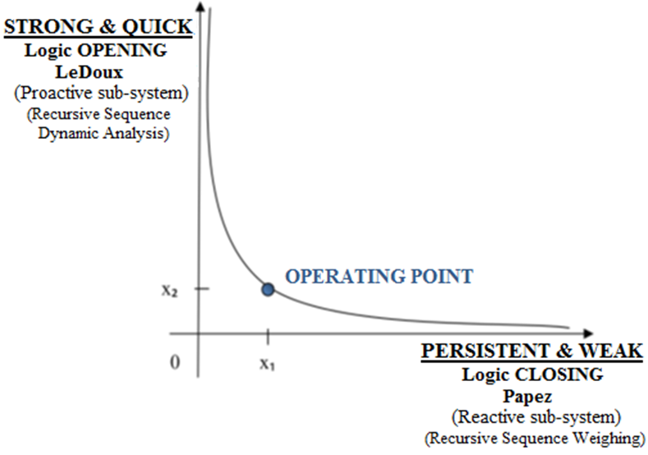
2. Overcoming The Cartesian Duality (15)
Emergent Transdisciplinary Reality Level
Emotional Intelligence (EI) and Emotional Creativity (EC) coexist at the same time with Rational Thinking, sharing the same input environment information.
Operating point as a trans-disciplinary reality level can emerge from two complementary irreducible, asymptotic ideal coupled concepts.
To behave realistically, system must guarantee both Logical Aperture (to get EI and EC, to survive and grow) and Logical Closure (to get Rational Thinking, to learn and prosper), both fed by environmental "noise" (better… from what human beings call "noise").
(R.A. Fiorini, 2013)
Rodolfo A. Fiorini, http://www.linkedin.com/pub/rodolfo-a-fiorini-ph-d/45/277/498

Slide 40
2. Overcoming The Cartesian Duality (16)
Any Real Creative Process
Has a Core of
Deep Thinking
Rodolfo A. Fiorini, http://www.linkedin.com/pub/rodolfo-a-fiorini-ph-d/45/277/498

Slide 41
2. Overcoming The Cartesian Duality (17)
"Five-step Graham Wallas (1926) Creative Process Model“
As Deep Learning Evolutive Approach
(i) preparation (preparatory work on a problem that focuses the individual’s mind on the problem and explores the problem’s dimensions);
(ii) incubation (where the problem is internalized into the unconscious mind and nothing appears externally to be happening);
(iii) intimation (the creative person gets a “feeling” that a solution is on its way);
(iv) illumination or insight (where the creative idea bursts forth from its preconscious processing into conscious awareness);
(v) verification (where the idea is consciously verified, elaborated, and then applied).
Rodolfo A. Fiorini, http://www.linkedin.com/pub/rodolfo-a-fiorini-ph-d/45/277/498

Slide 42
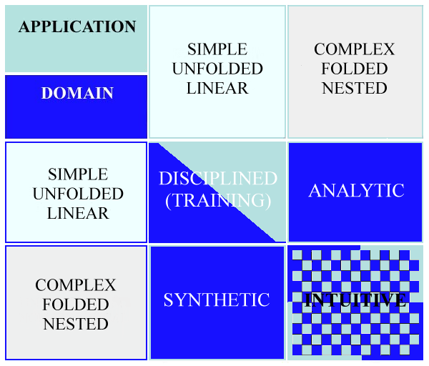
2. Overcoming The Cartesian Duality (18)
Structured Types of Learning
(R.A. Fiorini, 2016)
Rodolfo A. Fiorini, http://www.linkedin.com/pub/rodolfo-a-fiorini-ph-d/45/277/498

Slide 43
3. Deep Learning Approach (00)
3. Deep Learning Approach (23)
Robert Rosen Modeling Relation
Deep Learning As Nondualistic Learning
Rodolfo A. Fiorini, http://www.linkedin.com/pub/rodolfo-a-fiorini-ph-d/45/277/498

Slide 44
3. Deep Learning Approach (01)
Robert Rosen’s System Awareness of Anticipation
« …any material realization of the (M,R)-system must have non-computable models. »
Robert Rosen (1934 - 1998)
(prediction)
(observation & measurement)
Rodolfo A. Fiorini, http://www.linkedin.com/pub/rodolfo-a-fiorini-ph-d/45/277/498

Slide 45
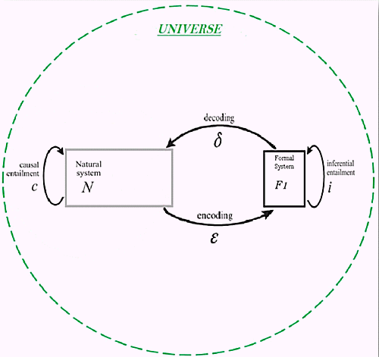
3. Deep Learning Approach (02)
R. Rosen Fundamental Modeling Relation
Rodolfo A. Fiorini, http://www.linkedin.com/pub/rodolfo-a-fiorini-ph-d/45/277/498

Slide 46
3. Deep Learning Approach (03)
System Anticipation according to Robert Rosen
Anticipatory System:
« A system containing a predictive model of itself and/or its environment, which allows it to change state at an instant in accord with the model's predictions pertaining to a later instant. »
(Robert Rosen, 1985)
Rodolfo A. Fiorini, http://www.linkedin.com/pub/rodolfo-a-fiorini-ph-d/45/277/498

Slide 47
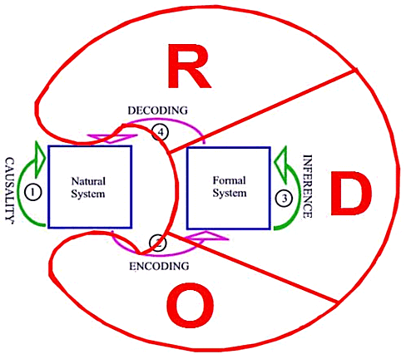
3. Deep Learning Approach (04)
From Rosen Modeling Relation to ODR Model Mapping
Rodolfo A. Fiorini, http://www.linkedin.com/pub/rodolfo-a-fiorini-ph-d/45/277/498

Slide 48
3. Deep Learning Approach (05)
From ERGODIC OBSERVER to EGOCENTRIC INTERACTOR
Rodolfo A. Fiorini, http://www.linkedin.com/pub/rodolfo-a-fiorini-ph-d/45/277/498

Slide 49
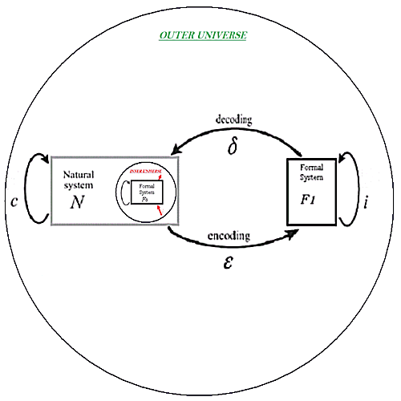


3. Deep Learning Approach (06)
R. Rosen Fundamental Modeling Relation (Reflexive/Reflective)
Rodolfo A. Fiorini, http://www.linkedin.com/pub/rodolfo-a-fiorini-ph-d/45/277/498

Slide 50
3. Deep Learning Approach (07)
R. Rosen Fundamental Modeling Relation (Reflexive/Reflective)
R. Rosen Fundamental Modeling Relation with explicit Reflexive and Reflective Representations.
Immediately, Reflexive and Reflective Representations create two base system scaling symmetries into ODR Model: convergent and divergent scaling symmetries.
They allow for the correspondence of a Inner Universe - SELF representation to an Outer Universe representation, both linked by the Kelvin Transform.
Convergent Scaling:
Divergent Scaling:
Rodolfo A. Fiorini, http://www.linkedin.com/pub/rodolfo-a-fiorini-ph-d/45/277/498

Slide 51
3. Deep Learning Approach (08)
From Rosen Modeling Relation to ODR Recursive Model
Rodolfo A. Fiorini, http://www.linkedin.com/pub/rodolfo-a-fiorini-ph-d/45/277/498

Slide 52
3. Deep Learning Approach (09)
From EGOCENTRIC to RECURSIVE INTERACTOR
Rodolfo A. Fiorini, http://www.linkedin.com/pub/rodolfo-a-fiorini-ph-d/45/277/498

Slide 53
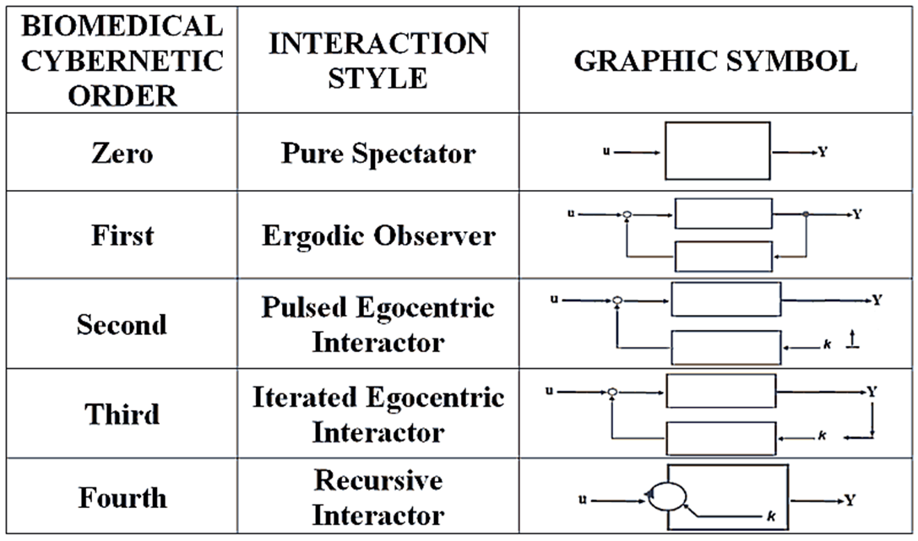
3. Deep Learning Approach (10)
Our final post-Bertalanffy Systemics Framework
This new awareness can guide any quantum leap to more convenient future post-human cybernetics approaches in science and technology.
(R.A. Fiorini, 2011)
Rodolfo A. Fiorini, http://www.linkedin.com/pub/rodolfo-a-fiorini-ph-d/45/277/498

Slide 54
3. Deep Learning Approach (11)
A Five-Level post-Bertalanffy Cybernetics Framework
ZERO (Clausius): Ideal, closed system, totally isolated open-loop system.
ONE (Wiener): "Self-steering" is assumed to be isolated from the act of observation and negative feedback functions as part of a mechanical process to maintain homeostasis.
TWO (von Foerster): The process of "self-steering" is now understood to be affected by observer/s, but the related mathematical modeling is insufficiently complex to encourage new values emerge. Nevertheless, it is understood that Positive and Negative Feedback can lead to morphogenesis intuitively.
THREE (Bateson): The process is understood as an interaction that can affect/be affected by many observers, but it does not address what this means for the "social" response-ability of the single participant observer. Articulated values emerge.
FOUR (Rosen): Multiple realities emerge by the freedom of choice of the creative observer that determines the outcome for both the system and the observer. This puts demands on the self-awareness of the observer, and response-ability for/in action.
Rodolfo A. Fiorini, http://www.linkedin.com/pub/rodolfo-a-fiorini-ph-d/45/277/498

Slide 55
3. Deep Learning Approach (12)
The Value of Values
Value Knowledge Concept
as
Fundamental Attractor
to
Systemic Convergence
to a Goal.
Rodolfo A. Fiorini, http://www.linkedin.com/pub/rodolfo-a-fiorini-ph-d/45/277/498

Slide 56
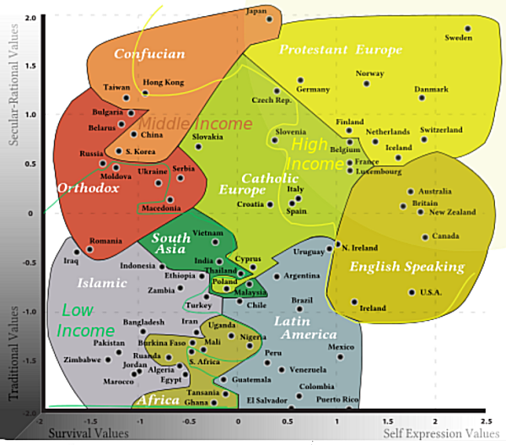
3. Deep Learning Approach (13)
The Challenge of Transcultural Learning
(Inglehart–Welzel cultural map of the world, 2010)
Rodolfo A. Fiorini, http://www.linkedin.com/pub/rodolfo-a-fiorini-ph-d/45/277/498

Slide 57
3. Deep Learning Approach (14)
Hartman Axiological Value Definition
for a Generic Entity (TD Approach))
1 INTRINSIC VALUE (All the Properties
contained in the Meaning of the Name)
2 EXTRINSIC VALUE (Name with a Meaning
defined by a Set of Properties)
3 SYSTEMIC VALUE (Certain Name)
Rodolfo A. Fiorini, http://www.linkedin.com/pub/rodolfo-a-fiorini-ph-d/45/277/498

Slide 58
3. Deep Learning Approach (15)
Hartman Axiological Value Definition
OUTER UNIVERSE | INNER UNIVERSE - SELF
INTRINSIC, “Empathy” Other persons as unique individuals; the spiritual, irreplaceable worth of others; the value of a “thing” as it exists in itself. | INTRINSIC, “Self Esteem” The self as infinitely valuable; the unique individuality of each person; the understanding of “who” one is; actual strengths and limitations.
EXTRINSIC, “Practical Judgment” Material value; things; classes or groups of things; other things as they serve useful roles or have functional value; comparison of things, people or situations; concrete, functional value in general, practical concrete organization. | EXTRINSIC, “Role Awareness” “What” one is; the role function one plays; the sense of using time in a useful, functional way; career thinking; satisfaction or dissatisfaction with what one is doing in the world.
SYSTEMIC, “Systems Judgment” Analytical or structured thinking; structure, order or consistency in thinking; theoretical or conceptual organization and planning; valuing what “ought to be”; the rules. | SYSTEMIC, “Self Direction” “Where” one is going or “ought” to be going; self direction; persistence; drive motivated from commitment to inner principles and goals; self concept; ideal self image.
Rodolfo A. Fiorini, http://www.linkedin.com/pub/rodolfo-a-fiorini-ph-d/45/277/498

Slide 59
3. Deep Learning Approach (16)
Nondualistic Learning
Inner and Outer Universe Nondualistic Learning
To Overcome
Classic Cartesian Duality
Rodolfo A. Fiorini, http://www.linkedin.com/pub/rodolfo-a-fiorini-ph-d/45/277/498

Slide 60
3. Deep Learning Approach (17)
Nondualistic Learning
Symmathesy Theory
(Mutual Learning in Living Systems, Nora Bateson, 2015)
vs.
General Systems Theory
(Karl Ludwig von Bertalanffy, 1934)
Rodolfo A. Fiorini, http://www.linkedin.com/pub/rodolfo-a-fiorini-ph-d/45/277/498

Slide 61
3. Deep Learning Approach (18)
Nondualistic Learning
Nondualistic Learning
as
Deep Learning
Rodolfo A. Fiorini, http://www.linkedin.com/pub/rodolfo-a-fiorini-ph-d/45/277/498

Slide 62
3. Deep Learning Approach (19)
The Ability to Learn and
To Change Accordingly our Mind
is intimately connected to
Deep Thinking
Rodolfo A. Fiorini, http://www.linkedin.com/pub/rodolfo-a-fiorini-ph-d/45/277/498

Slide 63
3. Deep Learning Approach (20)
Deep Thinking and Creativity
are the Essence of Human Mind
Rodolfo A. Fiorini, http://www.linkedin.com/pub/rodolfo-a-fiorini-ph-d/45/277/498

Slide 64
3. Deep Learning Approach (21)
Human Mind
can be Augmented
only, not Substituted
by Machines
Rodolfo A. Fiorini, http://www.linkedin.com/pub/rodolfo-a-fiorini-ph-d/45/277/498

Slide 65
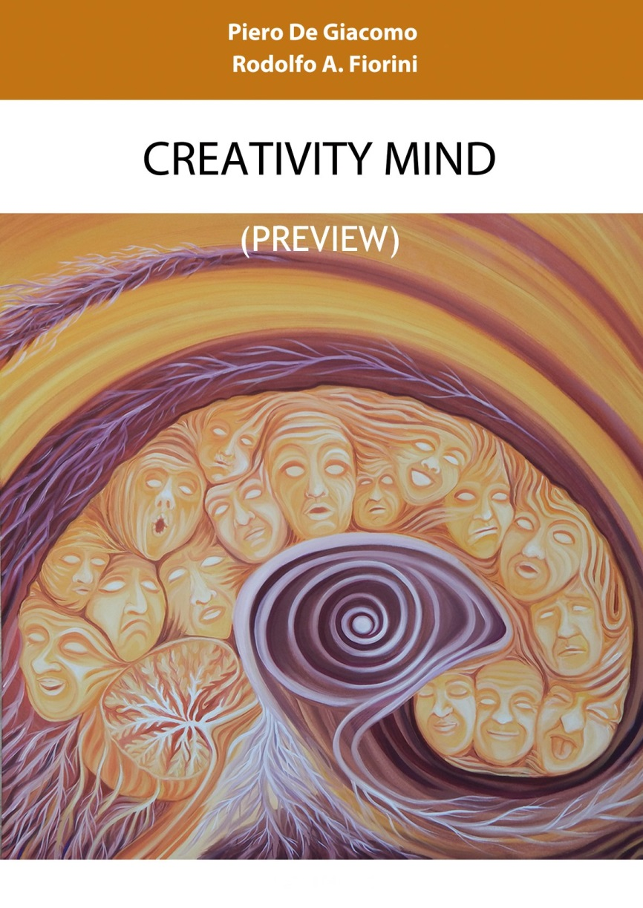
3. Deep Learning Approach (22)
Rodolfo A. Fiorini, http://www.linkedin.com/pub/rodolfo-a-fiorini-ph-d/45/277/498

Slide 66
3. Deep Learning Approach (23)
Neuralizer Work In Progress
Rodolfo A. Fiorini, http://www.linkedin.com/pub/rodolfo-a-fiorini-ph-d/45/277/498

Slide 67

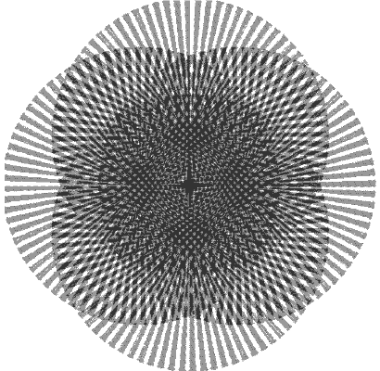
Deep Learning
Implications for Education
Thank You for
Your A t t e n t i o n
Rodolfo A. Fiorini, http://www.linkedin.com/pub/rodolfo-a-fiorini-ph-d/45/277/498

