Slide 1
The power of analogIES, metaphorS AND SYMBOLS
Notes:
The limitations I am going to talk about are of the same nature of those that we are addressing in this course, but at a lower level of complexity
I will I will be using examples that relate to the public at large in order to illustrate some fundamental limitations in the way we understand and utilize the human mind and the mental processes on which knowledge is based.

Slide 2
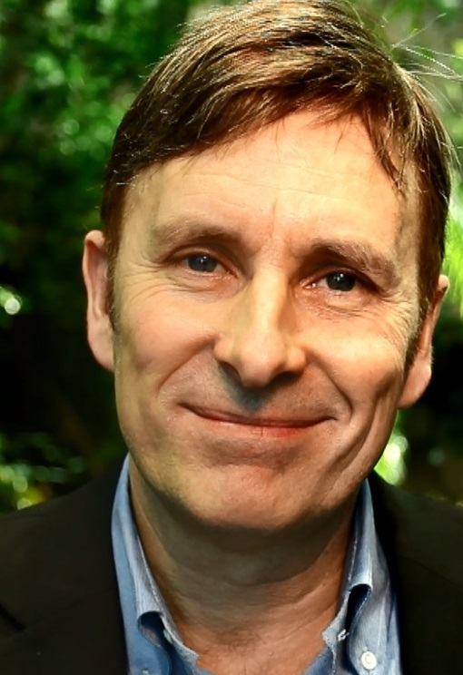
MARIO HYTTEN
Swedish
CEO, Planetaire AB, Sweden
35 years of communication through sports

Slide 3
Human cognition consists of analogy, metaphor, and conceptual blending
(Hofstadter; Lakoff and Johnson 1980, 1999;
Fauconnier and Turner 2002)

Slide 4
The power of analogIES, metaphorS AND SYMBOLS
Notes:
The limitations I am going to talk about are of the same nature of those that we are addressing in this course, but at a lower level of complexity
I will I will be using examples that relate to the public at large in order to illustrate some fundamental limitations in the way we understand and utilize the human mind and the mental processes on which knowledge is based.

Slide 5
Table of content
Metaphors, Analogies, Symbols
Heuristics
Instinctively Sustainable
Notes:
I also avail myself of examples of skilled actors in the commercial world
….who have significantly evolved the techniques they use to interact with consumers, creating behavior change on a scale that social institutions could only dream of.

Slide 6
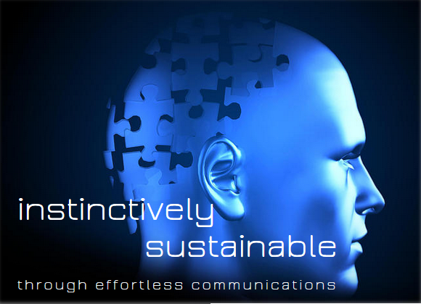
www.mariohytten.com
Notes:
I am covering these subjects in more detail in my white book, published on the internet
Today I will summarise them BUT NOT EXPLAIN THEM IN DETAIL

Slide 7
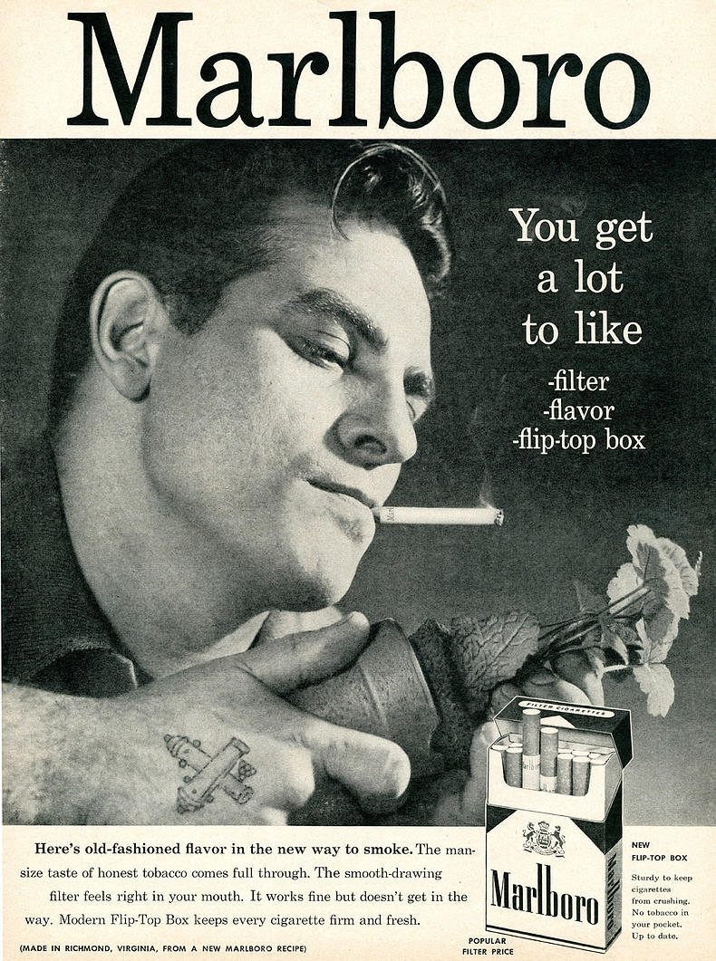
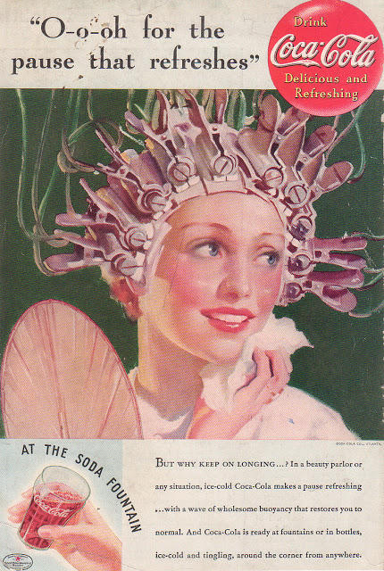
Persuasion adverttising
Notes:
Persuasion advertising

Slide 8
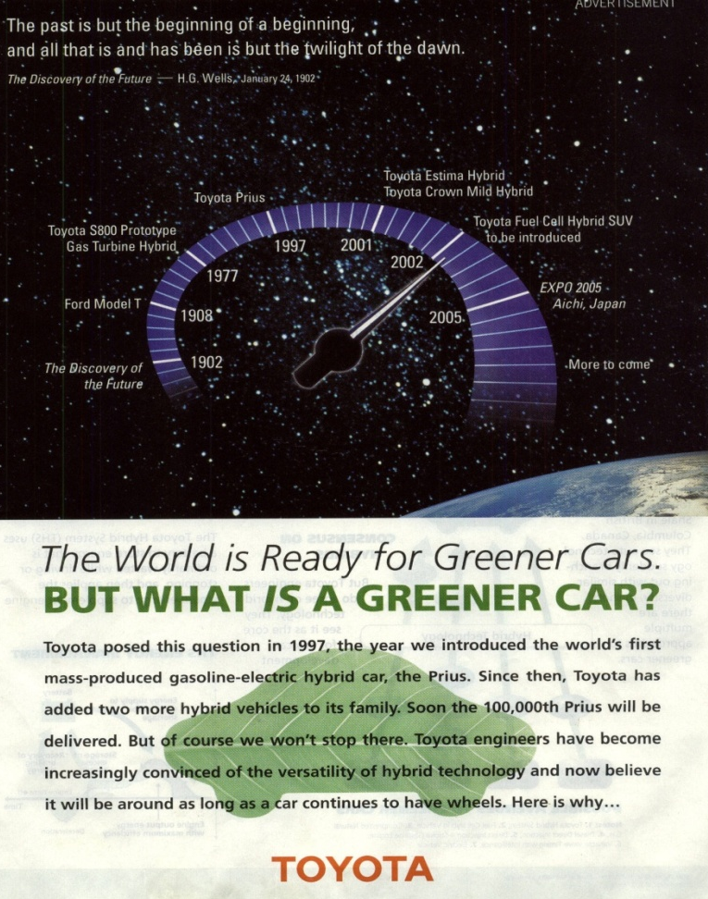
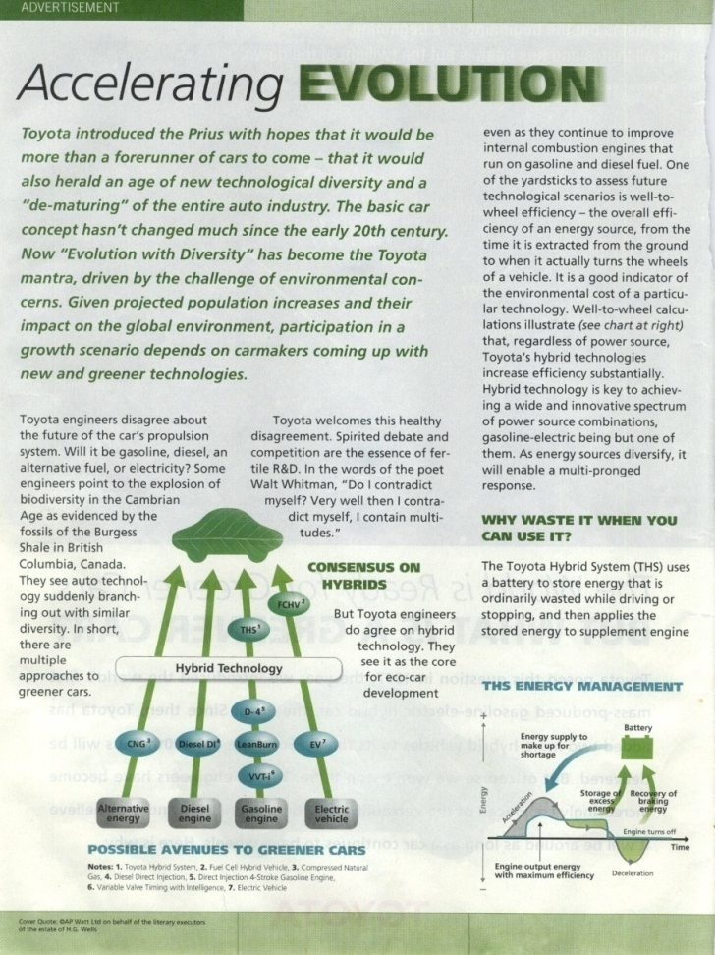
Notes:
DOESEN’T IT REMIND YOU OF THIS?

Slide 9
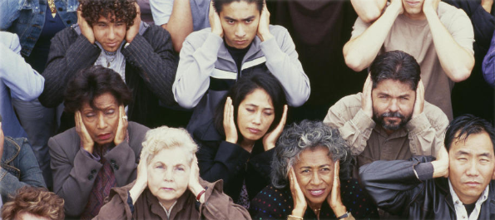
educating consumers about environmental issues, ethical consumerism, sustainable transport, combating exotic diseases, saving energy, combating the destruction of the ozone layer, managing water resources,recycling, internal production processes

Slide 10
Closure
Sales pitches
Advertising messages
Slogans
All elicit ”closure”
Notes:
Laran, 2011) ‘Five experiments demonstrate that brands cause priming effects (i.e., behavioural effects consistent with those implied by the brand), whereas slogans cause reverse priming effects (i.e., behavioral effects opposite to those implied by the slogan). […]
‘We suggest that priming effects are reversed when consumers perceive a marketing tactic as a source of persuasion. […]
While virtually all marketing stimuli are persuasion tactics, consumers might perceive certain marketing stimuli, but not others, as persuasion tactics. […]
Because slogans have a more transparent purpose than brands do, consumers should be more likely to perceive slogans as persuasion tactics compared to brands. […]
[Our study] provides unequivocal evidence that slogans elicit correction without any conscious intervention.’
= could this in fact indicate a natural resistance to any message that is formulated in a patronising or biased way?
This would explain the disproportional efficiency of Humor, which is the art of conveying your idea indirectly, by wrapping it into an incoherent narrative.

Slide 11
Zero resistance to Brands

Slide 12
Do NOT seek to engage System 2 thinking

Slide 13
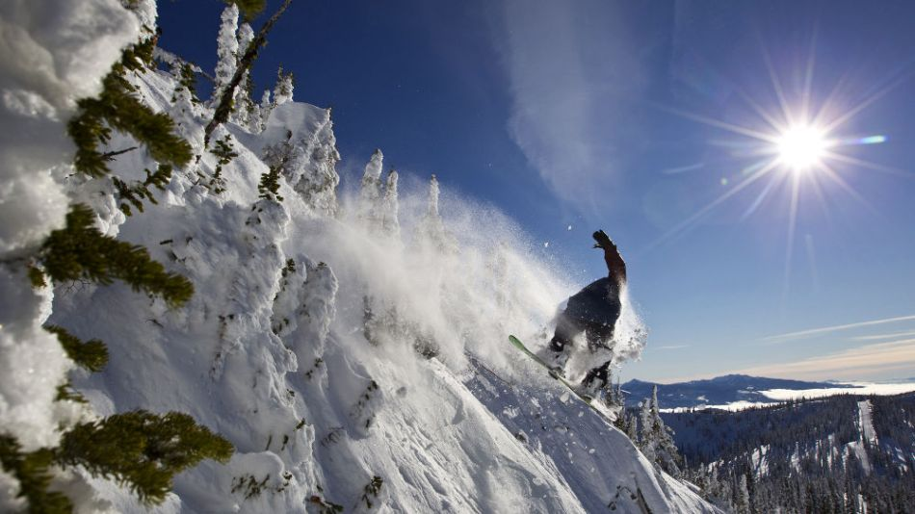
©copyrights Planetaie AB 2012

Slide 14
One of the fundamental findings of cognitive science is that people think in terms of metaphors.
(Lakoff, Don't think of an elephant, 2004)
Notes:
The frames are in the synapses of our brains physically present in the form of neural circuitry.

Slide 15
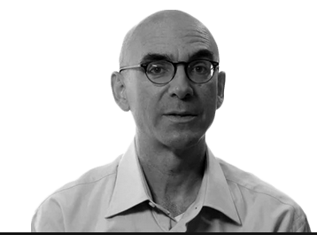
If you cannot change the public's metaphors, then you cannot change how they perceive the facts
(Jo Romm – Language intelligence )
Notes:
Author of Language Intelligence

Slide 16
“
”When the facts don’t fit the frame, the facts get rejected, not the frame.”
Susan Bale, The FrameWorks Institute
Notes:
“If the facts don’t fit the theory, change the facts.”
Albert Einstein

Slide 17
An organic process
Metaphors and analogies are generated through storytelling:
literature
entertainment
sports

Slide 18
Symbols are replaced by brands, therefore brands are perceived as innocuous.

Slide 19
Analogies, metaphors, symbols,
are triggers for
HEURISTICS

Slide 20
Sum of your knowledge
a committed belief

Slide 21
Mental spaces

Slide 22
deliberate rational

Slide 24
heuristics
Affect heuristic
Halo effect
Availability cascade
Attribute substitution
Framing heuristic
Priming effect
Notes:
‘affect’ stands for emotional response.
Swedish Professor Arvid Carlsson (Nobel Prize in Physiology or Medicine 2000, for demonstrating dopamine’s role as a neurotransmitter) confirmed to the author: ‘There is no doubt that an exciting sports event will trigger the release of dopamine. Thus the individual’s reward system will be involved, cause emotional arousal and amplify the response to stimuli of various kinds.’
Halo effect: An attractive person may also be perceived to be honest.
Availability cascade: a self-reinforcing process in which a collective belief gains more and more plausibility through its increasing repetition in public discourse
Attribute substitution: underlies a number of cognitive biases and perceptual illusions. It occurs when an individual faces a complex question, and chooses to substitute it with a related but easier question that can he can answer on gut feeling, without realizing that a substitution has taken place:
How far will this woman go in politics? > Does she look like a winner?
Framing heuristic and Priming effect >>>> see next pages

Slide 25
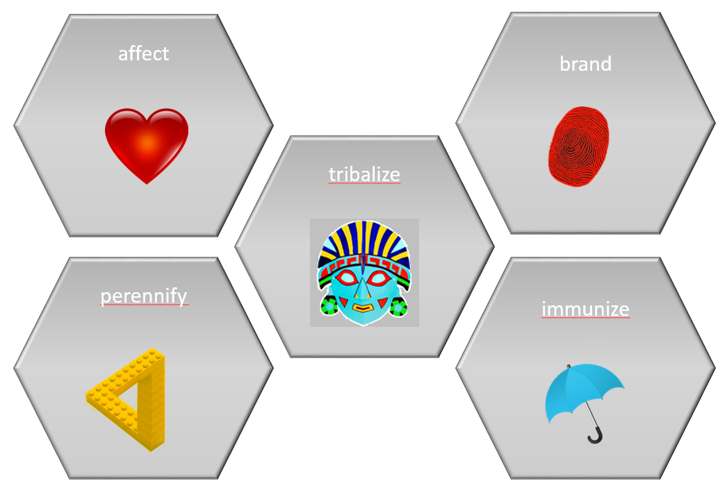
Communicating through heuristics
Explained in INSTINCTIVELY SUSTAINABLE.
Rests on 5 pillars:

Slide 26
Affect
Avoid
Use exclusively
Persuasion
Copy or slogan
Negative messages
Aim for system 2 thinking
Trigger affect
Role models that lead by example
Storytelling
System 1 thinking

Slide 27
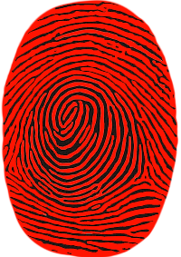
Brand
Avoid
Use exclusively
Verbal communications
Complex rationales
Metaphors, analogies, symbols
Rely on heuristics
Enticing content
Allow commercial brands to symbolize the message

Slide 28
Perennify
Avoid
Use exclusively
One-off events
Staged or scripted events
Revolving calendar
Embrace competition and controversy
Authenticity, allow the narrative to take on life of its own

Slide 29
Tribalize
Avoid
Use exclusively
Political tribes
Tribes based on sports, teams, nationalities, sponsors
Self-defined lifestyle

Slide 30
Immunize
Avoid
Use exclusively
Greenwashing
Ringfence to brands with proven sustainability credentials
Halo-effect
Self-policing

Slide 31
ends

