Slide 1
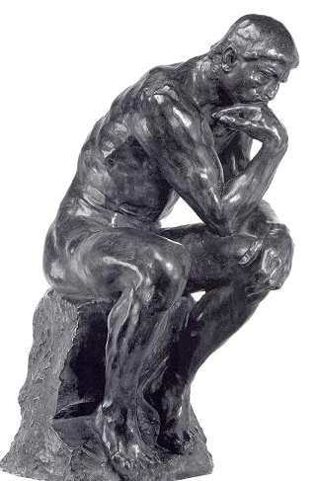
Varieties of Thinking
Garry Jacobs
CEO, World Academy of Art & Science
Chairman of the Board & CEO, World University Consortium
Vice-President, The Mother's Service Society

Slide 2
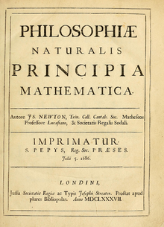
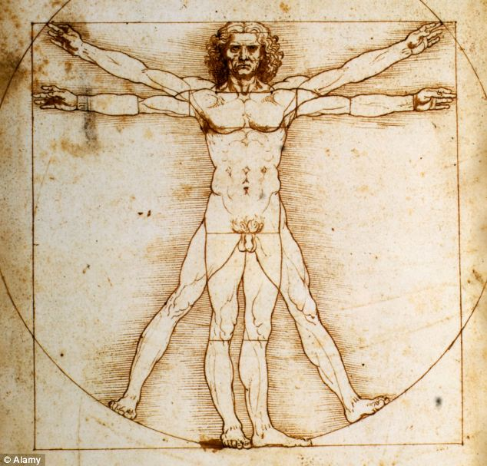
Concept formation
Abstract concepts
Logical reasoning
Conceptual systems
Mathematics

Slide 3
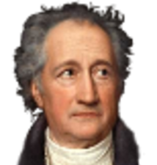
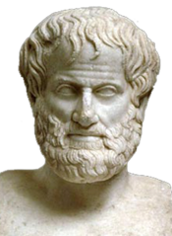
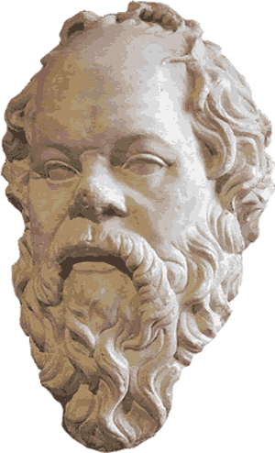
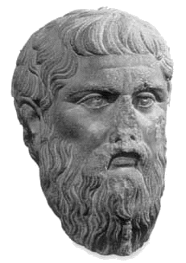
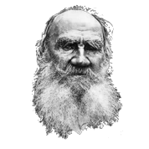
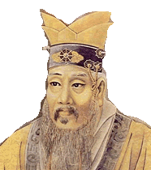
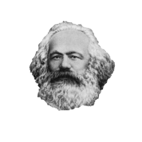
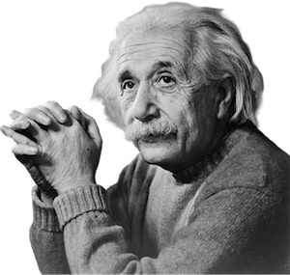
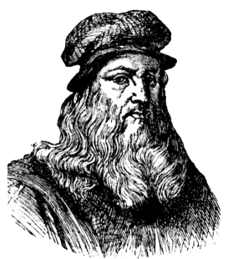
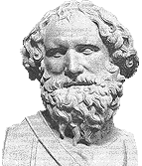
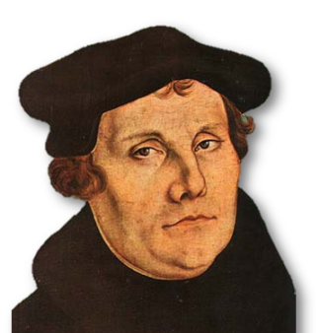
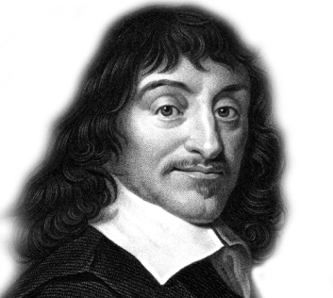
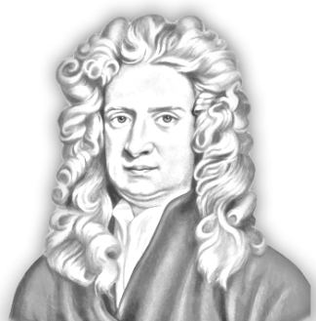
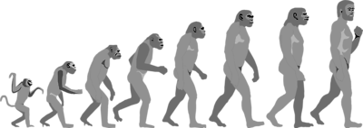
Evolution of Mind
Goethe
Aristotle
Socrates
Plato
Confucius
Tolstoy
Marx
Einstein
Da Vinci
Archimedes
Martin Luther
Descartes
Newton

Slide 4
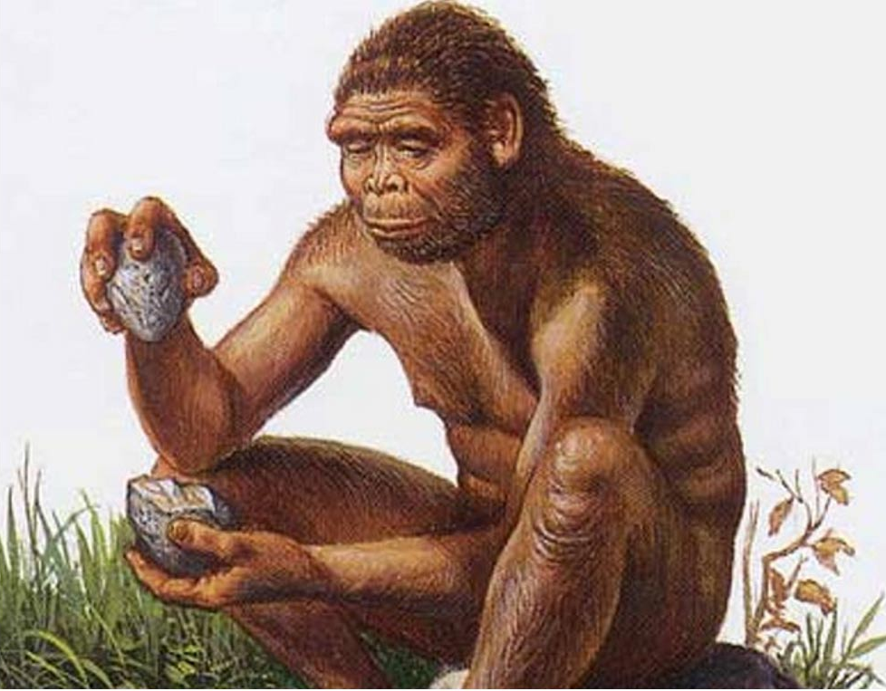
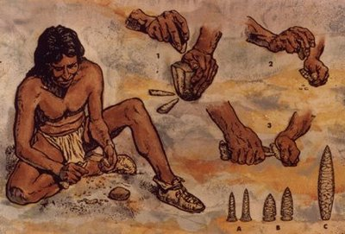
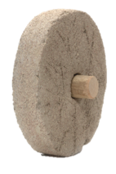
Physical Mind
Practical adaptation
Observation
Memory

Slide 5
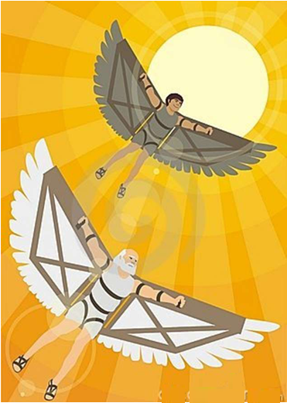
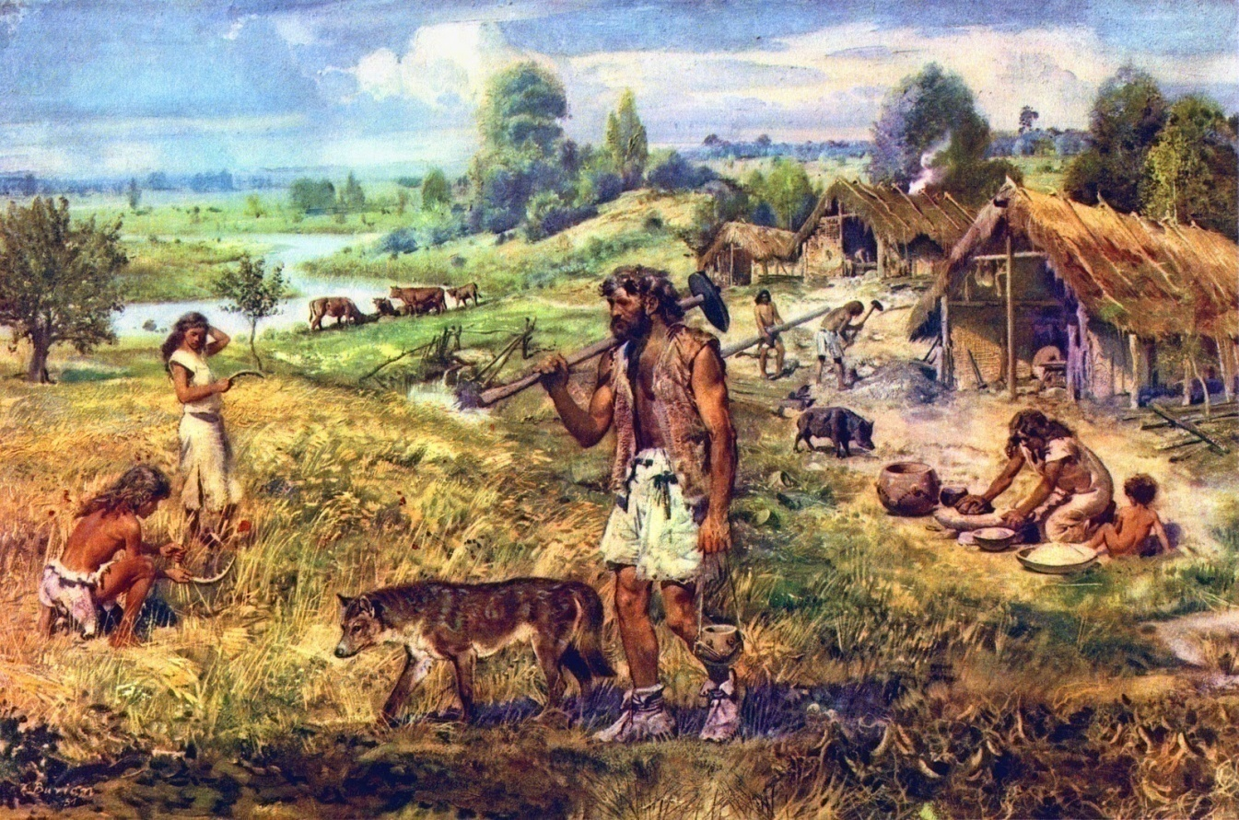
Mimetic or Social Mind
Imitation of Nature
Imitation of human behavior

Slide 6
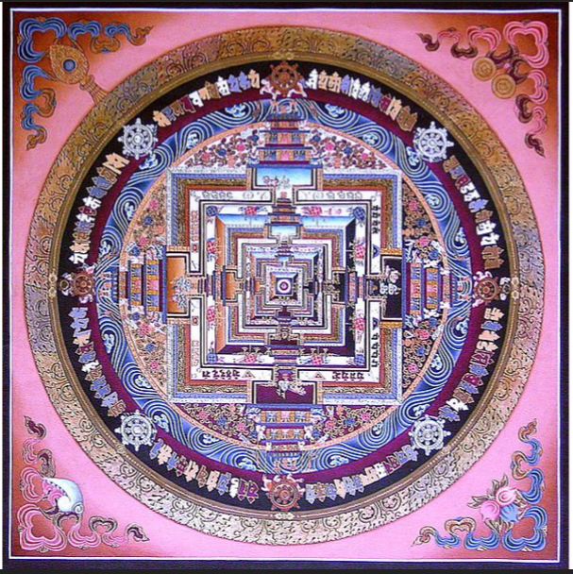
Symbol formation
Symbols = Ideas + Power
Images
Signs
Insignias
Numbers
Alphabet

Slide 7
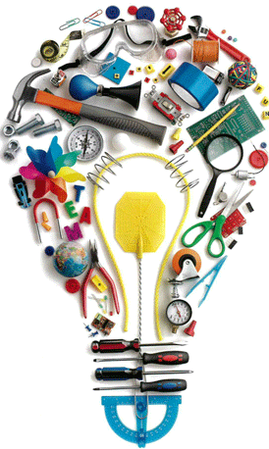
Imagination
Invention
Discovery
Religion
Commerce
Philosophy
Science
Arts

Slide 8
What is thinking?
X + Y = ?
Relating two or more sensations, memories, objects, people, actions, events, feelings, facts, thoughts, ideas, values
Relation of facts generates thought
Relation of thoughts generates ideas
Relation of ideas generates conceptual systems
Typewriter + TV = PC
PC + Network = Internet
E = MC²
Notes:
Marriage is related to wealth, class status, security, physical appearance, social skills and personal preference
Facts - A wealthy bachelor must be in search of a wife
Thoughts -- Any man that handsome must be good

Slide 9
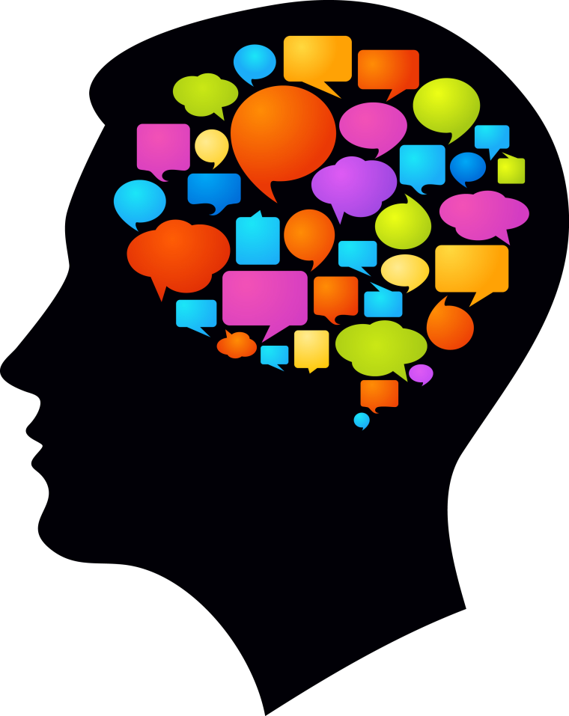
Faculties of Thinking
Relationship
Discrimination
Compare & Contrast
Measurement
Categorization
Organization
Judgment
Definition
Inference
Deduction

Slide 10
Characteristics of Mental Knowing
Perceives indirectly through the senses
Creates thought-symbols to represent reality
Proceeds linearly from thought to thought
Divides reality into smaller parts
Aggregates the parts to reconstitute the whole
Constructs concepts and conceptual systems out of the pieces
Separates the observer from the object
Concentrates by self-limitation and self-absorption
Views reality from a single perspective and set of premises

Slide 11
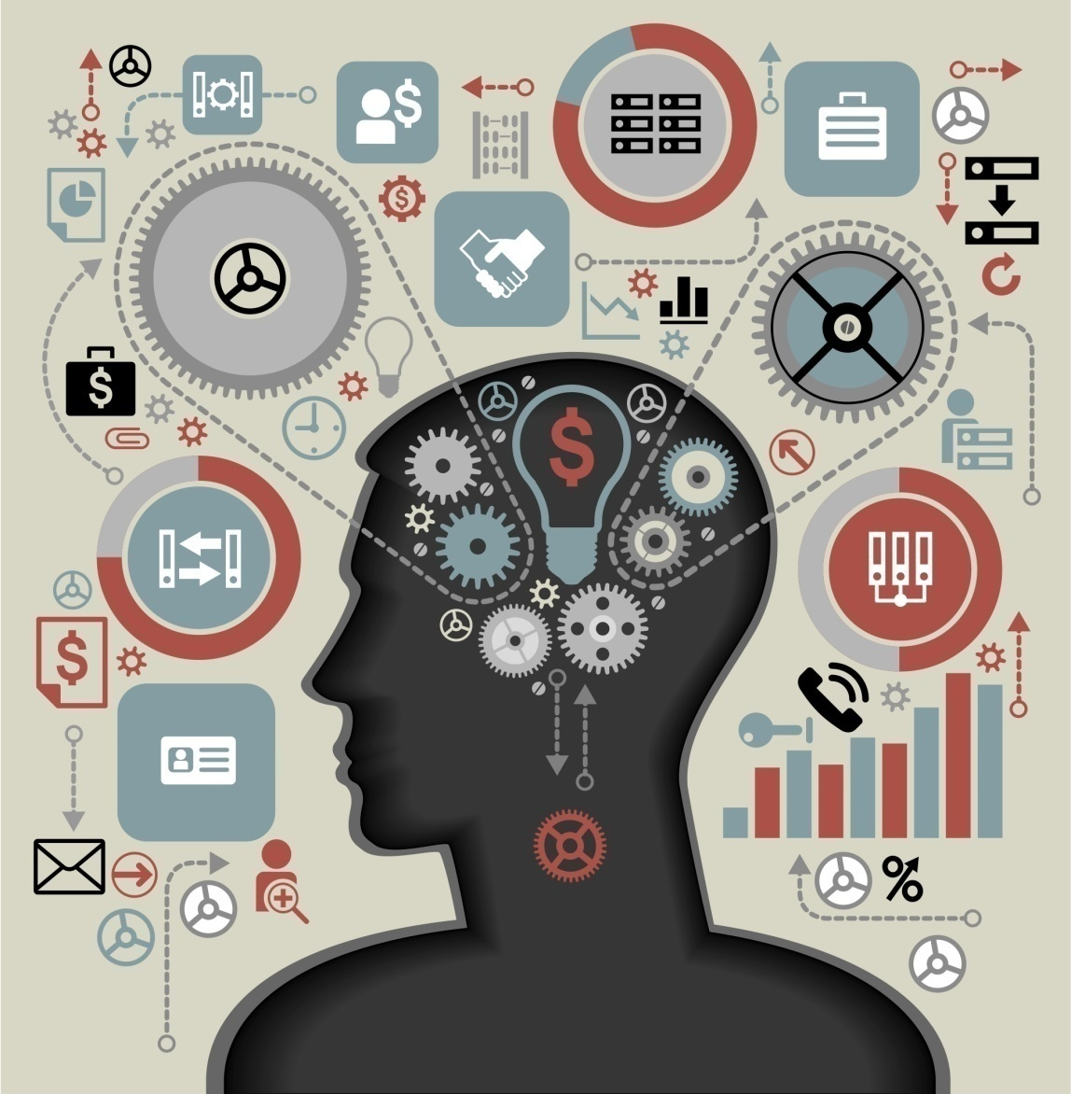
Analytic Thinking
Divides reality into smaller parts and studies each as the whole
Compartmentalize everything into categories
Study each subject as if it were independent
Reduces causality to the lowest common denominator

Slide 12
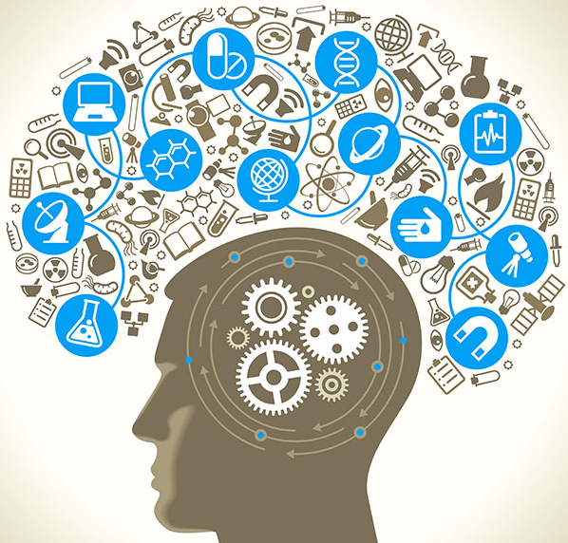
Achievements of Analytic Thinking
Standard model of the atom
Periodic table of elements
Structure of molecules
Varieties of species
Genetics of DNA
Physiological processes
Computer analysis
Artificial intelligence

Slide 13
Limitations of Analytic Thinking
Reduces complex reality to basic constituents
Fragments knowledge
Divides related fields
Constructs models divorced from reality
Ignores significant differences “Willful Ignorance”
Replaces clinical expertise with statistical analysis
Reduces behavior to chemical-electrical impulses
Reduces human relations to fixed patterns
Reduces individual uniqueness to general types
57% H₂0
Notes:
57% water
Herbert Weinberg
Finance and economy
Technology and employment
Economy and governance
Economy and human welfare and values
Economy and ecology

Slide 14
Synthetic, Systemic, Ecological Thinking
Focus on the interconnectedness and interdependence of reality
Recognizes complexity
Strives to conceptualize the whole

Slide 15
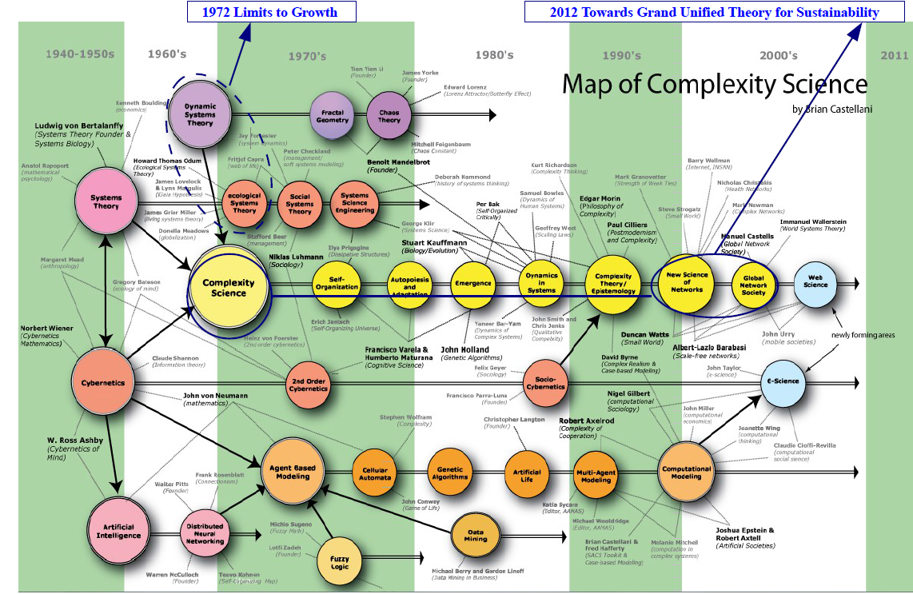

Slide 16
Achievements of Systems Thinking
Electric network theory
Mechanical engineering
Logic modeling
Evolutionary biology
INTERNET

Slide 17
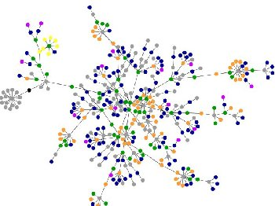
Transdisciplinary systems research
Information theory
Artificial intelligence
Robotics
Medical science
Economic systems
Biology
Cognitive science
Management
Sociology
Earth sciences

Slide 18
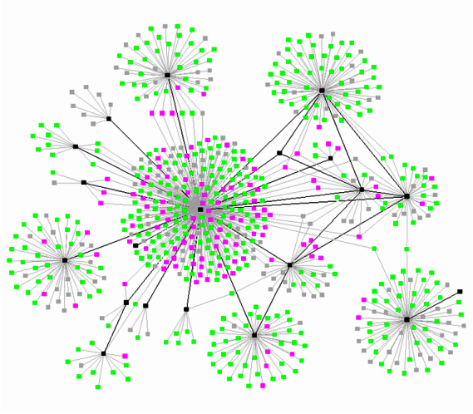
Transdisciplinary principles
Feedback
System dynamics
Emergence
Self-organization
Self-reproduction – autopoiesis
Complexity

Slide 19
Limitations of systems thinking
Mechanization of reality
Reduces human behavior to systems rules
Suppresses the subjective dimension of reality
Suppresses individual differences and uniqueness

Slide 20
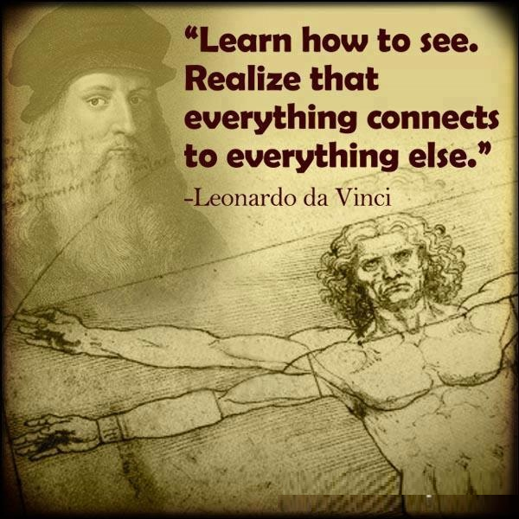
Integral, Organic Thinking
Sees the whole greater than the sum of its parts
Unifies the objective and subjective dimensions
Reconciles individuality with collectivity
All knowledge seeks unity

Slide 21
Integral Conceptions
Harmony
Health
Personality
Happiness
Life
Beauty
Peace
Mind
Society
Truth

Slide 22
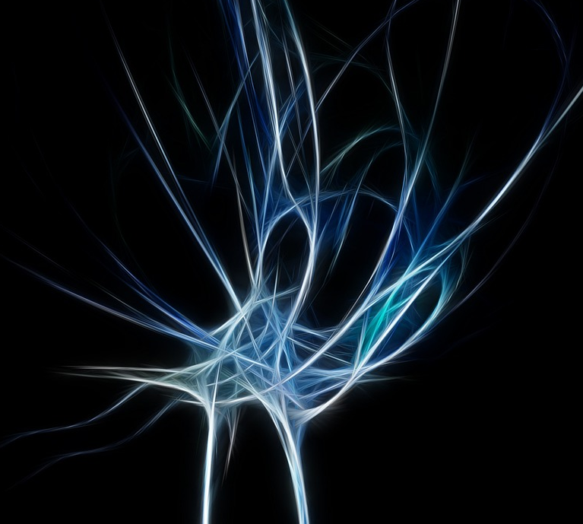
Insight and Intuition
Our self-awareness is knowledge by identity
Perceives the truth in ambiguity and paradox
Reconciles opposites & contradictions within a larger unity
The intuitive mind is a sacred gift and the rational mind is a faithful servant. We have created a society that honors the servant and has forgotten the gift.
Albert Einstein

Slide 23
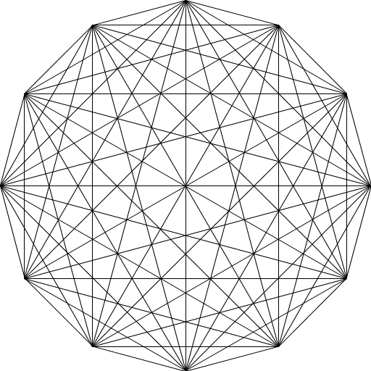
All is in each, each is in all

