Slide 1



School of Industrial and Information Engineering
Campus Leonardo
Department of Electronics, Information and
Bioengineering
Post-Graduate Certificate Course at Inter-University Centre, Dubrovnik, Croatia
Mind, Thinking & Creativity
April 12-15, 2016
Ways of Knowing
Rodolfo A. Fiorini, DEIB-Politecnico di Milano, Italy
Rodolfo A. Fiorini, http://www.linkedin.com/pub/rodolfo-a-fiorini-ph-d/45/277/498

Slide 2
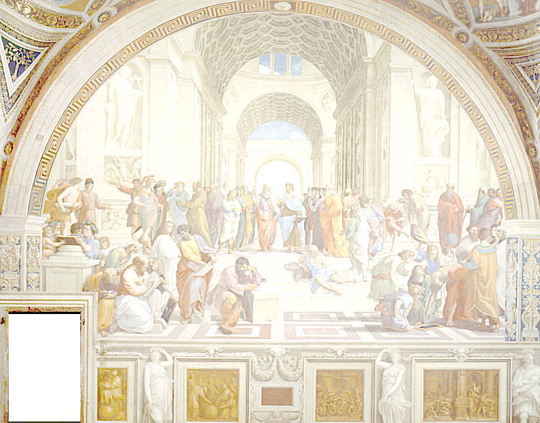
Ways of Knowing
« Le seul véritable voyage
ce ne serait pas
d'aller vers de nouveaux paysages,
mais d'avoir d'autres yeux… »
Valentin Louis Georges Eugène Marcel Proust (1871-1922)
from La Prisonnière (1923).
Rodolfo A. Fiorini, http://www.linkedin.com/pub/rodolfo-a-fiorini-ph-d/45/277/498

Slide 3
Ways of Knowing
« Observer
c’est pour la plus grande part, imaginer ce que l’on s’attend à voir. »
Ambroise-Paul-Toussaint-Jules Valéry (1871-1945)
from "Degas, Danse, Dessin",
in Oeuvres de Paul Valéry (Librairie Gallimard, 1960), II, p. 1169.
Rodolfo A. Fiorini, http://www.linkedin.com/pub/rodolfo-a-fiorini-ph-d/45/277/498

Slide 4

Presentation Outline
1. Introduction (15)
Types of Knowledge
Knowledge and Knowing
2. Nondualistic Knowing (14)
Knowing and Ignorance
Ontologic Uncertainty Management (OUM)
3. Symmathesy Example (21)
Structured Types of Knowing
Humiverse vs. Universe
Rodolfo A. Fiorini, http://www.linkedin.com/pub/rodolfo-a-fiorini-ph-d/45/277/498

Slide 5
1. Introduction (00)
Paradigma Sistemico di Riferimento
1. Introduction (15)
Types of Knowledge
Knowledge and Knowing
Rodolfo A. Fiorini, http://www.linkedin.com/pub/rodolfo-a-fiorini-ph-d/45/277/498

Slide 6
1. Introduction (01)
"Horror Vacui" may have had an impact, consciously or unconsciously, as "dread for emptiness" from Nature to primeval man, overwhelmed by an excess of emptiness, forced to live in a world not yet filled up with signs, symbols, and meaning.
In visual art Horror Vacui is horror of empty spaces; especially an aversion to empty spaces in artistic designs.
In ancient Greece during the Geometric Age (1100 - 900 BCE), Horror Vacui was considered a stylistic element of all art. The same for Arabesque Islamic art, from ancient times to the present.
More recently, the concept of Horror Vacui in art was associated with Italian-born critic of art and literature Mario Praz (1896–1982) who used the term to describe the suffocating atmosphere and clutter of interior design in the Victorian age.
Rodolfo A. Fiorini, http://www.linkedin.com/pub/rodolfo-a-fiorini-ph-d/45/277/498

Slide 7
1. Introduction (02)
On the other hand, the current proliferation of new sciences extends our powers of sense and thought, but their rigorous techniques and technical language hamper direct communication.
The common field of knowledge becomes a diminishing fraction of the total store, stuffed by an overwhelming excess of irrelevant signs and symbols and the horizons of accumulating ignorance are expanding faster than any person can keep up with.
It’s happening something like it already happened in the mass-media arena, where the "mass-mediatic scum" has totally overwhelmed our way to communicate, by the incessant growth of irrelevant information, visual and auditive requests.
Laymen can find themselves in a "Horror Pleni" situation, totally unable to discriminate the difference between an optimized encoding information-rich message and a random jumble of signs.
Rodolfo A. Fiorini, http://www.linkedin.com/pub/rodolfo-a-fiorini-ph-d/45/277/498

Slide 8
1. Introduction (03)
So Horror Vacui or Horror Pleni?
As a matter of fact, our unconscious background is pervaded with an ancestral, primeval, cosmic and abysmal dread for both situations. A dread that our current existential level is amplifying to upper levels of global confusion.
Horror Vacui and Horror Pleni are two fundamental concepts to human beings an their deep meaning can be extended to many different disciplined areas like art, literature, sociology, science, etc...
As an example, in the scientific and bioengineering areas, they can create operative reflections from experimental verification, for the never ending human knowledge advancement, without forgetting to remember our fundamental component:
LIFE
Rodolfo A. Fiorini, http://www.linkedin.com/pub/rodolfo-a-fiorini-ph-d/45/277/498

Slide 9
1. Introduction (04)
Fundamentalist vs. Evolutive Mindset
Rodolfo A. Fiorini, http://www.linkedin.com/pub/rodolfo-a-fiorini-ph-d/45/277/498

Slide 10
1. Introduction (05)
The question of what constitutes "knowledge" is as old as philosophy itself. Its earliest instances are found in Plato's dialogues, notably "Meno" (97a–98b).
The problem has been raised by Austrian philosopher Alexius Meinong (b.1853– d.1920) and British philosopher Bertrand Russell (b.1872– d.1970) in his "Human knowledge: Its scope and limits."
Later, American philosopher Edmund Gettier (b.1934-) inspired a great deal of work by philosophers attempting to recover a working definition of knowledge. Well known for his "justified true belief" (or JTB) account of knowledge (1963).
Rodolfo A. Fiorini, http://www.linkedin.com/pub/rodolfo-a-fiorini-ph-d/45/277/498

Slide 11
1. Introduction (06)
Knowledge is a dominant feature in our post-industrial society, and knowledge workers comprise an enterprise. If knowledge is the basis for all that we do these days, then gaining an understanding of what types of knowledge exist within an organization may allow us to foster internal social structures that will facilitate and support learning in all organizational domains.
In 1995, British philosopher Frank H. Blackler (b.1927-) expands on a categorization of knowledge types that were suggested by American cognitive scientist Alan M. Collins (1993).
Rodolfo A. Fiorini, http://www.linkedin.com/pub/rodolfo-a-fiorini-ph-d/45/277/498

Slide 12
1. Introduction (07)
Traditional Cartesian Duality
World of Substance
(Embodied, Valued, Subjective)
vs.
World of Appearance
(Shared, Formal, Objective)
Rodolfo A. Fiorini, http://www.linkedin.com/pub/rodolfo-a-fiorini-ph-d/45/277/498

Slide 13
1. Introduction (08)
Traditional Knowledge Types
Embrained Knowledge
Embodied Knowledge
Encultured Knowledge
Embedded Knowledge
Encoded Knowledge
Enactive Knowledge
Extended Knowledge
Enworlded Knowledge (Zdravko Radman, 2016)
Rodolfo A. Fiorini, http://www.linkedin.com/pub/rodolfo-a-fiorini-ph-d/45/277/498

Slide 14
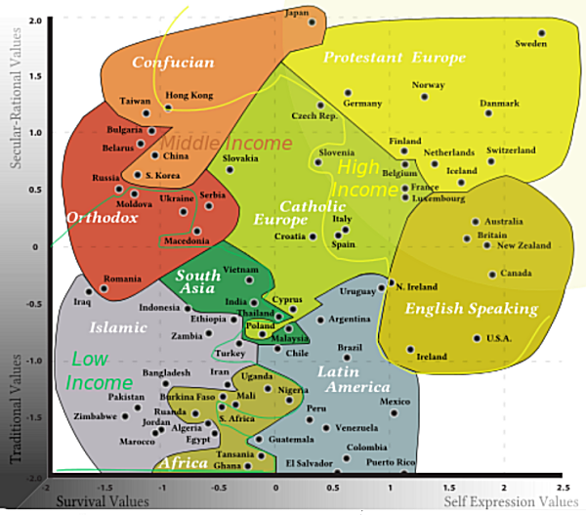
1. Introduction (09)
The Challenge of Transcultural Knowledge
(Inglehart–Welzel cultural map of the world, 2010)
Rodolfo A. Fiorini, http://www.linkedin.com/pub/rodolfo-a-fiorini-ph-d/45/277/498

Slide 15
1. Introduction (10)
Value Knowledge Concept
is even quite more recent
than
Data Knowledge Concept
by Classical Information Science perspective.
Rodolfo A. Fiorini, http://www.linkedin.com/pub/rodolfo-a-fiorini-ph-d/45/277/498

Slide 16
1. Introduction (11)
The Value of Values
Value Knowledge Concept
as
Fundamental Attractor
to
Systemic Convergence
to a Goal.
Rodolfo A. Fiorini, http://www.linkedin.com/pub/rodolfo-a-fiorini-ph-d/45/277/498

Slide 17
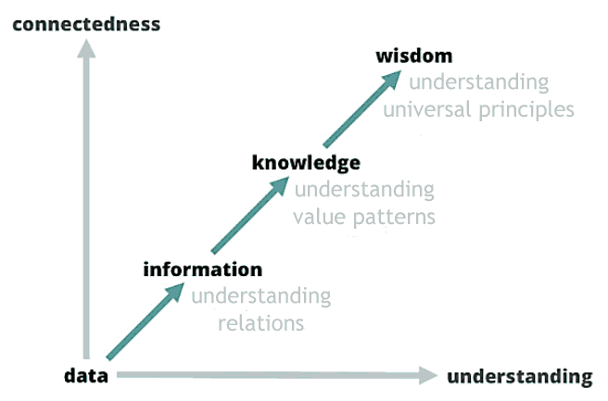
1. Introduction (12)
Information Evolutive Scale
Rodolfo A. Fiorini, http://www.linkedin.com/pub/rodolfo-a-fiorini-ph-d/45/277/498

Slide 18
1. Introduction (13)
Traditional Cartesian Duality
"Warm Data" Approach
(Embodied, Valued, Subjective)
vs.
"Cold Data" Approach
(Shared, Formal, Objective)
Rodolfo A. Fiorini, http://www.linkedin.com/pub/rodolfo-a-fiorini-ph-d/45/277/498

Slide 19
1. Introduction (14)
Knowledge and Knowing
There is a big difference between "knowledge" and "knowing." There is a major difference between "reading" a book and "living" the book.
Knowledge is nothing more than organized information. How many know what to do and yet…they don’t do anything with what they know?
Knowledge is an intellectual process. Knowing is an emotional/spiritual process. Knowledge comes from acquiring information. Knowing comes from living ownership.
To continually move from knowledge to knowing, from education to ownership, we need living ownership. It comes from 3 keys: Study, Application, Repetition!
Rodolfo A. Fiorini, http://www.linkedin.com/pub/rodolfo-a-fiorini-ph-d/45/277/498

Slide 20
1. Introduction (15)
Knowledge and Knowing
"Knowing" Approach
(Embodied, Valued, Subjective)
vs.
"Knowlege" Approach
(Shared, Formal, Objective)
Rodolfo A. Fiorini, http://www.linkedin.com/pub/rodolfo-a-fiorini-ph-d/45/277/498

Slide 21
2. Nondualistic Knowing (00)
2. Nondualistic Knowing (14)
Knowing and Ignorance
Ontological Uncertainty Management (OUM)
Rodolfo A. Fiorini, http://www.linkedin.com/pub/rodolfo-a-fiorini-ph-d/45/277/498

Slide 22
2. Nondualistic Knowing (01)
Scientists as well as laymen do ignore evidence incompatible with their preconceptions.
New theories which fail to fit established views are resisted, in the hope that they will prove false or irrelevant; old ones yield to convenience rather than to evidence.
Although there are many sources of ignorance and uncertainty, they can be related to two basic areas of uncertainty that are fundamentally different from each other and recognized as traditional reference knowledge from scientific community: natural and epistemic uncertainty.
While the advantage of differentiating between natural (aleatory) and epistemic uncertainty in analysis is clear, the necessity of distinguishing between them is not, by an operative point of view. As a matter of fact, epistemic and aleatory uncertainties are fixed neither in space nor in time.
Rodolfo A. Fiorini, http://www.linkedin.com/pub/rodolfo-a-fiorini-ph-d/45/277/498

Slide 23
2. Nondualistic Knowing (02)
In decision theory and economics, ambiguity aversion (also known as uncertainty aversion) is a preference for known risks over unknown risks.
An ambiguity averse individual would rather choose an alternative where the probability distribution of the outcomes is known over one where the probabilities are unknown.
This behavior was first introduced through the Ellsberg paradox (people prefer to bet on the outcome of an urn with 50 red and 50 blue balls to on one with 100 total balls but for which the number of blue or red balls is unknown).
The paradox was popularized by the author Daniel Ellsberg (1931-), although a version of it was noted considerably earlier by John Maynard Keynes.
Rodolfo A. Fiorini, http://www.linkedin.com/pub/rodolfo-a-fiorini-ph-d/45/277/498

Slide 24
2. Nondualistic Knowing (03)
That is, given a choice of risks to take (such as bets), people "prefer the devil they know" rather than assuming a risk where odds are difficult or impossible to calculate.
Scholars have sliced and diced the terms "ambiguity," "uncertainty," and "ignorance," among others, in a variety of different ways. Oftentimes, the usefulness of these sharp lines isn’t plainly apparent.
But one dividing line between types of unknowns, i.e. the distinction between risk and ambiguity, has recently led neuroscience and neuropsychology researchers to fascinating new biological insights.
Evidence from brain science has shown that the amygdala and the orbitofrontal cortex (OFC) are more active when people face ambiguous odds rather than merely risky ones, suggesting that ambiguity is fundamentally more emotional.
Rodolfo A. Fiorini, http://www.linkedin.com/pub/rodolfo-a-fiorini-ph-d/45/277/498

Slide 25
2. Nondualistic Knowing (04)
Today, we know that incredibly small groups of atoms, much too small to display exact statistical laws, do play a dominating role in the very orderly and lawful events within a living organism.
The great revelation of quantum theory (QT), discovered by Max Planck in 1900, is that features of a discreteness were discovered in the Book of Nature at system microscale (nanoscale) level ("discreteness hypothesis“, DH), in context in which anything other than continuity seemed to be absurd, according to the views held until then at macroscale level.
Furthermore, in 1924 de Broglie introduced the idea in QM of a wave description of elementary systems. Later QFT emerged from a major ontological paradigm shift with respect to Classical Physics which still provides the framework of the vision of nature of most scientists currently.
Rodolfo A. Fiorini, http://www.linkedin.com/pub/rodolfo-a-fiorini-ph-d/45/277/498

Slide 26
2. Nondualistic Knowing (05)
Quantum Field Theory
The traditional QFT description of a physical system is given in terms of a matter field, which is the space-time distribution of atoms/molecules, coupled to the gauge field with the possible supplement of other fields describing the nonelectromagnetic interactions, such as the chemical forces.
According to the QFT principle of complementarity, there is also another representation where the phase assumes a precise value. This representation which focuses on the wave-like features of the system cannot be assumed simultaneously with the particle representation.
The relation between these two representations is expressed by the uncertainty relation, similar to the Heisenberg relation between position and momentum:
ΔN ΔΦ ≥ 1/2
connecting the uncertainty of the number of quanta (particle structure of the system) ΔN and the uncertainty of the phase (which describes the rhythm of fluctuation of the system) ΔΦ.
Rodolfo A. Fiorini, http://www.linkedin.com/pub/rodolfo-a-fiorini-ph-d/45/277/498

Slide 27
2. Nondualistic Knowing (06)
Quantum Field Theory
Therefore, a complex system involves two kinds of interaction:
(A) If ΔN = 0, the number of quanta is well defined, so that we obtain an atomistic description of the system, but lose the information on its capability to fluctuate, since ΔΦ becomes infinite. An interaction similar to that considered by Classical Physics, where objects interact by exchanging energy. These exchanges are connected with the appearance of forces. Since energy cannot travel faster than light, this interaction obeys the principle of causality (Science 1.0 approach).
(B) If ΔΦ = 0, the phase is well defined, we obtain a description of the movement of the system, but lose the information on its particle-like features which become undefined since ΔN becomes infinite. An interaction where a common phase arises among different objects because of their coupling to the quantum fluctuations and hence to an e.m. potential. In this case there is no propagation of matter and/or energy taking place, and the components of the system "talk" to each other through the modulations of the phase field travelling at the phase velocity, which has no upper limit and can be larger than c, the speed of light. The system is termed "coherent" (QFT approach).
Rodolfo A. Fiorini, http://www.linkedin.com/pub/rodolfo-a-fiorini-ph-d/45/277/498

Slide 28
2. Nondualistic Knowing (07)
System Decoherence Modeling
Decoherence offers a way to understand system classicality as emergent from within the quantum formalism.
(W.H. Zurek, 2005)
Rodolfo A. Fiorini, http://www.linkedin.com/pub/rodolfo-a-fiorini-ph-d/45/277/498

Slide 29
2. Nondualistic Knowing (08)
Emergent Transdisciplinary Reality Level
(Ambigram by Douglas R. Hofstadter, 2008)
Rodolfo A. Fiorini, http://www.linkedin.com/pub/rodolfo-a-fiorini-ph-d/45/277/498

Slide 30

2. Nondualistic Knowing (09)
Uncertainty First Example
(Nobuyuki Kayahara’s Spinning Dancer, 2003)
Rodolfo A. Fiorini, http://www.linkedin.com/pub/rodolfo-a-fiorini-ph-d/45/277/498

Slide 31
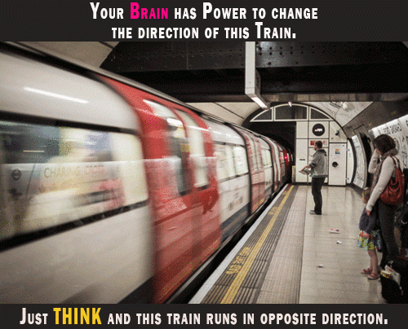
2. Nondualistic Knowing (10)
Uncertainty Second Example
(David Pescovitz, 2013)
Rodolfo A. Fiorini, http://www.linkedin.com/pub/rodolfo-a-fiorini-ph-d/45/277/498

Slide 32
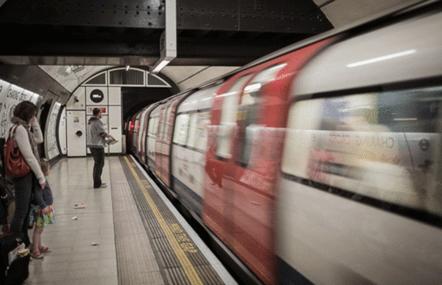
2. Nondualistic Knowing (11)
Uncertainty Second Example (Cont’d):
(David Pescovitz, 2013)
Rodolfo A. Fiorini, http://www.linkedin.com/pub/rodolfo-a-fiorini-ph-d/45/277/498

Slide 33
Ontological Uncertainty Management (OUM)
2. Nondualistic Knowing (12)
Epistemic and aleatory uncertainties are fixed neither in space nor in time. What is aleatory uncertainty in one model can be epistemic uncertainty in another model, at least in part. And what appears to be aleatory uncertainty at the present time may be cast, at least in part, into epistemic uncertainty at a later date.
They can be thought as an irreducible complementary ideal asymptotic dichotomy only.
Rodolfo A. Fiorini, http://www.linkedin.com/pub/rodolfo-a-fiorini-ph-d/45/277/498

Slide 34
2. Nondualistic Knowing (13)
Two Irreducible Subsystems based on Ideal Asymptotic Dichotomy
Learning Operative Point can emerge as a new Trans-disciplinary Reality Level, based on an irreducible complementary ideal asymptotic dichotomy: Two Complementary Irreducible Coupled Information Management Subsystems.
Rodolfo A. Fiorini, http://www.linkedin.com/pub/rodolfo-a-fiorini-ph-d/45/277/498

Slide 35
2. Nondualistic Knowing (14)
To grasp a more reliable representation of reality and to get more resilient and antifragile techniques, researchers and scientists need "two intelligently articulated hands": outer universe and inner universe knowledge synergicastically articulated by natural coupling (Science 2.0 Approach).
In order to take robust and reliable decision in a complex world, we need to educate and train people to use simple, but effective and powerful strategies and strategic tools, in many different critical application areas.
To design and develop more robust, resilient and antifragile cyber-physical system, we need novel tools to combine effectively and efficiently analytical asymptotic exact global solution panoramas to deep learning local computational precision achievement.
Rodolfo A. Fiorini, http://www.linkedin.com/pub/rodolfo-a-fiorini-ph-d/45/277/498

Slide 36
3. Symmathesy Example (00)
Paradigma Sistemico di Riferimento
3. Symmathesy Example (21)
Structured Types of Knowing
Humiverse vs. Universe
Rodolfo A. Fiorini, http://www.linkedin.com/pub/rodolfo-a-fiorini-ph-d/45/277/498

Slide 37
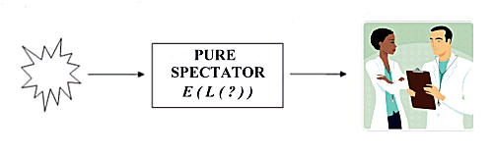
3. Symmathesy Example (01)
From PURE SPECTATOR to ERGODIC OBSERVER
Rodolfo A. Fiorini, http://www.linkedin.com/pub/rodolfo-a-fiorini-ph-d/45/277/498

Slide 38
3. Symmathesy Example (02)
From ERGODIC OBSERVER to EGOCENTRIC INTERACTOR
Rodolfo A. Fiorini, http://www.linkedin.com/pub/rodolfo-a-fiorini-ph-d/45/277/498

Slide 39
3. Symmathesy Example (03)
From EGOCENTRIC to RECURSIVE INTERACTOR
Rodolfo A. Fiorini, http://www.linkedin.com/pub/rodolfo-a-fiorini-ph-d/45/277/498

Slide 40
3. Symmathesy Example (04)
Robert Rosen’s Systemic Incompleteness Awareness
« …any material realization of the (M,R)-system must have non-computable models. »
Robert Rosen (1934 - 1998)
(prediction)
(observation & measurement)
Rodolfo A. Fiorini, http://www.linkedin.com/pub/rodolfo-a-fiorini-ph-d/45/277/498

Slide 41
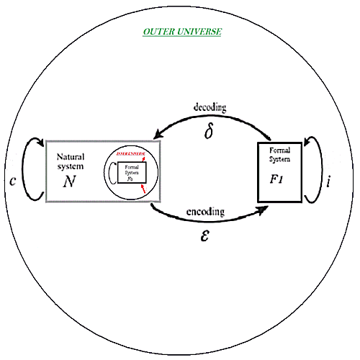
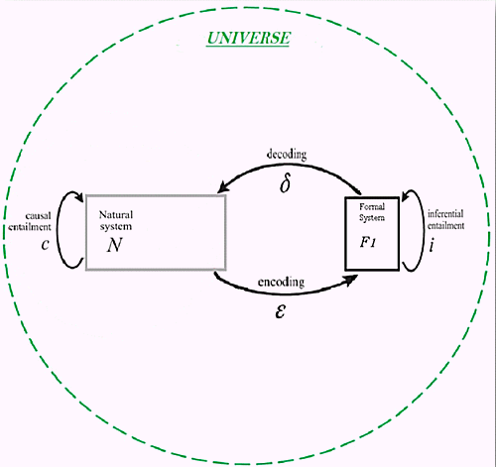


3. Symmathesy Example (05)
R. Rosen Fundamental Modeling Relation (Reflexive/Reflective)
Rodolfo A. Fiorini, http://www.linkedin.com/pub/rodolfo-a-fiorini-ph-d/45/277/498

Slide 42
3. Symmathesy Example (06)
R. Rosen Fundamental Modeling Relation (Reflexive/Reflective)
R. Rosen Fundamental Modeling Relation with explicit Reflexive and Reflective Representations.
Immediately, Reflexive and Reflective Representations create two base system scaling symmetries into ODR Model: convergent and divergent scaling symmetries.
They allow for the correspondence of a Inner Universe - SELF representation to an Outer Universe representation, both linked by the Kelvin Transform.
Convergent Scaling:
Divergent Scaling:
Rodolfo A. Fiorini, http://www.linkedin.com/pub/rodolfo-a-fiorini-ph-d/45/277/498

Slide 43
3. Symmathesy Example (07)
Human brain as an Harmonization Machine
EULOGIC THOUGHT
PALEOLOGIC THOUGHT
Intelligent
Coupled
Relational
Teleologic
Harmonization
Surviving
Deterministic
Open Logic
Learning from Experience
Subjective
NEOLOGIC THOUGHT
Rational Thinking
Analytical
Metacognitive Abstraction
Free Will
Symbolic Reasoning
Learning To Learn
Focused Attention
Closed Logic
Body Independent
Shared (Objective)
HUMAN CREATIVITY
Rodolfo A. Fiorini, http://www.linkedin.com/pub/rodolfo-a-fiorini-ph-d/45/277/498

Slide 44
3. Symmathesy Example (08)
Awareness and Creativity (EPM)
According to Elementary Pragmatic Model (EPM), two coupled fundamental systems are at the core of human mind:
System #1 is fed by definition doubting and compromising mainly; the availability of an environmental chaotic information redundant support is required (RATL, Right Anterior Temporal Lobe):
emotion→FOP (re-)wiring→sensation→action (survival oriented).
System #2 is based on opposing, complementing and commanding; clearly defined formal rules are required to actively operate:
emotion→sensation→perception→action (learning oriented)
(i.e. solution path logical articulation→checking→difference learning).
(Piero De Giacomo, 1982)
Rodolfo A. Fiorini, http://www.linkedin.com/pub/rodolfo-a-fiorini-ph-d/45/277/498

Slide 45
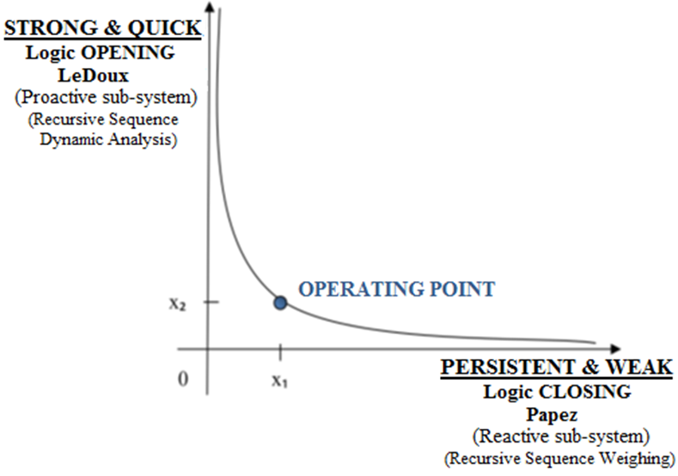
3. Symmathesy Example (09)
Emergent Transdisciplinary Reality Level
Emotional Intelligence (EI) and Emotional Creativity (EC) coexist at the same time with Rational Thinking, sharing the same input environment information.
Operating point as a trans-disciplinary reality level can emerge from two complementary irreducible, asymptotic ideal coupled concepts.
To behave realistically, system must guarantee both Logical Aperture (to get EI and EC, to survive and grow) and Logical Closure (to get Rational Thinking, to learn and prosper), both fed by environmental "noise" (better… from what human beings call "noise").
(R.A. Fiorini, 2013)
Rodolfo A. Fiorini, http://www.linkedin.com/pub/rodolfo-a-fiorini-ph-d/45/277/498

Slide 46
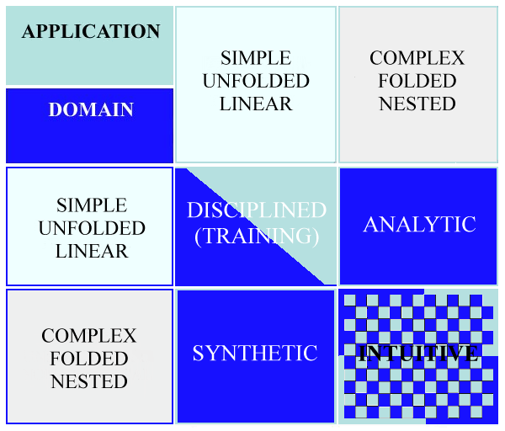
3. Symmathesy Example (10)
Structured Types of Knowing
(R.A. Fiorini, 2016)
Rodolfo A. Fiorini, http://www.linkedin.com/pub/rodolfo-a-fiorini-ph-d/45/277/498

Slide 47
3. Symmathesy Example (11)
Rethinking Knowing and Thought
We can have thought without thinking.
(Jesse J. Prinz, Gut Reactions: A Perceptual Theory of Emotions, 2004).
We can have knowing without thinking. (Zdravko Radman, The hand, an organ of the mind,2013).
Every conversation changes our brain.
(Eric Kandel, In search of memory, 2006. The Age of Insight: The Quest to Understand the Unconscious in Art, Mind, and Brain, from Vienna 1900 to the Present, 2012).
Mind feels as well as thinks, and feelings involve more than thinking.
(Joseph LeDoux, Emotions and the Limbic System Concept, Concepts in
Neuroscience, Vol. 2, 1992. Sensory Systems and Emotions, Integrative Psychiatry, Vol. 4., 1986) .
Rodolfo A. Fiorini, http://www.linkedin.com/pub/rodolfo-a-fiorini-ph-d/45/277/498

Slide 48
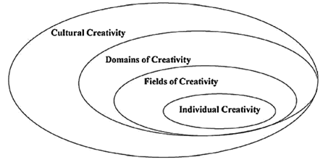
3. Symmathesy Example (12)
Creativity scheme according to Hungarian psychologist Mihaly Csikszentmihalyi (1975)
Rodolfo A. Fiorini, http://www.linkedin.com/pub/rodolfo-a-fiorini-ph-d/45/277/498

Slide 49
3. Symmathesy Example (13)
Kolb’s Experimental Learning Theory
Rodolfo A. Fiorini, http://www.linkedin.com/pub/rodolfo-a-fiorini-ph-d/45/277/498

Slide 50
3. Symmathesy Example (14)
Interior – Individual VS. Exterior - Collective
Rodolfo A. Fiorini, http://www.linkedin.com/pub/rodolfo-a-fiorini-ph-d/45/277/498

Slide 51
3. Symmathesy Example (15)
Interior – Individual VS. Exterior - Collective
Rodolfo A. Fiorini, http://www.linkedin.com/pub/rodolfo-a-fiorini-ph-d/45/277/498

Slide 52
3. Symmathesy Example (16)
Interior – Individual VS. Exterior - Collective
Rodolfo A. Fiorini, http://www.linkedin.com/pub/rodolfo-a-fiorini-ph-d/45/277/498

Slide 53
3. Symmathesy Example (17)
Nondualistic Knowing
Symmathesy Theory
(Mutual Learning in Living Systems, Nora Bateson, 2015)
vs.
General Systems Theory
(Karl Ludwig von Bertalanffy, 1934)
Rodolfo A. Fiorini, http://www.linkedin.com/pub/rodolfo-a-fiorini-ph-d/45/277/498

Slide 54
3. Symmathesy Example (18)
Novel Knowing Approach
"Humiverse" (Radman, 2004/5)
(Embodied, Valued, Subjective)
vs.
"Universe"
(Shared, Formal, Objective)
Rodolfo A. Fiorini, http://www.linkedin.com/pub/rodolfo-a-fiorini-ph-d/45/277/498

Slide 55
3. Symmathesy Example (19)
Novel Knowing Approach
Does this make
Science less Objective?
No, It only makes it
more Human-like.
Rodolfo A. Fiorini, http://www.linkedin.com/pub/rodolfo-a-fiorini-ph-d/45/277/498

Slide 56
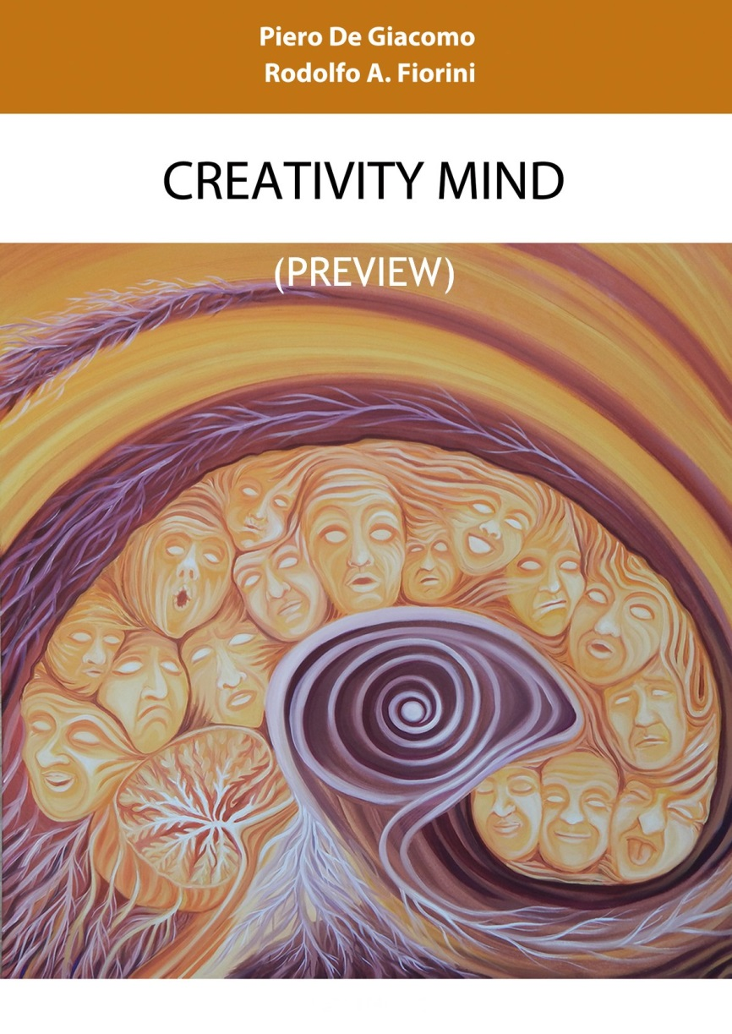
3. Symmathesy Example (20)
Rodolfo A. Fiorini, http://www.linkedin.com/pub/rodolfo-a-fiorini-ph-d/45/277/498

Slide 57
3. Symmathesy Example (21)
Neuralizer Work In Progress
Rodolfo A. Fiorini, http://www.linkedin.com/pub/rodolfo-a-fiorini-ph-d/45/277/498

Slide 58

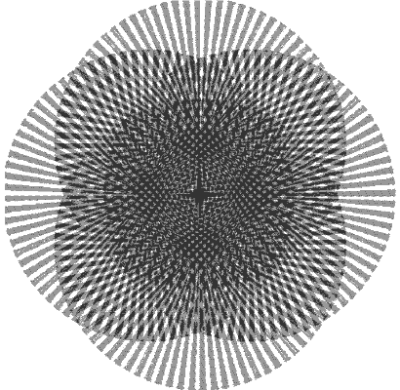
Ways of Knowing
Thank You for
Your A t t e n t i o n
Rodolfo A. Fiorini, http://www.linkedin.com/pub/rodolfo-a-fiorini-ph-d/45/277/498

