Slide 1
Decision-Making:
Deciding Which Tack to Take
Prepared for Post-Graduate Certificate Course in Effective Leadership, March 31-April 3, 2015, Inter-University Centre, Dubrovnik, Croatia Donato Kiniger-Passigli, Head of Fragile States and Disaster Response (FSDR) & WAAS Fellow Employment Department / International Labour Organization
Disclaimer: This is not an official document, check against delivery.

Slide 2
How do leaders make effective decisions?
Strategic thinking as a regular exercise...
Systemic perspective (voice of reason)
And what if…?
Strategic intent
Open mind
The ability to contextualise
a synthesis of inituition + creativity with an integrated perspective

Slide 3
Strategic Planning / Decision Making
Strategic Planning:
obtaining Information
identifying key issues
committing to a course of action
considering alternatives based on facts / resources/ constraints / values / logical assumptions.
Strategic Decision-making:
comparing data on policy/ operational effectiveness
establishing goals and requirements
predicting cause-effect from a base of information.

Slide 4
Reflecting on Strategic Thinking
„The ILO must push ahead decisevely with measured ambition aware of the means at its disposal. Today it does not have the resources to do everything its constituents request. In the face of growing demand, the ILO needs to set priorities, concentrate its efforts, avoid dispersal and produce quality products, based on its wide-ranging mandate. If it advances too slowly when globalization is moving forward by leaps and bounds, it will miss the chance to make a contribution many see of critcal importance. But it must act within limited means. We need strategic thinking.“
ILO Stategic Policy Framework 2006-2009

Slide 5
Questions for Decision-making
What exactly has to be decided?
What are the options?
What are the advantages and disadvantages of each option?
Which option is the best?
What needs to be done to implement the best option?

Slide 6
How do leaders influence people? The importance of emotional intelligence
„ We should take care not to make the intellect our god. It has, of course, powerful muscles, but no personality. It cannot lead, it can only serve.“
Albert Einstein

Slide 7
Leadership Emotional Competencies
Self-Awareness
Emotional Self -Awareness
Self-Management
Self-Control
Social-Awareness
Empathy
Relationship Management
Inspiration
Accurate Self-Awareness
Self-confidence
Transparency
Adaptability
Achievement
Initiative
Optimism
Organisational Awareness
Service-Orientation
Influence
Coaching
Drive for Change
Conflict Management
Teamwork and collaboration

Slide 8
Leadership Styles / Decision-Making Styles
Visionary
Coaching
Affiliative
Democratic
Ethical

Slide 9
New Paradigm: Leaders’ Degree of Influence in the “Global Village” for Peace and Resilience
ABILITY
To operate across cultural boundaries
To predict cross-cultural changes and transformation
To envision / upscale prevention rather than responses ahead of major crises
To decide quickly generating consensus

Slide 10
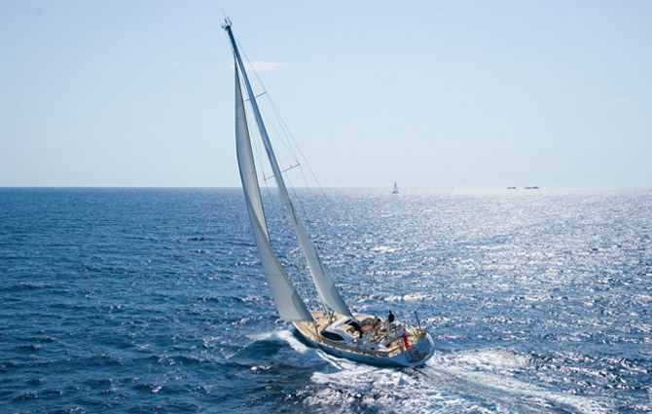
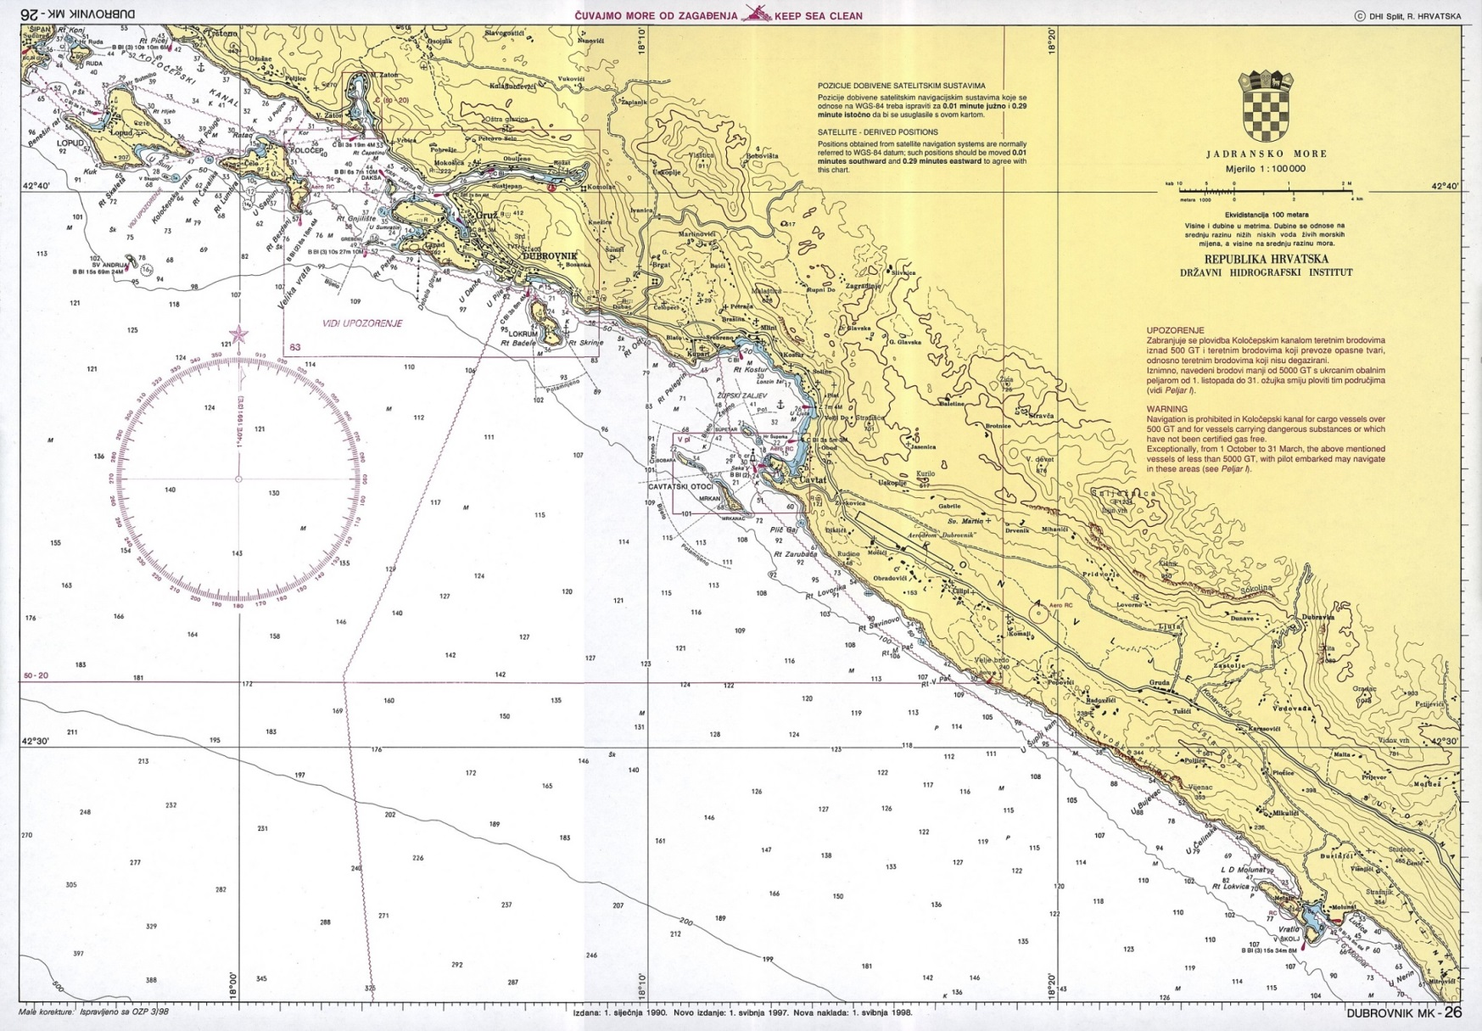
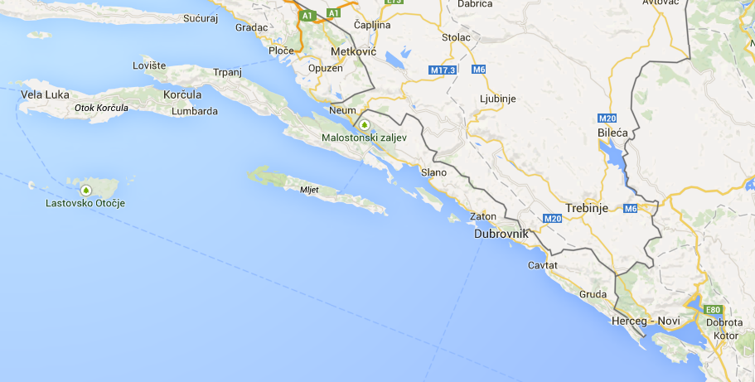
Exercise: “Deciding which tack to take”

Slide 11
Conclusion
Art and science
Knowledge
Experience
Navigation / Course Direction
Risk management
Ethical behaviour
Seamanship is…
Leadership is…

