Slide 1



Education for Leadership

Slide 2



Different times - Different needs
1945-1975
Natural growth
21st century is vuca
2027^{(*)} : 75% of S&P replaced
Linear sequential
1 man show is possible
Adaptive / organic organizations needed
Production Lines
Innovation
Now only a collective intelligence can master this complexity
Egoless leaders are preferred
^{(*)} http://www.reuters.com/article/2012/02/13/idUS206536+13-Feb-2012+BW20120213
Effective Leadership - World Academy of Art & Science

Slide 3


But university methods hardly changed…
OVEREMPHASIZED
NEEDED
Individual performance
Lots of Information
Passive - Repetition
Focus on the head
Industrial needs
Academic
Competition
Team work & self responsibility
Wisdom & Knowledge
Active & Passive
Body & Mind & Soul
Natural cycle & modern life
Passion & effort
Compassion & performance
Useful qualities in conservative times
Useful qualities in transition times
Effective Leadership - World Academy of Art & Science

Slide 4
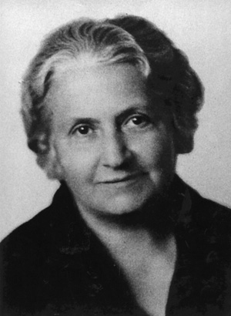
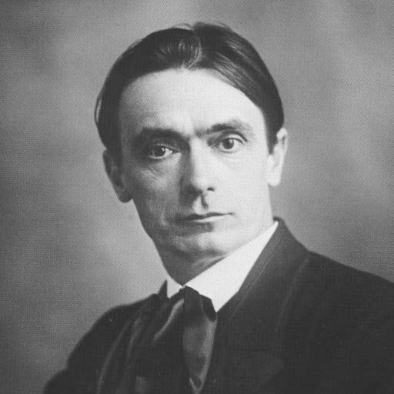
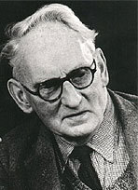
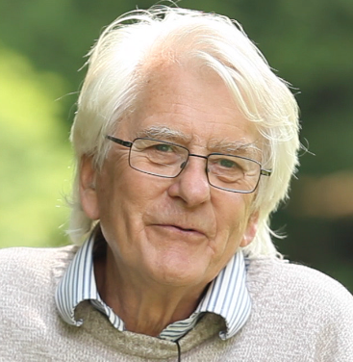
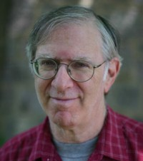
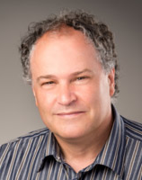
Some Leaders created school based on these principles
Maria Montessori
20’000
Rudolf Steiner
1000 schools
Alexander Sutherland Neill – Summerhill
Jerry Mintz
50 schools
David grimble
Sand School
Rino Lévêque
130 ECEC
Effective Leadership - World Academy of Art & Science

Slide 5
Highly Sensitive Person already get those natural skills
Characteristics of 20% of people
How do we treat them today?
1. Have great imagination
2. Have great intellectual abilities
3. Are creative
4. Have a curious mind
5. Are hard workers
6. Are good problem solvers
7. Are extremely conscious and compassionate
8. Are intuitive, caring and spiritual
9. Have a strong sense of aesthetic awareness
10. Respect nature, art and music greatly
11. Have profound and intense sensations
12. Can access important information from the unconscious mind
13. Have a depth of understanding and feelings
14. Are objective and can see the bigger picture
They suffer in current organizations and education:
Repetition
Concrete and walls
Materialist only
Raw competition
Purposeless..
ADHD : 11% of US kids in 2011. Ritalin 1-2%
Burnout figures : 7-9% of workers in Europe
Source : Elaine Aron http://www.huffingtonpost.com/roya-r-rad-ma-psyd/highly-sensitive-people_b_1286508.html?
Effective Leadership - World Academy of Art & Science
Notes:
The percentage of children with an ADHD diagnosis continues to increase, from 7.8% in 2003 to 9.5% in 2007 and to 11.0% in 2011.
Source :
http://www.cdc.gov/ncbddd/adhd/data.html
Ritalin in the US
http://www.rch.org.au/kidsinfo/fact_sheets/ADHD_Stimulant_medication/
http://www.drugs.com/stats/methylphenidate
Ritalin in the UK
http://www.theguardian.com/society/2012/may/06/ritalin-adhd-shocks-child-psychologists

Slide 6
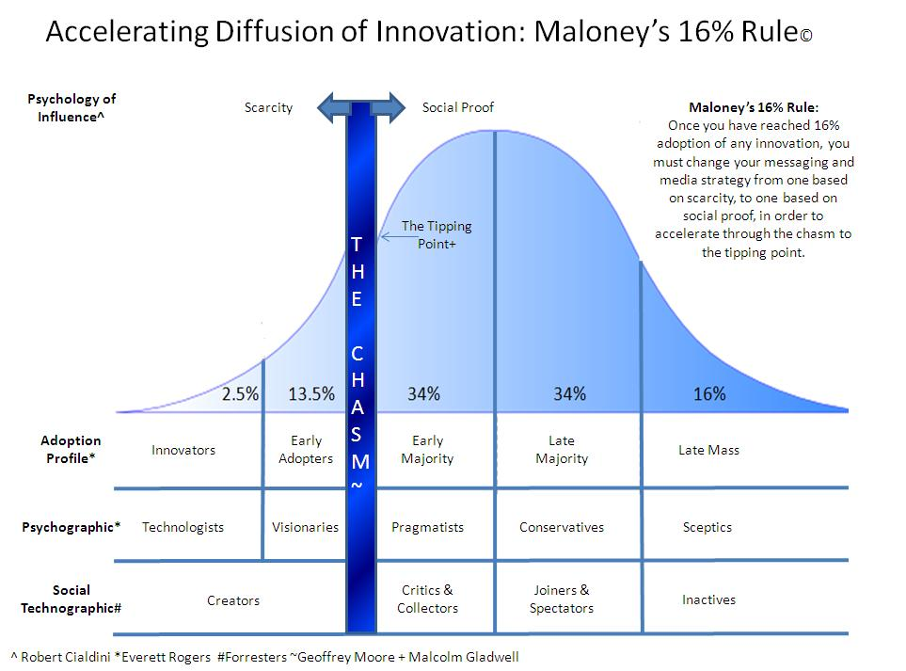
We are living a tipping point
Chasm occurs @ 16%. We must leave scarcity and go social
Evolution via rupture
Not 100% is required
Only 16%
The rest (68%) just follows
As long as we get enough evidence and examples.
Identifying those HSP and adapting the structure to their uniqueness is a key to go through the chasm
Effective Leadership - World Academy of Art & Science

Slide 7

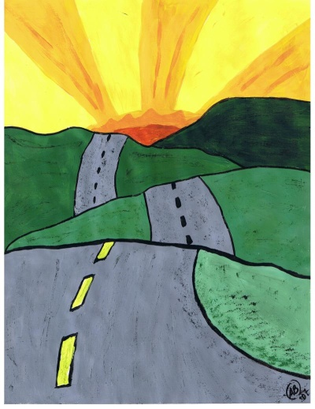
HSP just highlight the path. Every student needs to develop intrinsic qualities to become 21st century leaders.
It is more about tailor-made leaders :
Embracing each unique potential
Passion – school of life
Mind science – spiritual journey
Growth fueled by love
it is less about an industrial process
« one size fits all »
Survival-of-the-fittest
An industrial sequential process
Growth fuel by fear
We believe in 4 guiding principles
uniqueness – failure – mind - love
Effective Leadership - World Academy of Art & Science

Slide 8
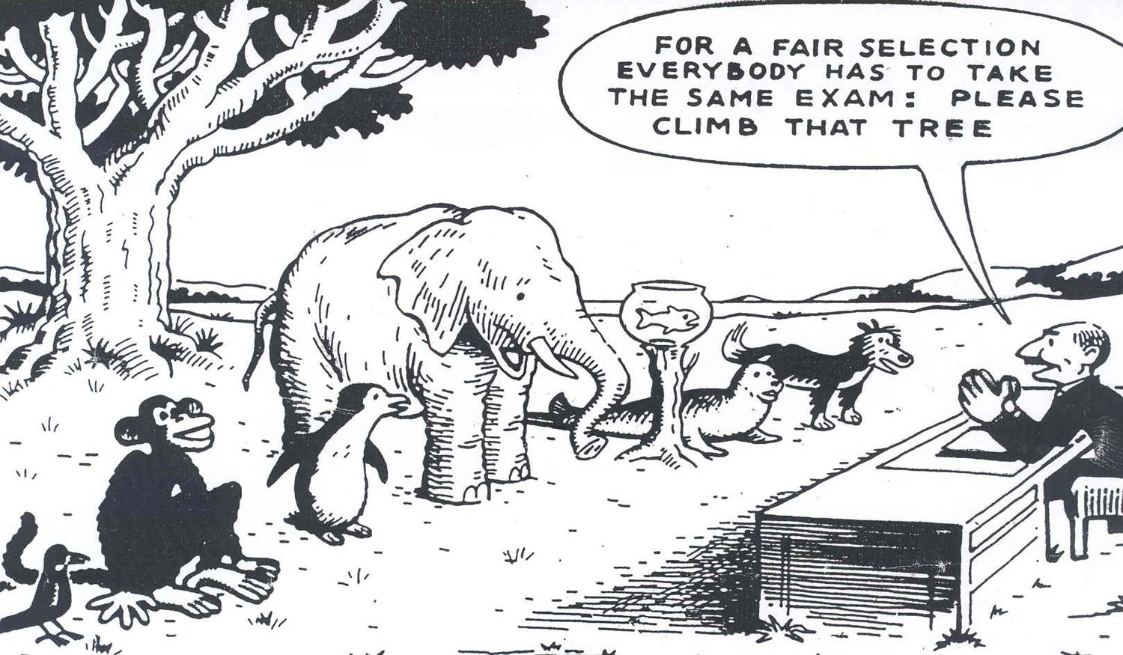
Belief n#1 : Embracing every individual’s unique potential
Education could better develop our uniqueness.
Belief n#1 : Educating leaders is haute couture job
not ready-to-wear. Uniqueness leads to passion.
Effective Leadership - World Academy of Art & Science
Notes:
The 21st century leader is not full of every skills : he recognizes the situation is far too complex for a single mind to handle everything.
He «just» enables the space for a collective intelligence to emerge

Slide 9
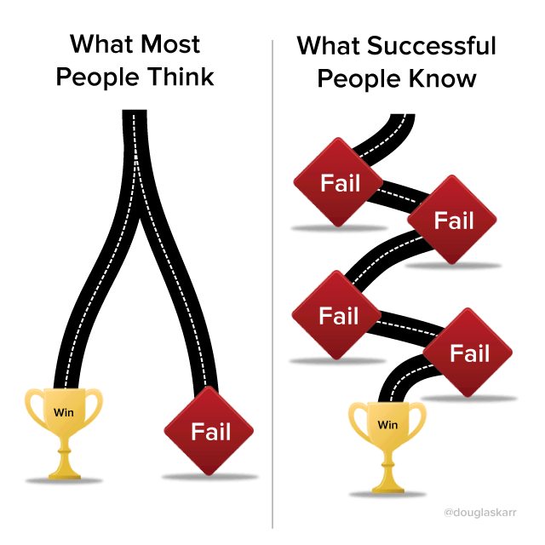
Belief n#2 : Passion
Education could better develop passion.
Winston Churchill:
« Success consists of going from failure to failure without loss of enthusiasm. »
Confucius:
Choose a job you love, and you will never have to work a day in your life.
Albert Schweitzer:
« Success is not the key to happiness. Happiness is the key to success. If you love what you are doing, you will be successful. »
Belief n#2 : passion makes leaders go through failure without loosing their final goal
Effective Leadership - World Academy of Art & Science
Notes:
06-82 80 95 53 M. Lebrun Pascal Jean de Montois
“Our greatest glory is not in never failing, but in rising up every time we fail.”
Ralph Waldo Emerson
“if you set your goals ridiculously high and its a failure, you will fail above everyone elses success”
― James Cameron
“Our greatest glory is not in never failing, but in rising up every time we fail.”
― Ralph Waldo Emerson
“As you proceed through life, following your own path, birds will shit on you. Don't bother to brush it off.
Getting a comedic view of your situation gives you spiritual distance.
Having a sense of humor saves you.”
― Joseph Campbell

Slide 10

Belief n#3 : Spiritual journey is key to unlock full potential
Education could better develop our inner self.
Einstein :
“Education is not the learning of facts,
but the training of the mind to think.”
SN Goenka:
I am only teaching you:
Morality
Mastery over the mind
Purification of the mind
Belief n#3 Management-less organizations need egoless leaders with stable and sharp mind fueled by compassion
Effective Leadership - World Academy of Art & Science
Notes:
“We are all butterflies. Earth is our chrysalis.”
― LeeAnn Taylor

Slide 11
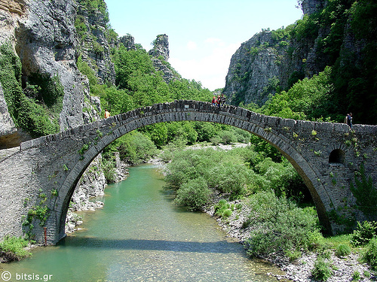
Belief n#4 : Growth fueld by care rather than fear
Education could better develop our capacity to love.
When fear needs always more
Control,
Planification,
Conformity,
Processes,
Silos
Love allows allways more
Space to try,
Self confidance,
Empowerment
Quality relationship
Complex mindset
Belief n#4 : cultivate love in leaders’ education so that they could also use this force in their organization
Effective Leadership - World Academy of Art & Science

Slide 12
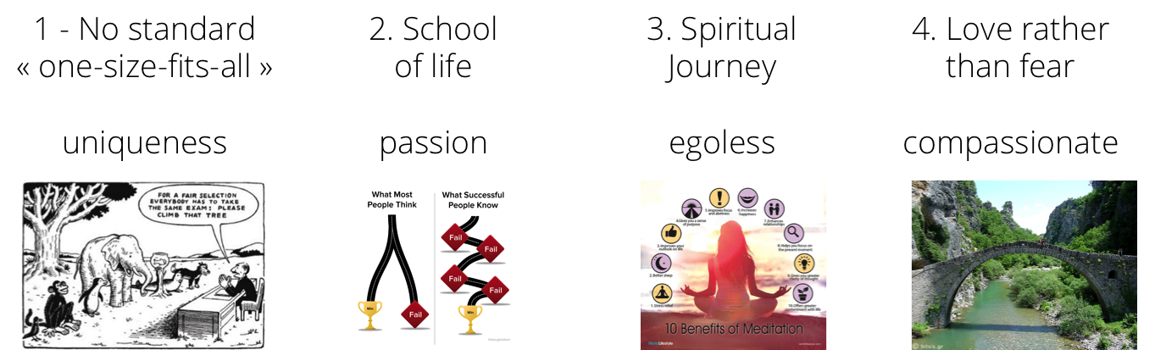
Our Conclusion
We think
Complex systemic environment need different leaders
Current education system is unbalanced.
Some kids/student are naturally connected - egoless
We believe in 4 improvements for teaching methods
Effective Leadership - World Academy of Art & Science

Slide 13

Thanks !

Slide 14
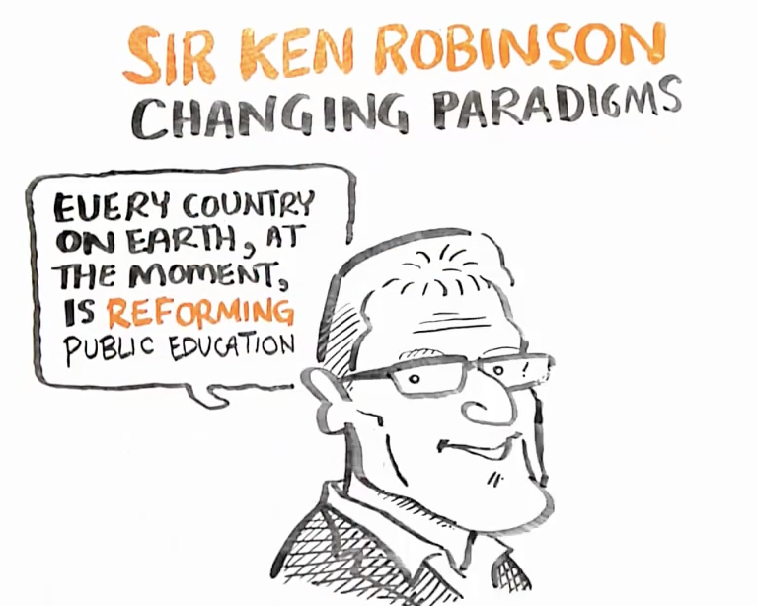
Annex 1 : Ken Robinson : changing paradigm of education
Sir Ken Robinson has been writer, researcher, adviser, teacher and speaker
His mission statement :
« to transform the culture of education and organizations with a richer conception of human creativity and intelligence.”
Click on the image to view the conference
Effective Leadership - World Academy of Art & Science

Slide 15
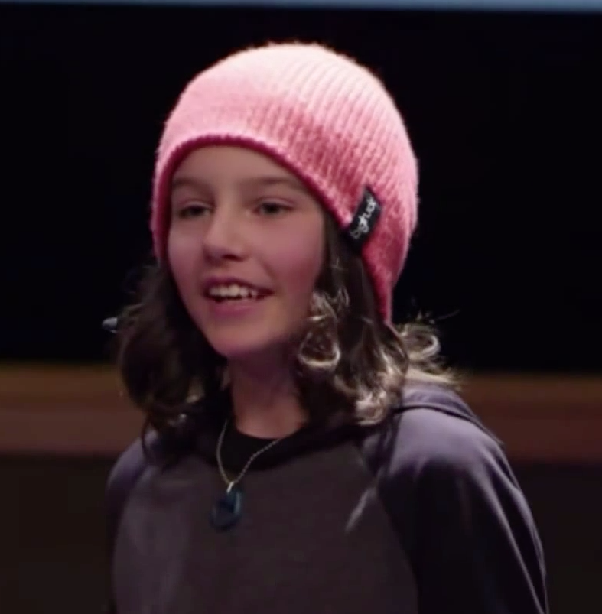
Annex 2 : Leaving school at 13 and learning differently
What will you do when your are an adult kid ? When I grow up… I want to be happy, healthy through :
Exercise
Diet &nutrition
Time in nature
Contribution and service
Relationship
Recreation
Relaxation and stress management
Religious & spiritual…. »
Click on the image to view the conference
Effective Leadership - World Academy of Art & Science

Slide 16
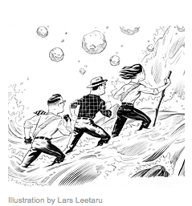
Annex 3 : How to Lead in Ambiguous Times
Stability, resilience, and relationships are the keys to thriving amid geopolitical crises.
The more volatile and hostile the environment, the more success and survival begin to converge.
The old geopolitical model is breaking down, but the only thing emerging in its place is crisis.
Click on the image to
read the article
Effective Leadership - World Academy of Art & Science

Slide 17
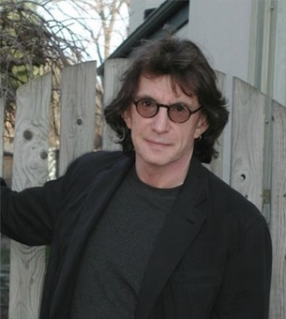
Annex 4 : Henry Giroux : university and its societal role
« We live at a time when it is more crucial than ever to believe that the university is both a public trust and social good.
At best, it is a critical institution infused with the promise of cultivating intellectual insight, the imagination, inquisitiveness, risk-taking, social responsibility and the struggle for justice. »
Effective Leadership - World Academy of Art & Science

Slide 18
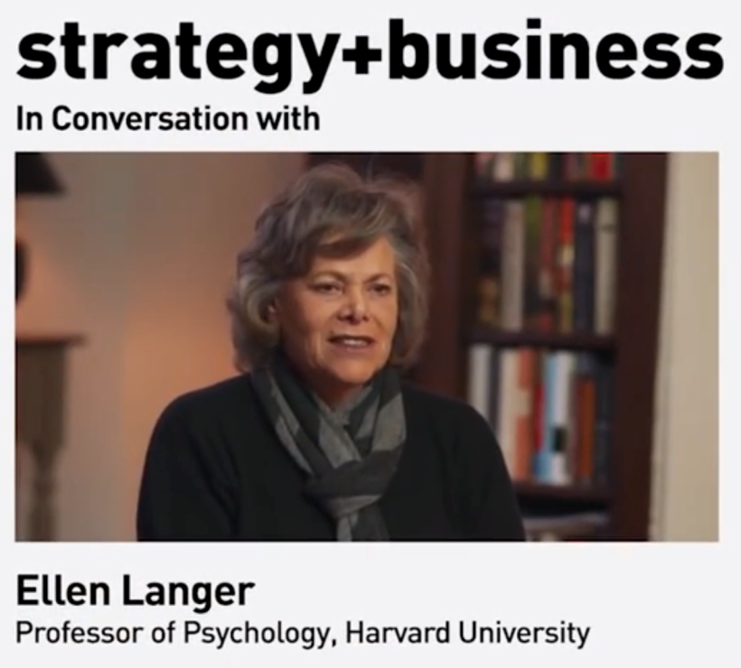
Annex 5 : Meditation in Business
As many business leaders know, mindfulness is gathering momentum as a management practice. Conferences such as Wisdom 2.0, and companies such as Google, are making a clear case that more deliberate awareness leads to stronger performance and better decision making.
The leader’s main job should not be to provide a script, but to provoke the mindfulness of everyone in the company. For example, innovation depends on the ability to recognize and recontextualize failures. That’s what 3M did with the Post-it note: A glue that failed to adhere became one of its greatest successes.
Click on the image to
Read the article
It includes a 3’ video
Effective Leadership - World Academy of Art & Science
Notes:
http://www.strategy-business.com/article/00310?gko=73023&cid=TL20150219&utm_campaign=TL20150219

