Slide 1
Essence of Effective Leadership March 31-Apr 3, 2015
WAAS AND WUC offer A WEBINAR ON
Process of Leadership
GARRY JACOBS
1

Slide 2
Fields of Leadership
Politics & Government
Business
Civil Society
Military
Sciences
Arts & Humanities
Religion
2

Slide 3
Objectives of this Webinar
What type of leadership?
Value-based
Empowering
Inclusive
Creative
Evolutionary
Transformative

Slide 4
Leadership & Individuality
Individuality is the capacity of a leader to think for himself, to act on his own understanding, values and beliefs – rather than merely reflect and conform to established social norms
Individuality in leadership is the capacity to identify with the wider aspirations, values and potentials of other people, society or humanity and act in a manner that promotes the progress of the collective
4

Slide 5
Accomplishment is a process
It is a psychological and social process
Human energy is the fuel for all accomplishment
All human accomplishment involves the
Generation & release of energy
Focusing that energy into a directed Force
Transformation of that Force into effective Power
Expression of that power in skilled action

Slide 6
Process of Leadership
Effective leaders are able to
Awaken Aspiration and will to accomplishment that generates and releases Energy
Convert the energy into focused Force through Vision, Values, Stories, Goals, Plans, & Decisions that inspire trust, confidence and support
Transform the force into effective Power through Organization
Express the power effectively through skilled Action
6

Slide 7
George Washington
High energy individual who embodied the American aspiration for freedom & independence
Inspired rag-tag colonial militia to remarkable feats of courage & endurance against the best army in the world
He organized the continental army from scratch, subordinated it to government and then defined the role & limits of the US presidency which have prevailed since then
Notes:
Gorbachev

Slide 8
Steve Jobs
Super high energy individual who embodied the aspiration of his generation for freedom, individuality, and creativity
He tuned in to the Orwellian anxiety about domination by impersonal machines and conceived of user friendly empowering computers
Apple Computers became the prototype of the creative Silicon Valley organization
Notes:
Gorbachev

Slide 9
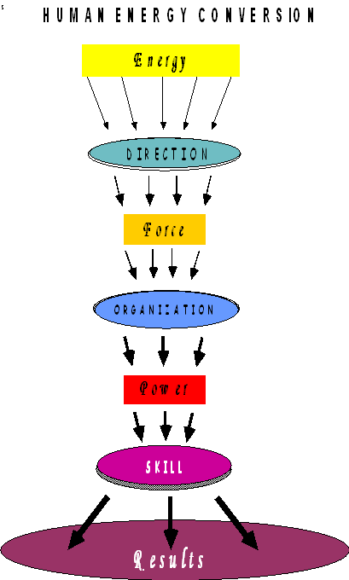
ENERGY CONVERSION FLOW DIAGRAM
9

Slide 10
Leadership Challenge
Leadership Challenge
How can we prepare leaders capable of addressing the pressing challenges posed by increasing speed of change, complexity and globalization?
How can we develop leaders capable of envisioning and steering global society toward a New Paradigm?
How can the education system be made an effective medium for development of those leaders?

Slide 11
Levels of Leadership Study
Personal characteristics & capacities of leaders
Mind of the leader – how do leaders think
Leadership in thought – power of ideas
Leadership in values
Organizational leadership
Leader’s relationship with other people
Development of self-aware leadership in others
Leader’s relationship with society and the public
Leadership and Life – essential wisdom

Slide 13
Issues
How do leaders develop the capacity to think more objectively and creatively?
How do visionary leaders acquire the insight and intuition needed to navigate through a rapidly changing and increasingly complex world?
What is the role of values in effective leadership?
How do leaders make decisions to manage complexity and conflict and reconcile apparent contradictions?
How do dynamic leaders release, direct, and channel the energies of people for high accomplishment?
How do professional leaders harness the power of impersonal organization to convert personal intentions into results?
How do effective leaders acquire and exercise power for high achievement?
How do inspirational leaders empower and motivate other people?
How do adaptive leaders utilize and convert challenges into opportunities?
What are the essential skills required for effective leadership?
How do leaders promote initiative, innovation and creativity in their people and organization?

Slide 14
Questions on Leadership
Are there transcendent principles of effective leadership common to different fields of application?
What are they key dimensions or elements of effective leadership the leader have to manage?
What is the relationship between personal leadership and organizational leadership and how are they related to one another?
What psychological attributes/characteristics make for successful leadership?
What is the relationship between leadership and individuality?
What role do values play in successful leadership?
What type of knowledge is most essential for effective leadership?
What are the most critical leadership skills?
What constitutes the life wisdom of effective leadership?
What type of education is needed to consciously foster the development of leadership?
What should be the objectives of the IUC leadership course?

