Slide 1
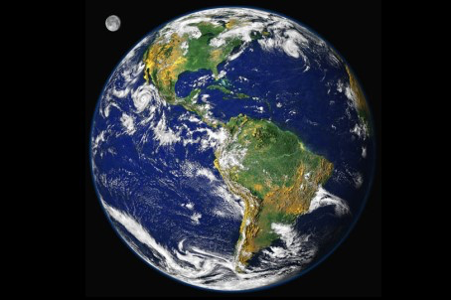
Ecological Foundations and Limits of
Sustainable Economy
Stefan Brunnhuber
MD PhD CMO
Psychiatrist
Endowed Professor Sustainability & Psychology
Senator European Academy of Science and Arts
Fellow WAAS

Slide 3
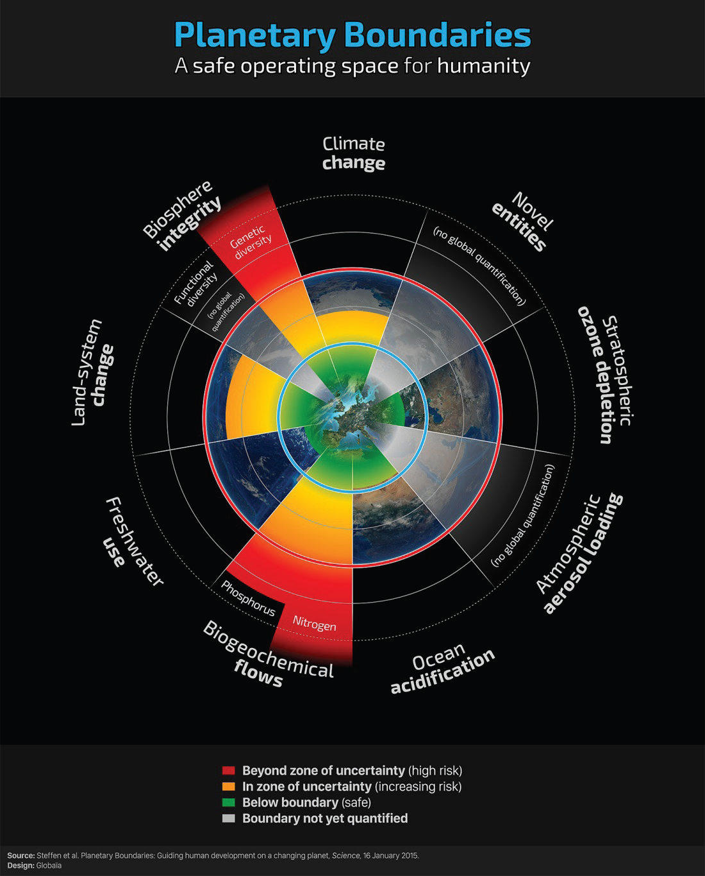
Johan Rockström u. a.: A safe operating space for humanity. In: Nature. 461, 2009, S. 472–475. (24 September 2009)

Slide 4
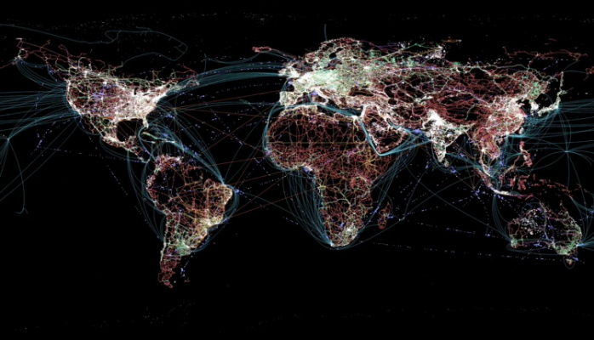
Para Khanna: Connectography. Mapping the Future of Global Civilization», Random House (New York) 2016

Slide 5
Limits and Links determine Sustainable Economics
Boundaries and Bonds determine Economic Rationale
The four traditional approaches fail: Technology
Growth
Governmental Regulation
Demography based Policy
There is no free lunch, no Exit: Non-linear Big Loop
Rawl’s 2.0
Planetary Consciousness
Notes:
Sustainability „...is a development, which fulfills the present needs without risking that future generations cannot fulfill their own needs...“.
What does sustinability means? 1. non renewable resources ( oil) should not be explioted more that renewble resources ( solar) are intalled) 2,Water, land eroision, air should not be polutd more then it can be regenerated… 3. Income gap should not be increasing…. 4. debth load should be covred by one generation how to get there: long term horizon ( politican shuld thnkn like parents for their kids)….. New incentive structures….people need information about the consequenzes….

Slide 6
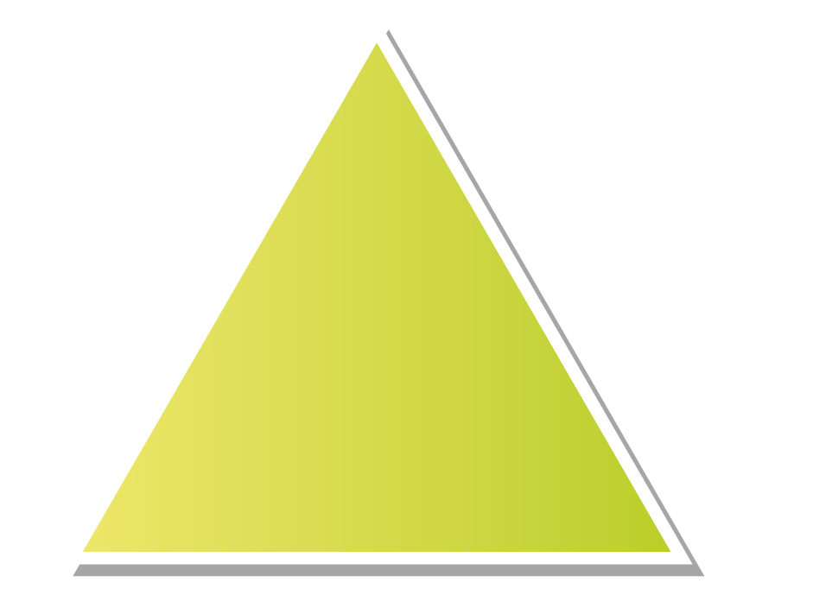
Towards a polycentric view…
Economy
Consciousness
Values
Monetary System
Real Economy
Social
Ecology
Social
Ecology

