Slide 1
The Limits of Conventional Economics & the Need for a New Paradigm
Pascal van Griethuysen PhD in Evolutionary Economics, Research Fellow at UN Research Institute for Social Development
Executive in Residence at Geneva Centre for Security Policy
vangriethuysen@unrisd.org
Roundtable in Human Centered Economics Inter-University Centre, Dubrovnik, Croatia February 1-3, 2017

Slide 2
OUTLINE
conventional economics & the paradigm shift
limits of mechanistic analogy
need for a paradigm shift
evolutionary economics as a candidate for NET
from mechanistic to evolutionary foundations (equilibrium to process)
An open, two-level cognitive process
normative implications of evolutionary economics
the heuristic value of evolutionary economics
diagnosing world development
envisioning alternative paths
Notes:
‹#›
‹#›

Slide 3
Conventional economics
A MECHANISTIC EPISTEMOLOGY
a liberal normative perspective
market as the best organizing principle for society
no need for regulating the private actors
a formal validation of the invisible hand
the general equilibrium model
a set of problematic assumptions
methodological individualism, rational choice & exogenous preferences
perfect information & competition
market exchanges of private goods & no externality
monetary (uni)dimension, substitutability & reversibility
Notes:
‹#›
‹#›

Slide 4
Conventional economics
MAIN LIMITS
Image of Man
human psychology, motivations & needs
institutions (symbolic & normative references)
social asymmetries & power dynamics
technology (exosomatic evolution)
Human-Nature coevolution
complexity
temporalities
qualitative change, irreversibility & novelty
Notes:
‹#›
‹#›

Slide 5
The paradigm shift
A PRELIMINARY CONCERN
"There are several regrettable consequences of the adoption of the mechanistic epistemology by standard economics. The most important is the complete ignorance of the evolutionary nature of the economic process."
(Georgescu-Roegen 1977:267)
Notes:
‹#›

Slide 6
The paradigm shift
EVOLUTIONARY ECONOMICS AS NET
"a new approach which makes it possible to deal with the dynamic interrelations between economic systems and the whole network of physical and social systems and, indeed, the entire composite system of structural relationships."
(William K. Kapp, 1976:97)
Notes:
‹#›

Slide 7
The paradigm shift
PERIPHERY ↔ CORE
It is "necessary to consider most of the factors which economic theory has so far regarded as constant or given data as the very problem which needs to be solved or … as dependent variables. "
(William K. Kapp, 1976:97)
Notes:
‹#›
would imply a complete reversal of the analytical procedures of the discipline as hitherto practised and applied. Instead of postulating a given state of technology, given behaviour patterns and given individual preferences and aiming at the explication of the allocation mechanism of a hypothetically closed system under autonomous and self-regulating market forces and on the assumption of rational optimising action of individual producers and consumers, the new task of economics would be to elucidate the manner in which collectively determined social goals and objectives could be attained in the most effective and socially least-costly manner.

Slide 8
The paradigm shift
THE MECHANISTIC PARADIGM
“In the metaphysics of normality, the process is rated in terms of the equilibrium to which it tends or should tend, not conversely"
(Veblen [1900] 1919:165)
Notes:
‹#›

Slide 9
The paradigm shift
THE EVOLUTIONARY PARADIGM
“In the metaphysics of process, creation and transformation of order is always taken to be the deepest and most fundamental account of the laws of a process.“
(David Bohm, 1969:43)
Notes:
‹#›

Slide 10
Towards a New Economic Theory
EVOLUTIONARY ECONOMICS
evolutionary ontology & epistemology
multiple dimensions & temporalities
Human-Nature coevolution
circular & cumulative causation (CCC)
trajectories & attractors
path dependence & lock-in
thresholds & bifurcations
Notes:
‹#›
‹#›

Slide 11
An evolutionary knowledge creation process
COMMUNALITIES, SPECIFIC REALISATIONS & EMERGENT PROPERTIES
Ǝ ontological communalities (communality hypothesis)
Ǝ emergent, irreducible properties (continuity hypothesis)
An open, two-level cognitive process
Notes:
‹#›

Slide 12
Evolutionary Economics
NORMATIVE IMPLICATIONS
"would imply a complete reversal of the analytical procedures of the discipline as hitherto practised and applied. Instead of postulating a given state of technology, given behaviour patterns and given individual preferences and aiming at the explication of the allocation mechanism of a hypothetically closed system under autonomous and self-regulating market forces and on the assumption of rational optimising action of individual producers and consumers, the new task of economics would be to elucidate the manner in which collectively determined social goals and objectives could be attained in the most effective and socially least-costly manner."
(William K. Kapp, 1976:156)
Notes:
‹#›

Slide 13
The value of evolutionary economics
ENVISIONING ALTERNATIVES
alternative technological paths
self-reproduction & renewables-related technologies
societal metabolism & industrial ecology
alternative institutional modalities
state & collective property
common ownership & stewardship
multilevel and polycentric governance
Notes:
‹#›
‹#›

Slide 14
The capitalist-industrial complex
ATTRACTING WORLD DEVELOPMENT
financing
capitalist expansion
industrial development
materialising

Slide 15
The value of evolutionary economics
DIAGNOSING WORLD DEVELOPMENT
key factors of cultural evolution
technology (exosomatic evolution)
institutions (symbolic & normative references)
techno-institutional interplay
cultural attractor & trajectory
capitalist-industrial complex & World development
path dependence & lock-in
industrial path dependence & carbon lock-in
capitalist path dependence & governance lock-in
Notes:
‹#›
‹#›

Slide 16
The value of evolutionary economics
ENVISIONING ALTERNATIVES
alternative technological paths
self-reproduction & renewables-related technologies
societal metabolism & industrial ecology
alternative institutional modalities
state & collective property
common ownership & stewardship
multilevel and polycentric governance
alternative economic rationale
circular economy, functional economy, sufficiency economy, social & solidarity economy (eco-social rationale)
Notes:
‹#›
‹#›

Slide 17
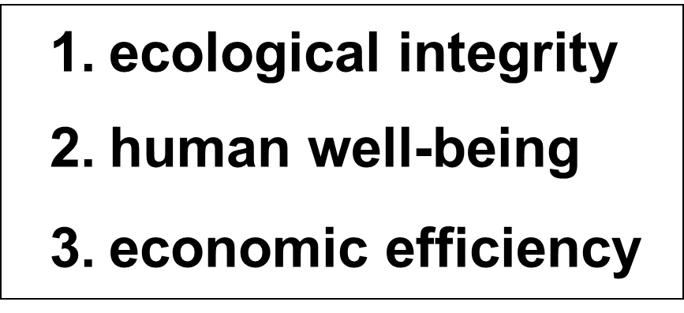
The eco-social rationale
Substantive rationality for development
⇨ A development corridor framed by ecological maxima & existential minima

Slide 18
Evolutionary economics as NET candidate
CONCLUSION
The limits of the mechanistic analogy
a paradigm shift for a new economic theory
a metaphysics of process (evolutionary epistemology)
Communalities, emergence & specific realisations (in line with other scientific disciplines)
potential for diagnosing contemporary development & envisioning alternatives
Notes:
‹#›
‹#›

Slide 19
References
Georgescu-Roegen N (1971), The Entropy Law and the Economic Process. Cambridge MA, London: Harvard University Press.
Kapp KW (1976), The Open-System Character of the Economy and its Implications, in: Dopfer K (ed.), Economics in the Future. London: Macmillan, 90‑105.
Kallis G & RB Norgaard (2010), Coevolutionary ecological economics. Ecological Economics 69, 690–9
Soto de H (2000). The Mystery of Capital: Why Capitalism Triumphs in the West and Fails Everywhere Else. London et al. : Bantam Press.
Unruh GC (2000), Understanding carbon lock-in. Energy Policy 28, 817–30.
Veblen T (1904). The Theory of Business Enterprise. New York : Charles Scriber’s Sons.
Steiger O (2008). Property Economics – Property Rights, Creditor’s Money and the Foundations of the Economy. Marburg : Metropolis.
Notes:
‹#›

