Slide 1
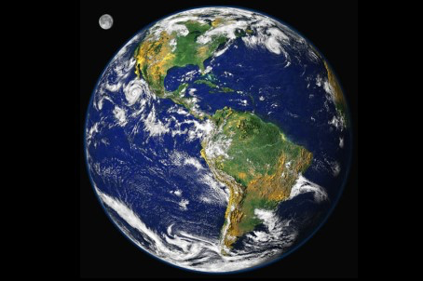
Why The Monetary
System Matters…..
Stefan Brunnhuber
MD PhD CMO
Psychiatrist
Endowed Professor, Sustainability & Psychology
Senator, European Academy of Science and Arts
Fellow, WAAS

Slide 2
A common attractor?
Disparity of Wealth
Social security systems
Debt load
Fundamentalism
Aging
Income gap
Terrorism
Social
discrimination
Digital gap
Transportation costs
Short-term thinking
Ecological
externalities
Pensions
Security
standards
Unstable financial
markets
Degradation
of species
Unemployment
Poverty
Starvation
Source: UN 1995

Slide 3
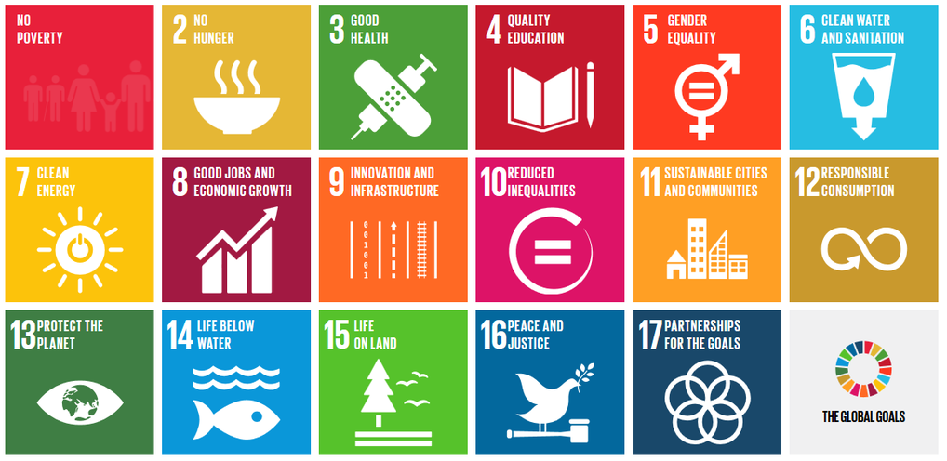
Millenium Goals have been replaced by the Sustainability
Development Goals (17) Sept. 2015 in NY
Source: UN 2015

Slide 4
The System Is Not A Neutral Veil:
1. Amplification of boom and bust cycles: ‘When is rains it pours’
2. Force to grow: ‘On Debt and compound interest rate’
3. Short-termism: ‘Why the future is discounted’
4. Income disparity: ‘Poor versus super rich’
5. Erosion of social capital: ‘Competitive Behavior overpowers Cooperation’
Source: Lietaer & Brunnhuber 2013
Brunnhuber 2016
Notes:
…….3

Slide 5
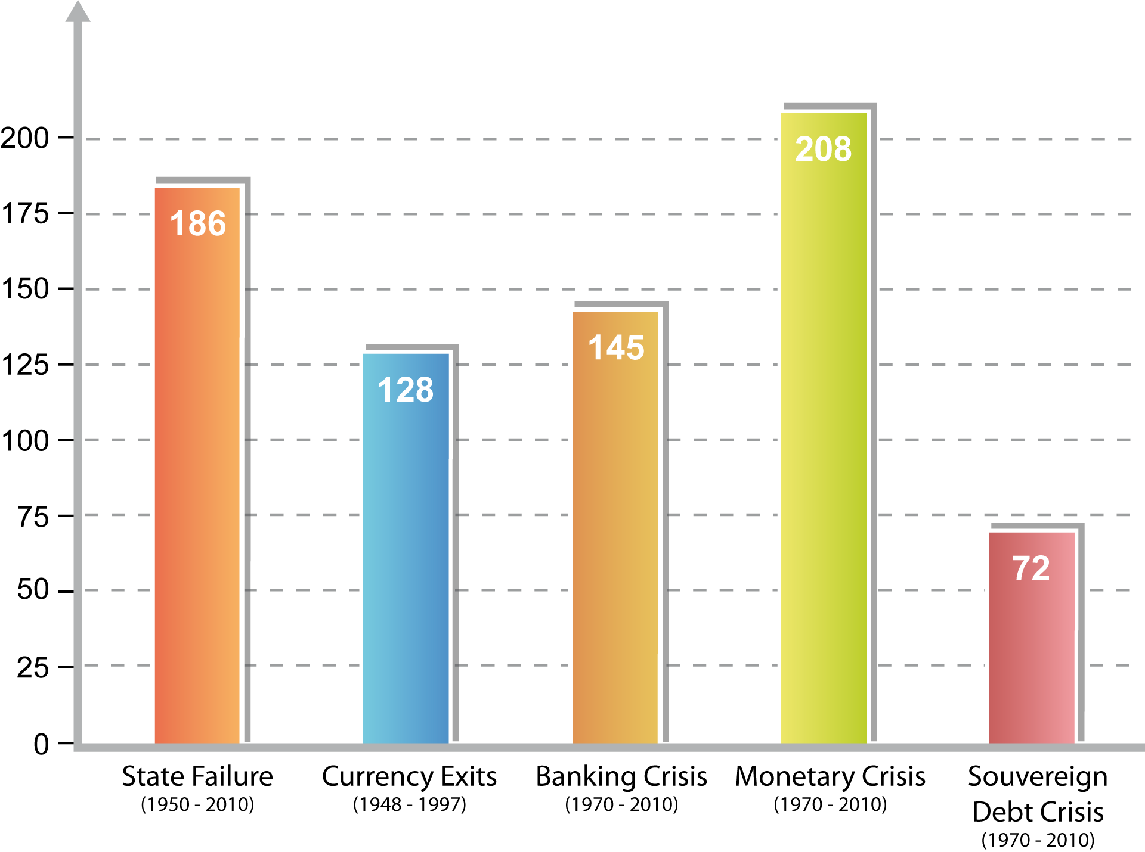
The System is intrinsically unstable:
‘The Toothpaste is out of the Tube’
Number of events
Sinn 2015; US Das; Papaioannou et al. 2012; Lietaer et al. 2013

Slide 6
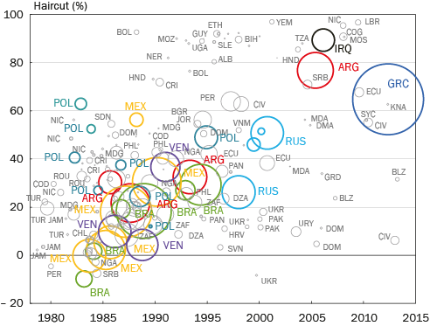
Full and partial sovereign defaults (1978-2013)
‘A regular and common default’
Source: Sinn 2015

Slide 7
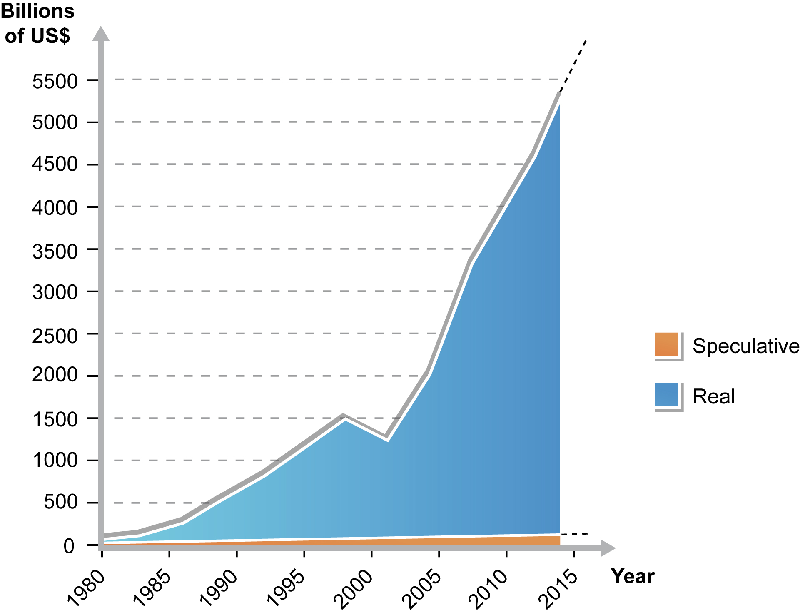
Finance at Risk: The System is unstable
F.ex: The Currency Market
Source: Lietaer Brunnhuber 2013 (update: 2015)
Notes:
.......4,6 Trill in 2012 5 Trill expected in 2013

Slide 8
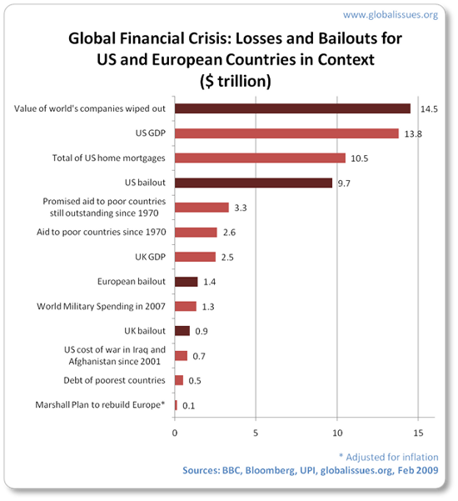
Monetary system is expensive:
‘There is no free lunch in a connected world‘
Impact:
Output costs
Transfer costs
Indirect costs
Direct costs
----------------
25% GDP
Pension gap (pre-post) 13%-26%
Source: Gorton 2012, BIS 2012, Stern 2008, OECD 2012, ILO 2012, GFC 2013
Notes:
Marshall plan: Germany Sum score in 1952 (5,2% of GDP) compared to 2011 in Greece ( 11 Bill): However we spent already 41 x times more and germany has liabilities of 10 x marshall plans for Greece only. !!!!! GFC speals 3,2 Trill USD for preventing Global warming!!
90% of growth will happen outside oft he EU with a negative domestic growth rate for the EU

Slide 9
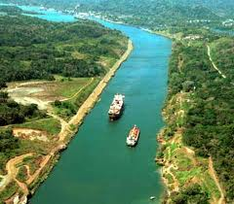
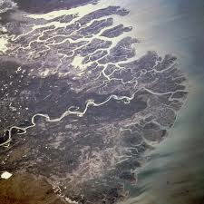
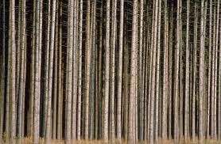
Towards a Monetary Ecosystem:
Notes:
Amazon..... Indus or kamtchatka delta. Sastachewan Delta
Riverbank and dams determin where the water is encourgaed to flow, our monetary system (Latin currere tp flow) determines the direction in wchi human capacities are encouraged or diencouraged, waht can be achieved and what not.....
Our money sysem is not suffenciently diverse, we do have a monetary monoculture.... It dams and bottlenechs our potentials and jkeeps yus trapped in a world of suffering, greed, anxiety and, scarcity, short sightedness, on going force and complusion to grow, inbalance in health and welath
B2B ,global and community...
How do we find the money needed to transform our energy, food and health infrastructures, to eradicate unemployment and create green jobs, clean up the environment, and ensure that people have proper access to housing, education and meaningful work? Have you ever wondered why cash shortage so bottlenecks our best efforts and initiatives when we actually live in a world where there is neither a shortage of things needing to get done, nor a shortage of people wanting to do them?
Money Diversity is just as important then species diversity....Convnetional: monopoly, with interest rate, scarcity criterion..its not an argument against the national currencies nor against the intersts rate, but against ist monopoly...
Ist our future, the future of our children and the future of this plant which is at stake.....
As Paul Hawken succinctly put it in his memorable address to Portland University’s graduate class in May of 2009, “civilization needs a new operating system,” and fast. Why? Because many of the socio-economic rules under which we operate were created under a worldview that failed to recognize that the earth is a living system and that every form of life has its unique and valuable place and purpose in sustaining the larger web of life. By ignoring the conditions that support the health of our ecosystems and communities,
We all want clean air, a reasonable income, save brougheoudd
, education, healty food, being in a healtu state, We all refuse piverty, ineuality, unfairness, polution, kac of eeducation, and unehaktu state. And anytime if ist comes to solveone of these problems we try to solve them through the same bottleneck of the given monetary system. I would like to demonstrate that teh given system has ist advantdvgte but has bias counteracting eveyr time we are.....
Our conventional money facilitates particular types of (commercial) flows but does not adequately support other types of flows within communities. When a broader spectrum of currencies is in place, people can complete more transactions, enabling more people to meet their needs and enter into exchange relationships. Because complementary currencies do not bear interests and are issued in sufficient supply, they encourage cooperation amongst participants, and can counterbalance some of the side-effects of conventional money.
In 1984, only two such complementary currency systems existed. By 1990, their numbers had grown, but there were still fewer than 200 systems operating in the world. Today, there are thousands such currencies worldwide. Hundreds of Time Banks operate in 22 countries. And in the United States alone, there are already 700 business to business complementary currency systems in which 500,000 businesses participate
Money is an agreement within a particular community to use some standardized object as a means of exchange.

Slide 10
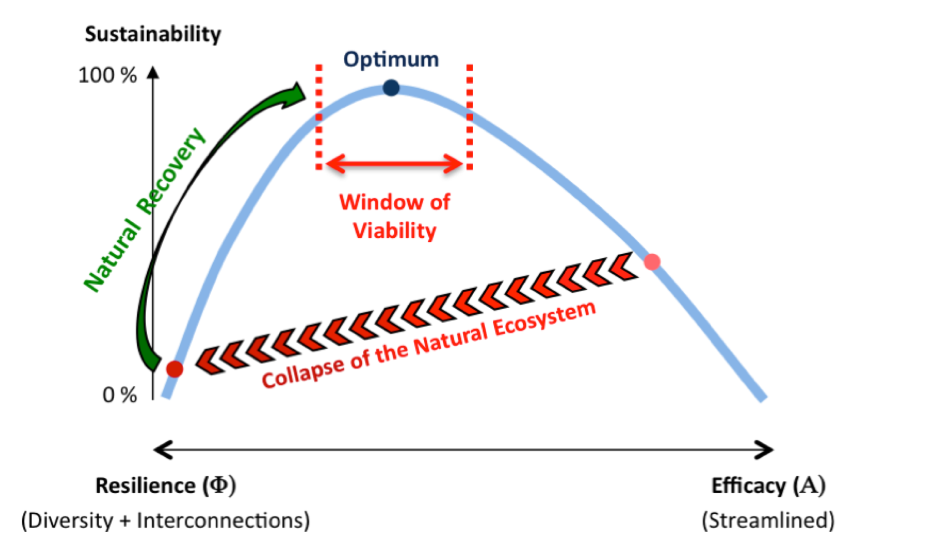
The Physics of Stability:
Collapse and Recovery in Natural Ecosystems
Notes:
-

Slide 11
A Twin-strategy can tackle the problems:
Structure of the
financial system
Instability
Compulsory growth pressure
Short-term priority
Income disparity
Erosion of social capital
Notes:
………5…………

Slide 12
A Twin-strategy can tackle the problems:
conventional solutions:
(neo-) liberal:
Privatization
Deregulation
Liberalization
Individual responsibility
Keynesian:
Deficit spending
Regulation
Anti-cyclical
Financing public goods
Structure of the
financial system
Instability
Compulsory growth pressure
Short-term priority
Income disparity
Erosion of social capital
Notes:
………5…………

Slide 13
A Twin-strategy can tackle the problems:
conventional solutions:
(neo-) liberal:
Privatization
Deregulation
Liberalization
Individual responsibility
Keynesian:
Deficit spending
Regulation
Anti-cyclical
Financing public goods
complementary parallel Innovations
Structure of the
financial system
Green QE
Regional complementary currencies
Instability
Compulsory growth pressure
Short-term priority
Income disparity
Erosion of social capital
Notes:
………5…………

Slide 14
“The debate on the future of money
is not about inflation or deflation, fixed or flexible exchange rates, gold or paper standards, but about the kind of society in which money is to operate?”
G. Simmel, 1900
Notes:
………..6…………

Slide 15
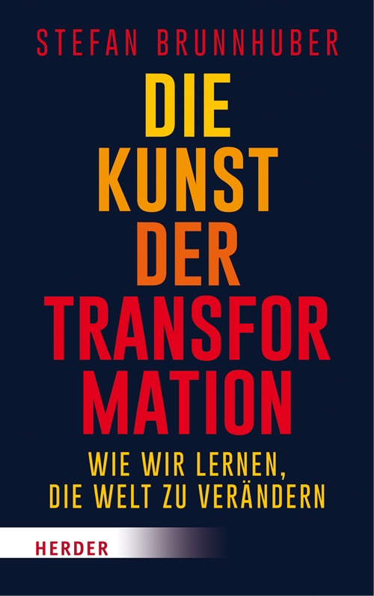
‚Den Kollisionskurs der Menschheit umlenken in Richtung Nachhaltigkeit. Das wollen wir eigentlich alle.
Stefan Brunnhuber gibt psychologisch fundierte Antworten. So etwas brauchen wir beim Club of Rome.‘
- Ernst Ulrich von Weizsäcker, Ko-Präsident des Club of Rome -
‚Nur aus dem Inneren heraus kann Nachhaltigkeit gefördert und gelebt sein. Wir brauchen ein solches Buch,
um die Debatte für die wohl wichtigste Debatte über unser zukünftiges Zusammenleben zu eröffnen’
- Prof. Dr. Dr. Felix Unger, Herzchirurg, Präsident der Europäischen Akademie der Wissenschaften und Künste -
‚Der Titel des Buches „Kunst der Transformation“ trifft genau ein zentrales Problem der Nachhaltigkeitsdiskussion
.wir sind nicht unbeteiligte Beobachter, sondern wir sind der Overshoot.’
-Prof. v. Hauff- Entwicklungsökonom Universität Kaiserlautern -
‚Brunnhuber gelingt es eine psychologische Anthropologie zu entwerfen und das psychosoziale Potential
für einen Wandel in Richtung Postwachstumsökonomie zu entfalten.’
-Prof. Peukert- Finanzökonom Universität Erfurt -
‚Ein kleiner Harry Potter für die aktuelle Nachhaltigkeitsdiskussion. Muss man unbedingt lesen!‘
-Prof. Leukefeld Energieexperte und Energiebotschafter der Bundesregierung -
‚Dieses Buch ist ein wichtiger Beitrag über die gesellschaftlichen Herausforderungen in der Abenddämmerung des Kapitalismus!‘
-Rainer Voss- ehemaliger Investmentbanker, protagonist in <master of the universe>-
‚Erkenntnis über die gegenwärtige Situation der Welt ist schwer zu erreichen, aber Erkenntnis führt nicht automatisch
zur richtigen Einsicht, und richtige Einsicht führt nicht automatisch zu richtigem Handeln. Da gibt es in unserem Kopf
eine Menge Hürden. Dazu wird dieses Buch wesentlich beitragen.’
-Prof. Dr. Dr.Gerhard Roth, Neurobiologe und Hirnforscher, Bremen -
‚Ein interessanter neuer Ansatz…viel Erfolg‘.
-Prof. Dr. Dr. J. Radermacher, Universität Ulm-
‚Ein Buch, das Mut macht zur Veränderung!‘
-Prof. Dr. Gustav Dobos, Direktor, Universität Duisburg-Essen-
‚Ein Muss für alle…’
-Prof. A. Michalsen, Charite, Berlin-
‚Menschen haben der biologischen die kulturelle Evolution hinzugefügt und seither durch ihr kulturelles und zivilisatorisches Tun die
vorgefundene Welt nachhaltig verändert. Dieses Buch zeigt auf, wie diesem Dilemma begegnet werden kann.’
-Prof. Wolf Singer, Direktor Neurophysiologie, Max Planck Institut, Frankfurt am Main-
‚a psychological perspective on sustainability -- that is fully real. It is just waiting to be realized.‘
-Garry Jacobs, President World Academy of Science and Arts (WAAS)-
‚A book that must be read - is my strong recommendation.’
-Heitor Gurgulino de Souza, President, World Academy of Art and Science (WAAS)-
‚Diese Publikation, die trotz eines hohen fachlichen Niveaus sehr verständlich und lesbar ist, dringt zum Kernproblem
aller Nachhaltigkeitsbemühungen vor: Warum tun wir uns mit der nötigen Transformation so schwer?
Die vom Verfasser aufgedeckten Perspektiven schließen eine klaffende Lücke innerhalb der Nachhaltigkeitsforschung.’
-Prof. Niko Paech, Universität Oldenburg,-
‚strongly recommend…‘
Prof. Michal Kleiber, Präsident (em.) der polnischen Akademie der Wissenschaften,ehemaliger Wissenschaftsministern Polens

Slide 16
Ecological Foundations and Limits of Sustainable Economy
Stefan Brunnhuber
MD PhD CMO
Psychiatrist
Endowed Professor, Sustainability & Psychology
Senator, European Academy of Science and Arts
Fellow, WAAS

Slide 18
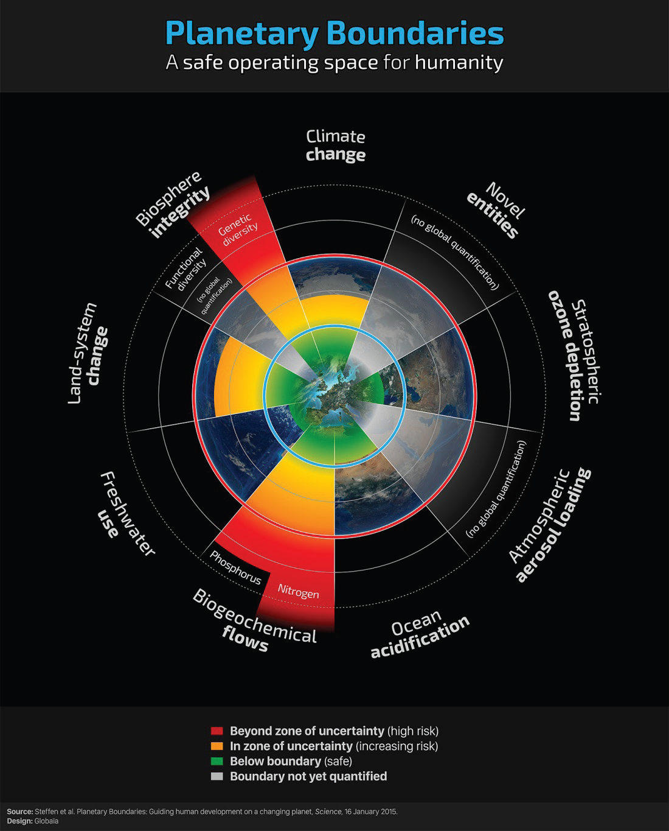
Johan Rockström u. a.: A safe operating space for humanity. In: Nature. 461, 2009, S. 472–475. (24 September 2009)

Slide 19
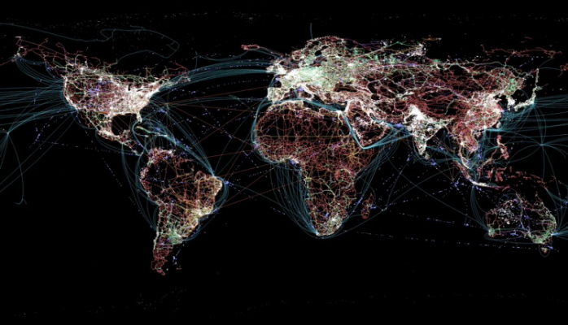
Para Khanna: Connectography. Mapping the Future of Global Civilization», Random House (New York) 2016

Slide 20
Limits and Links determine Sustainable Economics
Boundaries and Bonds determine Economic Rationale
The four traditional approaches fail: Technology
Growth
Governmental Regulation
Demography-based Policy
There is no free lunch, no Exit: Non-linear Big Loop
Rawl’s 2.0
Planetary Consciousness
Notes:
Sustainability „...is a development, which fulfills the present needs without risking that future generations cannot fulfill their own needs...“.
What does sustinability means? 1. non renewable resources ( oil) should not be explioted more that renewble resources ( solar) are intalled) 2,Water, land eroision, air should not be polutd more then it can be regenerated… 3. Income gap should not be increasing…. 4. debth load should be covred by one generation how to get there: long term horizon ( politican shuld thnkn like parents for their kids)….. New incentive structures….people need information about the consequenzes….

Slide 21
Principles of Sustainable Economy
Stefan Brunnhuber
MD PhD CMO
Psychiatrist
Endowed Professor, Sustainability & Psychology
Senator, European Academy of Science and Arts
Fellow, WAAS

Slide 22
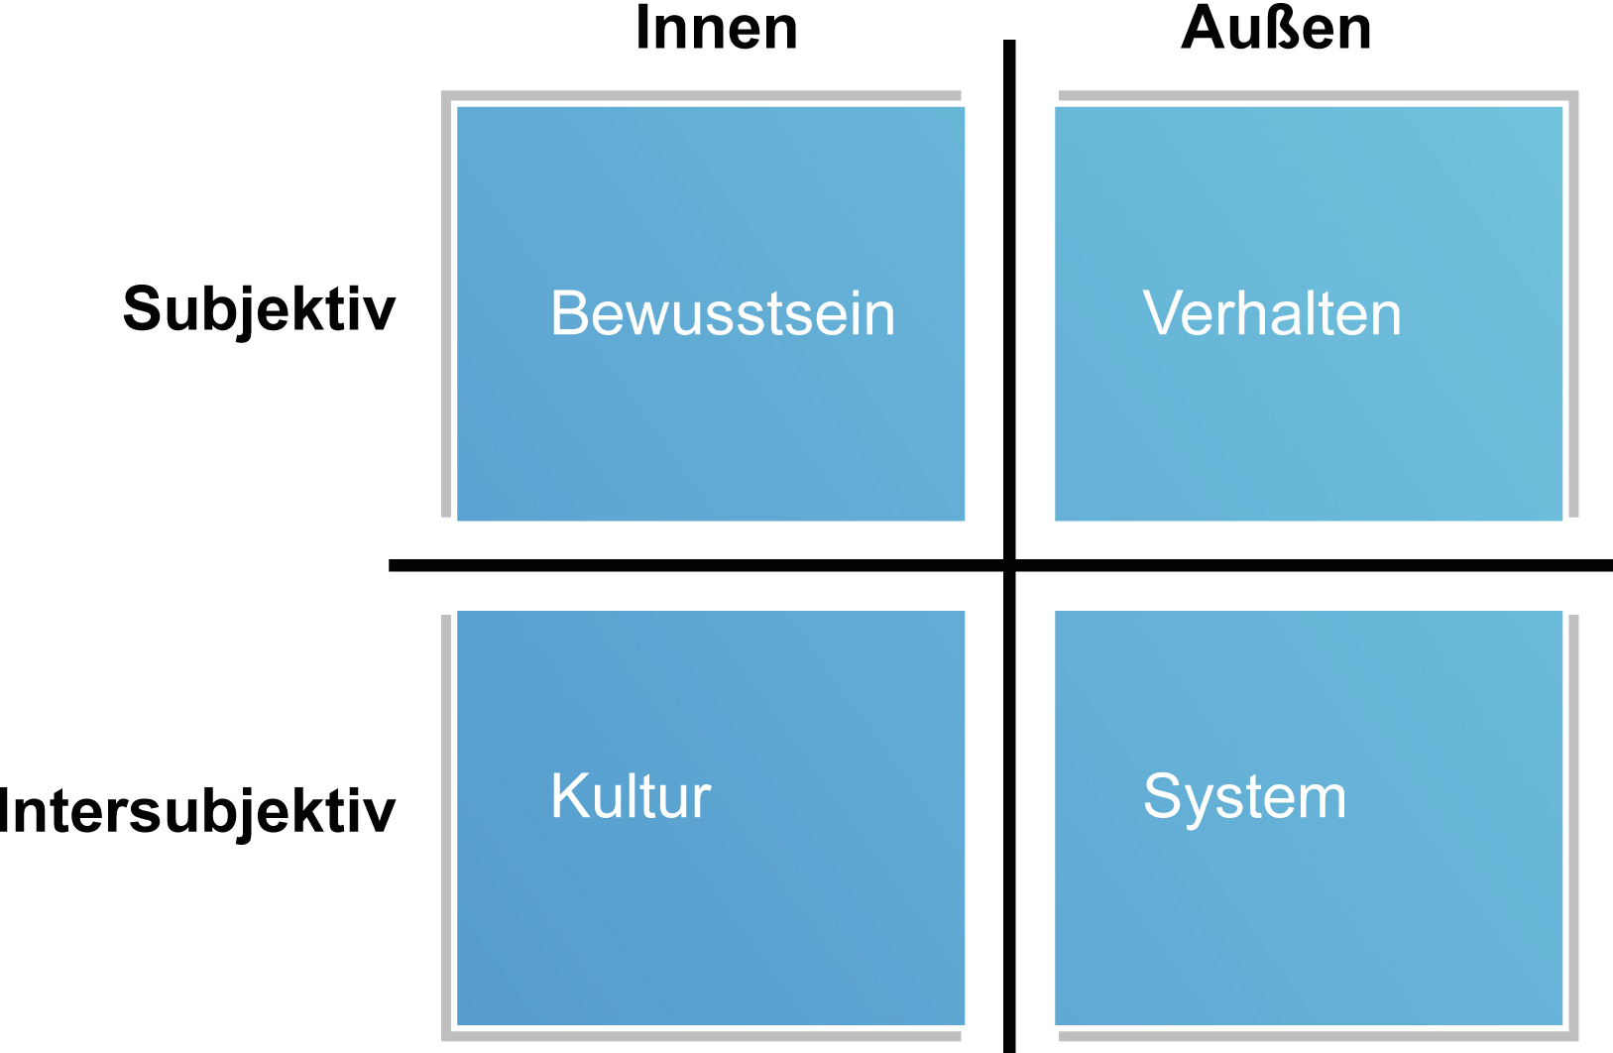
Towards an integral approach…
Internal
External
Subjective
Consciousness
Morals/Values
Behavior
Technology
Social
Growth
Demography
Inter-subjective
Systems
Governance

Slide 23
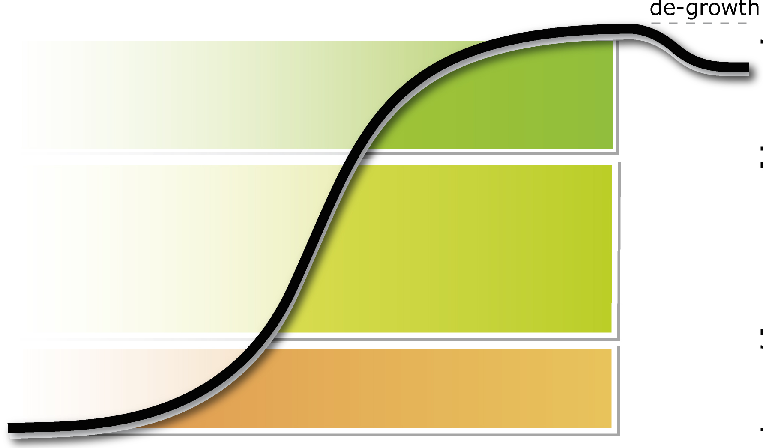
Towards steady state…
Notes:
Sustainability „...is a development, which fulfills the present needs without risking that future generations cannot fulfill their own needs...“.
What does sustinability means? 1. non renewable resources ( oil) should not be explioted more that renewble resources ( solar) are intalled) 2,Water, land eroision, air should not be polutd more then it can be regenerated… 3. Income gap should not be increasing…. 4. debth load should be covred by one generation how to get there: long term horizon ( politican shuld thnkn like parents for their kids)….. New incentive structures….people need information about the consequenzes….

Slide 24
Towards polycentric view…
Economy
Social
Ecology

Slide 25
Towards polycentric view…
Economy
Consciousness
Values
Monetary System
Real Economy
Social
Ecology
Social
Ecology

