Slide 1

Coming Revolution in
Higher Education
Garry Jacobs, Chief Executive Officer
World University Consortium
www.wunicon.org
IAUP 17th Triennial Conference – Yokohama – June 11-14, 2014

Slide 2
Global Challenges to Human Security
Political Freedom and Human Rights
Finance and Economy
Employment and Social Security
Energy & Ecology
Peace and International Security
Global Governance & Rule of Law
Notes:
Problems aggravated by global conformity to a single model
There are no simple answers to meeting these global challenges – no one side fits all
It requires a rich diversity of innovative creative responses.

Slide 3

Education is essential to address each of these challenges
Notes:
Social responsibility of Education
Our most precious cultural heritage for preserving the best of the past
Our most powerful technology for creating the best of the future
During these turbulence times, humanity looks to our educational institutions for leadership in thought to navigate a better future.
Enormous responsibility falls on educational institutions to contribute creatively to the formulation of new ways of thinking and acting.

Slide 4

Revolutionary Transition in Global Higher Education
Rising expectations for higher education
Democratization is universalizing access
Massification is standardizing the product
Commercialization & globalization are increasing competition
Government deficits are exerting financial pressure
Search for jobs drives vocationalization
Technology is spurring innovations in pedagogy

Slide 5
Need for Cultural Diversity
  Globalization is fostering a monoculture of conformity and uniformity
  We need the creativity of social and cultural diversity
We need a New Paradigm for Human Development
We need a resurgence of Asian originality and Resilience

Slide 6
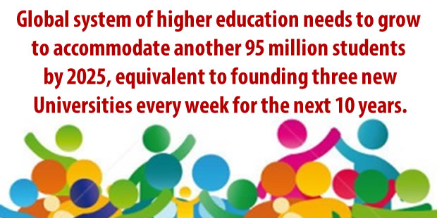
Challenges in Higher Education
95 million students

Slide 7
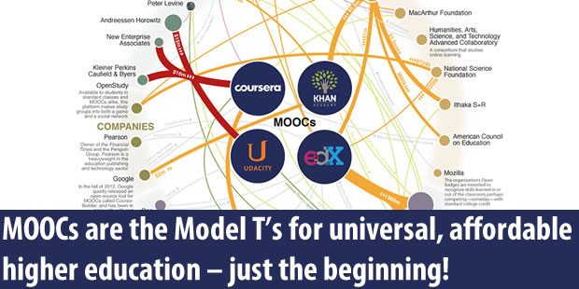
Virtualization
from the classroom to the world

Slide 8
Individuation of Learning
New technology challenges us to develop appropriate pedagogy
Future learning will be much more active and participative than the classical model of knowledge transfer
We need a pedagogy that promotes development of the whole person and true mental individuality
Creative Individuality – not self-centered Individualism

Slide 9

The Big Question

Slide 10
World University Consortium
Alliance of Stakeholders
  Universities
  Research institutes
  Governments
  Business
  Civil Society NGOs
  Trade Unions
Notes:
We are honored to have IAUP as one of our charter members and Neal King as a member of the Board of Directors

Slide 11
WUC Objectives
To generate new ideas, innovative strategies and new models of cooperation in teaching, research, government-university partnerships, national partnerships, knowledge application, and responsible leadership.

Slide 12
WUC Priorities
New metrics for Quality
Active Learning processes & tools
Employability
Social Relevance
Sustainability
Original Thinking & Creativity
Individuality
Values-based knowledge
New Paradigm Trans-disciplinary Courses
Notes:
Quality survey
Active learning – 100 tools
Employability – Bosnia
Relevance – Ljubljana

Slide 13
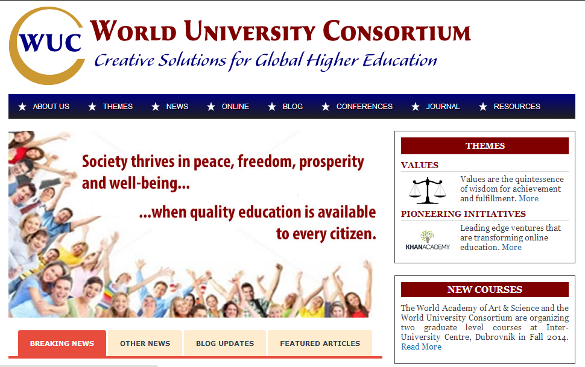
www.wunicon.org

