Slide 1
Civilizational Role of Ukraine
What lessons
can Ukraine share with the world?
Valerii Pekar

Slide 2
Question No. 1
What is happening
in Ukraine?

Slide 3
The Human History
Human societies evolve
New societies
Societies
of progress
Societies
of order
Societies
of power
Tribal
societies

Slide 4
The Human History
Marxists call them…
They don’t know
Capitalism
Feudalism
Slavery
Primitive

Slide 5
The Human History
Political history experts call them…
They don’t know
Open societies,
democracy
Developed states,
Rule of law
Fragile
natural states
Pre-states

Slide 6
The Human History
Social psychologists call them…
Ecological
thinking
Rational
thinking
Fundamentalist
thinking
Heroic
thinking
Magical
thinking

Slide 7
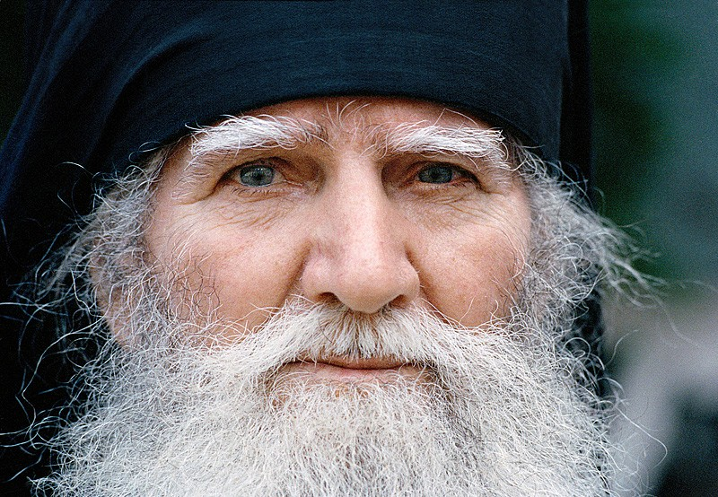
55%

Slide 8

15%

Slide 9
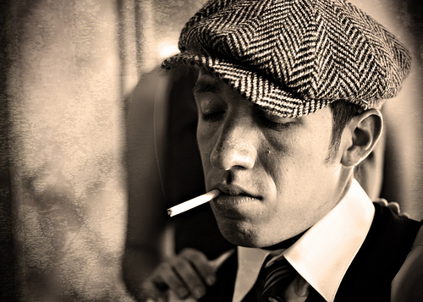
15%

Slide 10
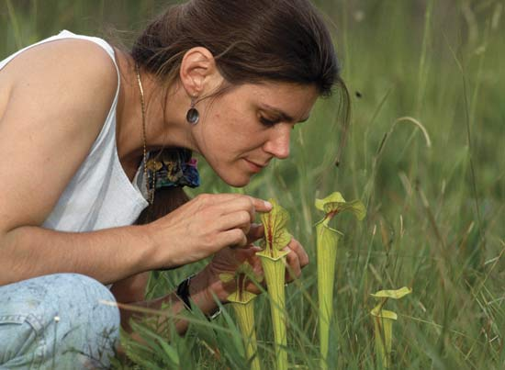
3%

Slide 11
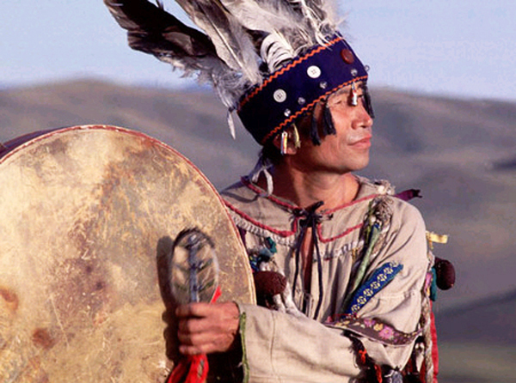
10%

Slide 12
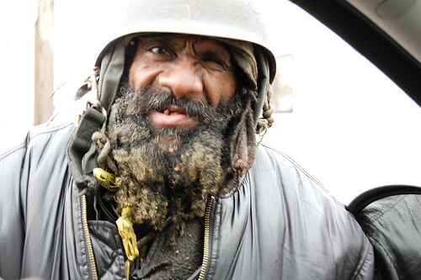
1%

Slide 13
~0%

Slide 14
A Profile of Late Medieval Society

Slide 15
But Minorities Want to Move

Slide 16
A Snail on a Slope

Slide 17
The Modernization Urge

Slide 18
The Essence of the Revolution
Economic: A middle class revolution against neofeudalism
Geopolitics: Ukrainian national liberation movement, anti-colonialist, anti-imperialist
Revolution of Dignity: values shift

Slide 19
The Human History
So we are here
The New One
Modern
Medieval
We are here
Ancient
Primitive

Slide 20
A Medieval Society
Economics: the rent of status,
barons and/or oligarchs
Politics: clans and patrons
States: empires and colonies
Technology: agricultural
and low-added-value industries
Values: fundamentalist, paternalistic;
subjects
Identity: ethnic
Social elevators: closed

Slide 21
A Modern Society
Economics: the rent of capital,
liberal market
Politics: political parties and
accountable government
States: national states
Technology: industrial and high-tech
Values: rational, self-responsible;
citizens
Identity: political nations
Social elevators: open

Slide 22
Modernization as an Objective
A late medieval country
with the powerful urge to modernity
Modernization = Europe
That is why European Integration motto was proclaimed
That is why EuroMaidan was happen

Slide 23
The Transition Moment
The modern world is suffering from
a global crisis
The new world is being born
Thus, we have to come closer
to the fire
And go through
Jumping over
is not allowed
We are here

Slide 24
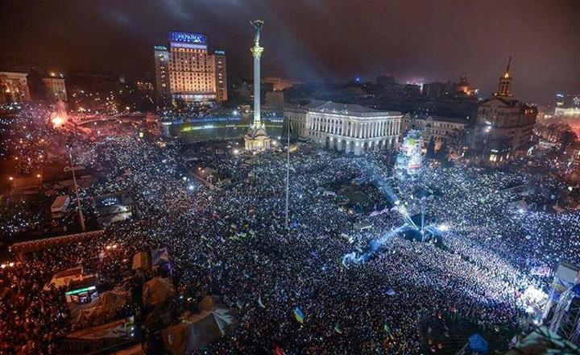

Slide 25
The Essence of the Revolution
Economic: The middle class revolution against neofeudalism
  Fight for an open market against oligarchs
Geopolitics: Ukrainian national liberation movement, anti-colonialist, anti-imperialist
  To be free from the empire’s legacy and pressure
  The Independence War as a consequence
Revolution of Dignity: values shift
  New values against old values

Slide 26
Three Major Forces
Middle class
Romantic nationalists
Students

Slide 27
Three Major Objectives
Economic modernization: reforms
The Independence War
and Ukraine’s new role
Human capital development
and a new culture
We are living inside three revolutions
Active minority sets the direction,
passive majority sets the pace

Slide 28
Yes we can
The old is weak and ruined, it can’t resist
Ranked 27 in the World Talent Index
Ranked 11-14 at Olympic Games
Ukraine has several legacies
The new world becomes apparent here
Our geopolitical opponent has no future

Slide 29
The New World
Crowdfunding and crowdsourcing
Open code principles
Wiki cooperation
Granting and common usage
Relations mean more than money
No bosses, no hierarchies
Collective leadership
Open access and sharing
Cossack Sich of XXI century

Slide 30
Mission Possible No. 1
Experience of late modernization and entering the new world is valuable
We are followed by many nations

Slide 31
Question No. 2
What is Ukraine’s place in Europe?

Slide 32
Do we have a project of the future?
A country without its own project of the future becomes just a resource for those who have their projects
And not only a resource, but an action space as well
Like Ukraine in World Wars I and II

Slide 33
The New Role
The empire as a stability manager is not efficient any more
The position of the stability manager in Eastern Europe is vacant
New European system of security

Slide 34
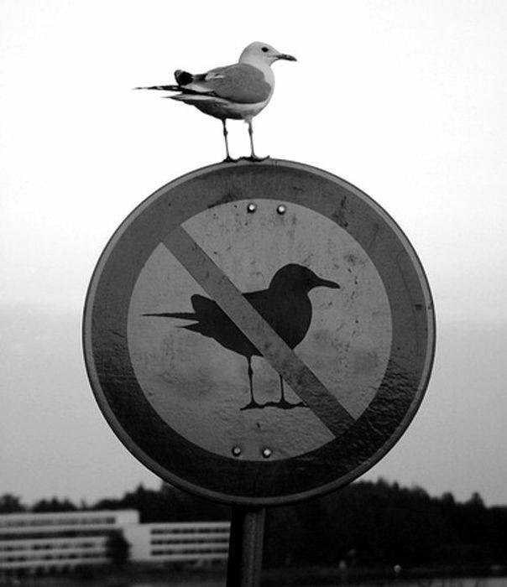
The Rules of Tomorrow

Slide 35
The New Project
New geopolitical project: a commonwealth of free nations
to the counterbalance to the empire
From a number of closed nationalisms to an open poly-ethnic contra-colonial concept

Slide 36
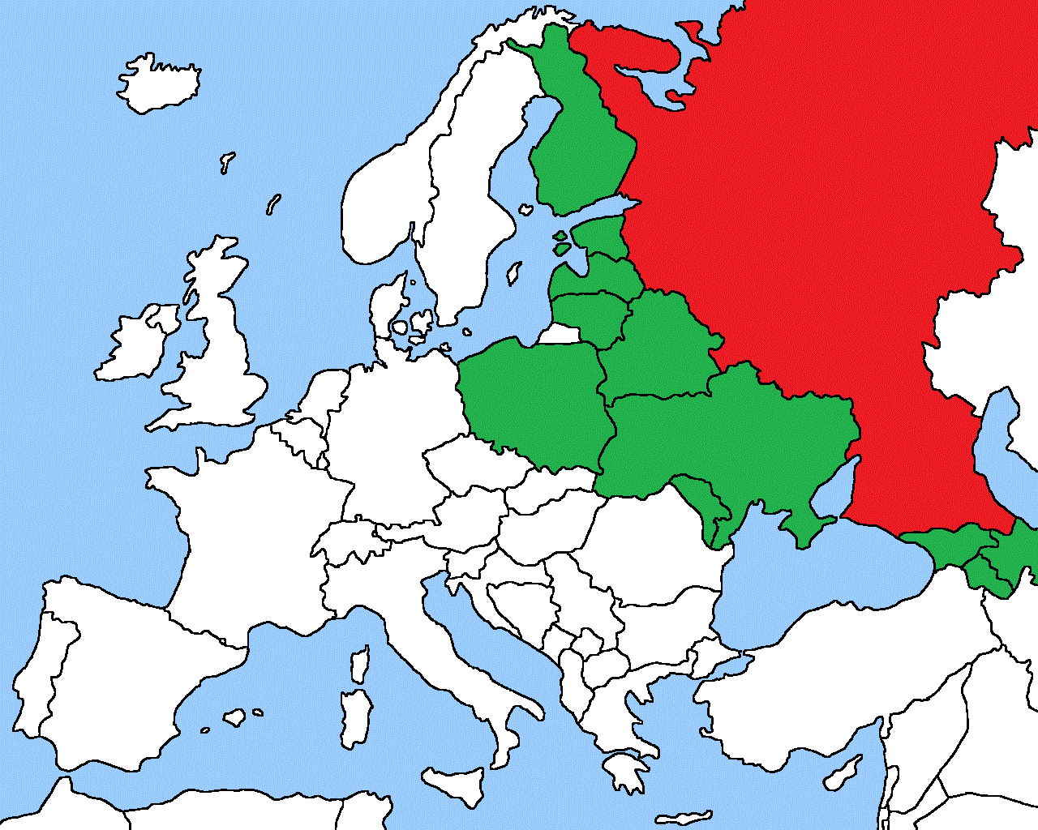
Baltic-Black Sea Belt of Stability

Slide 37
The Last Empire
A mission: to dismantle the empire
An additional mission: to help Russia to re-think and re-pack itself
  We contributed to the creation of the empire
  We contributed to the destruction of the empire (1918)
  We contributed to the restoration of the empire (1922)
  We contributed to the 2nd destruction of the empire (1991)
  We are responsible

Slide 38
Mission Possible No. 2
The stability manager
The central point of the belt of security and modernization
The new model of commonwealth
The re-thinkers of the empire

Slide 39
Question No. 3
Who will do this?

Slide 40
The Typical Failed State
No governance
No army
No justice
No national projects

Slide 41
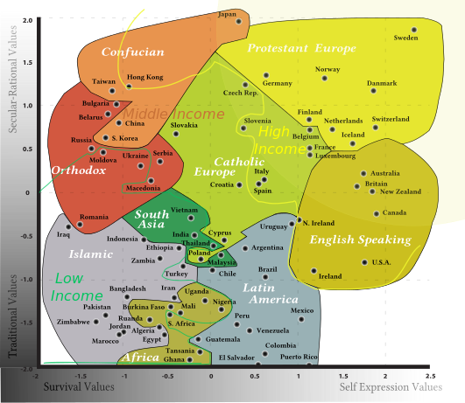
The Normal Tracks

Slide 42
Two Tracks
European Track
  New values and new social practices
  New institutions arising from the bottom
  Politics as a consequence
Asian Track
  Strong state
  New institutions installed from the top
  New values as a consequence
Our case
  No time to grow
  No state to install
  Active civil society

Slide 43
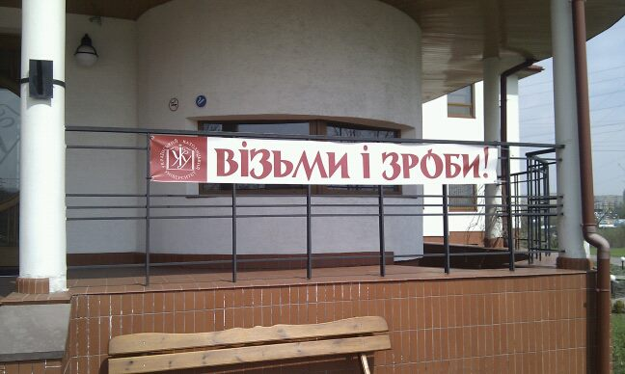
The Do-It-Yourself Country

Slide 44
Mission Possible No. 3
A model of post-modern track of modernization
What a country offers to the world
is less important than
what a country offers to the future

Slide 45
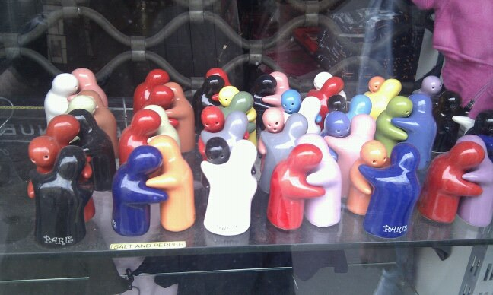
The National Consensus as a Basis

Slide 46
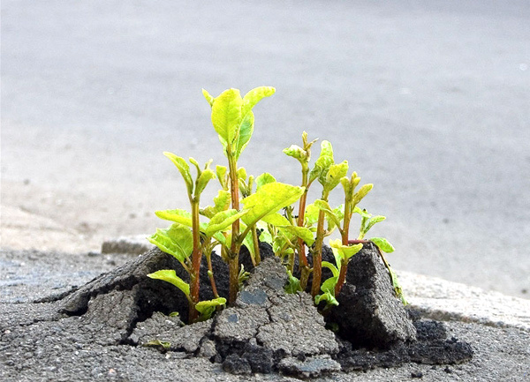
The New Country
The New Country will grow through the old country like grass grows through broken asphalt

