Slide 1
Stop wasting the best natural resource of every nation:
Their own people - A Manifesto for human resources protection and promotion.
Alberto Zucconi
Board of Trustees and of the Executive Board of WAAS,
Secretary general World University Consortium (WUC)
President Person Centered Institute (IACP)

Slide 2
Nobel Prize recipient and World Academy of Art and Science (WAAS) Fellow Paul Crutzen reminds us that nowadays
“human activities are the main variable impacting on all planet’s life forms”
There are a mounting number of challenges to be faced; we need to foster new and solid bases for a sustainable global society, re-examining the dynamics of global economic, political, human, social and cultural constructs.

Slide 3
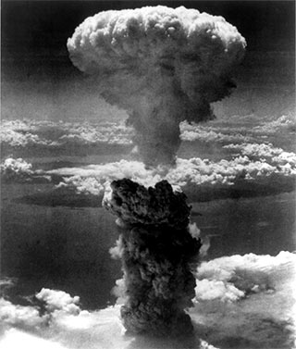

Slide 4
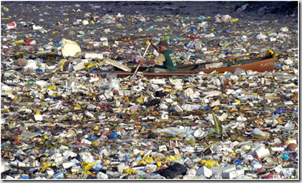

Slide 5
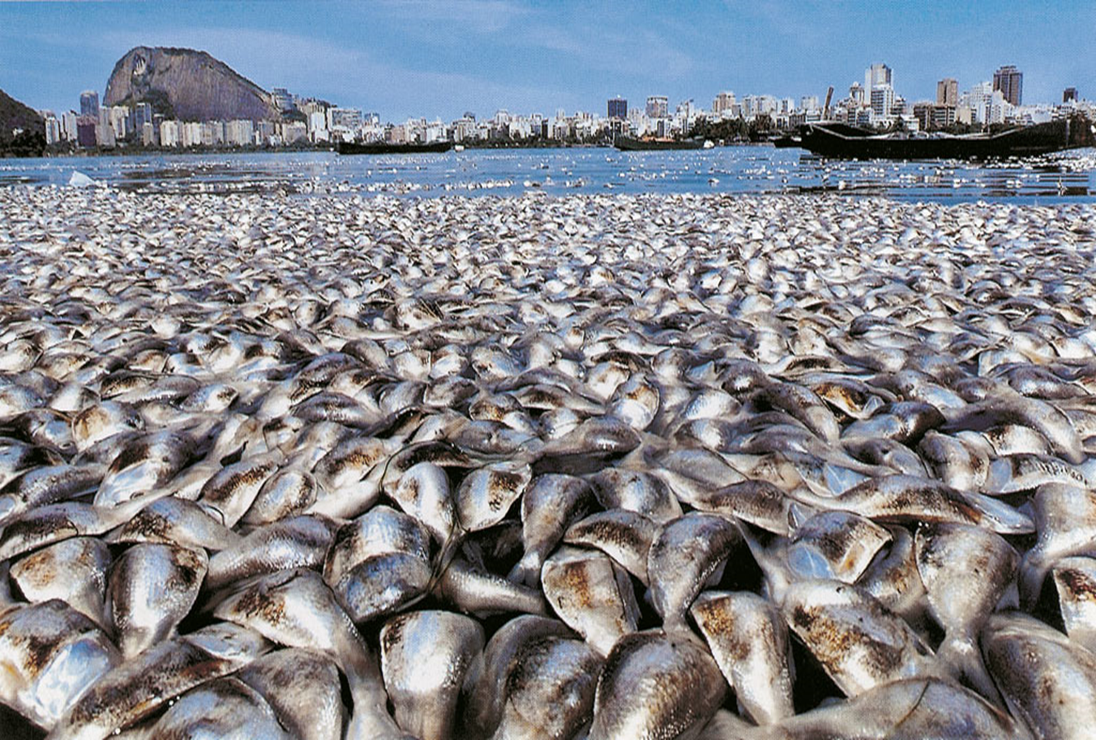

Slide 6
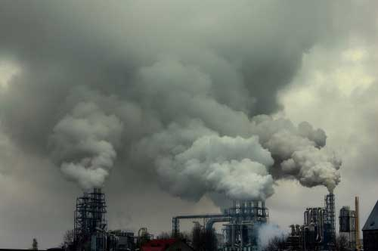


World Academy of Art and Science
World University Consortium

Slide 7
We are blind
We cannot see clearly how we create the problems
and
We are impotent
We are lacking the effective ways
to manage the challenges facing us

Slide 8
The state of the planet and of human affairs shows that there are several barriers to the awareness of the real nature of the problems we need to face and the needed changes in the awareness and behaviours from all the stakeholders in order to be able to effectively manage the serious challenges facing humanity.

Slide 9
Some of the barriers to change are deeply imbedded in the ways people and institutions construe their experience of reality and are the product of some basic mechanisms that are at work in cultures, societies and families of origin:
How reality is socially construed and how individuals and organizations construe their experiences are relevant to the understanding of the promotion of change as well the understanding of some defence mechanism like denial.

Slide 10
Some tools for the effective understanding and the promotion of change at the individual, group, community, national and international levels can be offered by the interdisciplinary and intersectorial vision deriving from the synergy of the various fields of knowledge that we still keep isolated and segregated

Slide 11
We need to ask ourselves some basic questions:
How our social and personal Selves are socially structured?
This social construction is effective for promoting the sustainable the development of human potentialities of all the people & the living forms of our planet or not?

Slide 12
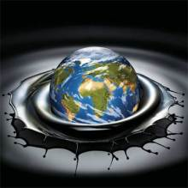
How we construe our experience?
What kind of narratives we create?
What kind of consequences we bring upon ourselves and the planet?
How we use our power?

Slide 13
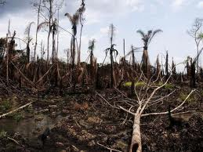
High is the price we pay from being unaware of the constructs with which we construe our experiences, or the ways in which we distort or suppress our awareness.

Slide 14
Some of the costs we self inflict are deriving from:
Using mechanistic/reductionist perspectives
Overspecialization and compartmentalization
Education based on the acquisition of notions but not student-centered, learning of how to learn.
Stereotyped social construction of self-identities that do not allow people to recognize and fulfil their human needs : racism, sexism, gender discrimination, homophobia, ageism etc.
Dysfunctional social organization: lack of clear rights, lack of equal opportunities, marginalization of some groups, corruption, stifling bureaucracy, discouraging entrepreneurship etc.
Social construction of professional roles and coping stiles, as well the social construction of the levels of social intelligence, equal rights and opportunities and sustainability or the lack of it.
Wrong metrics: how presently we measure it actually hide real wealth or real social progress.

Slide 15
Empowerment
Democratic relationships
Equal rights & opportunities
Promotes responsibility
Bio-Psycho-Social Paradigm
Health Promotion
Patient Centered Medicine
Biofeedback, neurofeedback
Transparency, shared knowledge
Person Centered & People Centered
Capacity for deep contact, empathy
respect for all the life forms
Microcredit, sustainable enttrpreneurship
Disempowerment
Authoritarian Relationships
Oppression & discrimination
Promotes passivity
Mechanistic-reductionist Paradigm
Reductionist Medicine
Disease Centered Medicine
Electroshock
Manipulation of information
Racism, sexism, ageism, bigotry etc.
Alienation from self, others, depletion of Natural & human resources
Profit to all cost, monopolies, Subprime caper

Slide 16
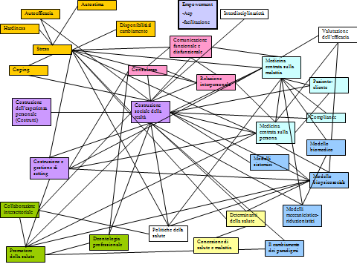
Are we effectively protecting and promoting health & well being of individuals, couples, families, groups, organizations, communities etc. ?
Do we have an human ecology approach and do we establish & foster respectful and empowering relationships?

Slide 17
Profound differences and results are created by different narratives.
Do we work to create narratives of hope and liberation or narratives of compliance with the status quo even when it is blind, unjust, oppressive, destructive?

Slide 18
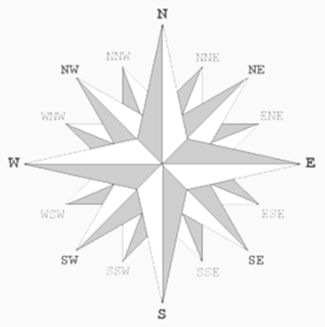
A sort of new compass for the Antropocene Era’ for is scientists, politicians, opinion makers , professionals and people from all the walk of life is badly needed
“…at the basis of anything that a scientist undertakes is, first of all, an ethical and moral value judgment that he makes.” Carl Rogers

Slide 19
PROMOTING AWARENESS is MULTILEVEL circular continuous action of psycho-socio-cultural change of:
the individual
the organization
the community
the society
the culture…….and vice versa…..

Slide 20
The World Academy of Art and Science (WAAS)
&
The World University Consortium
Together with other organizations that are well aware of the present quagmire in which the world is stuck
Are promoting the creation of a new paradigm offering effective
ways & means to change involving all the stakeholders
from being part of the problem to
becoming part of the solution

Slide 21
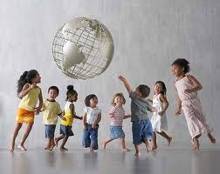

Slide 22
Thank you! Grazie!
World Academy of Art and Science
www.worldacademy.org
World University Consortium
www.wunicon.org
Person Centered Approach Institute (IACP)
www.iacp.it
azucconi@iacp.it

